Slide 1




TOURIST PLATFORM OVERVIEW
TOURIST: Thoracic Umbrella Radiotherapy Study in stage IV NSCLC
Two CSTs are currently recruiting within the TOURIST platform: PRINCE and QUARTZ LUNG
34 sites open
England, Scotland, Wales, Northern Ireland
Republic of Ireland due to open Feb 2026
To use advanced radiotherapy techniques to establish the utility of thoracic radiotherapy in the treatment of stage IV NSCLC
Recruiting SWAG CAG Sites
Bath (PI: Dr Ashley Cox)
Bristol - UHBW (PI: Dr Waheeda Owadally)
Somerset – Musgrove Park (PRINCE PI: Dr Julie Walther, QUARTZ LUNG PI: Elinor Barker)
TOURIST SWAG CAG 2026 Slides v1, 27-Jan-2026T

Slide 2
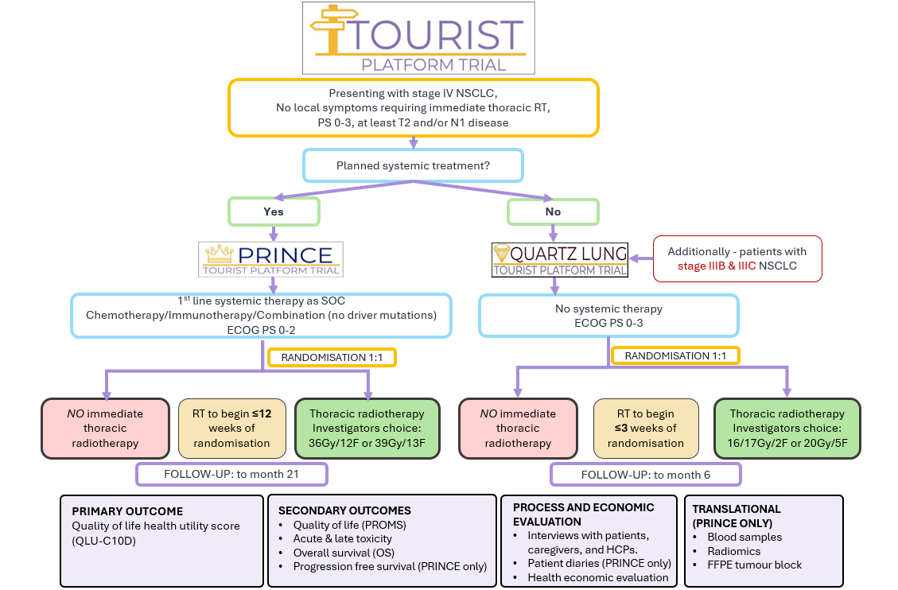

Slide 3


TOURIST – PRINCE and QUARTZ LUNG What can you do?
Infographic
https://youtu.be/IpN48GEILV4
For more information
Email: tourist@soton.ac.uk
TOURIST is looking for more sites to take part
Be aware of the trials and consider potential patients at MDTs and clinics
Make relevant colleagues aware of the trials
Any questions about the trial, contact SCTU TOURIST Team

Slide 4

TOURIST in practice – key take-home messages
TOURIST enables individualised use of palliative radiotherapy alongside modern systemic therapy
QUARTZ: an option for patients unfit for systemic treatment, focusing on symptom control and quality of life
PRINCE: integrates palliative thoracic radiotherapy alongside chemo-immunotherapy
Early identification of eligible patients at MDT and clinic is key to maximising trial access

