Slide 1
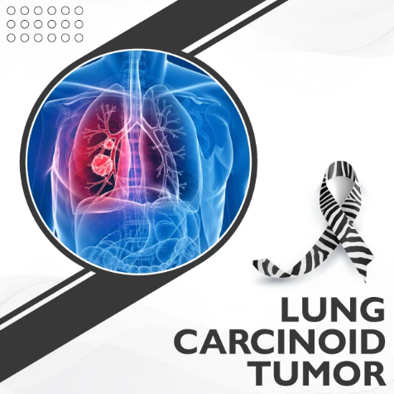
SWAG Lung Carcinoid
(Pulmonary NET) Pathway
Diagnostic, Staging and Follow-Up Strategy
Stylianos Gaitanakis
Consultant Thoracic Surgeon
Bristol Royal Infirmary
Notes:
[Sources] - PET/CT scanner photo (CC BY-SA 3.0): https://commons.wikimedia.org/wiki/File:PET-CT_Siemens_Biograph01.jpg [/Sources]

Slide 2
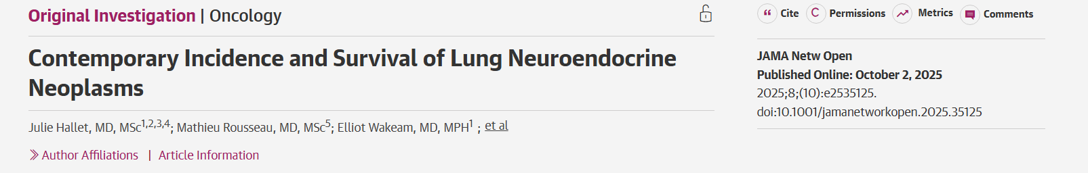
Why a Pathway?
Create a consistent, biology-matched approach across SWAG
Drivers
What good looks like
More incidental carcinoid detection (e.g., CT screening and wider cross-sectional imaging)
Different staging needs vs NSCLC
Long, risk-stratified follow-up with safety-netting
Aim: reduce unwarranted variation and support equitable access
Right test
Right patient
Right time
Right place
Incidence has risen from 0.85 in 2000 to 2.5 in 2020 on a population of 100.000
Right follow-up
Right safety-net
SWAG Lung Carcinoid (Pulmonary NET) Pathway | Draft Feb 2026
2
Notes:
[Sources] - UKINETS Lung NET follow-up guidance (includes baseline CT and Ga-DOTATATE and long follow-up algorithm): https://www.ukinets.org/wp-content/uploads/UKINETS-bitesize-guidance-Lung-NETs-Follow-Up-FINAL-MS-24092020-1.pdf [/Sources]

Slide 3
Scope at a Glance
End-to-end pathway: imaging → tissue → staging → MDT plan → follow-up
1
Standard contrast CT protocol
Consistent thorax/abdomen/pelvis staging when indicated
2
Tissue-first biopsy strategy
Plan biopsy route with downstream surgery and nodal assessment in mind
3
Biology-matched staging
68Ga-DOTATATE ± FDG PET-CT based on risk/histology
4
MDT referral and surgery at BRI hub
Clear triage thresholds and referral proforma
5
Risk-stratified follow-up
Safety-netting + patient-initiated re-access beyond routine surveillance
SWAG Lung Carcinoid (Pulmonary NET) Pathway | Draft Feb 2026
3
Notes:
[Sources] - UKINETS Lung NET follow-up guidance (baseline CT TAP, Ga-DOTATATE; risk factors include Ki-67 >5 and FDG SUVmax >4): https://www.ukinets.org/wp-content/uploads/UKINETS-bitesize-guidance-Lung-NETs-Follow-Up-FINAL-MS-24092020-1.pdf - Kayani et al. comparison of 68Ga-DOTATATE vs 18F-FDG in pulmonary NETs (typical: higher DOTATATE, lower FDG): https://pubmed.ncbi.nlm.nih.gov/19910422/ [/Sources]

Slide 4
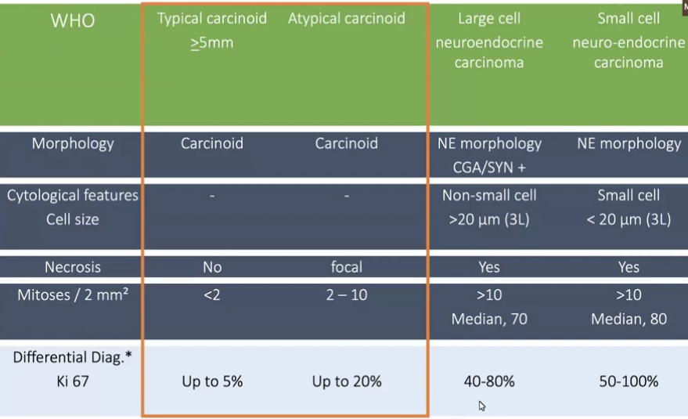
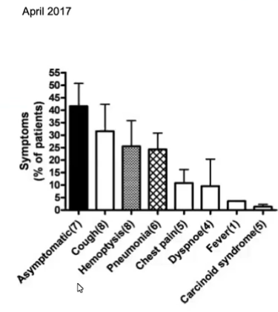
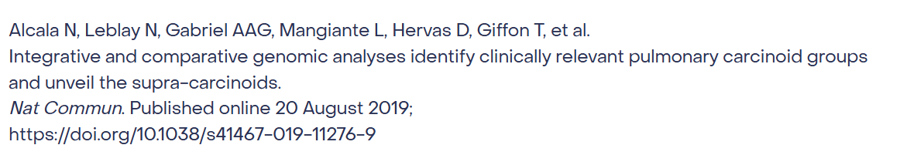
WHO Neuroendocrine classification 2017-2021
Beware of the supracarcinoids!!!

Slide 5
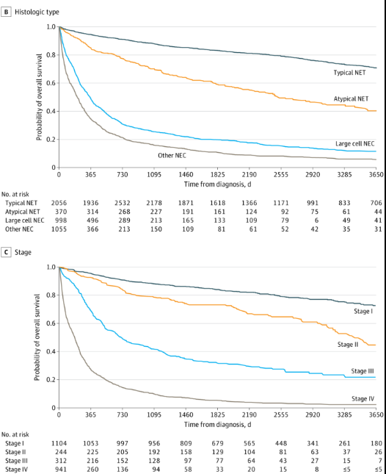

Slide 6
Typical vs Atypical Carcinoid
Why risk-stratification matters
Typical carcinoid (TC)
Atypical carcinoid (AC)
Resectability
Often resectable; surgery is mainstay
Often resectable, but higher nodal risk → plan systematically
Relapse risk
Low; recurrence reported ~1% in some surgical series
Higher; recurrence ~18% in one series; worse DFS
Imaging expectations
High SSTR expression → DOTATATE usually avid; FDG often low
More variable SSTR; FDG uptake more common (biology heterogeneity)
Follow-up consequence
Consider de-escalation only at lowest risk; still needs safety net
Structured long follow-up (radiology + clinical/biochem)
SWAG Lung Carcinoid (Pulmonary NET) Pathway | Draft Feb 2026
5
Notes:
[Sources] - Lee et al. (2016) recurrence/DFS differences (TC recurrence ~1% vs AC ~18% in that cohort): https://www.thieme-connect.com/products/ejournals/pdf/10.1055/s-0035-1544211.pdf - Lou et al. (2013) recurrence after resection; TC lower recurrence probability than AC: https://www.annalsthoracicsurgery.org/article/S0003-4975%2813%2901134-X/fulltext - Kayani et al. (2009) typical carcinoids higher DOTATATE and lower FDG uptake than higher grade tumors: https://pubmed.ncbi.nlm.nih.gov/19910422/ - Prosperi et al. (2023) review supports complementary 68Ga-SSA and FDG PET in pulmonary carcinoids: https://www.mdpi.com/2077-0383/12/11/3719 [/Sources]

Slide 7
Relapse Patterns
Relapses are uncommon, but can be late and multi-site
What we see in practice
Relapse distribution (when it happens)
Relapse rates ~10% after surgery in contemporary cohorts
When relapse occurs: liver and locoregional sites are common
Median time to relapse can be several years → plan for late recurrence
Include endocrine symptom screening (functional disease can emerge over time)
Bone
Liver
~52%
Lung /
Mediastinum
~45%
Timing signal
Median relapse-free interval reported ~48 months (≈4 years), supporting long surveillance.
SWAG Lung Carcinoid (Pulmonary NET) Pathway | Draft Feb 2026
6
Notes:
[Sources] - Moonen et al. (2024) relapse ~10%; liver ~51.8% and locoregional ~45%; median RFI ~48.1 months: https://www.sciencedirect.com/science/article/pii/S1479682124000250 - Heijboer et al. (2024) long-term radiological follow-up recommended due to risk of late recurrence: https://www.sciencedirect.com/science/article/pii/S0169500224005646 - ENETS guidance on carcinoid syndrome (symptoms such as flushing/diarrhoea) supports ongoing symptom screening in NET patients: https://www.onkologisches-zentrum.uk-erlangen.de/fileadmin/einrichtungen/onkologisches_zentrum/dateien/Leitlinien_NET/J_Neuroendocrinology_-_2022_-_Grozinsky%E2%80%90Glasberg_-_European_Neuroendocrine_Tumor_Society__ENETS__2022_Guidance_Paper_for.pdf [/Sources]

Slide 8
Failure Modes Without a Pathway
Where variation harms quality, efficiency, and equity
!
Missed nodal or liver disease
LDCT alone may miss occult spread → under-staging
!
Poor biopsy planning
Non-diagnostic samples, avoidable complications, re-biopsy delays
!
Missed hormone symptoms
Flushing/diarrhoea/wheeze not screened → late recognition
!
Misapplied imaging
Over-use of FDG or under-use of DOTATATE → noisy decision-making
!
Non-stratified follow-up
Everyone followed the same → either under- or over-surveillance
SWAG Lung Carcinoid (Pulmonary NET) Pathway | Draft Feb 2026
7
Notes:
[Sources] - UKINETS Lung NET follow-up guidance includes baseline CT TAP, Ga-DOTATATE and biochemistry (5-HIAA, CgA) to reduce under-staging and missed functional symptoms: https://www.ukinets.org/wp-content/uploads/UKINETS-bitesize-guidance-Lung-NETs-Follow-Up-FINAL-MS-24092020-1.pdf - SNMMI/EANM SSTR PET guideline notes SSTR PET has replaced older scintigraphy for NET workup where available: https://jnm.snmjournals.org/content/64/2/204 [/Sources]

Slide 9
Red-Flag Symptoms (Safety Net)
Prompt review and consider re-staging if new or progressive
🫁 Chest
🧠 Neuro
New/persistent cough
Haemoptysis
Wheeze or recurrent infections
Confusion
New seizures
Focal neurology / headache
🦴 Bone
💡 Endocrine
Focal bone pain
Night pain
Pathological fracture symptoms
Flushing
Diarrhoea
New wheeze / palpitations
Safety net: any red flag → re-discuss at MDT / re-image as appropriate.
SWAG Lung Carcinoid (Pulmonary NET) Pathway | Draft Feb 2026
8
Notes:
[Sources] - ENETS guidance on carcinoid syndrome (symptom examples such as flushing/diarrhoea): https://www.onkologisches-zentrum.uk-erlangen.de/fileadmin/einrichtungen/onkologisches_zentrum/dateien/Leitlinien_NET/J_Neuroendocrinology_-_2022_-_Grozinsky%E2%80%90Glasberg_-_European_Neuroendocrine_Tumor_Society__ENETS__2022_Guidance_Paper_for.pdf [/Sources]

Slide 10
Diagnostic & Staging Pathway
Stepwise approach: standardise the sequence and decision gates
Incidental CT
(nodule / mass)
MDT triage
Contrast CT
Biopsy
Histology + Ki-67
68Ga-DOTATATE PET
MDT plan
(BRI hub)
LDCT or routine CT
Confirm pathway entry
Standard protocol
Tissue-first strategy
TC vs AC; risk factors
± FDG if high-risk
Surgery / surveillance / systemic
Add FDG if:
• AC / Ki-67 >5
• High-risk features
Key standardisations
Document Ki-67 and adverse pathology (LV invasion, R1/R2, nodal status)
SSTR PET for staging and therapy planning; add FDG when biology suggests higher risk
Single MDT plan with clear follow-up schedule and safety netting
SWAG Lung Carcinoid (Pulmonary NET) Pathway | Draft Feb 2026
9
Notes:
[Sources] - UKINETS Lung NET follow-up guidance (risk factors include Ki-67 >5 and FDG SUVmax >4; baseline CT TAP and Ga-DOTATATE): https://www.ukinets.org/wp-content/uploads/UKINETS-bitesize-guidance-Lung-NETs-Follow-Up-FINAL-MS-24092020-1.pdf - Kayani et al. (2009) DOTATATE vs FDG uptake patterns in pulmonary NETs: https://pubmed.ncbi.nlm.nih.gov/19910422/ - Prosperi et al. (2023) systematic review supports combined 68Ga-SSA and FDG PET in pulmonary carcinoids: https://www.mdpi.com/2077-0383/12/11/3719 [/Sources]

Slide 11
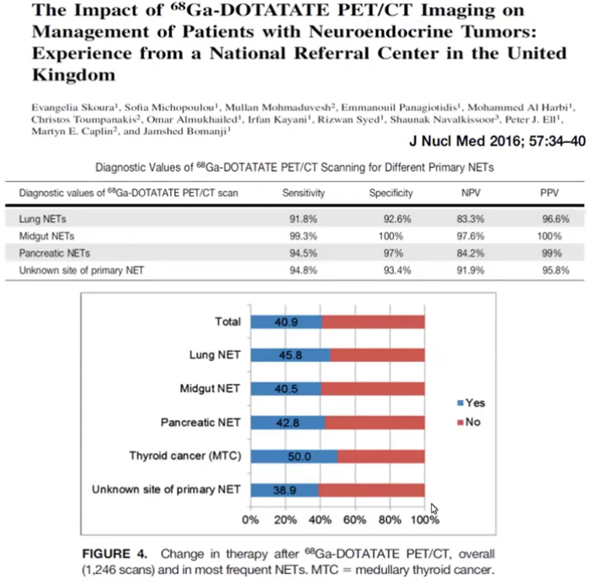
Role of 68Ga-DOTATATE PET-CT
Match imaging to tumour biology (SSTR expression)
Key points for MDT
SSTR PET has largely replaced older Octreoscan where PET is available
Typical carcinoids tend to be DOTATATE-avid with low FDG; atypical can be mixed
Use DOTATATE early when results will change operative planning or follow-up intensity
Clinical value
Improves staging sensitivity for well-differentiated NETs
Guides surgery extent and systemic options (e.g., PRRT eligibility)
FDG can add risk signal in AC / higher Ki-67 (heterogeneous uptake)
Pragmatic rule-of-thumb
DOTATATE for biology. Add FDG when biology looks “hotter” (AC, Ki-67↑, nodal disease, rapid growth).
SWAG Lung Carcinoid (Pulmonary NET) Pathway | Draft Feb 2026
10
Notes:
[Sources] - SNMMI Procedure Standard/EANM Practice Guideline for SSTR PET (SSTR PET replacing scintigraphic imaging where available): https://jnm.snmjournals.org/content/64/2/204 - Kayani et al. (2009) DOTATATE vs FDG uptake in pulmonary NETs (typical higher DOTATATE, lower FDG): https://pubmed.ncbi.nlm.nih.gov/19910422/ - Prosperi et al. (2023) combined 68Ga-SSA and FDG PET can inform management in pulmonary carcinoids: https://www.mdpi.com/2077-0383/12/11/3719 - EANM NEN imaging guideline notes receptor imaging is used to select patients eligible for PRRT: https://www.kfnm.dk/x-documents/guidelines/201701_EANM_NEN_GL_NationalReview.pdf - PET/CT scanner photo (CC BY-SA 3.0): https://commons.wikimedia.org/wiki/File:PET-CT_Siemens_Biograph01.jpg [/Sources]

Slide 12
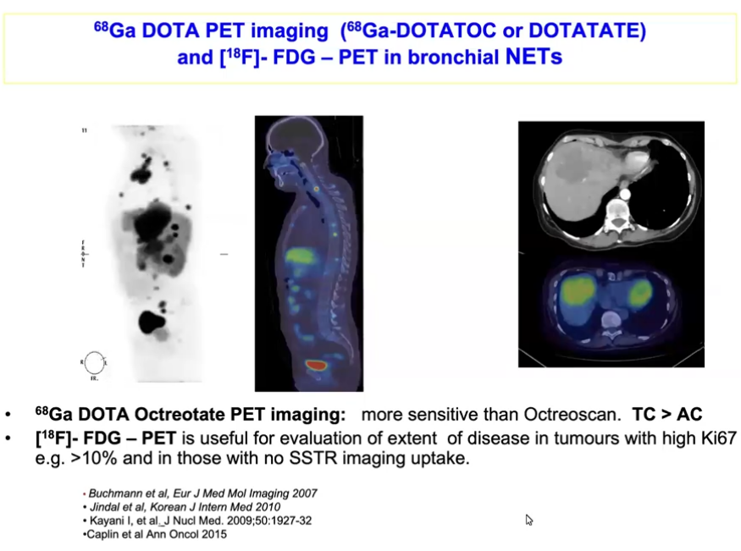
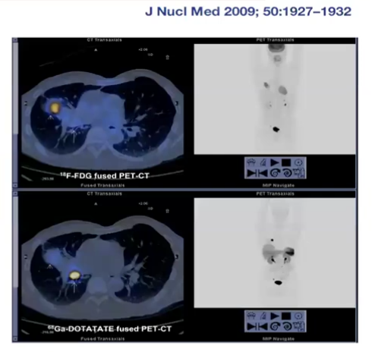

Slide 13
Follow-Up Strategy
UKINETS-aligned, risk-stratified surveillance up to 15 years
Principles
Who gets followed?
Baseline post-op CT TAP ± DOTATATE and baseline biochemistry (per local availability)
Escalate intensity for higher-risk features (AC, nodal disease, Ki-67 >5, FDG avidity, R1/R2)
De-escalate over time; maintain patient-initiated re-access beyond routine surveillance
UKINETS algorithm: TC and AC follow-up, with higher intensity when high-risk features present
Use shared decision-making to balance radiation burden vs late recurrence risk
Example timeline (post-resection)
0–2y
3–10y
11–15y
15y+
Clinic 6m
Biochem 6m
CT yearly
Clinic yearly
Biochem yearly
CT yearly (
24m from y5)
Clinic 24m
Biochem 24m
CT 24m
Safety
net
SWAG Lung Carcinoid (Pulmonary NET) Pathway | Draft Feb 2026
11
Notes:
[Sources] - UKINETS Lung NET follow-up algorithm (baseline CT TAP, Ga-DOTATATE; follow-up schedule through years 11–15 and “patient reporting” beyond): https://www.ukinets.org/wp-content/uploads/UKINETS-bitesize-guidance-Lung-NETs-Follow-Up-FINAL-MS-24092020-1.pdf - Heijboer et al. (2024) notes long-term follow-up recommended due to late recurrence risk and must be balanced against radiation: https://www.sciencedirect.com/science/article/pii/S0169500224005646 [/Sources]

Slide 14

DOTATATE Access Challenges
Build resilience into scheduling, production, and referral
Capacity constraints: limited Ga-68 DOTATATE PET-CT slots across the region
Geographical inequity: variable local availability → patient travel to regional PET hubs
Radiotracer fragility: short half-life + production/QC issues can cause late cancellations and rebooking
Referral friction: inconsistent criteria / approval routes can delay booking (NM/NET MDT requirements)
System delays: cross-Trust scheduling and reporting turnaround can extend
MDT-to-decision and MDT-to-treatment timelines

Slide 15
Implementation Proposal
Make it easy to do the right thing—every time
| Define & align
| Build & test
| Launch & measure
Agree entry criteria + exclusions
Standard CT protocol agreed
BRI hub referral thresholds + contacts
Draft proforma + MDT template
Biopsy planning prompts (EBUS/CT-guided) embedded
PET request checklist (DOTATATE/FDG) agreed with NM
Pilot pathway on 5–10 cases
Refine follow-up scheduling + safety net text
Go-live across SWAG sites
First dashboard report (process + equity metrics)
Iterate based on bottlenecks
SWAG Lung Carcinoid (Pulmonary NET) Pathway | Draft Feb 2026
13
Notes:
[Sources] - UKINETS Lung NET follow-up guidance provides core elements to standardise (baseline investigations, risk factors, follow-up cadence): https://www.ukinets.org/wp-content/uploads/UKINETS-bitesize-guidance-Lung-NETs-Follow-Up-FINAL-MS-24092020-1.pdf [/Sources]

Slide 16
Suggested Metrics
Process + equity + outcomes
Time to biopsy
Time to DOTATATE
MDT → treatment
Median days from index CT → diagnostic tissue
Referral → scan completed (days)
Decision → surgery / therapy start
Travel burden
Recurrence timing
Safety net triggers
Distance/time to PET hub; cancellations
RFI distribution; early vs late events
Red-flag re-presentations + re-staging yield
SWAG Lung Carcinoid (Pulmonary NET) Pathway | Draft Feb 2026
14
Notes:
[Sources] - Moonen et al. (2024) provides relapse-free interval concept for recurrence timing metrics: https://www.sciencedirect.com/science/article/pii/S1479682124000250 - UKINETS Lung NET follow-up guidance supports long follow-up window suitable for recurrence timing capture: https://www.ukinets.org/wp-content/uploads/UKINETS-bitesize-guidance-Lung-NETs-Follow-Up-FINAL-MS-24092020-1.pdf [/Sources]

Slide 17
Conclusions
FDG PET is not the wrong way to start
Dotate PET should be used for typical and atypical carcinoids
Carcinoid syndrome unusual but not rare for bronchopulmonary Carcinoids (2-5%)
When in doubt go to the expert

Slide 18
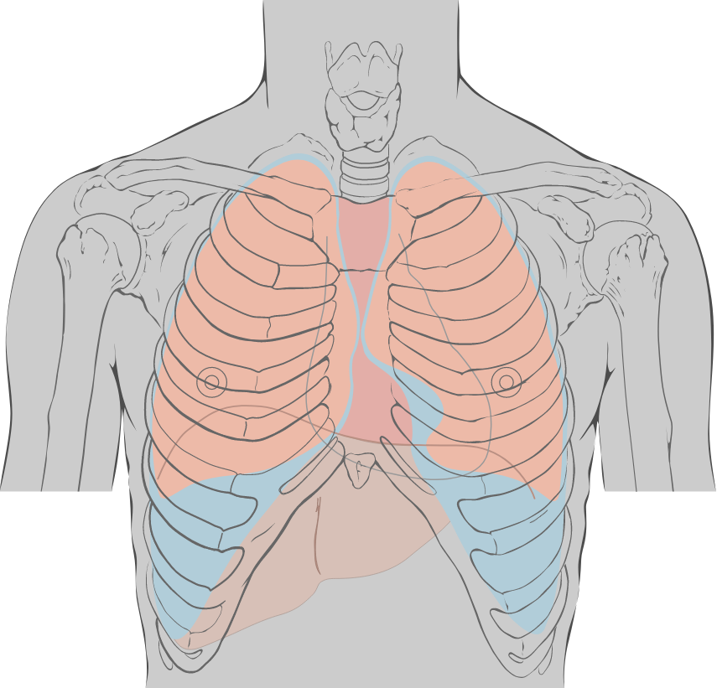
Call to Action
Today we’re asking the MDT to:
Consider a unified SWAG Lung Carcinoid (Pulmonary NET) pathway
Agree referral routes and MDT thresholds (including BRI hub planning)
Standardise risk-based follow-up and safety-netting across sites
Thank you
Contact: [email] | Pathway owner: [name]
Notes:
[Sources] - Thorax illustration (CC BY) from AnatomyTOOL: https://anatomytool.org/content/lynch-drawing-anterior-chest-landmarks-no-labels [/Sources]

