Slide 1


National Cancer Patient Experience Survey Results (2024)
Urology Clinical Advisory Group
Friday 29th January 2026

Slide 2
NCPES Introduction
Annual survey, commissioned & managed by NHS England (since 2010)
new design for 2021, therefore break in series data
2021 / 2022 / 2023 year on year comparison
Picker - responsible for designing, running & analysing the survey
Designed to:
Monitor progress in cancer care
Provide information to drive local quality improvements
Assist commissioners and providers of cancer care
Inform the work various charities and stakeholder groups, supporting cancer patients

Slide 3
NCPES Methodology
Provider survey samples
Adults (16 and over), with a confirmed diagnosis of cancer
Discharged from NHS Trust (after an inpatient or day-case attendance for cancer related treatment) in April, May and June 2024.
Survey fieldwork Oct. 2024 – Feb. 2025
Reports published July 2025 (National, Alliance, Trust).

Slide 4
Cancer Alliance report
Report reflects experience of people referred from within CA footprint (not all those treated by that CA’s Providers)
‘referring’ CA report - based on patient home postcodes
According to ONS postcode mapping

Slide 5
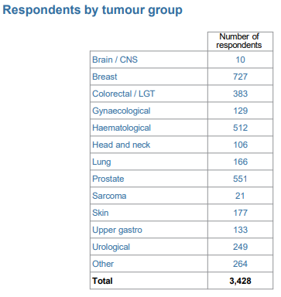
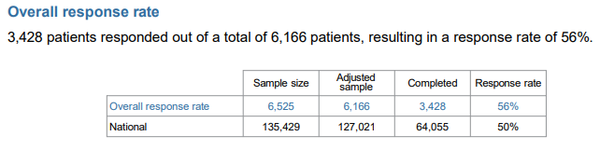
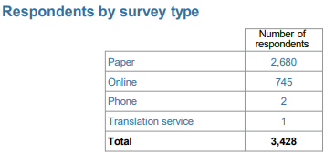
NCPES SWAG responses

Slide 6
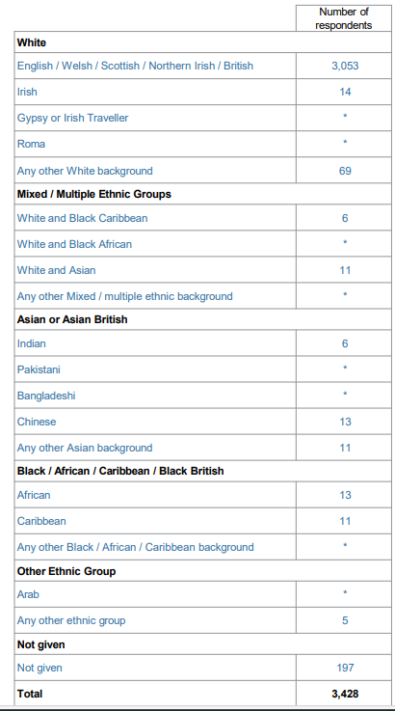
SWAG respondents by Ethnicity
91.4% (3136)
1.37% (54)
5.89% (202)

Slide 7
Urology
Total SWAG urology responses: 800 (prostate and other urology combined)
(people with a SWAG post-code, who responded to the survey)
4 - answers supressed, as responses were <10
55 - a % score given as >10 respondents for that question

Slide 8
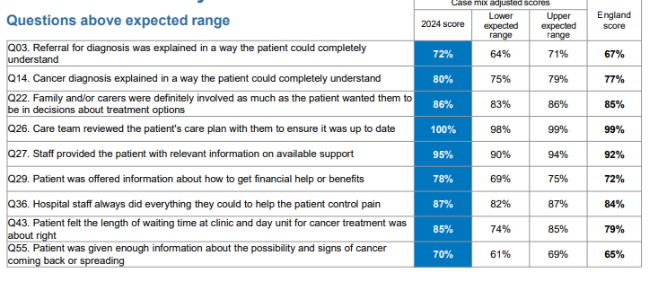
SWAG Summary
Q59 Overall patients average rating of care (0-10 scale) SWAG 2024 National score SWAG 2023
9.0 8.9 9.0
9 SWAG scores above Expected Range (none below the expected range in 2024) – all remaining scores within expected range

Slide 9
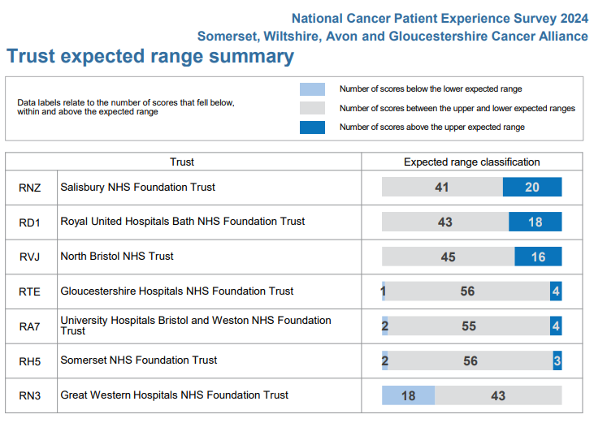
SWAG Trust Summary

Slide 10
Variations by tumour site
Comparison between tumour sites
Some significant variation in scores (e.g. >30%)
Significant variation in numbers of responses
Caution in making these comparisons and interpreting results

Slide 11
SWAG Urology lowest scores ≤ 60%
 | Question | SWAG | National average
23 | Patient could get further advice from a different healthcare professional before making decisions about their treatment options (urological) | 56 | 58
47 | Patient felt possible long-term side effects were definitely explained in a way they could understand in advance of their treatment (urological) | 59 | 61
48 | Patient was definitely able to discuss options for managing the impact of any long-term side effects (urological) | 54 | 56
50 | During treatment, the patient definitely got enough care and support at home from community or voluntary services (Urological) | 46 | 53

Slide 12
SWAG Urology lowest scores ≤ 60%
 | Question | SWAG | National average
51 | Patient definitely received the right amount of support from their GP practice during treatment. (prostate and urological) | 54 | 48
52 | Patient has had a cancer care review by GP practice (prostate and urological | 23/28 | 23
53 | After treatment, the patient could definitely get enough emotional support at home from community or voluntary services (prostate and urological) | 36/32 | 34

Slide 13
SWAG urology highest scores ≥ 90%
 | Question | SWAG | National average
5 | Patient received all the information needed about the diagnostic test in advance (prostate and urological) | 95/93 | 93
9 | Enough privacy was always given to the patient when receiving diagnostic test results (prostate and urological) | 98/94 | 95
15 | Patient was definitely told about their diagnosis in an appropriate place (prostate) | 90 | 86
16 | Patient was told they could go back later for more information about their diagnosis (prostate) | 92 | 85
19 | Patient found the advice from the main person helpful or very useful (prostate and urological) | 96 | 96
25 | A member of the care team helped the patient create a care plan to address any needs or concerns (prostate and urological) | 92/95 | 94
26 | Care team reviewed the patients care plan with the to ensure it was up to date (prostate and urological) | 100 | 99
27 | Staff provided the patient with relevant information on available support (prostate and urological) | 98/92 | 92

Slide 14
SWAG urology highest scores ≥ 90%
 | Question | SWAG | National
36 | Hospital staff always did everything they could to help the patient control pain (prostate) | 94 | 84
37 | Patient was always treated with dignity while in hospital (prostate) | 92 | 88
38 | Patient received easy to understand information about what they should or should not do after leaving hospital (urological) | 91 | 87
41 | Beforehand patient always had enough understandable information about surgery (prostate and urological) | 93/92 | 90
41 | Beforehand patient always had enough understandable information about chemotherapy(prostate and urological) | 94/90 | 86
46 | Patient was given information they could access about support in dealing with immediate side effects of treatment (prostate) | 90 | 88
56 | The whole care team worked well together (prostate and urological) | 90/91 | 90
59 | Patient’s average rating of care scored from very poor to very good | 9.0/8.9 | 8.9

Slide 15
Patient comments
Patients were asked
Please tell us what you found to be positive about your experience of cancer care?
Please tell us how your experience of cancer care could have been better?
‘Patient comment’ feedback and analysis has been presented by topic, themes and sentiment
Patient comments are available in Trust level reports only.

Slide 16
Clinical Advisory Group - Next Steps
Discuss and agree SWAG urology patient experience improvement priorities, including areas of lowest scores (Slide 11)
Next steps / timeline
Nominated lead
Recognition of areas of good practice

