Slide 1
SWAG Network Lung Cancer
Clinical Advisory Group
Research Update
Claire Matthews
03/02/2026

Slide 2
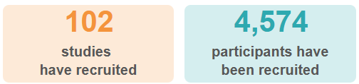
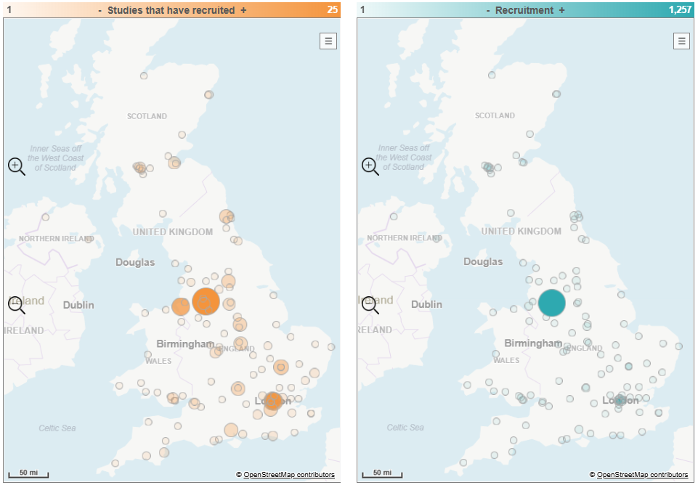
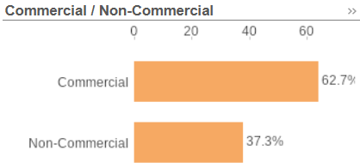
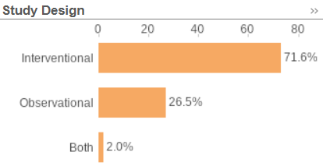
National Lung Cancer Research Recruitment Apr 25-Jan 26
Data cut: 30/01/2026
Source: ODP All Portfolio

Slide 3
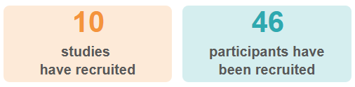
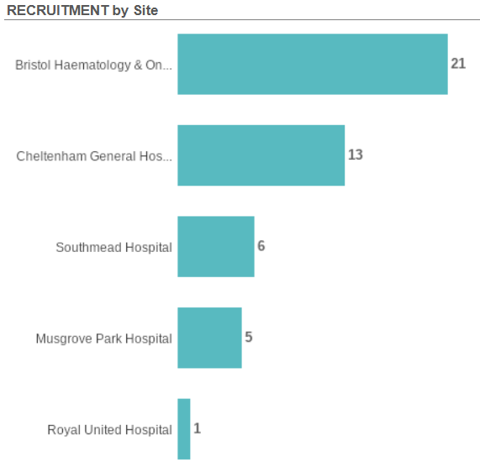
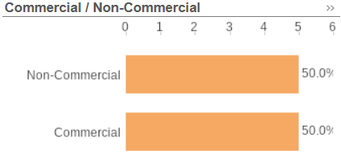
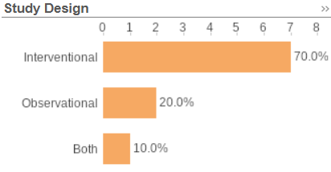
SWAG Region Lung Cancer Research Recruitment Apr 25- Jan 26
Data cut: 30/01/2026
Source: ODP All Portfolio

Slide 4
Open Lung Cancer Studies (SWAG Region)

Slide 5
Pleural
ASSESS-Meso | Observational cohort study collecting data on demographics, symptoms and biomarkers in people with mesothelioma | NBT, Taunton
Meso-ORIGINS | Observational study of Risk prediction and Generation of paired benign-meso tissue sample | NBT, Taunton
eVOLVE-Meso | Volrustomig (bivalent PD1 / CTLA4 MAb) vs carbo-pem or Ipi-Nivo | Taunton
HIT-Meso | RCT of proton hemithorax irradiation in MPM | NBT, Cardiff
OPTICAL | Observational study to understand outcomes in lung cancer-associated pleural effusion | NBT
Peri-operative
CANFit | Ph2 RCT of a home-based exercise programme | Taunton, Yeovil
Fit4Surgery | App-based, personalised prehab programme to enhance recovery and reduce complications after lung cancer surgery | NBT
Surgical
LARCS | Lung cAncer Robotic Comparative Study - Observational cohort Understand peri-operative outcomes and identify the real world selection process of VATS and RATS resection | Bristol

Slide 6
Adjuvant following | pre-op chemo-pembro
Interpath V940-009 | Pembro +/- V940 in Participants With Resectable Stage II to IIIB (N2) NSCLC not Achieving pCR After neoadjuvant chemo-pembro | BHOC
Stage 3 NSCLC
PACIFIC-8 | Durvalumab +/- domvanalimab (TIGIT) following cCRT for inoperable stage 3 NSCLC | Cheltenham
Metastatic NSCLC
REFINE | Maintenance pembro dosing interval (6 – 18 weeks) | BHOC, Cheltenham, Salisbury, Yeovil
TROPION-Lung-10 | 1L: Pembro vs Rilvegostomig (TIGIT/PD1) +/- Dato-Dxd (TROP2 ADC) in NSCLC with PDL1>50% | Cheltenham
BNT-324-01 | Ph1b / 2 single arm study of BNT 327 (VEGF/PD1 bivalent MAb) + BNT 324 (B7-H3 ADC) for 1L or pre-treated NSCLC or small cell | Bristol
KRAScendo-02 | 1L KRAS G12C. Ph3 RCT of Divarasib/pembro vs chemo/pembro | Bristol
BNT-327-07 | 1L NSCLC. Chemo-pembro vs Chemo-BNT327 (bivalent PD1/VEGF) | Cheltenham are feeder site to Cardiff

Slide 7
Radiotherapy
TOURIST (PRINCE + QUARTZ) | Efficacy of palliative RT in metastatic NSCLC | BHOC, Cheltenham, Taunton
Small cell
PRIMALung | MRI surveillance +/- prophylactic cranial irradiation in SCLC | BHOC, Cheltenham
Non-site specific
MITRE | Impact of host microbiome on immunotherapy efficacy and toxicity | BHOC, Bath, Taunton, Salisbury
WAYFIND-R | Registry in patients profiled with NGS | BHOC, Taunton, Cheltenham
DETERMINE | Lung cancer arm: MET dysregulation (Capmatinib for MET mutations other than exon 14 skipping, high level amplification, fusions) | BHOC
Respiratory
SELF-BREATHE | A self-guided, internet-based intervention for patients with chronic breathlessness: feasibility randomised controlled trial | Taunton, Yeovil

Slide 8
Pipeline studies
1L NSCLC | PF-08634404 | Ph3 RCT of chemo + pembro vs chemo + bivalent PD1/VEGF MAb | Bristol
 | BNT 327-06 | Ph 2/3 RCT of Chemo + BNT327(bivalent PD1/VEGF Mab) vs SOC | Taunton
2L NSCLC | TROPION-Lung17 | Dato-Dxd vs docetaxel in TROP2 positive NSCLC | Cheltenham
EGFR | LEPIDOPTERA | Observational Study of Clinical Outcomes in EGFR-mutated NSCLC Treated With Amivantamab-containing Regimens | Taunton, Bath
 | IZABRIGHT-Lung01 | Izalontamab Brengitecan (EGFR/HER3 ADC) vs chemo after progression on 1L EGFR TKI | Taunton
Small cell | GSK5764227 | 2L+ small cell: B7-H3 ADC vs topotecan | Taunton
HER2 | DESTINY-Lung06 | 1L: enhertu + pembro vs chemo-pembro (PDL1 < 50%) | Cheltenham
Screening | IMPALA | Increasing informed participation in lung cancer screening | NBT
Supportive | Thrombo Stop | Apixaban to Prevent Venous Thromboembolism in Ambulatory Lung Cancer Patients Undergoing Systemic Anticancer Treatment | Salisbury

Slide 9
Rare mutation trials out of area:
Uncommon EGFR:
Torbay: REZILIENT 3 (1L mNSCLC - chemo +/- zipalertinib – option to crossover on PD)
Cardiff: REZILIENT-4 – resected uncommon EGFR mutation
HER2:
SOHO 02 (1L Oral HER2 TKI vs SOC chemo) – Open in Torbay and in set-up at Cardiff

Slide 10


Be Part of Research is a UK-wide service that helps people find and take part in health and care research across nearly every health condition.
A resource for:
patients or their families keen to get involved in research
Researchers looking for target population for research
https://bepartofresearch.nihr.ac.uk/

Slide 11
Key messages for patients
Be Part of Research makes it easier than ever to find and take part in health and care research.
Simply sign up online and choose the areas of research you’re interested in.
You’ll then be matched to suitable studies and sent clear information about what’s involved and how you can take part.
The decision on whether to take part is always yours.

Slide 12

Associate Principal Investigator
Scheme
Six month in-work training opportunity, providing practical experience for healthcare professionals starting their research career.
People who would not normally have the opportunity to take part in clinical research in their day to day role have the chance to experience what it means to work on and deliver a NIHR portfolio trial under the mentorship of an enthusiastic Local PI.
CIs working with a CTU can register their study on the scheme
https://www.nihr.ac.uk/health-and-care-professionals/career-development/associate-principal-investigator-scheme.htm

Slide 13

Principal Investigator Pipeline Programme
(PIPP)
Overview
Research delivery nurses, midwives and AHPs
12 to 18 months
Free if you’re eligible
Live virtual lessons, online learning and hands-on experience
Cohort 5 applications open in April 2026, approx 60 places
Please email nursingandmidwifery@nihr.ac.uk for more information
https://www.nihr.ac.uk/career-development/clinical-research-courses-and-support/principal-investigator-pipeline-programme

Slide 14
NIHR ODP https://odp.nihr.ac.uk/
Open data platform. Data on performance across whole RDN, including all specialty areas
NIHR Be Part of Research https://bepartofresearch.nihr.ac.uk/
See which studies are open across the country
Find a Clinical Research Study (ODP) http://csg.ncri.org.uk/portfolio/portfolio-maps/
Search for a study to fit criteria. Good for horizon scanning, eligibility criteria

Slide 15
Contacts
swc.rrdn@nihr.ac.uk
Study Support Service Manager: claire.matthews@nihr.ac.uk
CAG Research Lead: gareth.ayre@uhbw.nhs.uk

