Slide 1
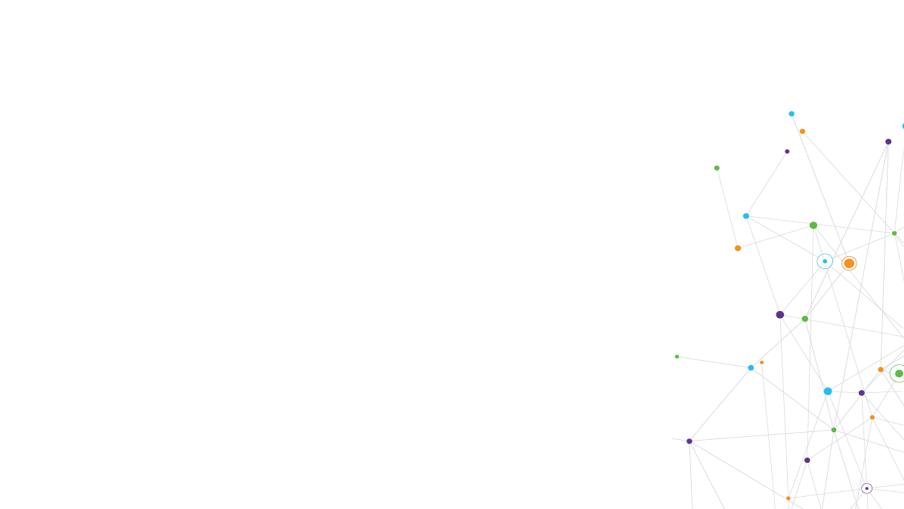


Benchmark of CNS Job Descriptions
3rd February 2026
SWAG Cancer Alliance Lung CAG

Slide 2
Issues raised at SW Lung CNS forum
Workload from GPs – up-banding of Band 6 CNS’s?​
Frequent referral of patients from GPs to CNS teams for advice on pain relief etc and complex conversations regarding their care​
Positive to compare CNS job descriptions across tumour sites both within SWAG and broader​
Impact of newer treatments – eg immunotherapy, business case submitted (Gloucester FT) for increased capacity – CNS- led clinics rather than medics. Cost saving at band 7.

Slide 3
Cancer Alliance planning
Continued focus on ACCEND in 26/27 CA planning ​
ACCEND:​
Number of providers with an ACCEND implementation plan in place (covering: strategic planning, leadership and governance; role design, job descriptions and career pathways; education and learning infrastructure) ​
Number of staff in all providers within the Alliance footprint using the ACCEND framework (including appraisals, training and development needs)

Slide 4
LCN plan
Where possible job descriptions should be matched to ACCEND competencies ​
Many variables currently with the implementation of ACCEND - enhanced/advanced practice and the ACP role​
There does need to be consistency across Trust/Alliance in relation to CNS roles and banding​
Setting standards in terms of knowledge, skills and practice for both B6 and B7 CNS roles to include the expectation of practice levels for both bands.

Slide 5
Plan to address issue
Start with an appraisal of the current CNS workforce position (including banding, qualifications, WTE, years in post, team structure, specific deliverables eg nurse led clinics, involvement in diagnostic pathway etc)​
Input from national CNS development programme ​
SWAG project support

