Slide 1
Increased perioperative risk pathway

Slide 2



Conclusion
Agenda
Agenda
Longest pathways
  Curative intent treatment
      Surgery, ChemoRT, SABR
    Stage 2 and 3
15 104 day waits reviewed
  Delayed/complex diagnostic pathway 3
  Surgical delays 3
  Crossed pathways surgery to oncology 4
  Other comorbidity 4
  Pt choice 1

Slide 3
Joint treatment clinics
Agenda
Agenda
Rationale – reduction in long waits, reduce numbers who cross pathways
All neoadjuvant patients
SABR vs resection in borderline fitness
Surgery vs chemoRT
Challenges
  Changing job plans
  Clinic room capacity
  Introducing inefficiency
? Best model
  Parallel rather than joint clinics

Slide 4
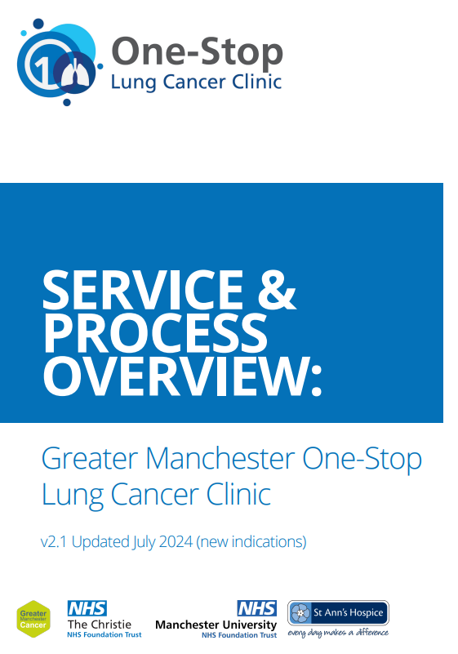
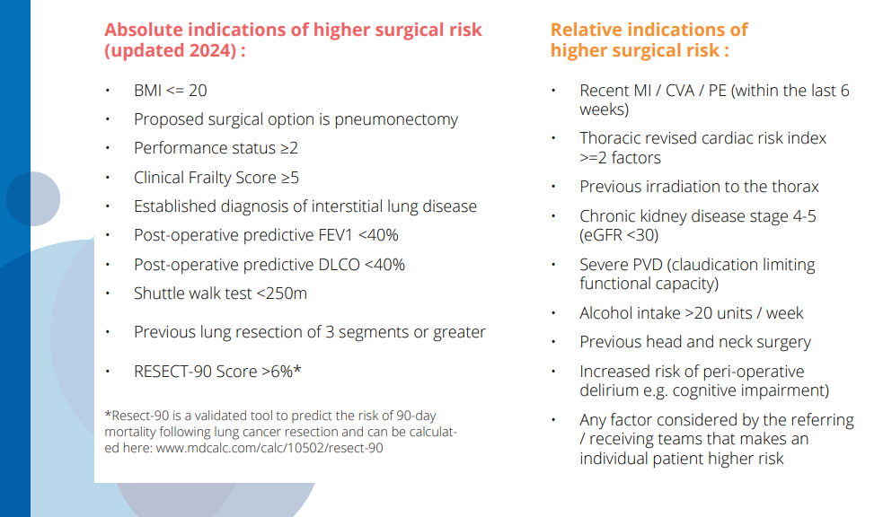

Slide 5
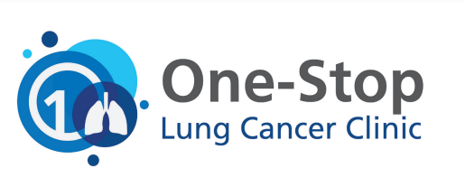


The GM One Stop Lung Cancer Clinic
Patient & family
Shared decision making & optiisation
Lung cancer physicians
Thoracic anaesthetists
Clinical oncologists
CURE Tobacco dependency team
Thoracic surgeons
Prehab
4cancer
Oncogeriatrics
Cancer Nurse Specialists

Slide 6
What elements can / should we replicate
Early identification of patients at risk
Shuttle walk / 6MWT
Criteria led early referral for CPET
Parallel thoracic / oncology referrals
Joint / parallel clinics

