Slide 1

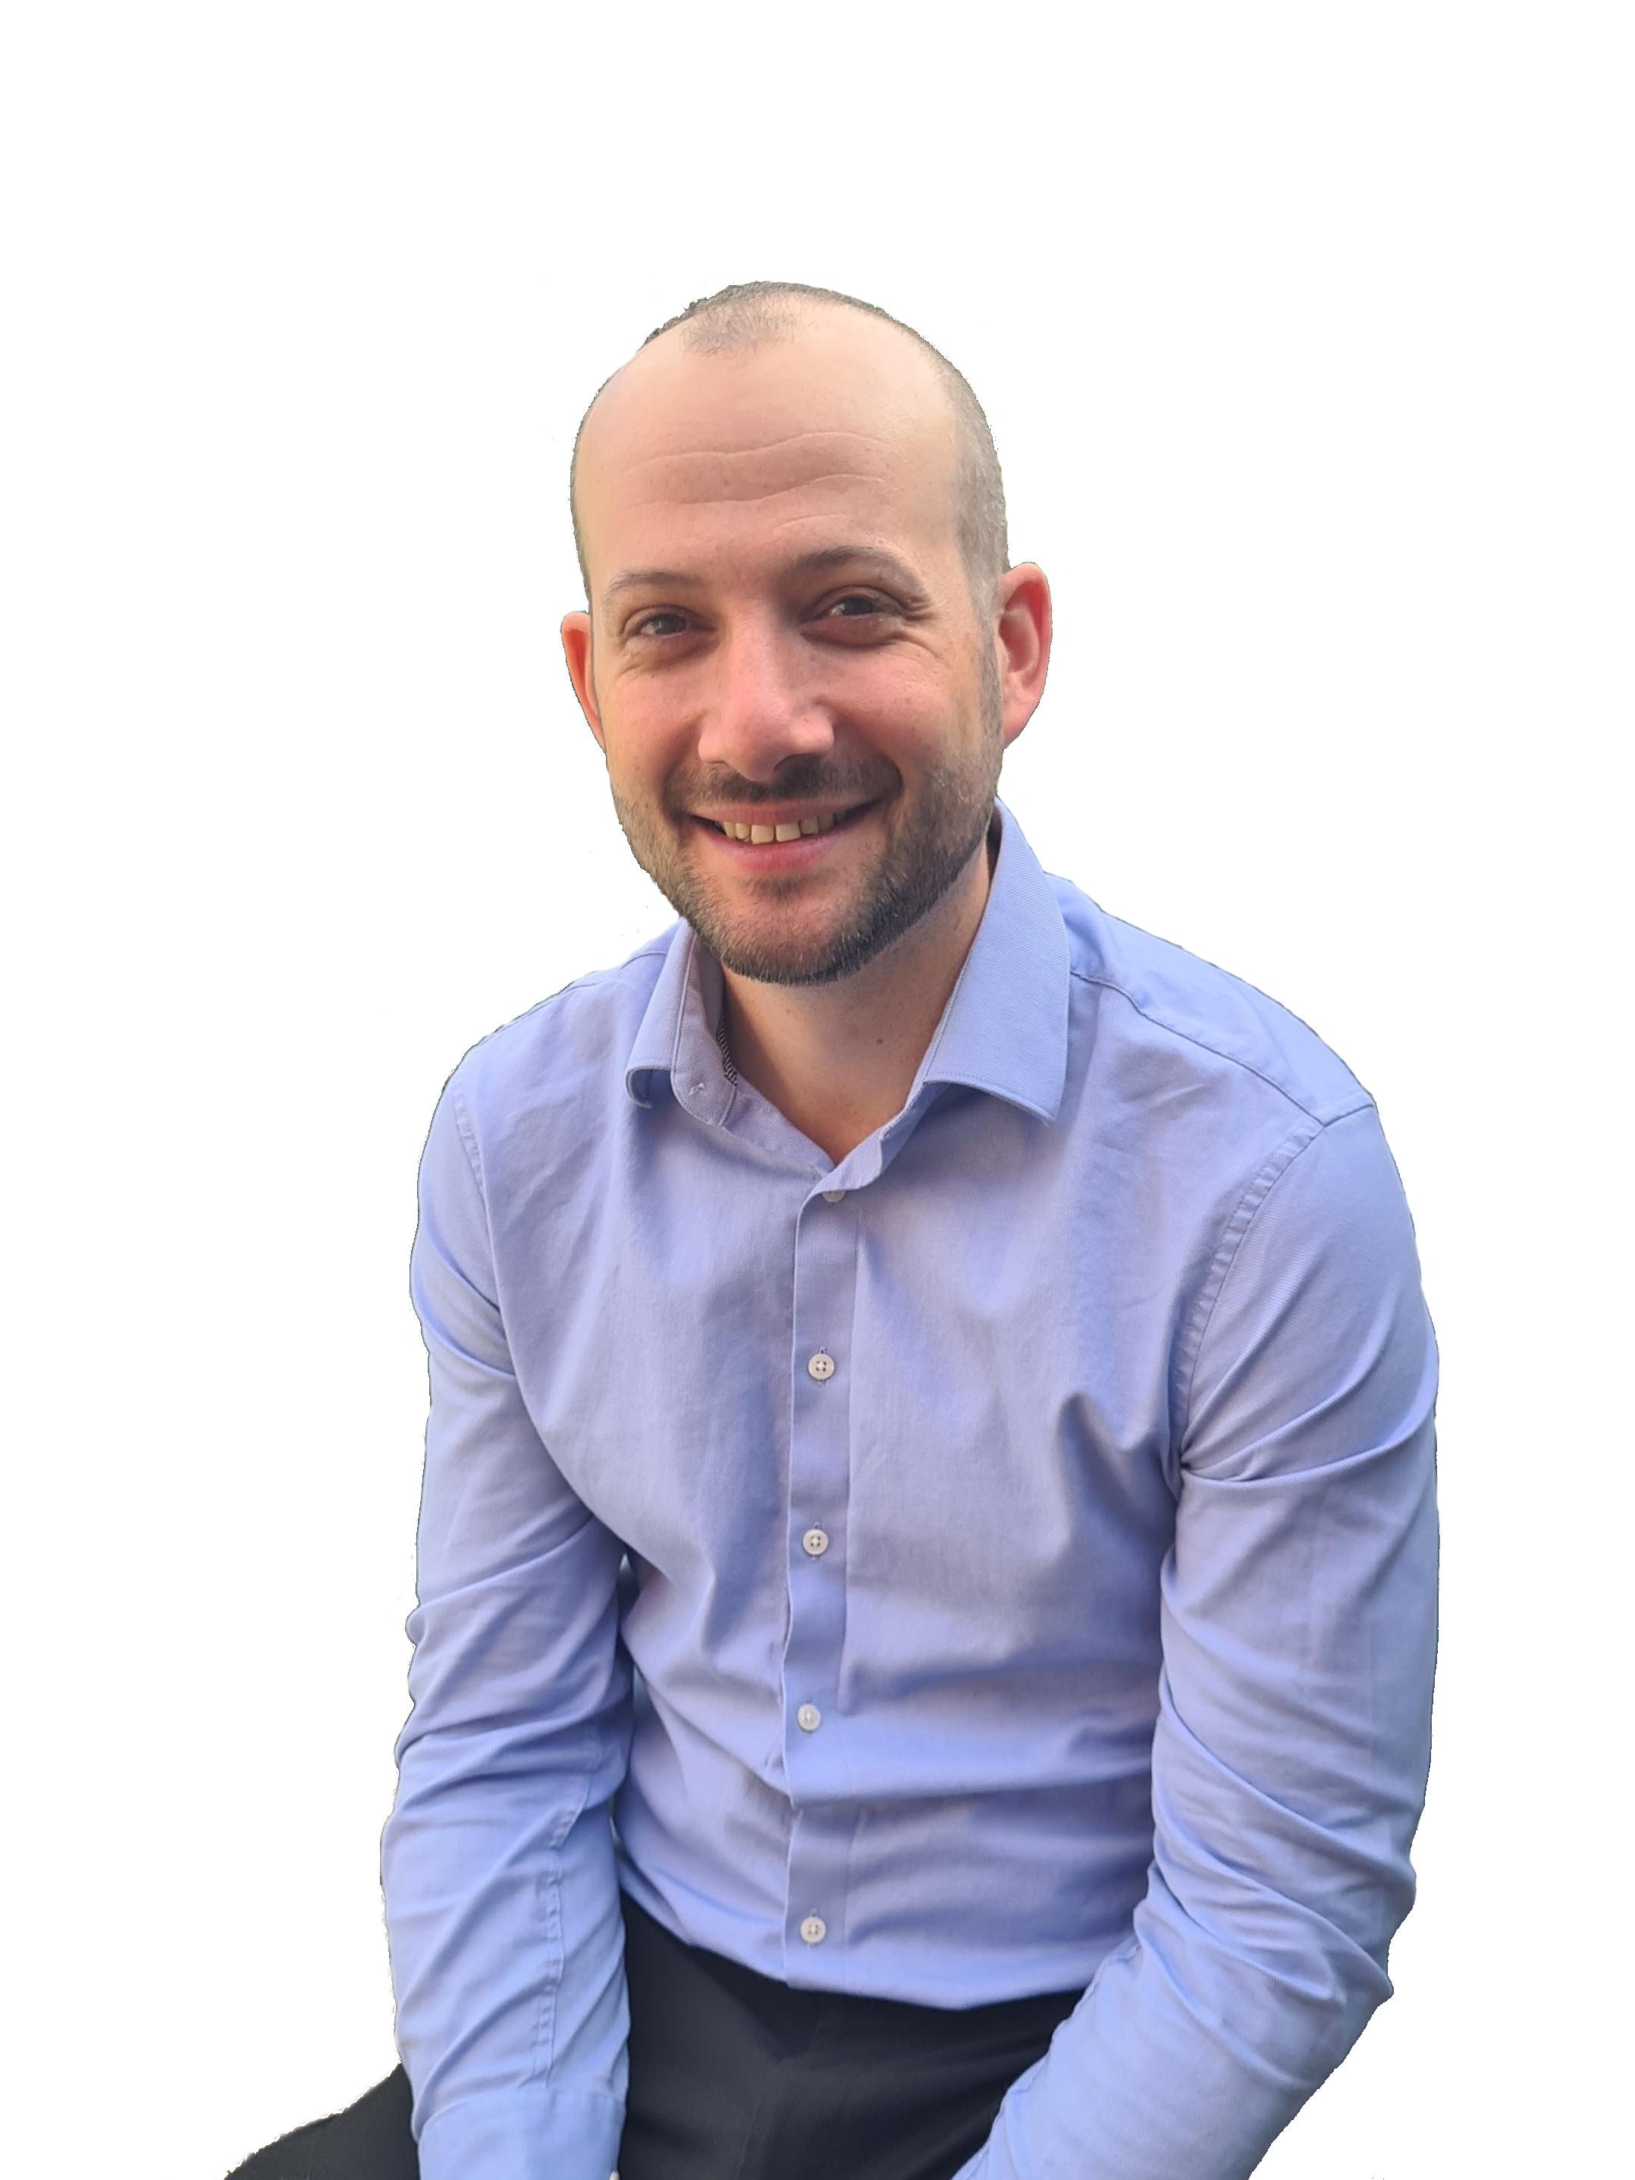
Cancer Vaccine Launch Pad (CVLP)
Virtual Research Hub:
Advancing Equity and Excellence in Cancer Trials
Dr. Tony Timlin
SWAG Cancer Alliance, CVLP Regional Manager
North Bristol NHS Trust, Research Programme Manager
tony.timlin@nbt.nhs.uk

Slide 2

The CVLP is a multicentre prospective observational cohort study for the collection of tumour samples and matched blood samples from patients with cancer.
Patients may be eligible to enter screening for one of the vaccine (or immunotherapy) trials.
CVLP is a recruitment-for-referral trial
Provides true equity of access for ALL patients
Notes:
As the CVLP scales and more cohort Trials come on-board, so recruitment will become more broad.

Slide 3
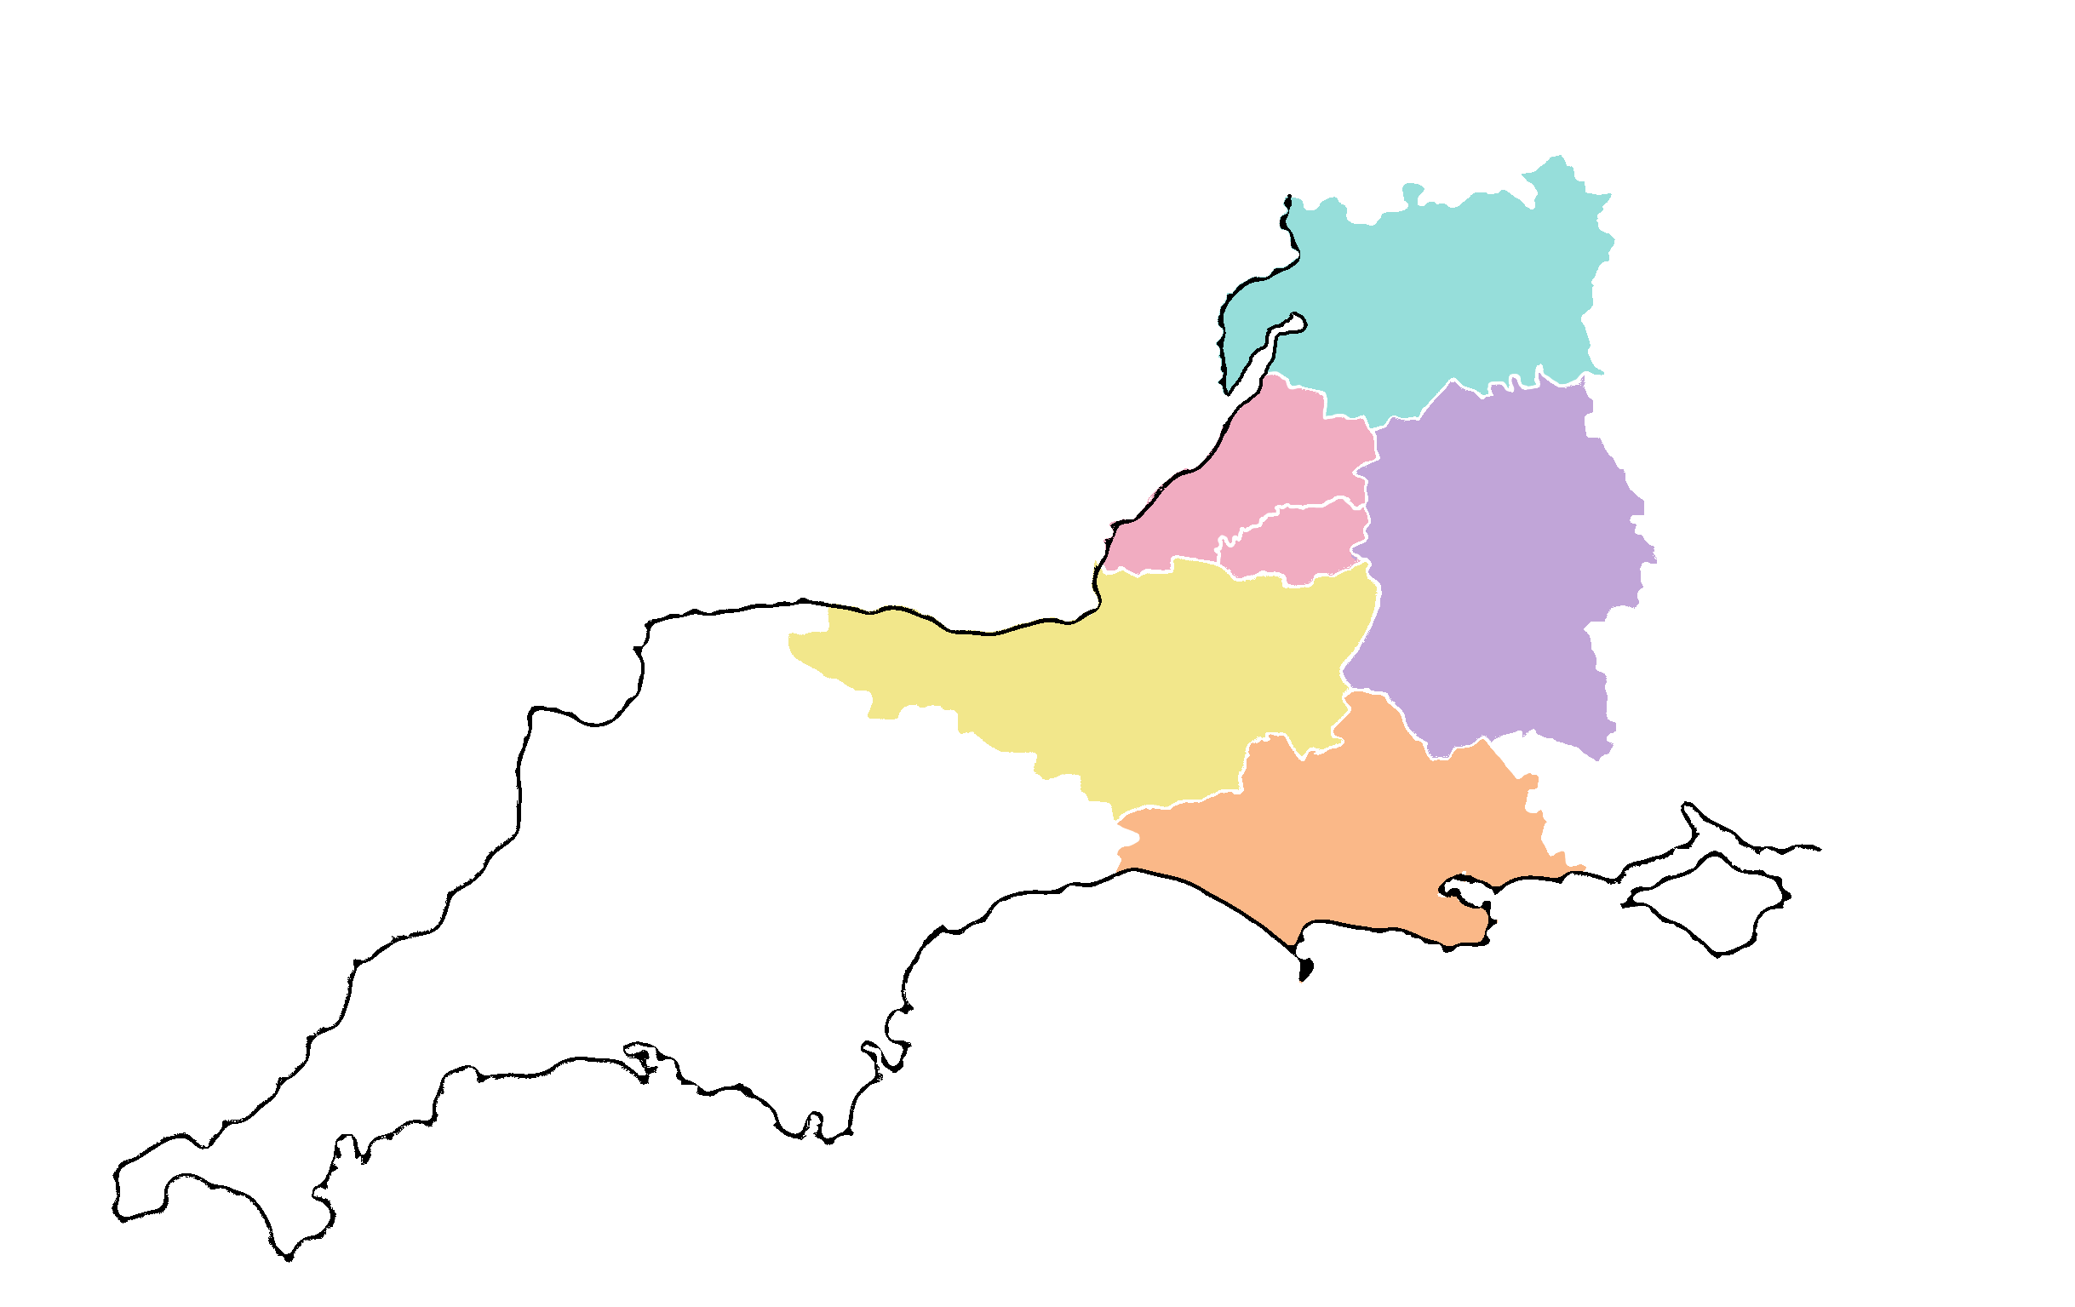
South-West: Core Region
SWAG and SWC RRDN
Pop: 3,919,946
Gloucestershire
Pop: 937,363
BNSSG
Pop: 750,000
Bath,
Swindon & Wiltshire
Pop: 940,000
Somerset
Pop: 982,941
Dorset
Pop: 781,401
Notes:
So, the core message here is that there should be no boundaries when it comes to delivering equity for patients.
In terms of the project, our focus area is that served by the host (SWAG) and funder (SWC RRDN)…

Slide 4
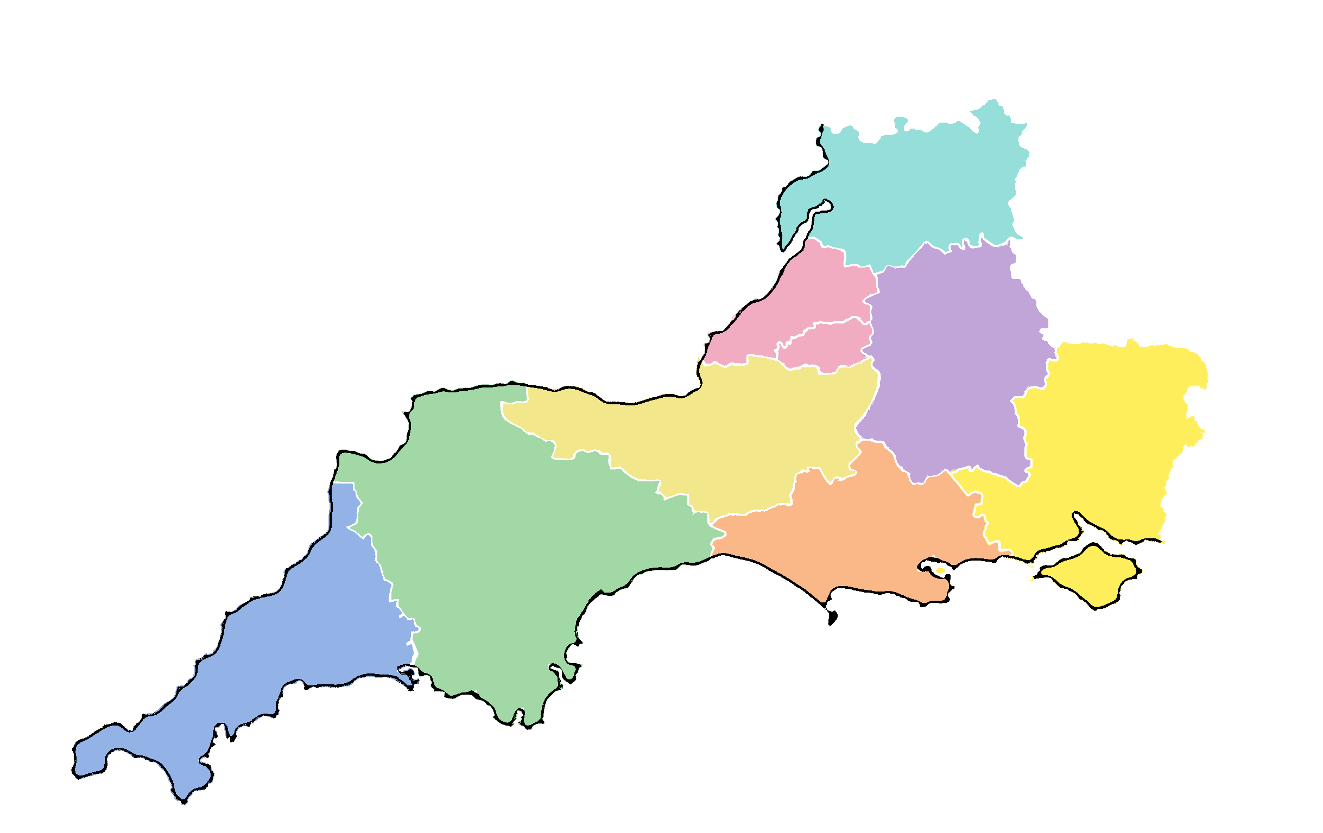
South-West: Extended Region
SWAG, SWC RRDN, SWP RRDN…
and Hampshire (home of CVLP)
Pop: 7,633,799
Gloucestershire
Pop: 937,363
BNSSG
Pop: 750,000
Bath,
Swindon & Wiltshire
Pop: 940,000
Somerset
Pop: 982,941
Hampshire
Pop: 1,920,959
Cornwall
Pop: 574,281
Devon
Pop: 1,218,613
Dorset
Pop: 781,401
Notes:
…But to provide true equity of access and a clear referral pathway for our population in Cornwall and Devon the extended aim is to serve the whole of the South-West.
And with the CVLP being hosted and sponsored by Southampton Clinical Trials Unit, and as part of Wessex CA, I’ll drop in Hampshire.

Slide 5
Ambition
Regional aim to become a CVLP cancer vaccine delivery site
CVLP target to be recruiting at ALL sites across the region…
…and delivering EVERY cohort trial within region
Mechanism
Regionalised eConsent pathway across the region
Regionalised eReferral Tool data entry
Upskilling research workforce (API Scheme)
Build capacity for future growth…
Notes:
To reduce / remove administrative burden from site teams
To simplify / de-stress research conversations for patients
To proceduralise CVLP so that pathways align regardless of the cohort Trial

Slide 6
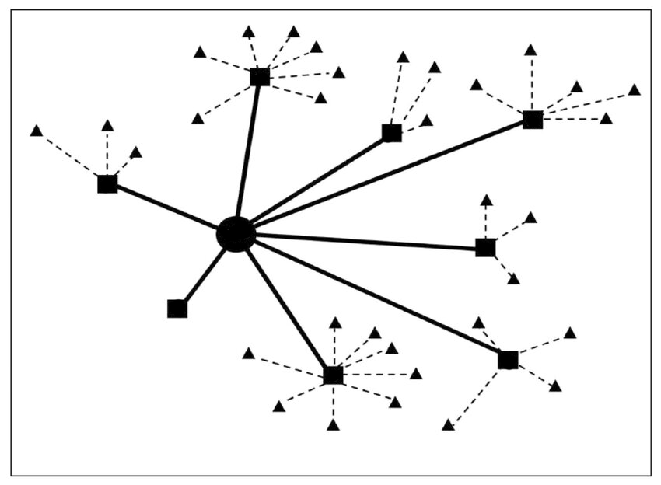
PIs and Associate PI Scheme
Regionally supported hub and spoke model
Virtual Research Hub at the centre
Collaborative network of CVLP PIs
  General CVLP oversight
Site API for each cohort trial
  Specific to cohort cancer target
API support network

Slide 7
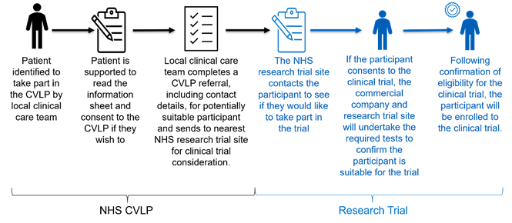
BNT327-06 ROSETTA Lung-02
systemic treatment-naïve advanced non-small cell lung cancer (NSCLC)
The first immunotherapy trial to come onto the CVLP portfolio following Amendment
BNT327 in combination with chemotherapy
Trial Sites
  OUH (Oxford) – Awaiting reactivation
  Velindre (Cardiff) – Open to referrals
  Musgrove Park (Somerset) – In set-up
  RUH (Bath) – In set-up
CVLP Sites
  NBT (Bristol) – Declined
  UHBW (Bristol) – Declined
  RUH (Bath) – Trial Site
  Musgrove (Somerset) – Trial Site
  Yeovil (Somerset) – Will be live when Musgrove opens
  Gloucestershire – Active (referring to Velindre)
  Salisbury – (low patient numbers) but to be re-approached

Slide 8
*NEW* Lung - non-small cell
One of the next Trials to be coming online with CVLP
New commercial partner
We should be targeting Trial delivery in region
We should be targeting CVLP referral across the region

Slide 9
Cancer Vaccine Launch Pad (CVLP)
Dr. Tony Timlin
tony.timlin@nbt.nhs.uk

