Slide 1
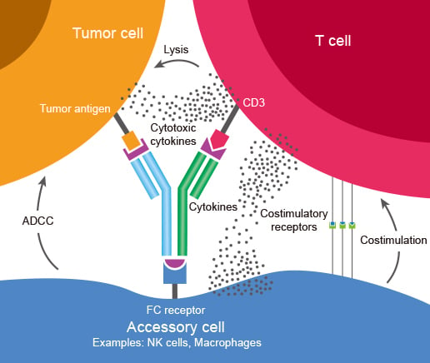
Bispecific drugs
Lung Cancer Clinical Advisory Group
Dr Tania Tillett
Medical Oncologist

Slide 2
Introduction to Bispecifics
Mechanism of Action
Data
Toxicity
Questions

Slide 3
What is better than one target?
Monoclonal antibody - -mab bind one antigen target can either be an immune target e.g. pembrolizumab (binds to the PD-1 receptor on T-cells) or non immune e.g. bevacizumab (binds VEFG receptor)
Bispecific antibody – antibody which binds two targets e.g. amivantamab (EGFR and MET binding)
BiTE type of bispecific antibody that has a T-cell engager so binds a T cell often to a cancer cell e.g. Tarlatamab (CD3 T cell binding and DLL3 cell surface protein on small cell lung cancer cells)

Slide 4
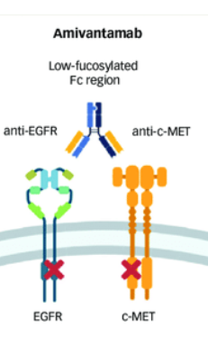
Mechanism of Bispecifics
Monoclonal antibody - highly homogeneous antibodies produced by a single B-cell clone that are directed only against a specific antigenic epitope and specifically bind to unique epitopes on targets such as pathogens and cancer cells.
Bispecific antibody - is an engineered protein designed to bind to two different targets (antigens or epitopes) simultaneously, unlike natural antibodies that bind to just one; this unique ability allows them to bridge cells, like bringing immune cells close to cancer cells to activate an attack, or block multiple disease pathways at once, making them powerful tools in immunotherapy for cancer and other diseases

Slide 5
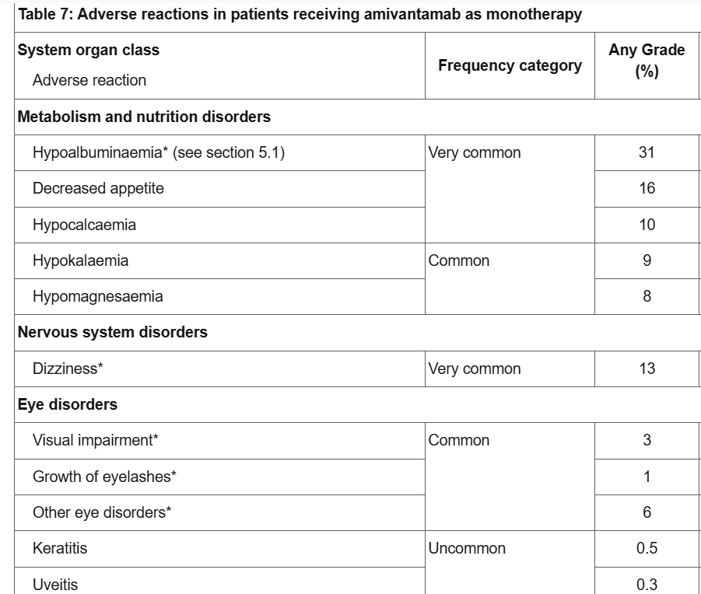
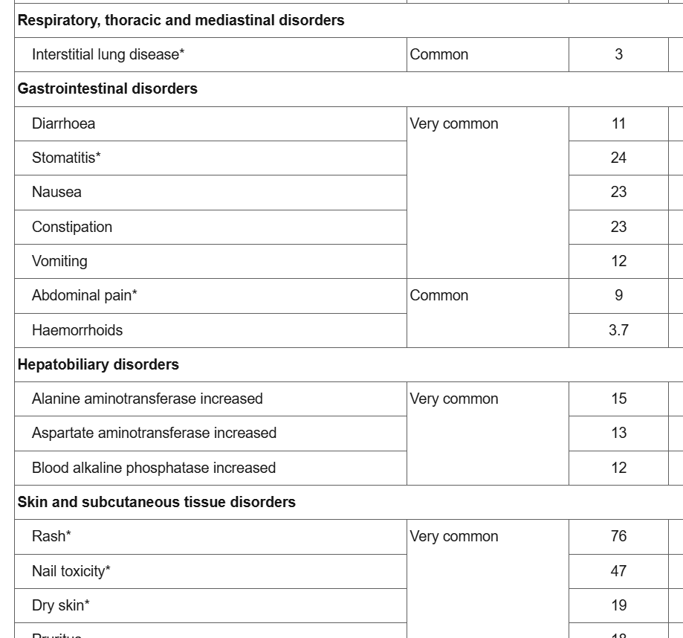
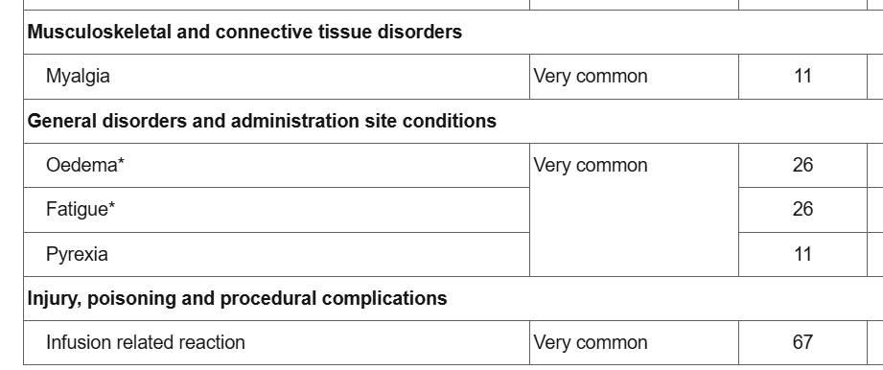
Amivantamab – bispecific – MET and EGFR target

Slide 6
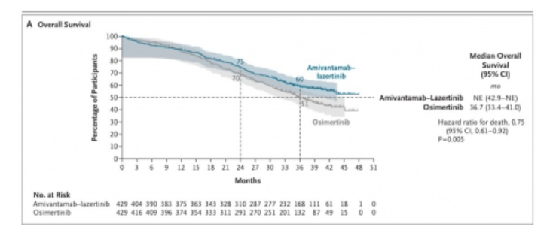
Mariposa overall survival curve
MARIPOSA - A Study of Amivantamab and Lazertinib Combination Therapy Versus Osimertinib in Locally Advanced or Metastatic Non-Small Cell Lung Cancer
Romero, D., 2025. MARIPOSA Lung cancer. Nature Reviews Clinical Oncology, 22(11), pp.801-801.

Slide 7
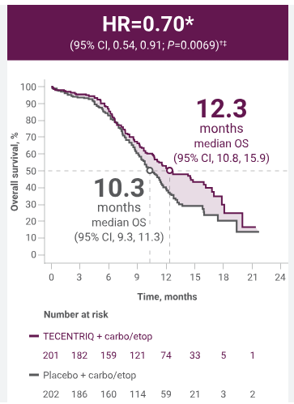
Reminder of tail of survival curve in immunotherapy
Immunotherapy changed shape of survival curve from standard ‘s shaped curve’ to the ‘tail on the curve’
You need to remember this when looking at statistics about response rates, median overall survival in immunotherapy
We are changing the way we assess our survival data to 5 alive at 2, 5 and 10 years after treatment and median duration of response
IMpower133 efficacy results in 1L ES-SCLC | TECENTRIQ® (atezolizumab)

Slide 8
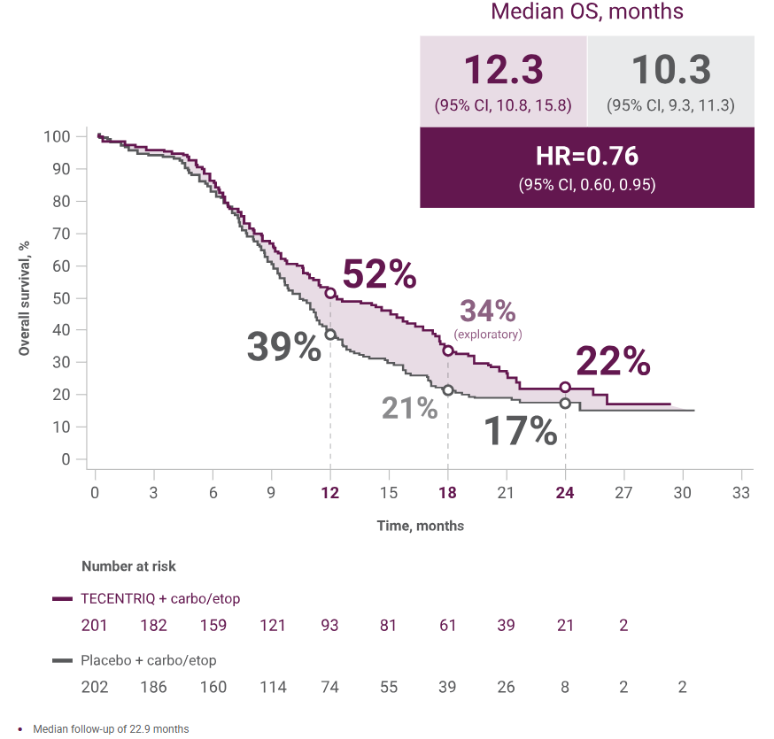
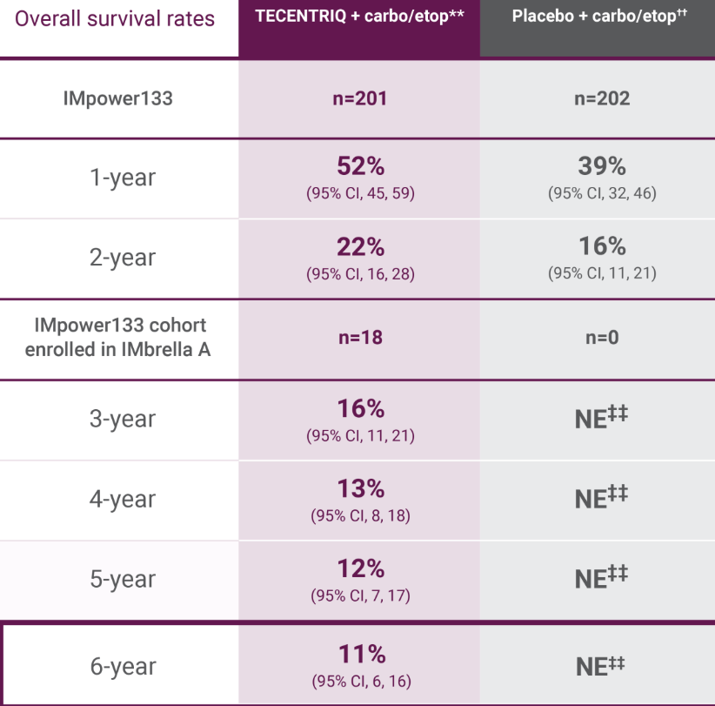
Long term survival data from IMpower133
Mpower133 efficacy results in 1L ES-SCLC | TECENTRIQ® (atezolizumab)

Slide 9
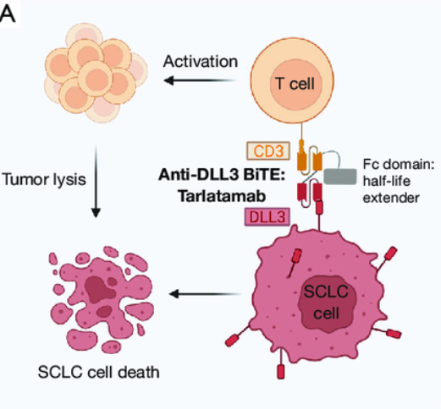
Tarlatamab - BITE
Bispecific – T cell engager (CD3) and small cell tumour antigen (DLL3)
Immunotherapy response profile
New toxicity profile

Slide 10
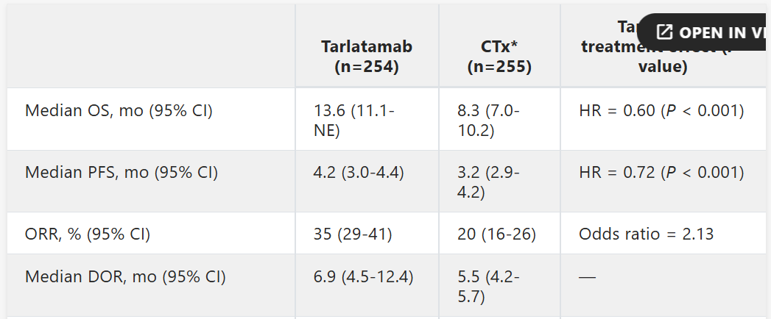
Tarlatamab – DeLLphi-301+4
DELLphi 301 Previously treated small cell lung cancer – Phase 2 n=100 at 100mg dose every 2 weeks –
ORR (overall response rate 25%),
mDOR (median duration of response) 11m (95% CI 6.6-22.3) and 29.4% had sustained disease control with time on treatment after 52 weeks.
CNS tumour shrinkage of >30% was seen 62.5% patients (10 of 16) who had baseline lesion >10mm.
Extended into Phase 3 DELLphi 304 randomised against second line cytotoxic treatment – showing significant results
Dowlati A, J Clin Oncol. 2024 Oct 10;42(29):3392-3399. doi and Rundin a., J Clin Oncol, 43 (17) DOI: 10.1200/JCO.2025.43.17_suppl.LBA8008

Slide 11
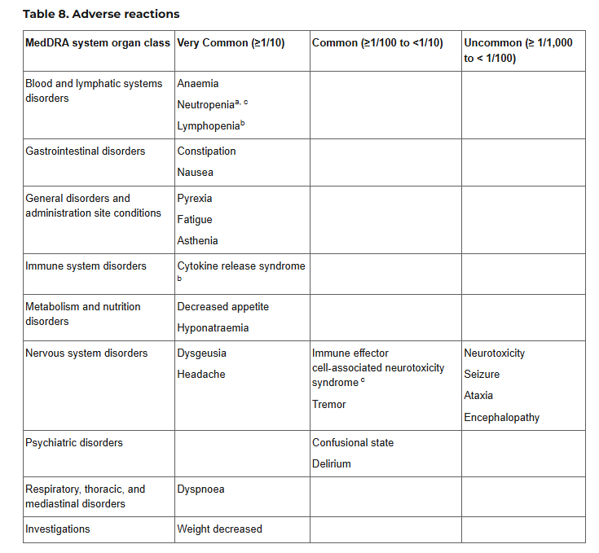
Why we worry
SPC (Summary Product Characteristics) of tarlatamab
CRS in DeLLphi-300 study occurred 56.7%, G3 1.7% G4 0.2% G5 0 – majority occurred after first two doses (8.5% had on third dose or later)
Median time for most recent dose to first onset CRS 15.9 hours (range 9 to 26.5)
ICANS in DeLLphi-300 seen in 4.7% and median time from first dose to first ICANS was 9 days (range 2-13)
Neutropenia seen 16.9% G3+4 8.2%

Slide 12
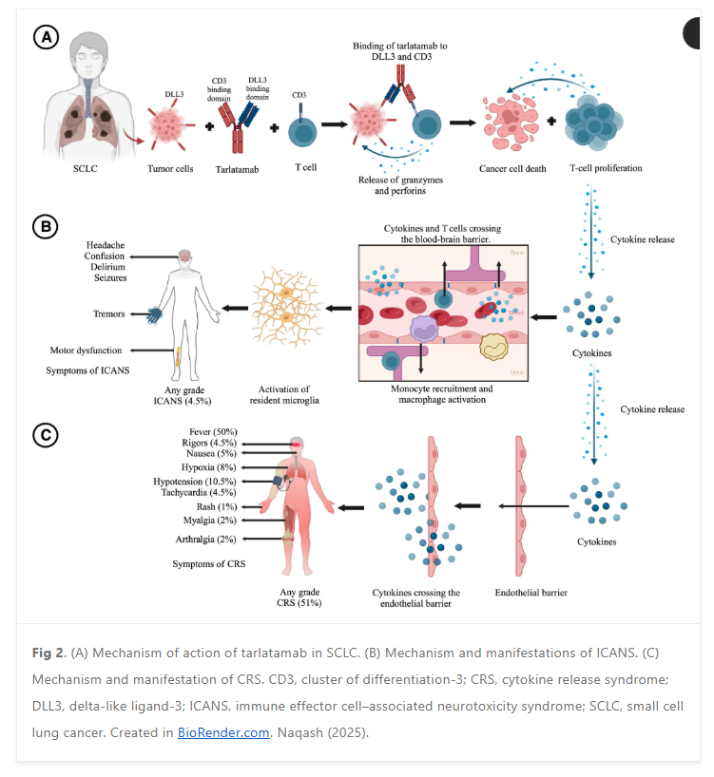
With thanks to Taking a Bite Out of Small Cell Lung Cancer By Leveraging Precision-Directed Delta-Like Ligand-3 Therapies | American Society of Clinical Oncology Educational Book

Slide 13
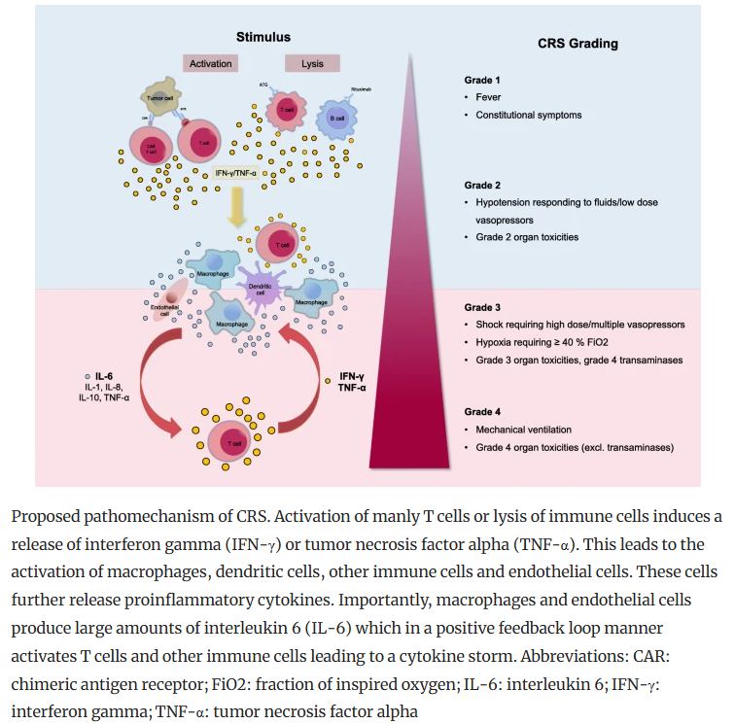
CRS – 56% patients in DeLLphi-30
With thanks to
Shimabukuro-Vornhagen, A., Gödel, P., Subklewe, M. et al. Cytokine release syndrome. j. immunotherapy cancer 6, 56 (2018). https://doi.org/10.1186/s40425-018-0343-9

Slide 14
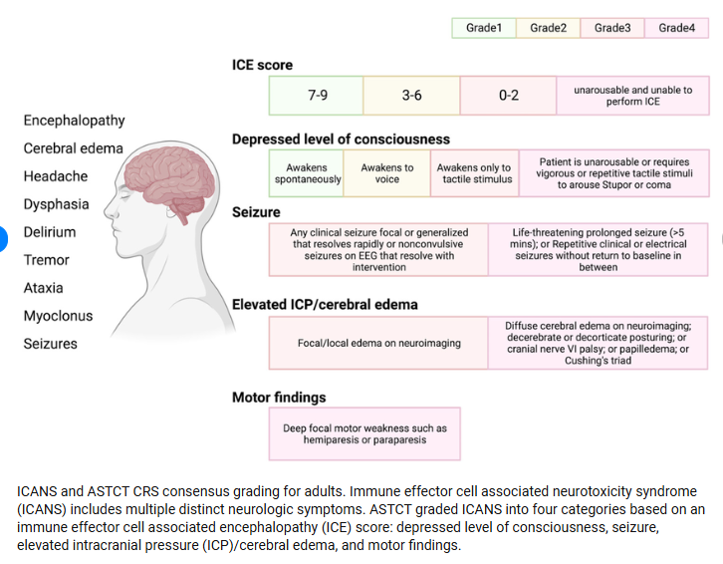
ICANS – 4.7% patients in DeLLphi-30
With thanks to
Zhang, Yugu & Qin, Diyuan & Shou, Arthur & Liu, Yanbin & Wang, Yongsheng & Zhou, Lingyun. (2023). Exploring CAR-T Cell Therapy Side Effects: Mechanisms and Management Strategies. Journal of Clinical Medicine. 12. 6124. 10.3390/jcm12196124. https://www.researchgate.net/publication/374124789_Exploring_CAR-T_Cell_Therapy_Side_Effects_Mechanisms_and_Management_Strategies

Slide 15
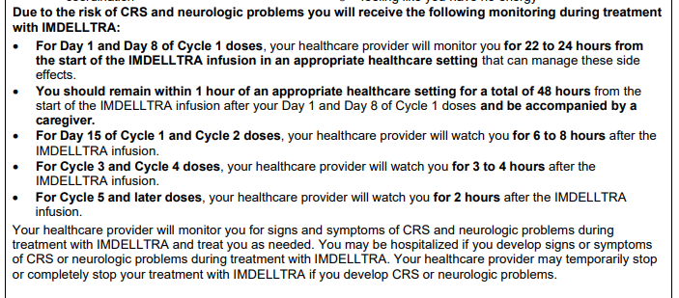
What is this changing?
We need to upskill at recognising and treating these new side effects – us, our 24 hour helpline staff, our ward team, our on call medics who cover our wards and admit our patients
Step up dosing schedules (28 day cycle) – C1 D1 reduced dose D8 and D15 full dose from C2 full dose 2 weekly
We need to admit these patients for treatment and observation putting pressure on our inpatient beds

Slide 16
Graphics

