Slide 1
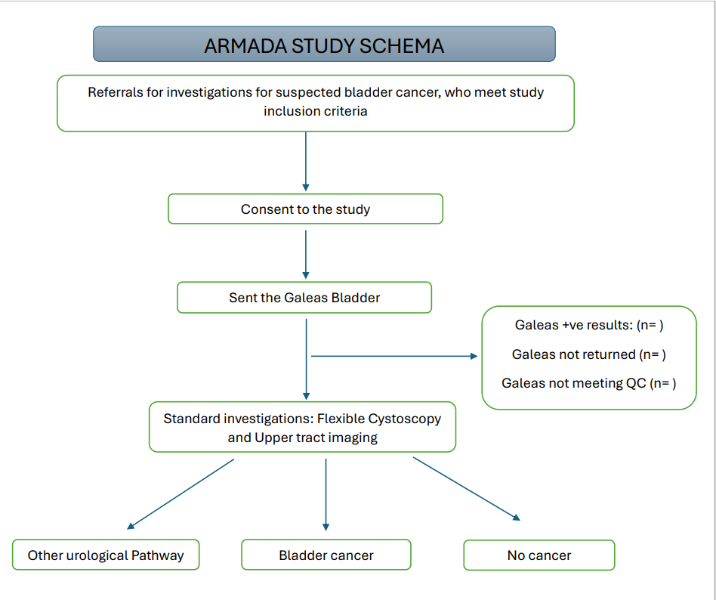
Biomarker study in set up (SWAG + Nonacus)
Bath – Edd Jefferies
Taunton – Neil Trent
Cheltenham – Ed Tudor
Bristol – Helena Burden, John McGrath, Vikki Gardener
Swindon – Sunil Mathur
Cohese Healthcare

