Slide 1

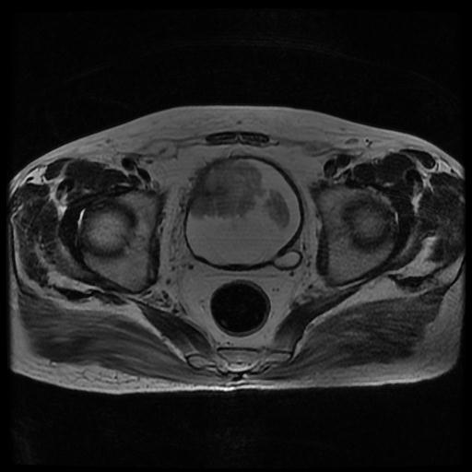
The role of MRI in the suspected bladder cancer pathway: results from a multicentre SWAG audit
Tom Malik
ST4 in Urology
NIHR Academic Clinical Fellow

Slide 2
Introduction
Muscle-invasive bladder cancer (MIBC) is associated with poor prognosis
Delay to definitive treatment associated with reduced survival^{1,2}
Recommended time from diagnosis to radical cystectomy <3 months³
Significant pressure on haematuria pathway
Fahmy (2006) 2. Russell (2020) 3. EAU (2025)

Slide 3
Introduction: MITRE
 | 2019 | 2025
Time from referral to TURBT | Median 40 days | Median 43 days
N0 M0 disease | 24/30 (80%) | 25/33 (76%)
No mention of NAC by MDT | 12/30 (40%) | 11/33 (33%)
Radical cystectomy | 12/30 (40%) | 8/33 (24%)
NAC received pre-cystectomy | 4/12 (33%) | 3/8 (38%)
Time from referral to cystectomy | Median 160 days | Median 174 days
No definitive treatment received | 11/30 (37%) | 7/33 (21%)

Slide 4
Introduction: MITRE
 | 2019 | 2025
Time from referral to TURBT | Median 40 days | Median 43 days
N0 M0 disease | 24/30 (80%) | 25/33 (76%)
No mention of NAC by MDT | 12/30 (40%) | 11/33 (33%)
Radical cystectomy | 12/30 (40%) | 8/33 (24%)
NAC received pre-cystectomy | 4/12 (33%) | 3/8 (38%)
Time from referral to cystectomy | Median 160 days | Median 174 days
No definitive treatment received | 11/30 (37%) | 7/33 (21%)

Slide 5
Introduction: BladderPath trial¹
143 randomised
72 to Pathway 1 - TURBT-staged as per standard of care
71 to Pathway 2 - mpMRI-staged if suspected MIBC at flexible cystoscopy (after FC biopsy or urine cytology)
Bryan (2025)

Slide 6
Introduction: BladderPath trial¹
143 randomised
72 to Pathway 1 - TURBT-staged as per standard of care
71 to Pathway 2 - mpMRI-staged if suspected MIBC at flexible cystoscopy (after FC biopsy or urine cytology)
Primary outcome
Median time to correct treatment (TTCT) = 98 days Pathway 1 vs 53 days Pathway 2 (P = 0.02)
Bryan (2025)

Slide 7
Introduction: BladderPath trial¹
143 randomised
72 to Pathway 1 - TURBT-staged as per standard of care
71 to Pathway 2 - mpMRI-staged if suspected MIBC at flexible cystoscopy (after FC biopsy or urine cytology)
Primary outcome
Median time to correct treatment (TTCT) = 98 days Pathway 1 vs 53 days Pathway 2 (P = 0.02)
Secondary outcome
No difference in TTCT for patients with suspected NMIBC
Bryan (2025)

Slide 8
Aims
Multicentre regional audit of the haematuria pathway in the South West
To assess time to definitive treatment in patients with suspected MIBC
To evaluate feasibility of introducing mpMRI in the bladder cancer pathway

Slide 9
Methods
Participating centres = Bristol, Bath, Cheltenham, Swindon, Taunton
Retrospective review of all patients referred on faster diagnostic pathway with suspected bladder cancer (1st January – 30th April 2025)
Data collected to evaluate appearance at flexible cystoscopy and time from referral to critical time-points on the bladder cancer pathway

Slide 10
Results: study sample 1st January – 30th April 2025
Total | 1944
Bristol | 707
Bath | 441
Cheltenham | 314
Swindon | 264
Taunton | 218

Slide 11
Results: patient demographics
Age (years) | Median 71 (IQR 61-78)
Gender | Male | 1186/1944 (61%)
 | Female | 758/1944 (39%)
Presenting complaint | VH | 1368/1944 (70%)
 | NVH | 512/1944 (26%)
 | Other | 57/1944 (3%)
 | Not known | 7/1944 (0.4%)

Slide 12
Results: abnormal flexible cystoscopy findings n=571/1944 (29%)
Notes:
‘Other’ = BPH, urethral stricture, bladder stone, inflammatory conditions etc
12

Slide 13
Results: pathology for suspected MIBC
Solid lesion at FC | 59/571 (10%)
Underwent TURBT | 53/59 (89%)
MIBC at TURBT histology | 23/53 (43%)
Notes:
6 not having TURBT:
3x cystoscopy + biopsy
1x diagnosed with metastatic prostate cancer
2x missing data
10 MIBC not presenting with solid tumour:
9x papillary at FC
1x FC report not available
13

Slide 14
Results: total cohort MIBC
MIBC at TURBT histology = 33/1944 (2%)
Radical cystectomy 8/33 (24%)
Radical radiotherapy 6/33 (18%)
No definitive treatment 7/33 (21%)
Palliative radiotherapy 3/33 (9%)
Palliative chemotherapy 3/33 (9%)
Endoscopic management 2/33 (6%)
Palliative immunotherapy 1/33 (9%)
Pending treatment decision 3/33 (9%)
Notes:
8 having cystectomy: 5 appeared solid, 3 appeared papillary
14

Slide 15
Results: pathway
 | Total cohort | MIBC
Time from referral to clinic | Median 14 days | Median 14 days
Time from referral to UT imaging | Median 14 days | Median 14 days
Time from referral to TURBT | Median 44 days | Median 43 days
Time from referral to MDT | Median 61 days | Median 58 days
Time from referral to cystectomy | - | Median 174 days

Slide 16
Conclusions
Not meeting EAU-recommended target for radical cystectomy
59 mpMRI scans would have been done in this sample (approx. 180 per year)
Estimated >3500 MRI prostates performed each year across five centres
Potential to reduce time to MIBC diagnosis and definitive treatment
Potential to improve survival
Notes:
16

Slide 17
Acknowledgements
Bristol Tom Malik, Jonathan Denfhy, Lubna Mohammed, Hpone Theinka Lin, Lin Aung Han, Jonathan Aning
Bath Amina Buba, Laura Waley, Aashna Bali, Gemma Shaw, Edward Jefferies
Cheltenham Kirthana Babureddy, Amber Pankhurst, Edward Tudor
Swindon Sian Dudley, Sunil Mathur
Taunton Jessica Head, Jade Brown, Tirion Smith, Neil Trent
Notes:
17

