Slide 1




Urology CAG
29th January 2026

Slide 2

Days Matter Project
Objective: Emulate the pathway improvements delivered by national and regional exemplars to sustainably improve Urology FDS 5%pts by October and 15%pts by January above May 2025 baseline
Success measures:
Achievement of milestones outlined in the 30/60/90-day implementation plan.
Improvement in tumour site specific Cancer Wait times performance – Faster diagnosis standard and 62 day
Best practice timed pathway timelines improvement
Equality impact assessment anticipates neutral or reductive impact on health inequalities
Feedback and satisfaction levels from both patients and healthcare professionals.
Peer review outcomes and stakeholder evaluations.
Highlights:
Methodology and materials adopted nationally by GIRFT and the National cancer programme including SWAG provider developed key pathway components adopted by GIRFT for national rollout
Surpassed FDS October target by nearly 10% Executive and MDT collaboration
GHFT CNS led BBN Clinics, pathway capacity management tool and nonmedical LATP (24 days off the pathway)
SFT clinic template reviews yielded additional 492 clinic slots / year, haematuria one stop, one the day Pre-op, job planned MDT preparation, navigator benign communications, CNP training, EPRO changes – bottom to top quartile
NBT CNS triage wait list to 0 from 70 in 4 weeks, increase STT threshold, standardised USS letters (-5 days), protocolised MDT, Day case TURBT WGH, 1250 letters/year eliminated via haematuria narrative form, additional LATP capacity
RUH STT pathway for patients <70, Release of 50 PAs consultant activity p/a from OP clinics, Ringfenced MRI lists and additional Radiologist recruited, LATP protocol for LIKERT 3 appropriate patients, Release of 15 LATP lists p/a, Registrar LATP training
SDH audit Haematuria 1 stop, PC liaison for improved referrals and digital dictation pilot
Notes:
And further 5% in November
62d by c21% to October – caveat CWT rule change impacted there
GHFT doing patient info / PPV involvement
Feedback
Urology pathway analysis baseline 2024/25 Q3

Slide 3


Feedback
“Useful and empowering”
"Futures/DMC page great resource"
“Given real organisational focus on cancer pathways and enabled to get some leverage on knotty issues”
“more information upfront re expectations”
“The national team recognises the significant work and effort dedicated to addressing various challenges”
“They have shown a strong focus on both short- and long-term planning to sustain and enhance the service, supported by an excellent process designed to drive transformational change.”
“CA have supported a joint approach to improvement. Trust and ICB have worked well to expedite actions.”
‘The availability of benchmarking data and examples from other places has been useful together with the support with getting more detail when needed’
‘At the start of the project it was very confusing what was being measured and what the timescales were’
“The ability to bring in colleagues from the radiology network and equivalents has been useful”
“No. of meetings and paperwork was excessive”

Slide 4

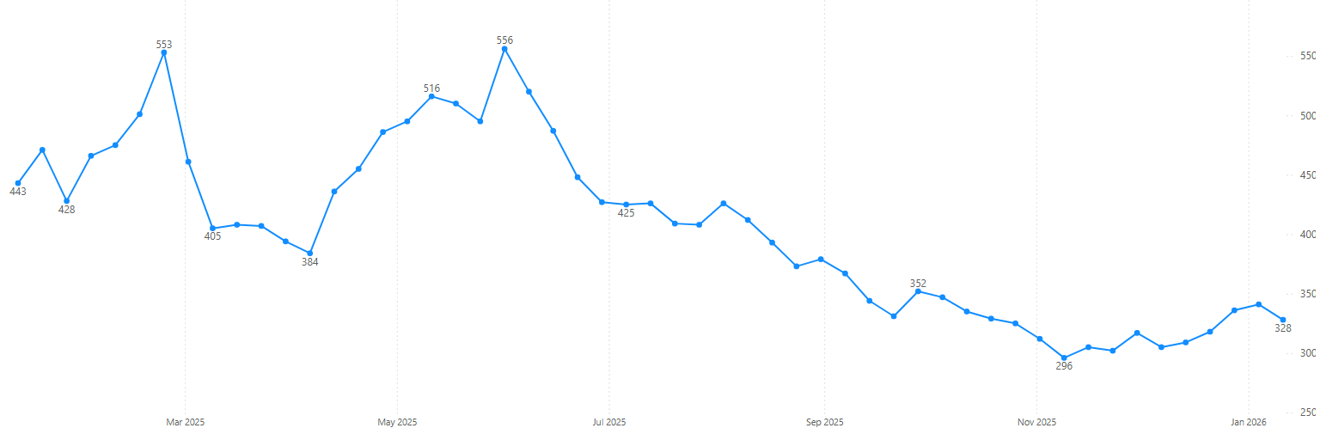
Urology Backlog Performance
Tim Briggs set SWAG CA the challenge – 19th May
⭐⭐⭐ 90 days
DM Start
⭐⭐⭐⭐ Q3 close
⭐⭐ 60 days
⭐ 30 days
Project Goals agreed
Letters to CEO’s and Medical directors (beginning of June)

Slide 5
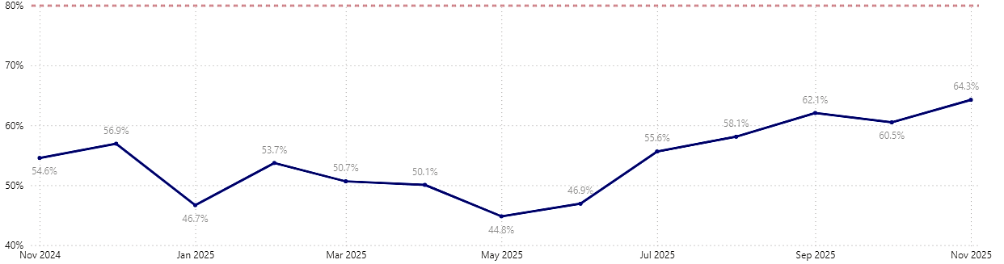
Urology FDS Monthly Performance
Tim Briggs set SWAG CA the challenge – 19th May
Project goals agreed
⭐⭐⭐ 90 days
⭐⭐ 60 days
DM Start
⭐ 30 days
Letters to CEO’s & Medical directors (beginning of June)
Notes:
0.2% improvement in pathway nationally compared to c19% improvement SWAG

Slide 6
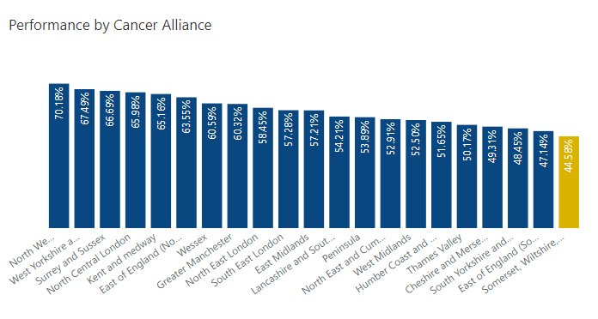
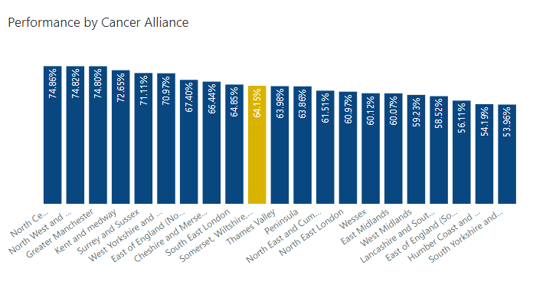
Urology FDS May 2025
Urology FDS November 2025

Slide 7
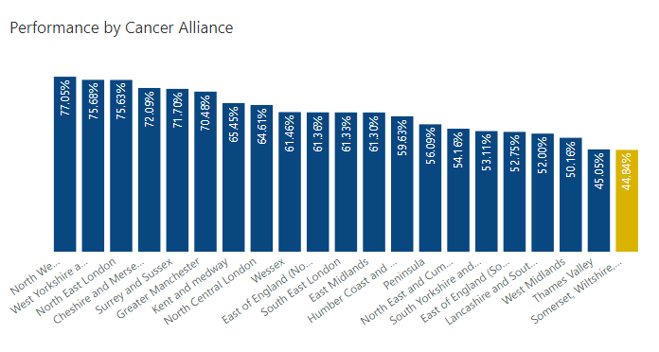
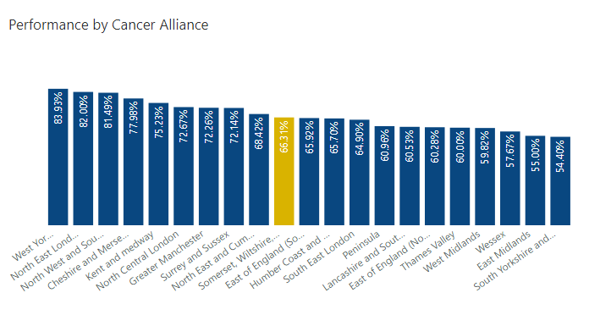
Urology 62d May 2025
Urology 62d November 2025

Slide 8
SWAG Key components incorporating NHSE BPTP Prostate diagnostic pathway
* Incorporates NHSE BPTP, national 25/26 10-day turnaround target for diagnostic steps and sits alongside clinical decision-making protocols as an overview of the key components needed to develop effective pathways
Day 0-2
Day 2-10
Day 20
Day 25/26
NHSE BPTP item 2&3
NHSE BPTP ST mpMRI
NHSE BPTP item 8 reported LATP
NHSE BPTP item 10
Day 0-2: Triage
By Day 10: OPA/Primary Diagnostics
Day 10-20: Secondary diagnostics
Before Day 25: MDT
Digital triage STT / daily CNS triage / book next step on same day
Ai enabled mpMRI and network reporting
SWAG biopsy protocol
Medical & Non- medical / HCP LATP
Protocolised MDT Standards of Care
A&G / A&R optimisation
Same day MRI and LATP booking
Standardised benign communications
SWAG best practice pathology processes
Job planned and digitally enabled MDT triage
Communication low or low to intermediate risk for active monitoring
Digital pathology reporting
Standardised SWAG staging pathway
Rockwood score completeness
Frail patient pathway – 1st seen
Refer to MDT and post MDT OPA at biopsy
Day 25 OPA (booked Pre MDT) F2F
Regular STT utilisation monitoring
Same day HCP or nurse led BBN clinics
Non-medical clinic templates standardised
Pathology tracking for MDT readiness
Same week surgical / oncological OPA
Navigator supports patient through the pathway, ensures milestone completion and supports benign communications
Workforce
Protocolisation
Monitoring
Triage
Process
No FILL NHSE BPTP
Digitally enabled administrative processes
Live pathway milestone demand capacity / wait times tracking and agile response downstream
Identify and escalation process for at risk milestones
Notes:
SWAG biopsy protocol – to be developed re T&F group
SWAG staging pathway / NHSE commissioning guidance tbc T&F group
SWAG best practice pathology processes-is more detail required here than - Roll out and sustain cassettes with 3 cores
Shortened MRI protocol – to be discussed by radiology group post completion of clinical trial

Slide 9
SWAG key components incorporating NHSE BPTP Bladder diagnostic pathway*
* Incorporates NHSE BPTP, national 25/26 10-day turnaround target for diagnostic steps and sits alongside clinical decision-making protocols as an overview of the key components needed to develop effective pathways
Day 0-2
Day 2-10
Day 20
Day 25/26
NHSE BPTP item 1-4
NHSE BPTP item 5,6&8
NHSE BPTP item 7&9
NHSE BPTP item 10&12
Day 0-2: Triage
Day 2-10: OPA/Primary Diagnostics
Day 10-20: TURBT and Secondary Diagnostics
Day 14-25: local or specialist MDT
Daily CNS / on call triage ST one stop
1 stop with CTU risk stratified upper tract imaging at UIU and hot reporting / 48 hrs
TULA option
Optimise Day case TURBT / Bladder biopsy and ureterenoscopy
CNS discuss options whilst on ward for TURBT
Protocolised MDT Standards of Care for low-risk BC pending GIRFT guidance
A&G optimisation
Frail and Nonvisible Haematuria patients
Non NG12 criteria telephone Appointment / Letter to GP
Same day / next day POAC
POAC by CNS
High risk TURBT by day 14
Pathology and radiology tracking for MDT readiness
Job planned and digitally enabled MDT triage
Frail patient pathway
HCP & Non-medical flexi cystoscopy
Weekly Bladder scheduling meeting*
48-hour histology request
Digital pathology reporting
Day 25 OPA (booked Pre MDT) F2F
Referral with U&Es
Staging request if MIBC working diagnosis
Patient informed on the day investigations complete if benign
Standardised SWAG staging pathway
Same day HCP and nurse led BBN clinics
Book / Refer to next step diagnostics, local or specialist MDT electronically and post MDT OPA at 1 stop (BPTP item 7,9,10,12)
Non-medical clinic templates standardised
Navigator supports patient through the pathway, ensures milestone completion and supports benign communications
Workforce
Protocolisation
Monitoring
Triage
Process
No FILL NHSE BPTP
Digitally enabled administrative processes
Live pathway milestone demand capacity / wait times tracking and agile response downstream
Identify and escalation process for at risk milestones
Notes:
USS 1st 1 stop pending GIRFT guidance in meantime risk stratified CTU use
*Weekly Bladder scheduling (WBS) meeting: to identify and allocate fast track cases to lists, and deescalate to TULA if appropriate

Slide 10

2026/27 Cancer Alliance Planning Guidance - Urology
Urological Cancer

Slide 11
Urology: Diagnostic pathway
Best Practice Timed Pathways
One-stop (or minimum-stop) pathways and Straight to Test making the best use of CDC capacity.
The below national pathway interventions should be considered for implementation across all providers, but Cancer Alliances should focus their plans on support to implement in providers in the bottom quartile for performance:
Urology (including Prostate, Bladder and Kidney pathways) (Faster Diagnosis Standard)
Rollout and transition to BAU of non-medical LATP biopsy:
Expansion of one-stop haematuria services and nurse-led cystoscopy where there are particular workforce pressures, including access to training.
Support evidence gathering for bi parametric MRI and AI supported reporting for providers with MRI capacity challenges.
Implement remote monitoring for PSA testing, including considering automation of recall for relevant patients.
Pilot and support evaluation of biomarker tests for bladder cancer to reduce cystoscopy demand.

Slide 12
Urology: Diagnostic pathway
Trust | Nonmed LATP | 1 stop Haematuria | Nurse led Cystoscopy | BI parametric MRI | Ai MRI | Remote monitoring PSA | Automated recall | Pilot biomarker bladder
GHFT | YES | In mobilisation | YES | NO | In mobilisation | TBC | TBC | SWAG Innovation Pilot
NBT | YES | YES | TBC | NO | In mobilisation | TBC | TBC
SFT | NO | YES | YES | NO | YES | TBC | TBC
RUH | NO | YES | TBC | NO | NO | TBC | TBC
SDH | Training | YES | TBC | NO | NO | TBC | TBC
Notes:
GHFT 1 stop haematuria clinic linked to AC UC
CL to update re PSA remote monitoring
Poss local priorities - TULA

Slide 13
Kidney: Treatment pathway
Review pathways for higher risk renal cell carcinoma (RCC) with a focus on reducing the variation in time to radical nephrectomy for people with a T3+ and/ or 10cm+ and/or N1 and M0 renal cell carcinoma (RCC).
SoN report data Q1 2020-Q4 2022.
Kidney surgery 31d – proxy Q3 planning purposes
 | NOVEMBER 2025 |  |  | OCTOBER 2025 |  |  | SEPTEMBER 2025 |  |  | Total
Providers | Total Treated | Within 31D standard | Performance | Total Treated | Within 31D standard | Performance | Total Treated | Within 31D standard | Performance | Total Treated | Within 31D standard | Performance
Gloucestershire Hospitals NHS Foundation Trust | 3 | 2 | 66.7% | 7 | 2 | 28.6% | 3 | 1 | 33.3% | 13 | 5 | 38.5%
North Bristol NHS Trust | 23 | 8 | 34.8% | 16 | 11 | 68.8% | 32 | 21 | 65.6% | 71 | 40 | 56.3%
Royal United Hospitals Bath NHS Foundation Trust | 3 | 3 | 100.0% | 2 | 2 | 100.0% | 2 | 2 | 100.0% | 7 | 7 | 100.0%
Salisbury NHS Foundation Trust | 4 | 2 | 50.0% | 3 | 3 | 100.0% | 2 | 2 | 100.0% | 9 | 7 | 77.8%
Somerset NHS Foundation Trust | 3 | 3 | 100.0% | 2 | 0 | 0.0% |  |  |  | 5 | 3 | 60.0%
University Hospitals Bristol and Weston NHS Foundation Trust |  |  |  | 2 | 2 | 100.0% |  |  |  | 2 | 2 | 100.0%
Grand Total | 36 | 18 | 50.0% | 32 | 20 | 62.5% | 39 | 26 | 66.7% | 107 | 64 | 59.8%

Slide 14
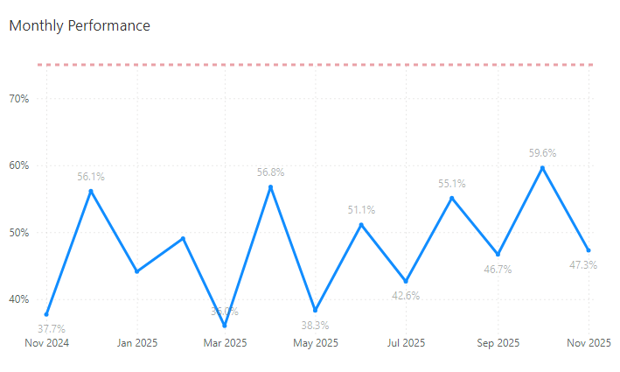
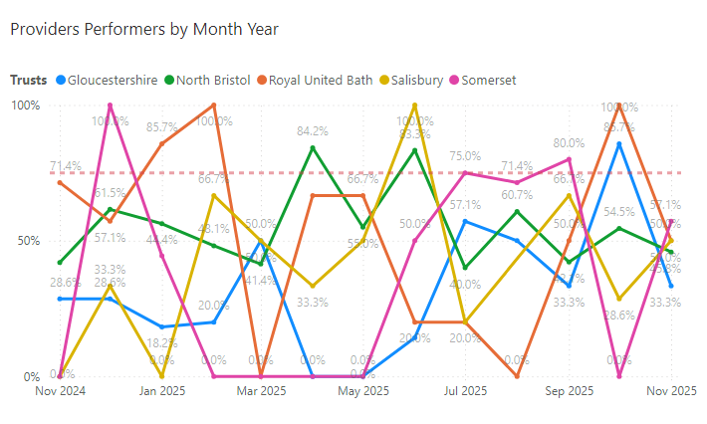
Kidney surgery performance
62d Urol-Kidney surgery
Review pathways for higher risk renal cell carcinoma (RCC), identify opportunities and constraints, and reduce variation
Notes:
North Bristol is most consistent but also considerably higher no’s per month – others below 5 per month

Slide 15
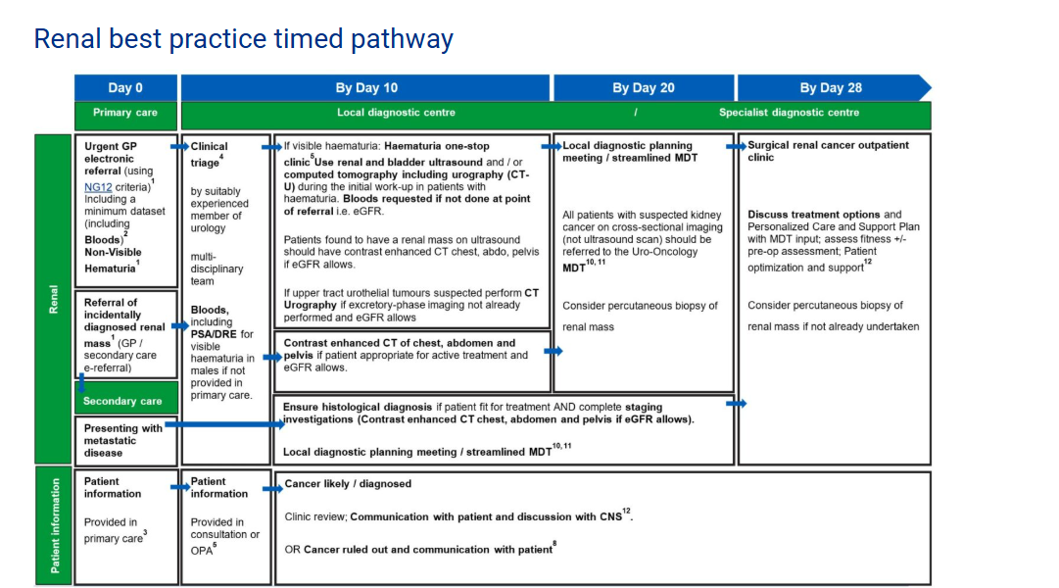
NHSE Best Practice Timed Pathways

Slide 16
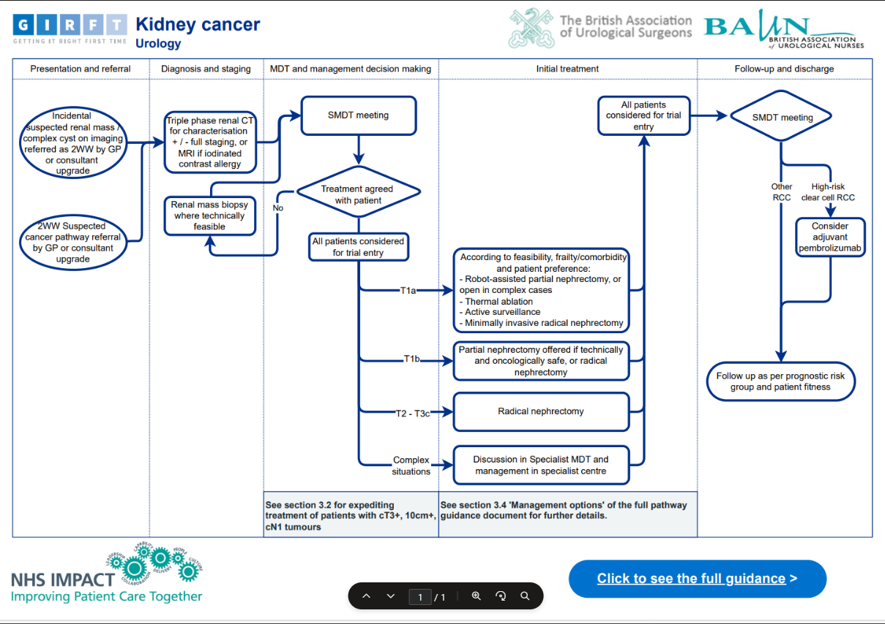
GIRFT – Good practice pathway
Notes:
2.10.1 For kidney cancer
Procedures which must only be carried out in the host hospital of the specialist team include:
• Resection of metastatic disease*.
• Resection of both primary and associated metastatic disease.
• Resection of bilateral primaries.
• Resection of any primary where it is predicted that the patient will subsequently require
dialysis.
• Surgical management of patients with von Hippel-Lindau disease or hereditary papillary
tumours.
• Resection of urothelial cancers of the upper urological tract.
• Resection by nephron-sparing surgery or other nephron sparing techniques.
• Resection of non-renal cell kidney cancer, excluding transitional cell carcinoma of the
kidney, treated by nephro-ureterectomy
*In cases of bone, hepatic or thoracic metastases the host hospital must have access to the
relevant organ site specialists.
Robotic Renal Surgery and other therapies for small renal masses must be undertaken in line with
separate guidance, where this exists.
All patients with Stage T1a/b renal cancers must be discussed at the specialist MDT and must also
be seen for consultation by a Specialist MDT Surgeon.
All Specialist MDT centres must undertake a minimum of 30 specialist renal cancer surgery cases
per annum, with a minimum of 15 cases per Surgeon per annum.
For complex Renal cancer cases with thrombus in the inferior vena cava and/or heart, surgery must
be undertaken in centres co-located or have a networked facility with vascular or hepatobiliary, and
cardiothoracic surgery. Urology network pathways must reflect this need at a supra-regional level.
Centres must undertake a minimum of 10 level II/III renal cancer inferior vena caval thrombus
procedures per annum.
In cases where two Surgeons operate jointly on one patient, this case may be attributed to both
Surgeons but must only account for one case in the centres total figures.
Procedures and treatments where the site of delivery is determined by agreement in the urology
network's guidelines:
• Adjuvant/Neoadjuvant systemic therapy.
• Molecular targeted therapy.
• Non-surgical management of non-renal cell kidney cancer

Slide 17

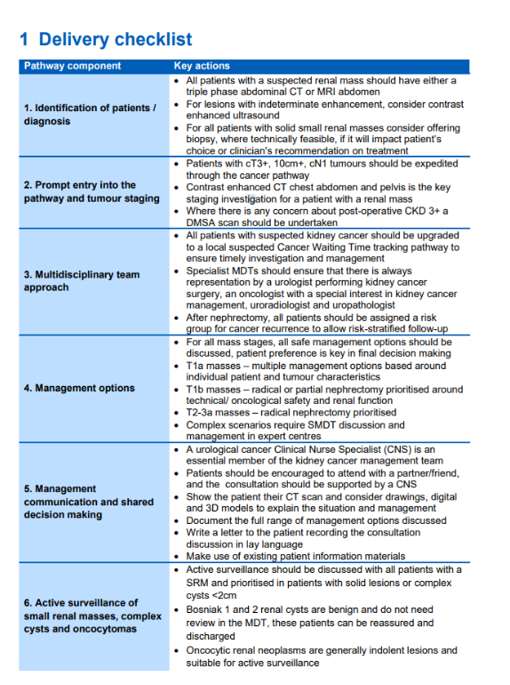
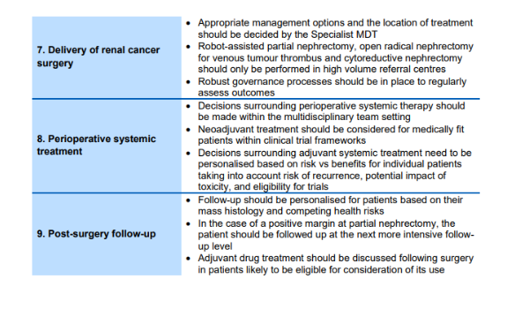
GIRFT – Delivery Checklist
Notes:
2.10.1 For kidney cancer
Procedures which must only be carried out in the host hospital of the specialist team include:
• Resection of metastatic disease*.
• Resection of both primary and associated metastatic disease.
• Resection of bilateral primaries.
• Resection of any primary where it is predicted that the patient will subsequently require
dialysis.
• Surgical management of patients with von Hippel-Lindau disease or hereditary papillary
tumours.
• Resection of urothelial cancers of the upper urological tract.
• Resection by nephron-sparing surgery or other nephron sparing techniques.
• Resection of non-renal cell kidney cancer, excluding transitional cell carcinoma of the
kidney, treated by nephro-ureterectomy
*In cases of bone, hepatic or thoracic metastases the host hospital must have access to the
relevant organ site specialists.
Robotic Renal Surgery and other therapies for small renal masses must be undertaken in line with
separate guidance, where this exists.
All patients with Stage T1a/b renal cancers must be discussed at the specialist MDT and must also
be seen for consultation by a Specialist MDT Surgeon.
All Specialist MDT centres must undertake a minimum of 30 specialist renal cancer surgery cases
per annum, with a minimum of 15 cases per Surgeon per annum.
For complex Renal cancer cases with thrombus in the inferior vena cava and/or heart, surgery must
be undertaken in centres co-located or have a networked facility with vascular or hepatobiliary, and
cardiothoracic surgery. Urology network pathways must reflect this need at a supra-regional level.
Centres must undertake a minimum of 10 level II/III renal cancer inferior vena caval thrombus
procedures per annum.
In cases where two Surgeons operate jointly on one patient, this case may be attributed to both
Surgeons but must only account for one case in the centres total figures.
Procedures and treatments where the site of delivery is determined by agreement in the urology
network's guidelines:
• Adjuvant/Neoadjuvant systemic therapy.
• Molecular targeted therapy.
• Non-surgical management of non-renal cell kidney cancer

Slide 18
South West Prostate Dashboard (SWPD)
Change Request and Project Progress

Slide 19
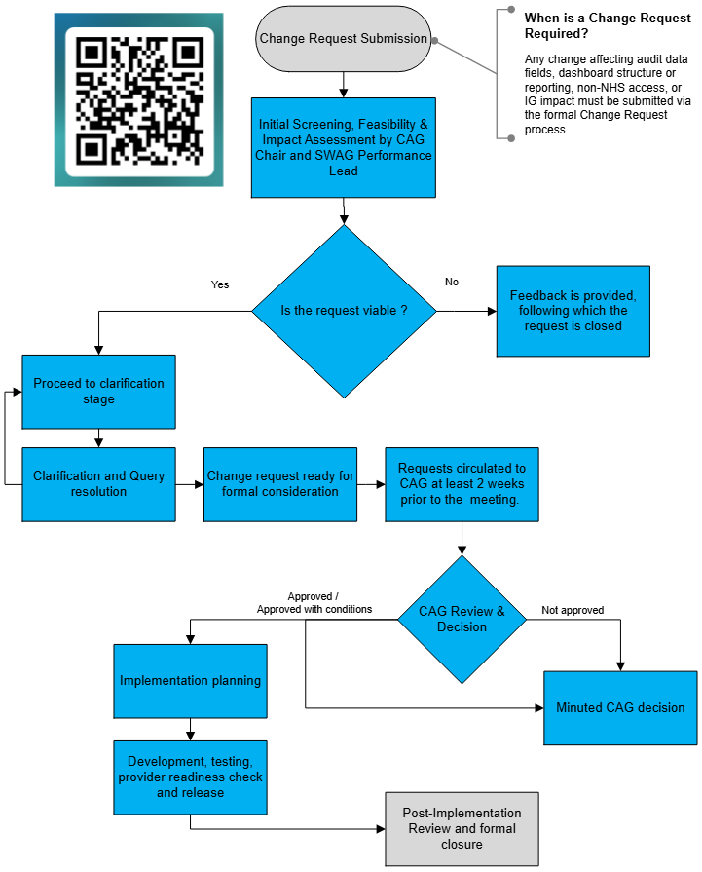
Change Request and CAG Approval Process for SWPD
Change request form Link

Slide 20
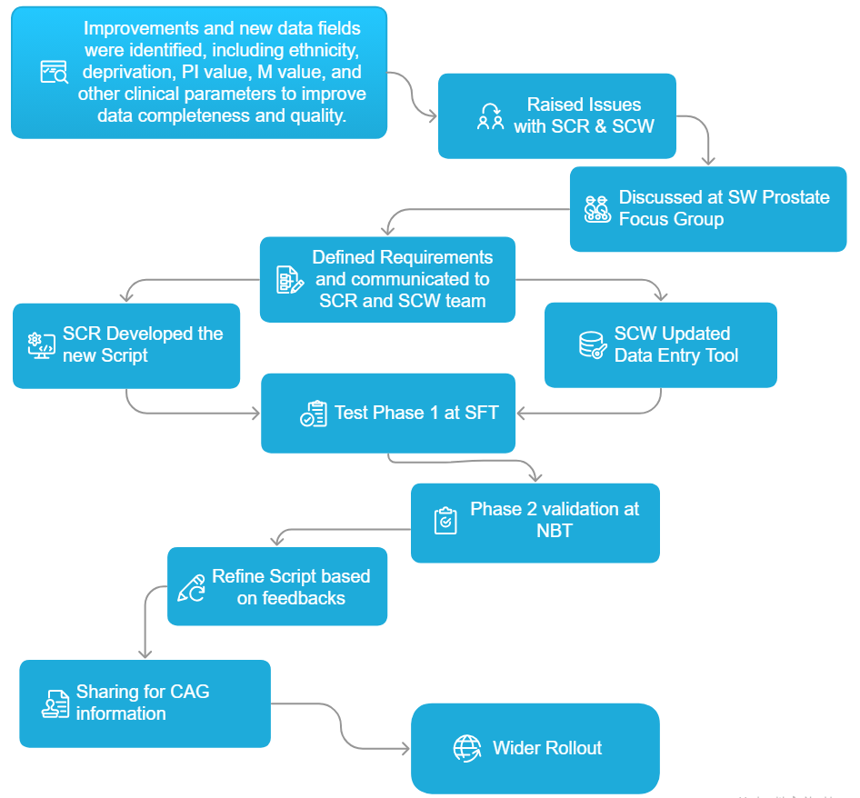
Current SWPD SCR Script roll out project progress

