Slide 1


Anthony Koupparis
Notes:
So I haven’t got very long to go through this ……but I think we have to make some changes throughout the pathway if we are to not drown
This presentation comes from a backround personal feeling of walking through treacle most of the time to get anything changed !
Jon has managed to calm me down as he tells me you guys are already sorting out most of this stuff and its just southmead !
This presentation is part of adherence to the teaching of master shifu so I can try and must path to inner peace

Slide 2


Notes:
Where to start …..,I have this rtale over 2 ears ago it coincided with the lancet article about prostate cases
And urged opinion leaders and healthcare policy makers to mark their findings about the impending increase on prostate cancer diagnoses and everything which goes with it

Slide 3
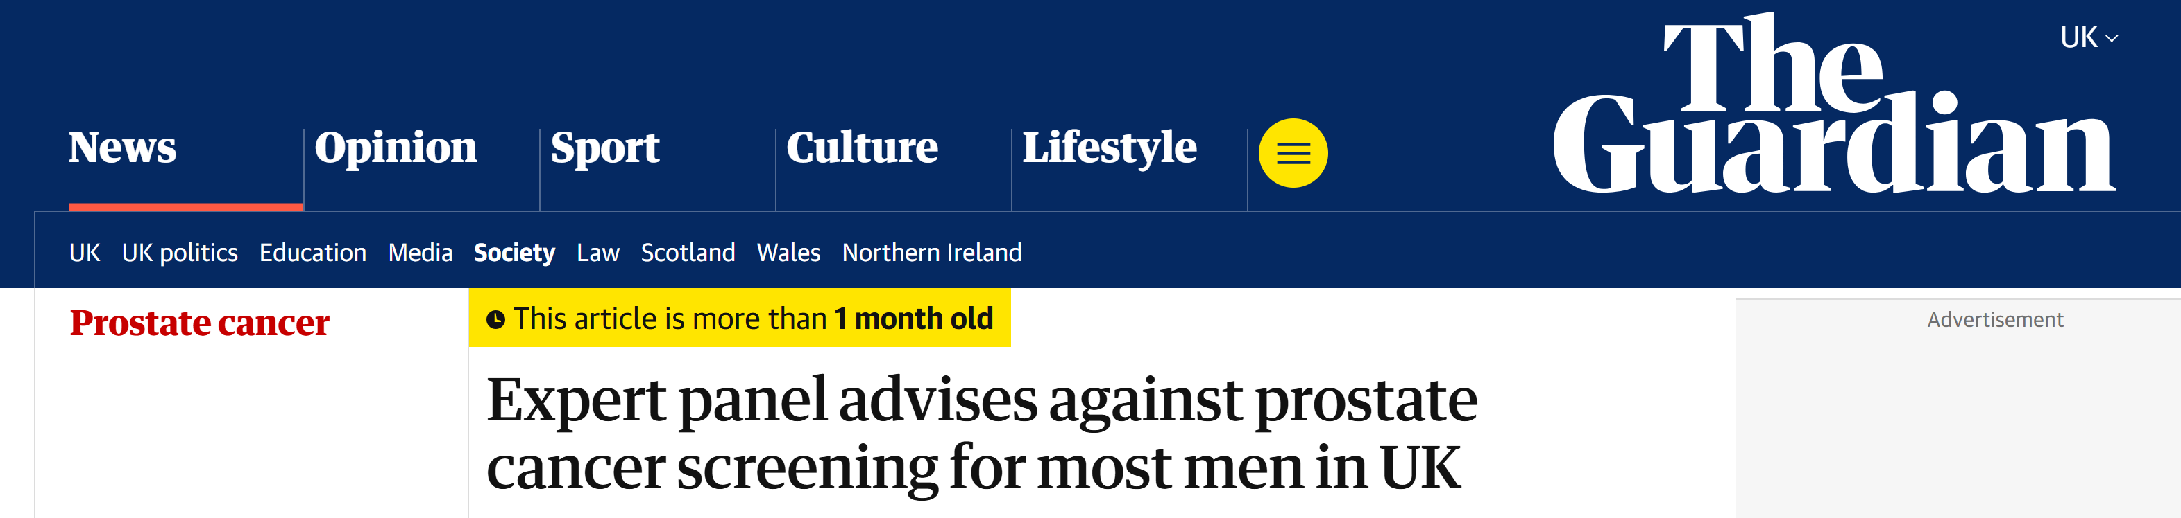
NICE 2WW referral criteria 3% cancer detection rate
G3pT1 = Gleason 9/10 pT3b N1
Bill-Axelson – 8 years !
Notes:
I also thought I would share some random facts and things to consider ver the next 2 slides when listening to the presentation
Based on what we do , we should be diagnosing at least a 3% of the patient with cancer
At 23 years after the start of the trial – approx. 3 years of life was gained by men who had a RP
More recently we have had the national screening committee advice against routine screening

Slide 4
Baseline Risk of Prostate Cancer by Age
Approximate lifetime risk of being diagnosed:
Age 40–49: <2%
Age 50–59: ~5–10%
Age 60–69: ~15–25%
Age ≥70: >30%
Many cancers are indolent and not life-limiting
Notes:
Also I thought I would just pause on the risk of prostate if I walk up to the first man outside and ask him his age

Slide 5
Objectives
Abnormal DRE and normal PSA
Indications for biopsy
Follow up after normal investigations
Primary care guidance for psa alone
Notes:
So that’s the preamble what am I trying to do with this talk
1 Remove abnormal DRE from 2ww referral guidelines
2 Tighten up indications for patients proceeding to biopsy – and I think this is more a NBT issue but worth mentioning here for context
3 suggest a plan for FU after normal investigations after a 2ww referral for suspected prostate cancer
I am going to use data from large screening cohorts and thereby give clear guidance to primary care regarding FU to dramatically reduce the intensity of work required, maintain safety and give clear guidance on re-referral
4 and finally as a BOGOF I thought we could provide some robust guidance for primary care to use in the de facto screening programme which exists in many practices
What these last 2 aspects currently do is come together and form a defacto screening porgramme

Slide 6
Abnormal DRE
Study / Analysis | Scenario | Findings
PLCO (Pinsky 2018) | DRE abnormal but PSA < 4 ng/mL | DRE added negligible detection benefit; PPV for clinically significant cancer was ≈0.08 % (≈1 in 1,250–1,300).
PLCO (Pinsky 2017, J Natl Cancer Inst) | DRE + PSA combined | Most cancers detected by PSA; DRE alone rarely found additional cases.
Post Hoc ERSPC-related cohorts PCPT | DRE abnormal but PSA < 3 ng/mL | CS CAP rare At low PSA levels, abnormal DRE had poor PPV
Modern UK & US primary-care data | Normal PSA (<3 ng/mL) + abnormal DRE | <0.1 % yield for Grade Group ≥ 2 (clinically significant).
Hamilton W et al. Br J Gen Pract. 2005;55:617–621 Lane JA et al. J Natl Cancer Inst. 2014 Protect
Thompson IM et al. NEJM. 2004;350:2239–2246 EAU Prostate Cancer Guidelines 2024–2025
Gosselaar C et al. Eur Urol. 2008 Roobol MJ et al. Eur Urol. 2012
Notes:
Lets start with abnormal DRE – now I think this is pretty straight forward
Now the concern we alI have is that men referred with an abnormal DRE and normal psa represent a group of patients who harbour non psa secreting tumours
So is that true ??? – lets look at the PLCO – remember 76000 men with an annual dre and psa ignoring the issues between the trial arm it still provided an enormous amount of data on this topic
Pinsky used the PLCO data and looked at the incremental yield of dre when he psa was below 4 – so the ppv or the probability of an abnormal dre equating to a significant prostate cancer is 0.08% and
Then when you add psa and dre together with higher psa’s DRE rarely find additional cancers with the majority being identified by PSA
Then if we look at similar analyses of ERSPC related cohorts we find that the finding of CSCAP with a psa of less than 3 is very rare
Then when we look at the aged PCPT which is actually consistent with ERSPC the an abnormal dre has a very low ppv
Finally We then have data from UK and US primary care data and also the protect study that reinforces the idea that psa is the dominant triage test and DRE has little diagnostic value when the psa is normal
Now just to be balanced and demonstrate some historical memory – part of the idea regarding the importance of DRE comes from data using dre alone in the pre-psa era where inevitably higher detection rates were found – but these data are not applicable
🇬🇧 UK primary care data
Hamilton et al., British Journal of General Practice, 2005
Risk of prostate cancer in symptomatic men in primary care DRE adds little diagnostic value when PSA is normal
📄 Hamilton W et al. Br J Gen Pract. 2005;55:617–621.
🇬🇧 CAP trial / ProtecT screening context
Lane et al., 2014 – ProtecT study
Showed that many cancers detected via DRE alone were:
Low grade
Clinically insignificant
Reinforced PSA as the dominant triage test
📄 Lane JA et al. J Natl Cancer Inst. 2014.
🇺🇸 US primary care and screening data
Thompson et al., PCPT (Prostate Cancer Prevention Trial)
DRE abnormality modestly increased cancer detection
But PSA was far more predictive
DRE had limited value at low PSA levels
📄 Thompson IM et al. NEJM. 2004;350:2239–2246.
🇺🇸 Contemporary review
Mottet et al. / EAU Guidelines
DRE:
Poor sensitivity for anterior and small tumours
Low reproducibility in non-specialist settings
Explicitly states DRE should not be used as a standalone screening test
📄 EAU Prostate Cancer Guidelines 2024–2025

Slide 7
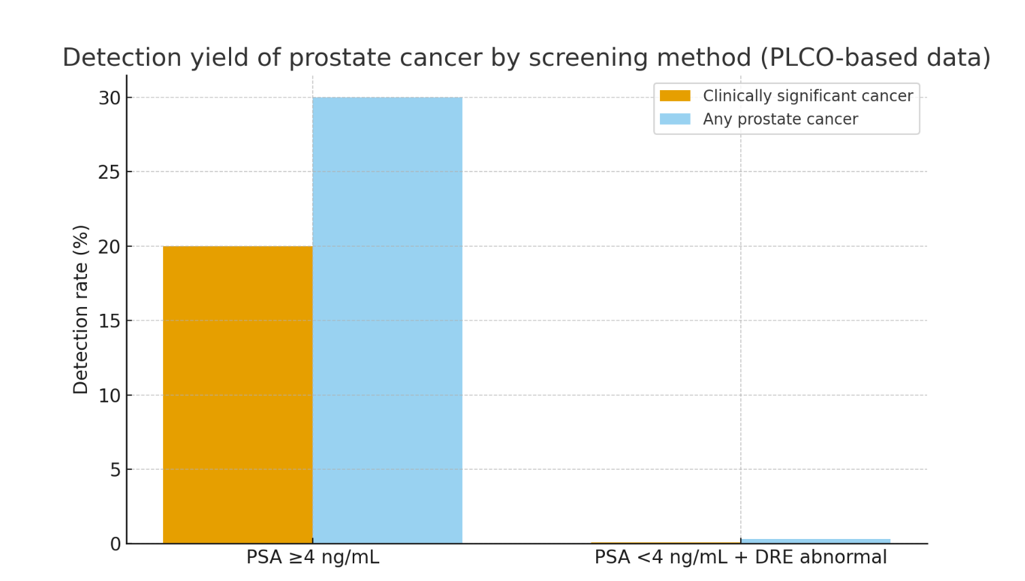
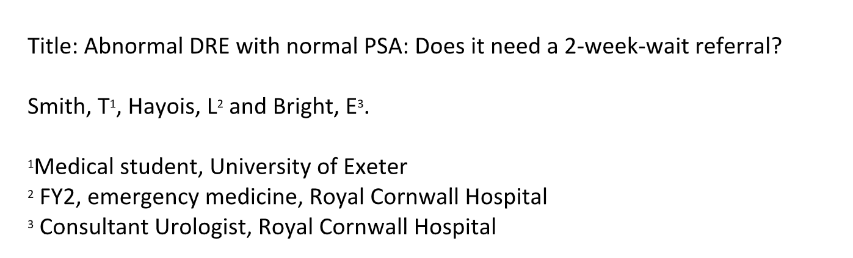
Notes:
So to put is visually – you can see the yield of any cancer and any clinically significant prostate cancer when the psa is over 4 ( irrespective of the dre and when its under 4 with an abnormal dre )
In addition these observations are reflected in data from the region – I wanted to thank Liz from truro who is miles ahead on all these thing , and whenever I speak to her she keeps me sane
170 patients , more than 95% were discharged at the first review and 2 patients were found to have prostate cancer

Slide 8
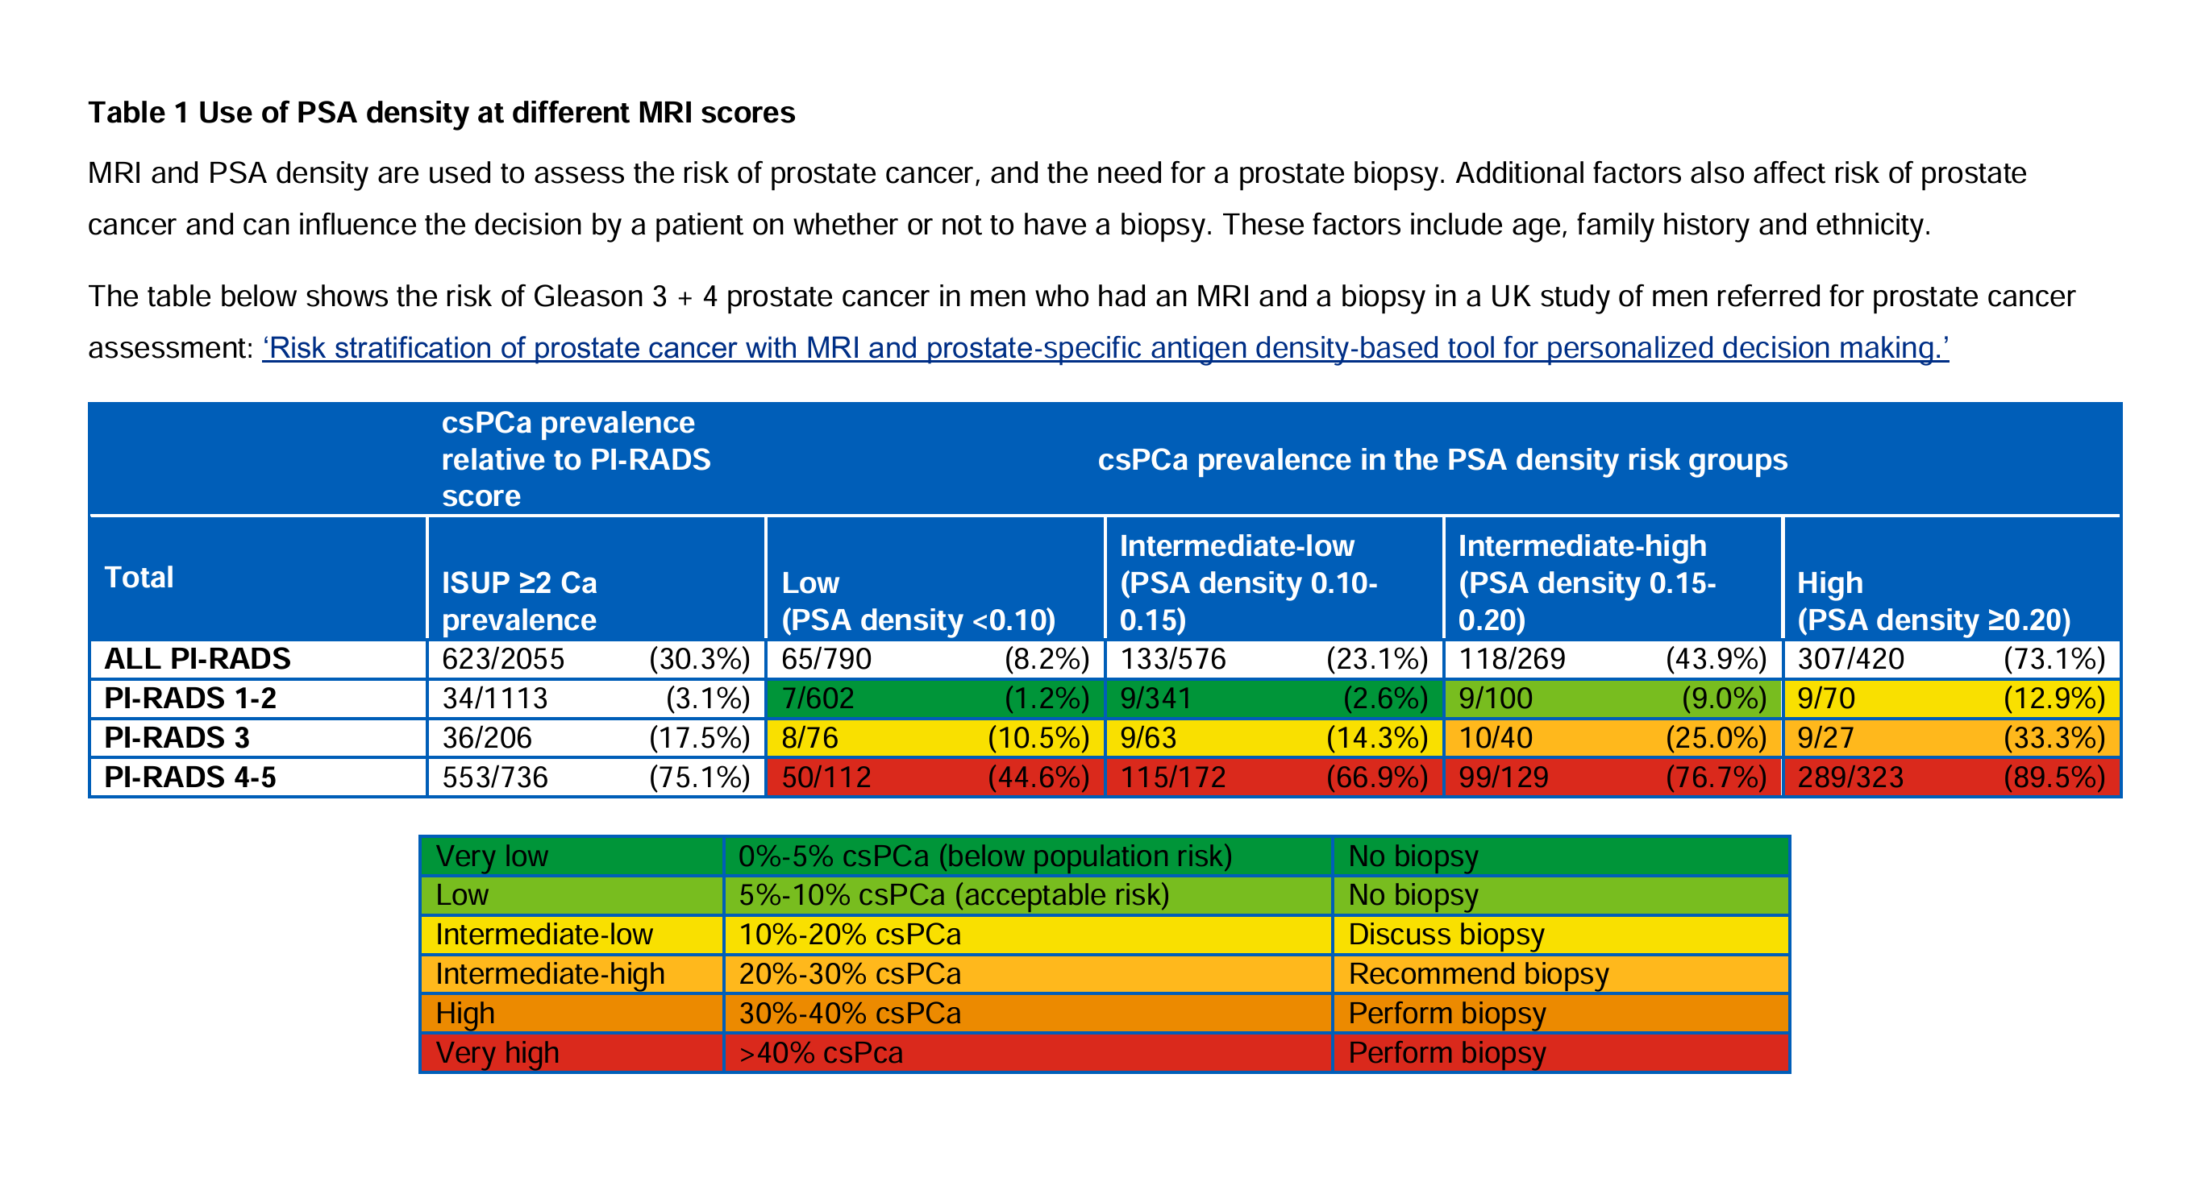
When to biopsy ???
Notes:
Just a quick mention on who proceeds to biopsy based on their MRI and the flip side of this it shows us some of the patients who are discharged after their MRI
We need to remember that the decisions about whether to biopsy are being delivered at the coal face by clinicians who are risk averse and less experienced and I who welcome robust guidance so we can make things easier and control the number of inappropriate biopsies
So below you have green , yellow , orange and red and a suggestion of whether to biopsy
I particularly want to bring your attention to pirads 1 and 2 and the risk of cancer if your PSAD is less than 0.2 – this group have a normal assessment and should be discharged

Slide 9
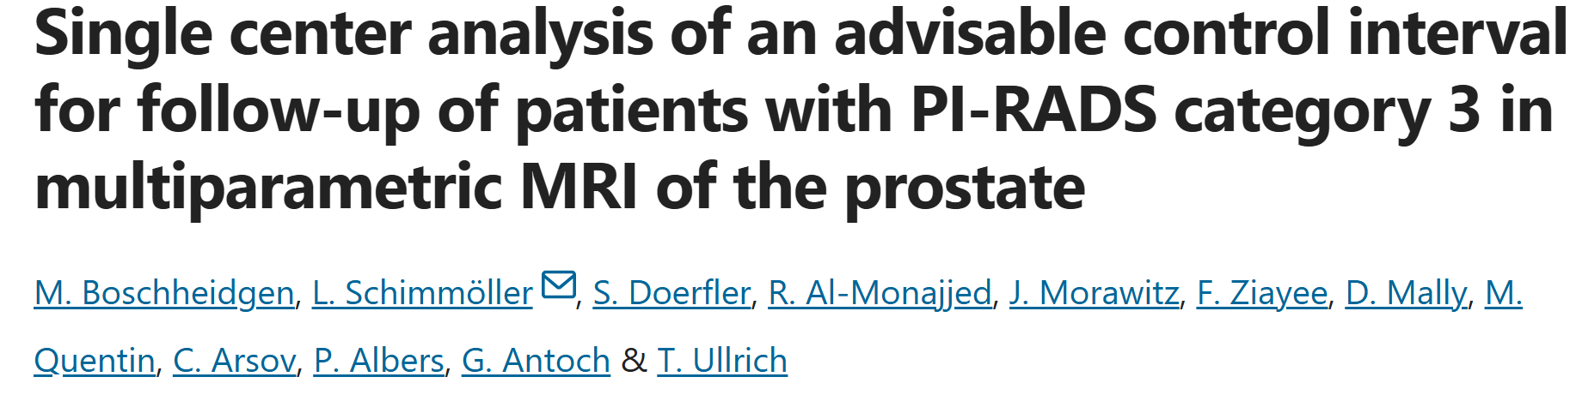
MRI-Based Criteria for Prostate Biopsy
PI-RADS 1–2:
No biopsy unless PSAD >0.20 (GIRFT)
PI-RADS 3:
PSAD <0.10 No biopsy??
– Surveillance vs Biopsy if 0.10 - 0.15 ??MRI
PSAD ≥0.15 Biopsy
PI-RADS 4–5:
– Biopsy recommended
Notes:
So this is not a detailed discussion about who to biopsy but in summary and I wanted to raise the issue of us having shared decision making with the patient
This study in a nature open access journal examines this group quite well
This paper looks at patients who had a pirads 3 at first review and who then had either a biopsy straight off or an interval mri
remember we have lots of pirads 3 appearances , these patients have a very low short term CS CAP risk
After a short interval up to 2 years , 23% were downgraded , 22% were upgraded and the remainder stayed the same
In the downgraded and stable group no Cscap were found and every CS CAP revealed themselves with an upgrade
In the upgrade group 23% were diagnosed with a CSCAP
and no patients were harmed from a delayed diagnosis in those who were upgraded
So should this group not have a discussion and simply be given a repeat mri in 24 months – reducing the number of normal investigations which we have to deal with ??

Slide 10

6 monthly psa tests with your GP and we would suggest a re-referral when the level reaches…..
I am writing with the results of your recent prostate MRI scan. I am pleased to inform you that this shows no worrying features. This is extremely good news. You do not require any further investigations or treatment. The value of repeat PSA testing is unproven to show benefit. If you wish to have a further PSA test, we would not recommend this for at least 2 -3 years.”
Notes:
So now we get onto fu after normal biopsies …….Ok follow up after normal investigations …. Where are we now
Just for info – David bowie song where are we now ended a 10 year period without releasing any music – released on his 66 birthday
Here are 2 examples at either end of the spectrum regarding advice after normal investigations

Slide 11
Nice guidance for follow up deliberately cautious
Large screening trial use multi-year intervals
Several cohorts with negative MRI show low event rates of csCAP over 2–5 years
mpMRI has a high NPP for csCAP (PROMIS reported an NPV ≈89%) - but it is not 100%
ERSCPC NEJM 2009
Kortenbach. Heliyon. 2021 Nov 6;7(11)
PROMIS
Notes:
The first type of approach is in keeping with the flawed NICE guidance – the background to the over-cautious guidelines is the assumption that all patients on a 2ww pathway are at high risk of diagnosis of significant cancer
It therefore suggests rechecking psa at 3-6month intervals
But the patients we see are essentially a screened population so should we not be extrapolating screening data to help us
What happens in large screening trials ???? They use multi year intervals for patient assessment
So ERCPC used 4 year intervals ,
goteburg study used 2 year intervals
….and the patients are not dying in between these periods , so in a screened population that 2-4 year spacing is safe - and this is using psa alone
If we then look at further analyses looking at event rates after a normal mri , so does something dreadful happen in the years after when you investigate a patient and they have a normal mri ……..we find that they are very low up to 5 years after !!
Finally in the diagnostic setting, mpMRI has a high negative predictive value for clinically significant prostate cancer (PROMIS reported an NPV ≈89%), but it is not 100% — some cases are still found on subsequent biopsy
NB ERSPC 160 000 men recent 23 year data – better than breast
Goteburg 1 trial Swedish – 20 000 men using psa alone
Goteburg 2 used psa and mri to reduce overdiagnosis but still find aggressive cancers – using targeted biopsy for mri lesions rather than systematic

Slide 12
What Do We Mean by Normal Investigations?
Normal PSA in community OR
Raised PSA with
Normal MRI (PI-RADS 1–2 ) with PSAD <0.2
PIRADS 3 MRI with PSAD <0.1
Negative MRI-targeted biopsy
Notes:
What do we mean by a normal investigations ???
A normal psa in the community …. I will come back to that in a minute
But for us im talking about

Slide 13
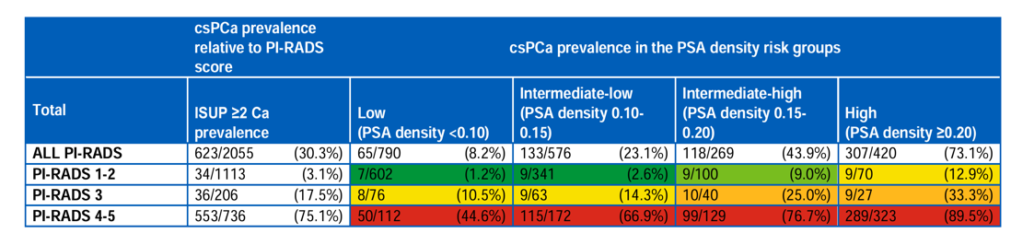
Exceptions/Caveats
Well performed MRI guided biopsies and quality MRI images
Discordant findings
Very high psa values
Life expectancy and PS
Notes:
if I quickly point you towards the table again – the statistics related to the chance of CSCAP are unsurprisingly reflected in the results – what I mean is that we are not trying to monitor patients in hospital or discharge patients to primary care who have a psa of 18 , pirads 5 and a psad of 0.45 with normal biopsies – we diagnose them with cancer
We should also be mindful of some exceptions or caveats
1 if you haven’t got prostate tissue or if the patient was wriggling around then we need to be careful
So for example there were 2 patients who apparently had a PIRADS 4 appearance and 1 one with a PIRADS 5 appearance – both PIRADS 4 were downgraded and the Pirads 5 had a repeat biopsy
We should also take the opportunity to advise no further assessments in those patients who , having been assessed , do not have an appropriate life expectancy or PS

Slide 14
Suggested Follow-up Guidelines
PI-RADS 1–2 & PSA density <0.2:
– PSA at 2–4 years (or stop testing)
If PSAD >0.20 re-refer
PI-RADS 3 & PSA density <0.1
PSA at 2–4 years
If PSAD >0.15 re-refer
Notes:
So what should we actually do ?????
But what if you have a pirads 1 or 2 and a psad of <0.2
I think a minimum is no psa for 2-4 years but the UKNSC does not support a screening program so maybe we adopt the Cornish approach

Slide 15

Schoots IG, et al. MRI in active surveillance of prostate cancer: A systematic review. Eur Urol. 2018.
Porpiglia F, et al. Prostate cancer detection after negative MRI-targeted biopsy. Eur Urol. 2023.
Panebianco V, et al. Negative multiparametric MRI for prostate cancer: Follow-up outcomes. Radiology. 2020.
Engehausen DG, et al. Cancer detection on repeat biopsy after negative MRI-targeted biopsy. J Urol. 2020.
PI-RADS 3 & PSAD >0.15 and negative biopsy
Residual risk approx. 3-5%
Elevated PSAD warrants repeat assessment
PSA 2 yearly and re-refer if PSAD >0.2
Notes:
So lets go down the rabbit hole of a pirads 3 mri, psad of more than 0.15 and normal biopsy – bit of a midfield , but I think its actually ok
Many of these patients will morph into patients you don’t have to worry about but those with a psad which remains elevated should be re-evaluated
And Ive summarised a number of papers into one small slide
PI-RADS 3 lesion before biopsy: 15–20% csPCa (Schoots et al., European Urology 2018)
After negative MRI-targeted ± systematic biopsy: ~4% residual csPCa (Porpiglia et al., European Urology 2023)
Negative follow-up MRI after negative biopsy: ~0–2% csPCa (Panebianco et al., Radiology 2020)
Persistent clinical suspicion / repeat MRI lesion: Up to ~23% csPCa (Engehausen et al., Journal of Urology 2020)
Higher risk consistently associated with: PSA density ≥ 0.15 ng/mL/cm³

Slide 16
Primary care guidance on PSA
PSA testing is not recommended for all men (no routine population screening).
Testing should be individualised based on age, life expectancy, and risk factors.
A baseline PSA in middle age (45–50y) can guide future strategy.
Men with a PSA below the age-specific median have very low risk and can be re-tested in 5–10 years, or not at all if older/limited life expectancy.
Repeat testing intervals should be shorter for higher PSA values, even if still within the normal range.
Notes:
This was my BOGOF for glenda and unless we address every bit of the pathway we will drown
I thought I would share a patient from yesterday
Where does all the info come from – its from screening data, protect and modelling studies

Slide 17
Suggested GP Guidelines: Eligibility for PSA Testing
Offer PSA only after informed discussion of pros/cons.
Consider in:
Age 45–70 with ≥10y life expectancy.
Higher-risk groups: Black ethnicity, BRCA2 carriers, strong family history.

Slide 18
Suggested GP Guidelines: When Not to Repeat PSA
Age >70 with PSA <1.0 ng/mL → no further PSA needed.
Life expectancy <10 years → PSA testing generally not indicated.
Men not wanting screening after informed discussion.

Slide 19
Suggested GP Guidelines: Intervals after a normal PSA
PSA <1.0 ng/mL at age 45–60 → recheck at 8–10 years (or not again if over 60 and low risk).
PSA 1.0–2.0 ng/mL at age 45–60 → recheck at 2–4 years.
PSA <1.0 ng/mL at age ≥60 → may stop further PSA testing (risk of prostate cancer death by age 85 is very low).
PSA ≥2.0 ng/mL at age ≥60 but still “normal” → recheck at 1–2 years, as risk is higher.
Notes:
So where does this all come from
For example the modelling studies done at MSK show your lifetime risk of Cap if you psa is below 1 at 60 is less than 1%
ERSPC (European Randomised Study of Screening for Prostate Cancer)
Men with PSA <1.0–1.5 ng/mL: Extremely low short-term risk of clinically significant cancer
Many centres:
Re-screened at 4 years
Cancer-specific mortality extremely low in this group
📄 Schröder FH et al. NEJM. 2009;366:981–990.
🇸🇪 Göteborg Screening Trial
Longest follow-up prostate screening trial
PSA <1.0 at age 60: <0.5% risk of prostate cancer death by age 85
Authors explicitly suggest stopping PSA testing in low-risk men
📄 Carlsson S et al. BMJ. 2014;348:g2296.
🇬🇧 ProtecT / CAP context
Demonstrated:
High prevalence of indolent disease
Very low prostate cancer mortality regardless of detection strategy
Supports less frequent testing in low-risk men
📄 Hamdy FC et al. NEJM. 2016;375:1415–1424.
📊 Modelling studies
Vickers et al., Memorial Sloan Kettering
PSA <1 at age 60:
Lifetime prostate cancer mortality risk <1%
Suggests:
Either very infrequent testing (5–10 years)
Or cessation of testing
📄 Vickers AJ et al. BMJ. 2010;341:c4521.

Slide 20
Summary
When PSA is normal, an abnormal DRE almost never uncovers significant prostate cancer
Possible to have robust guidance for biopsy
Cannot continue to perform high intensity screening programme after normal investigations
Cannot continue to check psa’s in the community without consideration
Notes:
So in summary
When PSA is normal, an abnormal DRE almost never uncovers significant prostate cancer:
Clinically significant (Gleason ≥ 7): ≈ 1 in 1,000–1,300 men
Any prostate cancer (including indolent): ≈ 1 in 200–300 men

Slide 21


Slide 22
Key References
• PROMIS Study – Lancet 2017
• ERSPC Trial – NEJM
• Göteborg Screening Trial
• EAU Prostate Cancer Guidelines 2024–2025
• NICE NG131 (Prostate cancer)
• GIRFT Urology Report – Prostate Cancer Diagnostics
• Ahmed HU et al. Eur Urol (MRI NPV data)

