Slide 1




GMSA prostate genomic pathway
Siobhan John
Inherited Cancer Nurse Lead
SW GMSA
Aligned to SWAG
@SWGenomics / @SWGLH / @NHSgms
Notes:
Thanks for inviting me today
I wanted to 1st introduce myself to you all
Ad then touch on the prostate pathway mapping work that we are currently developing in the SW GMSA with support from AZ (Steve Walton)
And I will be sharing across SWAG (hopefully in the next few months)
So, I’m working for the next 18 months on inherited cancer pathways as the lead nurse
Although employed through SWGMSA, hence my email saying I’m based in Devon, I am aligned to SWAG
My background was as a colorectal nurse specialist at RUH for well over 20 years
But I jumped ship from that clinical role 3 years ago, and caught the genomics bug

Slide 2




What is the Background?
Notes:
Genomics has been a ‘buzz word’ for well over 10 years – since the 100K genome project
In 2019, the NHS Long Term Plan in 2019 announced key ambitions
To improve overall survival and to diagnose more cancers at an earlier stage, by 2028
In 2022, the government went a step further when it published Accelerating genomic medicine in the NHS
And made a commitment to place Genomics at the heart of the future and the next generation of healthcare in the NHS,
Last year ‘Fit for the Feature’ was published
Integrating genomics into all aspects of healthcare will be in TEG ral
If the 3 shift are to be achieved
Moving care from hospital to community
From analogue to digital
And from sickness to prevention

Slide 3

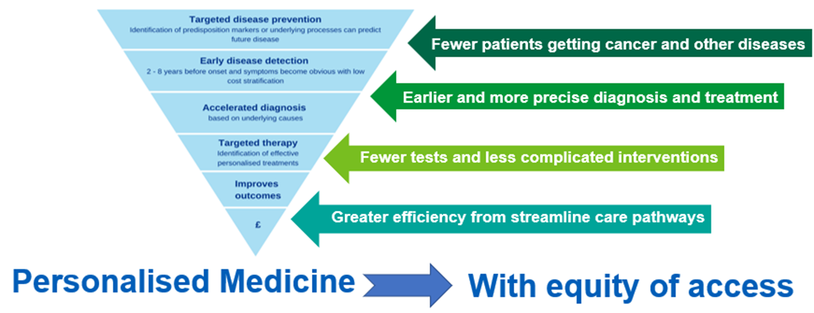
Why is genomics important in cancer?
Over 350,000 people are diagnosed with cancer every year
Over 160,000 people die from cancer every year
Diagnosis at early stage = better prognosis
More personalised treatments available, with improved outcomes
By 2028, 55,000 more people each year will survive their cancer for five years or more; and
By 2028, 75% of people with cancer will be diagnosed at an early stage (stage one or two).
Genomics is a central element for shifting from reactive to proactive healthcare, focusing on prevention and personalised medicine
Notes:
Looking specifically at Cancer
Why is genomics important in cancer?
You know the statistics I’ve just mentioned the reports
Increasing the 5 yr survival from cancer, and diagnose more people at an earlier stage.
Requires more personalised medicines, and more diagnoses of those cancer predisposition syndromes (BRCA / Lynch)
You can see the benefits of personalised medicines in the up side down triangle here
Personalised medicines are now available for treating prostate cancer
And so we need to ensure that we have the pathways in place to ensure that eligible patients
are identified in a timely manner through somatic (so tumour) and germline testing
Additionally, we need to identify more people who have these cancer predisposition syndromes through cascade testing

Slide 4



National Genomic Test Directory
Defines all the genomic tests commissioned by NHSE
– specifies appropriate tests for each clinical indication
Developed through national/ international review
Updated annually - led by expert review panel
Notes:
The NGTD specifies which demonic tests are commissioned by NHSE,
And sets out testing eligibility criteria
It’s developed through international and national review
And led by an expert panel.
It is updated at least annually
Last update was summer ’25
So already use the weblink to access the latest version
There are 2 test directories
Cancer and Rare disease
Please note, inherited cancers sit in the rare and inherited disease directory
An not the cancer one

Slide 5
NGTD Testing Criteria (R430)
Inherited Prostate Cancer
Diagnosed with prostate cancer <50 years of age
Ashkenazi Jewish ancestry and prostate cancer at any age
>1 grandparent from Whalsay (Shetland) and prostate cancer at any age
Diagnosed with metastatic prostate cancer <60 years
Diagnosed with prostate cancer with a CanRisk score of >10% and where they do not meet criteria for R207 or R210 – see overlapping Clinical Indications
Genetic testing may occasionally be appropriate outside these criteria following discussion at a specialist MDT with a cancer geneticist present
Notes:
R430 is the code for the testing of the panel of genes known to be linked to inherited prostate cancers
The criteria encompasses
Diagnosis under 50 yrs, or 60 if metastatic
FH particularly Ashkenazi Jewish ancestry or from Whalsay in the Shetland
A high CanRisk score is also considered an eligible criteria

Slide 6

UKCGG guidelines for prostate cancer
Prostate cancer and significant FH of breast, ovarian or prostate cancer
Target genes include BRCA1/2, ATM, PALB2, CHEK2, MLH1, MSH2, MSH6
Screening for men with known BRCA1/2 variant
Notes:
UK Cancer Genetics Group has also set out these guidelines for prostate cancer
Again FH is important – and it’s not just for prostate cancer
The panel looks at genes found in the homologous repair pathway –where the BRCA genes are found
As well as the Lynch Syndrome genes
And screening is now available for men with a known BRCA variant from aged 45 to 61 using PSA + MRI if raised

Slide 7
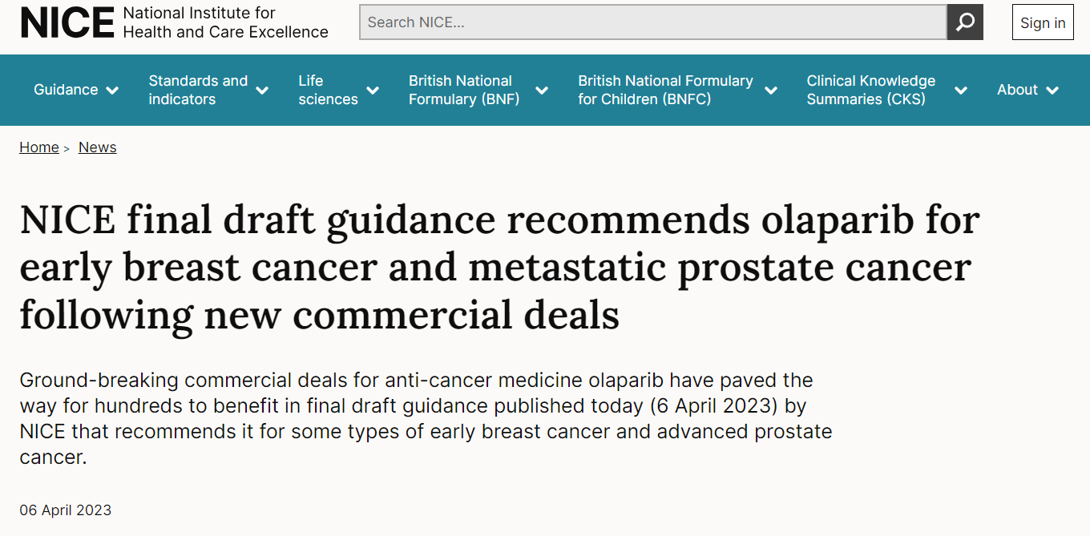
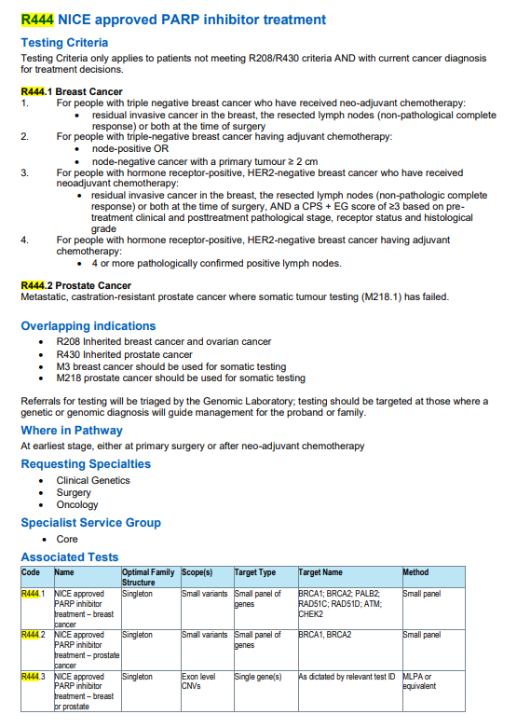
Eligibility to prescribe Olaparib: R444
For adults with HER2-negative, high-risk early breast cancer who have inherited faults in their BRCA1 or BRCA2 genes, after surgery and chemotherapy
and
for adults with previously treated hormone-relapsed metastatic prostate cancer who have the same BRCA mutations.
Notes:
The test directory also includes R444.2
It was preceded by R444.1 for breast cancer) hence the 2
R444.2 is a crucial step in ensuring ongoing personalised cancer care
As it links the genomic test results to a targeted therapy
Men with metastatic castrate – resistant prostate cancer
are offered this test to identify inherited germline BRCA1 / 2 variants to determine eligibility for the PARP inhibitor, olaparib,
This is only, after initial somatic tumour testing has failed or provided insufficient tissue

Slide 8
Prostate pathway
Work in progress!
Pathway mapping
Developing mainstreaming services
Notes:
So what are we doing in SWAG
Well it’s a Work in progress
Starting with mapping the pathway
And focussing on developing mainstreaming services

Slide 9
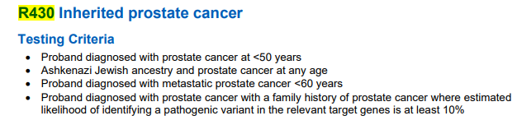
Straight to MDT discussion
Relevant family history taken at triage
MRI and Biopsy could be same day or separate appointments
by phone/in clinic – include genomic next steps in patient discussion
Requesting managed by MDM
Patient identified metastatic
Family history Yes/No
Metastatic/molecular status
Request activate tissue request AND blood (MDT co-Ordinator/ CNS) (document for lead nurse)
Results reported to histopathology and clinical team
R444 Germline required where M218 failed. No family history required
R430 Germline required where strong family history
Discussion MUST be recorded in the patient record in accordance with local guideline
Storage of a sample may be offered where the patient may require more time or discussion to make a decision
Test to Treat complete for second line treatment as required
(R240 confirmatory testing not required)
Can use code R346 OR clearly label why storage has been requested (GMS Test Order Form v1.3)
GMS Test Order Form
Request R444
Sample required
Test details
2x4ml EDTA
2x4ml EDTA
Email SWGLHexports@nbt.nhs.uk
For forms and information
R430, R444.2 and R240 – inherited prostate cancer and PARP inhibitor treatment for prostate cancer - South West Genomic Medicine Service
Suggested pathways:R444.2
Rare and Inherited Disease Eligibility Criterea:
https://www.england.nhs.uk/publication/national-genomic-test-directories/
Notes:
Pathway mapping is no easy task
This is what the proposed pathway for R444.2 looks like ATM
We are identifying a working group to look at each step in detail
(Do let me , or the SW GMSA, know if you’d like to be part of this work)

Slide 10

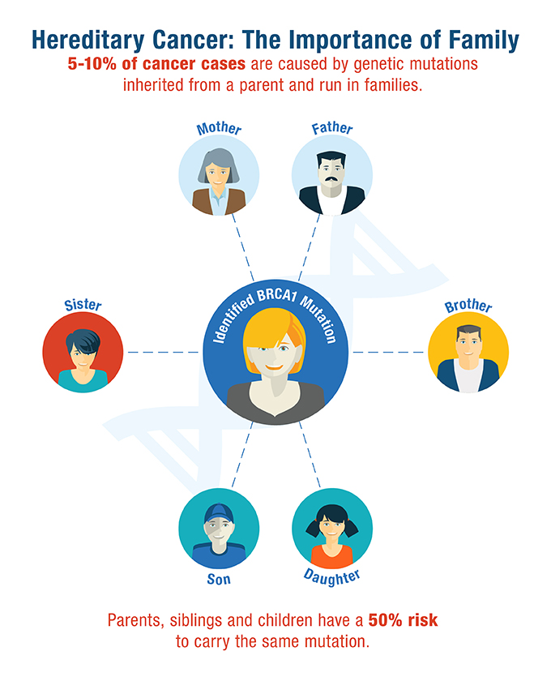
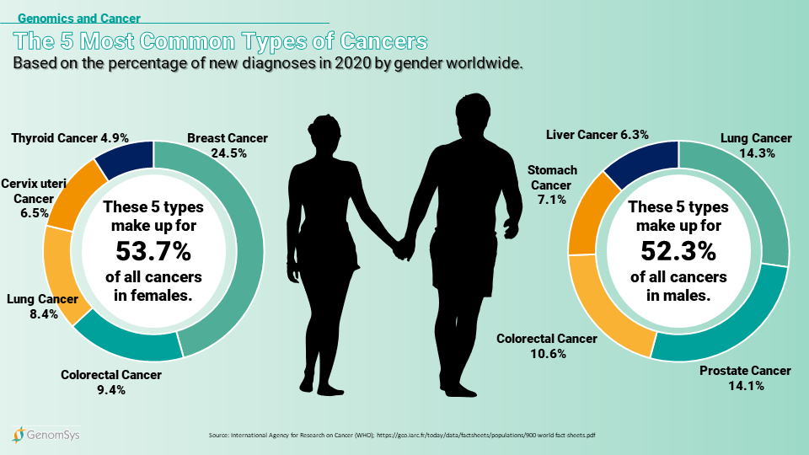
Mainstreaming in Genomic Medicine
What it is…
Supporting diagnosis at the earliest point in the pathway
Proactively direct resources where they can impact on patient care most
Adapt the way we work to make the best use of new technologies
Provide an infrastructure which supports decision making
Increasing access to safe and appropriate genomic testing
What it’s not…
A replacement for the expertise in the genetics service
Notes:
I mentioned earlier that we are looking to develop mainstreaming services in prostate cancer.
Mainstreaming about offering the counselling and consent appointment at the earliest point in the pathway,
In secondary care, this is often done by the patients cancer team, commonly the CNS.
This removes the wait to be seen in clinical genetics and enables resources to be directed when they can best impact patient care, giving access to personalised medicines when needed
Mainstreaming is about adapting our work patterns to make the best use of these drugs (in prostate cancer)
While providing an infrastructure to support decision making
And increase access to safe and appropriate genomic testing.
It DOES NOT replace the expertise in the genetics service
Who will still see patients with a strong FH and arrange further testing as appropriate, or if a proven gene variant to discuss implications, and arrange predictive testing of family members

Slide 11


Equality, Diversity & Inclusion
Race, age, sex assigned at birth and history of adoption can influence the availability and choice of testing offered or the medical management of the patient following diagnosis
A persons ethnic or social background, religion or culture can influence their perception of genomic testing and the options available to them.
A persons physical or learning difficulty, first language or location of home should be considered to ensure they have appropriate access to appointments and understanding of verbal and written information
Notes:
This is my final slide
Designed to remind you that genomics is about personalised medicine in it’s broadest sense
It is not just about considering the genetic make up
but also considering all the factors shown above
Embracing all aspects of equality, diversity and inclusion

