Slide 1
SWAG Network Urological Cancer
Clinical Advisory Group
Research Update
Claire Matthews
29/01/2026

Slide 2
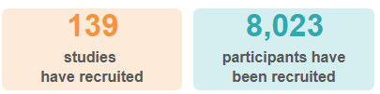
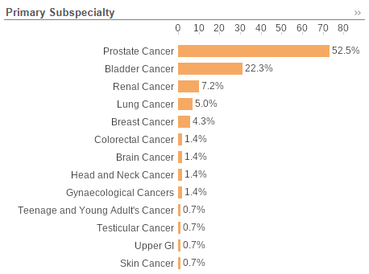
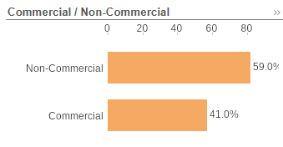
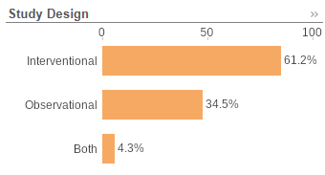
National Urological Cancer Research Recruitment
Apr 25 - Jan 26
Data cut: 20/01/2026
Source: ODP All Portfolio

Slide 3

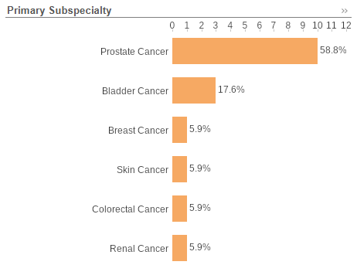
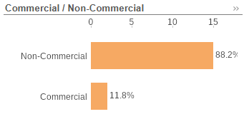
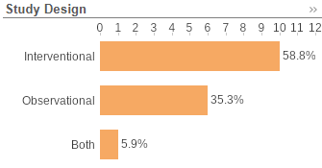
SWAG Region Urological Cancer Research Recruitment
Apr 25 - Jan 26
Higher proportion of non- commercial research
Data cut: 20/01/2026
Source: ODP All Portfolio

Slide 4
Open Urological Cancer Studies (SWAG Region) - Prostate Cancer
CPMS ID | Short Name | Recruiting Sites | Open | Close | Sample Size Eng | England Recruits
69903 | Investigating a new treatment strategy using prostate biopsy tissue | Southmead (4) | 20/11/2025 | 28/05/2027 | 60 | 4
66432 | Evaluation of Lutetium (177Lu) rhPSMA-10.1 injection in men with mCRPC | BHOC | 17/10/2025 | 27/05/2026 | 16 | 5
63289 | ELIPSE | Southmead (48), Chelt (1) | 30/09/2024 | 31/08/2026 | 0 | 339
60146 | Understanding Prostate Cancer Stigma in Black Men (DESTIGMATISE) | Southmead (6) | 27/05/2025 | 28/02/2030 | 453 | 36
54481 | CAAA617D12302: [177Lu]Lu-PSMA-617 in Oligometastatic Prostate Cancer | BHOC (1) | 05/12/2024 | 30/03/2026 | 17 | 2
52937 | TAPS02 | Southmead (10) | 24/04/2023 | 01/03/2026 | 90 | 67
52871 | IP7-PACIFIC | Southmead (124) | 03/10/2022 | 28/02/2027 | 2720 | 1,727
51837 | OSCAR | Yeovil (50) | 01/03/2022 | 01/09/2031 | 0 | 1,291
48496 | Diagnostic Accuracy of LI-MRI vs mp-MRI in Prostate Cancer (CLIMATE) | Southmead (36) | 31/03/2022 | 31/08/2026 | 602 | 469
48429 | PEARLS | BHOC (25) | 24/06/2021 | 30/09/2027 | 750 | 564
47442 | Urine Biomarkers for detecting prostate cancer | Salisbury (18) | 01/12/2020 | 31/12/2029 | 4000 | 1,651
16408 | The PROFILE Study | BHOC(3) | 06/02/2015 | 31/12/2026 | 1600 | 1,490

Slide 5
Open Urological Cancer Studies (SWAG Region)
Bladder Cancer
CPMS ID | Short Name | Recruiting Sites | Open | Close | Sample Size Eng | England Recruits
60694 | MoonRISe-1 | Southmead (2) | 17/05/2024 | 10/06/2028 | 30 | 20
55197 | HIVEC - HEAT | Chelt, Southmead (1) | 30/07/2025 | 27/07/2027 | 208 | 1
50666 | DISCUS | Musgrove (2) | 16/12/2021 | 30/04/2026 | 94 | 71
Renal Cancer
CPMS ID | Short Name | Recruiting Sites | Open | Close | Sample Size Eng | England Recruits
50169 | REFINE | Musgrove (2), RUH (1) | 25/05/2022 | 31/03/2026 | 96 | 53
Testicular Cancer
CPMS ID | Short Name | Recruiting Sites | Open | Close | Sample Size Eng | England Recruits
33372 | UK P3BEP Trial | BHOC (1) | 05/05/2017 | 31/12/2026 | 85 | 81
Data cut 20/01/2026
Source: ODP All Portfolio

Slide 6
Studies in set-up/under consideration in SWAG region
CPMS ID | Primary Subspec. | Sites | Short Name | All Phases | Planned Opening | Planned Closure | Sample Size Eng | Sponsor
70505 | Bladder | Musgrove, Yeovil, Salisbury | ADVANCED-2 | II | 02/02/2026 | 30/11/2026 | 15 | PROTARA THERAPEUTICS, INC.
69744 | Renal | BHOC | Randomized Phase 3 Trial of Casdatifa n & Cabozantinib Vs Placebo & Cabozantinib | III | 02/11/2025 | 30/09/2027 | 61 | ARCUS BIOSCIENCES, INC.
67433 | Prostate | Musgrove, Yeovil, Salisbury | Patients with metastatic castration-resistant prostate cancer (mCRPC) | II | 30/09/2025 | 31/12/2025 | 20 | F. Hoffmann-La Roche Ltd
67159 | Bladder | BHOC, Musgrove, Salisbury | Intravesical BCG + ALT-803 (N-803) in Patients With NMIBC | II | 09/02/2026 | 14/12/2029 | 50 | ImmunityBio, Inc
66284 | Bladder | Musgrove, Yeovil, Salisbury | CAVE | N/A | 20/08/2025 | 30/11/2025 | 200 | ENTIA LTD
57987 | Bladder | Musgrove, Yeovil, Salisbury | COBRA | III | 01/01/2026 | 31/07/2029 | 435 | Institute of Cancer Research: Royal Cancer Hospital
Data cut 20/01/2026
Source: ODP All Portfolio

Slide 7


Be Part of Research is a UK-wide service that helps people find and take part in health and care research across nearly every health condition.
A resource for:
patients or their families keen to get involved in research
Researchers looking for target population for research
https://bepartofresearch.nihr.ac.uk/

Slide 8
Key messages for patients
Be Part of Research makes it easier than ever to find and take part in health and care research.
Simply sign up online and choose the areas of research you’re interested in.
You’ll then be matched to suitable studies and sent clear information about what’s involved and how you can take part.
The decision on whether to take part is always yours.

Slide 9

Associate Principal Investigator
Scheme
Six month in-work training opportunity, providing practical experience for healthcare professionals starting their research career.
People who would not normally have the opportunity to take part in clinical research in their day to day role have the chance to experience what it means to work on and deliver a NIHR portfolio trial under the mentorship of an enthusiastic Local PI.
CIs working with a CTU can register their study on the scheme
https://www.nihr.ac.uk/health-and-care-professionals/career-development/associate-principal-investigator-scheme.htm

Slide 10

Principal Investigator Pipeline Programme
(PIPP)
Overview
Research delivery nurses, midwives and AHPs
12 to 18 months
Free if you’re eligible
Live virtual lessons, online learning and hands-on experience
Cohort 5 applications open in April 2026, approx 60 places
Please email nursingandmidwifery@nihr.ac.uk for more information
https://www.nihr.ac.uk/career-development/clinical-research-courses-and-support/principal-investigator-pipeline-programme

Slide 11
NIHR ODP https://odp.nihr.ac.uk/
Open data platform. Data on performance across whole RDN, including all specialty areas
NIHR Be Part of Research https://bepartofresearch.nihr.ac.uk/
See which studies are open across the country
Find a Clinical Research Study (ODP) http://csg.ncri.org.uk/portfolio/portfolio-maps/
Search for a study to fit criteria. Good for horizon scanning, eligibility criteria

Slide 12
RRDN Contacts
swc.rrdn@nihr.ac.uk
Study Support Service Manager: claire.matthews@nihr.ac.uk
CAG Research Lead: amit.bahl@uhbw.nhs.uk

