Slide 1




Teledermatology
Skin Clinical Advisory Group update
Sub-heading
3 December 2025

Slide 2

At the last CAG
In June, the CAG reviewed the status of telederm across the SWAG footprint and were drawn to the following areas
BSW's rollout plans for RUH Bath and Salisbury using a phased solution along a community hub model but with different internal service structures
Somerset's plans to extend telederm from routine dermatology pathways into cancer in a phased approach from autumn
Gloucestershire's acute hub approach and the continued role of their medical photography team supporting the process
BNSSG's pilot of the remaining 5 PCNs in the area in quarter 1

Slide 3
Picture across SWAG - BSW
The BSW Hospitals project to bring services together across Bath, Salisbury and Swindon continues apace
GWH's acute hub model launched in May independent of SWAG influence. This continues to be a success with nearly half of patients directly booked to a treatment clinic following remote review and around 30% discharged.
RUH commenced their full service on 4 August using Cinapsis as a review platform. Since that time, whilst phase 1 has so far only captured 15% of all skin cancer referrals there, they have discharged nearly 40% of patients remotely and are due to commence 'straight to treatment' clinics thus avoiding the outpatient clinic step in suitable cases. Phase two is due to begin imminently picking up 5 further Bath-facing PCNs with the ambition to reach full population coverage by the New Year.
Salisbury had a number of internal challenges but an RPA solution using PACS as the imaging review platform has gone live following a 'soft launch' phase in October. Currently one PCN Sarum Trinity – the largest referrer is using the service. Despite geographical challenges due to the rurality of catchment further PCNs are looking to join in the New Year.

Slide 4
Actions and updates since previous group
In BSW the last 6 months
August 2025 full service launch at RUH
Sept 2025 - Expressions of Interest circulated to 4 further PCNs
Sarum Trinity PCN agreed
Nov 2025 - Cameras purchased and training delivered South of Bath
End Nov 2025 full 'go live' function at Salisbury
Phase 2 hubs for rest of RUH and Salisbury into New Year

Slide 5
Picture across SWAG - Somerset
Somerset ICB covering Somerset FT (Yeovil and Musgrove Park sites)
Telederm has been in place in urgent and routine dermatology and used in Advice & Guidance
A new urgent suspected cancer (USC) telederm pathway is being phased in using Community Investigation Hubs
Phase one launched in November across 4 PCNs with 3 further rollout phases during the year to cover all PCNs in the county.
Training and support continues from the Medical Illustration team at Bristol with delivery by primary care staff using dermatoscopes paired with iPhones.

Slide 6
Picture across SWAG – Gloucestershire 1/2
Gloucestershire ICB covering Gloucestershire FT (Cheltenham and Gloucester sites)
Telederm pathways established last year with a mixed model of images captured by GPs complemented by an acute-based hub led by a pathway navigator and medical photographer
74% of referrals come with images with the rest picked up by the acute hub. Where images are of insufficient quality the acute hub will image the patients. Acute imaging hubs are flexible and consistently staffed
Less exclusion criteria than other PCNs widening access to quality imaging e.g training in consent and capacity, genital lesions using a specialist dermatologist and expertise amongst the MI team to image additional suspect lesions where judgement allows, seeing pts with high risk cancer history
100% of skin cancer referrals reported to be going through telederm virtual clinical assessment using this model
ICB were unable to agree to a long-term business case and a community-led hub model is now being developed with medical photography offering training support rather than direct imaging
Remote assessment clinics are continuing and now with the benefit of dedicated job planning for sessions leading to greater efficiency and throughput

Slide 7
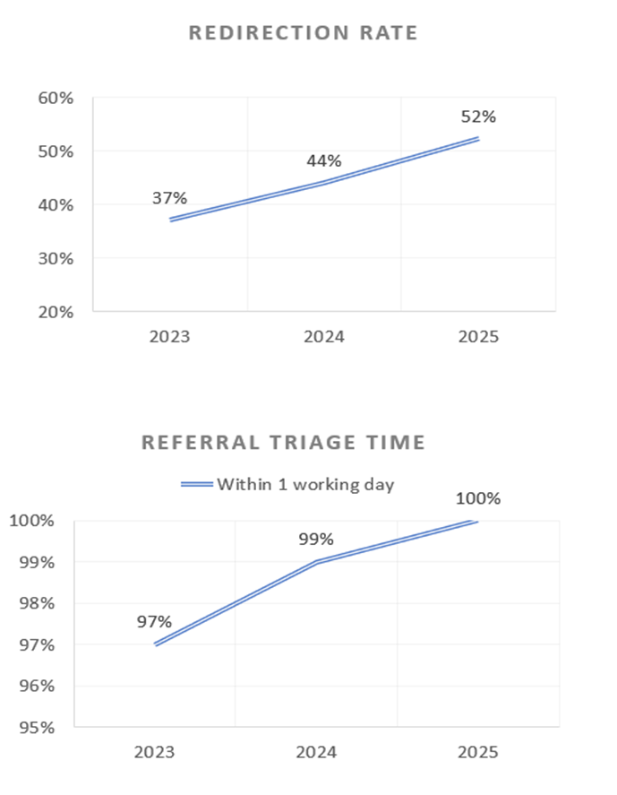
Picture across SWAG – Gloucestershire 2/2
Key achievements
Rapid Referral Processing: Timely access to care, achieving appointments by Day 3 supporting FDS and enhanced patient outcomes.
Increasing Redirection Rates: Discharge, MOPS, and other specialties - Redirection improved year-on-year (2023: 37%, 2024: 43.7%, 2025: 52%).
•Image-Based Triage: All referrals meeting inclusion criteria have image-based triage (Day1) with no patients having F2F appointments without prior image review.
Challenges
•Outreach Clinics: Patients unable to attend centralised imaging hubs (e.g mobility, transport, socio-economic barriers) may be disadvantaged unless outreach or community-based options are developed.
• Primary care education: Medical Photography Team to work with PCNs to ensure high quality images taken within Primary Care to strengthen the mixed model.
• Seasonal demand: Peaks 110–120 referrals/week in summer and in winter of 80–87/week so excess demand not absorbed quickly enough to meet targets.

Slide 8
Picture across SWAG - BNSSG
BNSSG (Bristol, North Somerset & South Gloucestershire ICB) covering the new Bristol NHS Group (University Hospitals Bristol & Weston and North Bristol Trusts)
Following a successful pilot in 2024 a secondary care funded Local Enhanced Service offer was agreed
The service is being rolled out across all BNSSG PCN areas
17 PCN areas are now making referrals to telederm services at both hospitals with the 3 remaining PCNs commencing pilots during the year, the last of which is due to start imminently.
Work is required to increase utilisation of the hubs and thus the proportion of referrals made with images across PCN areas. The Q2 return shows that this improved to 43% compared to 28% from the Q1 return, mainly through gains at NBT but further work is required particularly at UHBW.
FDS performance remains strong with September's at 91.7% diagnosed or 'all cleared' within 28 days at UHBW (2.7% up from the same time last year) and 89.2% at NBT (5.8% up on last year) bucking the national trend where seasonality continues to cause challenges.

Slide 9
YHEC Evaluation
YHEC evaluation process covering the 4 systems
York Health Economics Consortium have shared a draft evaluation model with the four systems which benchmarks telederm against 'standard care'
Feedback has been received and amendments made to the model around data sources and parameters as well as interpreting the different service models across the footprint
The key aims are to:
Review the evidence so far from each system
Develop an economic protocol that covers the different models
Provide clear cost comparators of telederm against previous standard care models

