Slide 1
SWAG Network Skin Cancer
Clinical Advisory Group
Research Update
Claire Matthews
03/12/2025

Slide 2
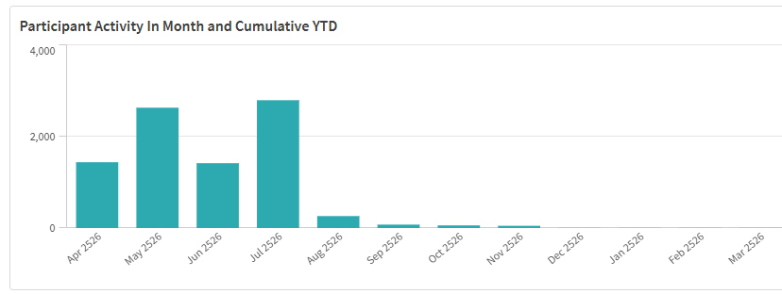
National Recruitment to Skin Cancer Studies 25/26

Slide 3
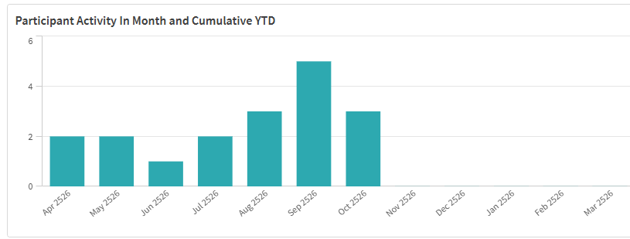
SWAG Region Recruitment to Skin Cancer Studies 25/26

Slide 4
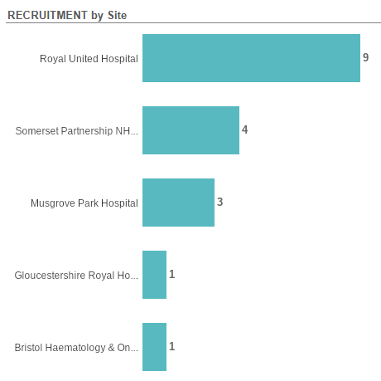
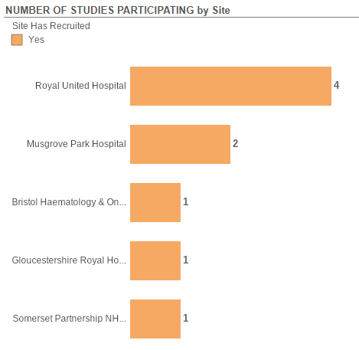
Studies and Recruitment by site FY 25/26

Slide 5
CVLP & Cancer Vaccine trials
From CVLP August Newsletter:
CVLP / SCOPE (Advanced Melanoma) – we’re pleased to share that 6 patients have consented to the CVLP trial for SCOPE, with 5 being HLA-matched and 1 HLA-mismatched. These are the final numbers for SCOPE, with Gloucestershire successfully consenting their first CVLP/SCOPE patient before screening and referrals paused - a fantastic achievement!
SCANCELL has achieved their target sample size, thanks to the outstanding efforts of both SCOPE and CVLP sites. Final numbers: 6 patients have consented to the CVLP with 6 being referred to the SCOPE vaccine trial.

Slide 6
SWAG Open Studies
Study ID | Short title | Sites | Open | closure | regional recruitment
62841 | SCC-AFTER | Musgrove | 10/12/2024 | 18/07/2028 | 0
62742 | PerceIVe | RUH | 25/06/2025 | 01/01/2028 | 2
58643 | DETECTION-2 | RUH | 27/11/2024 | 29/11/2025 | 2
54772 | IMPACT | BHOC | 28/09/2023 | 31/01/2026 | 4
52188 | Phase 3: Fianlimab (Regn3767, Anti-Lag-3) + Cemiplimab Vs Pembrolizumab In Patients With Melanoma | BHOC | 14/02/2023 | 13/04/2030 | 0
50634 | MyMelanoma: An Accessible Resource Melanoma Cohort Study | Yeovil | 01/09/2022 | 31/08/2027 | 0
50169 | REFINE | Musgrove, Yeovil | 25/05/2022 |  | 3
43756 | MITRE | Somerset, RUH, BHOC | 08/07/2020 | 28/02/2026 | 57
38748 | Observational Study of Melanoma Patients Treated with IMLYGIC® | Glos, Musgrove | 22/01/2019 | 31/08/2032 | 25
36774 | Long and short-term effects of SoC treatments for cancer | NBT | 13/05/2020 |  | 0

Slide 7
SWAG region In Setup Skin Cancer Studies
CPMS ID | Short Name | Title | Planned Opening | Planned Closure | Sponsor | Sites (EoI)
67073 | Vusolimogene Oderparepvec in combination with Nivolumab vs Physician's Choice in Advanced Melanoma | A Randomized, Controlled, Multicenter, Phase 3 Clinical Study Comparing Vusolimogene Oderparepvec in Combination with Nivolumab Versus Treatment of Physician’s Choice in Patients with Advanced Melanoma That Has Progressed on an Anti-PD-1 and an Anti-CTLA-4 Containing Treatment Regimen [IGNYTE-3] | 15/11/2025 | 28/06/2029 | REPLIMUNE LIMITED | BHOC
67187 | DARUM-010 | A Randomized, Phase 3, Open-label Study of Neoadjuvant Darovasertib in Subjects with Localized (or Primary) Uveal Melanoma (DARUM-010) | 01/03/2026 | 01/09/2027 | IDEAYA Biosciences,Inc | Musgrove, Yeovil, Salisbury

Slide 8


Be Part of Research is a UK-wide service that helps people find and take part in health and care research across nearly every health condition.
A resource for:
patients or their families keen to get involved in research
Researchers looking for target population for research
https://bepartofresearch.nihr.ac.uk/

Slide 9
Key messages for patients
Be Part of Research makes it easier than ever to find and take part in health and care research.
Simply sign up online and choose the areas of research you’re interested in.
You’ll then be matched to suitable studies and sent clear information about what’s involved and how you can take part.
The decision on whether to take part is always yours.

Slide 10

Associate Principal Investigator
Scheme
Six month in-work training opportunity, providing practical experience for healthcare professionals starting their research career.
People who would not normally have the opportunity to take part in clinical research in their day to day role have the chance to experience what it means to work on and deliver a NIHR portfolio trial under the mentorship of an enthusiastic Local PI.
CIs working with a CTU can register their study on the scheme
https://www.nihr.ac.uk/health-and-care-professionals/career-development/associate-principal-investigator-scheme.htm

Slide 11

Principal Investigator Pipeline Programme
(PIPP)
Overview
Research delivery nurses, midwives and AHPs
12 to 18 months
Free if you’re eligible
Live virtual lessons, online learning and hands-on experience
Cohort 5 applications open in April 2026, approx 60 places
Please email nursingandmidwifery@nihr.ac.uk for more information
https://www.nihr.ac.uk/career-development/clinical-research-courses-and-support/principal-investigator-pipeline-programme

Slide 12
NIHR ODP https://odp.nihr.ac.uk/
Open data platform. Data on performance across whole RDN, including all specialty areas
NIHR Be Part of Research https://bepartofresearch.nihr.ac.uk/
See which studies are open across the country
Find a Clinical Research Study (ODP) http://csg.ncri.org.uk/portfolio/portfolio-maps/
Search for a study to fit criteria. Good for horizon scanning, eligibility criteria

Slide 13
RRDN Contacts
swc.rrdn@nihr.ac.uk
Study Support Service Manager: claire.matthews@nihr.ac.uk
CAG Research Lead: christopher.herbert@uhbw.nhs.uk

