Slide 1


National Cancer Patient Experience Survey Results (2024)
Skin Clinical Advisory Group
Wednesday 3rd December 2024

Slide 2
NCPES Introduction
Annual survey, commissioned & managed by NHS England (since 2010)
new design for 2021, therefore break in series data
2021 / 2022 / 2023 year on year comparison
Picker - responsible for designing, running & analysing the survey
Designed to:
Monitor progress in cancer care
Provide information to drive local quality improvements
Assist commissioners and providers of cancer care
Inform the work various charities and stakeholder groups, supporting cancer patients

Slide 3
NCPES Methodology
Provider survey samples
Adults (16 and over), with a confirmed diagnosis of cancer
Discharged from NHS Trust (after an inpatient or day-case attendance for cancer related treatment) in April, May and June 2024.
Survey fieldwork Oct. 2024 – Feb. 2025
Reports published July 2025 (National, Alliance, Trust).

Slide 4
Cancer Alliance report
Report reflects experience of people referred from within CA footprint (not all those treated by that CA’s Providers)
‘referring’ CA report - based on patient home postcodes
According to ONS postcode mapping

Slide 5
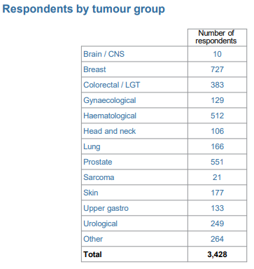
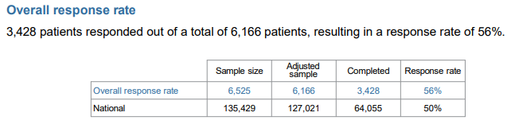
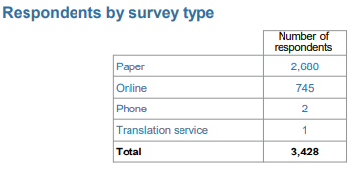
NCPES SWAG responses

Slide 6
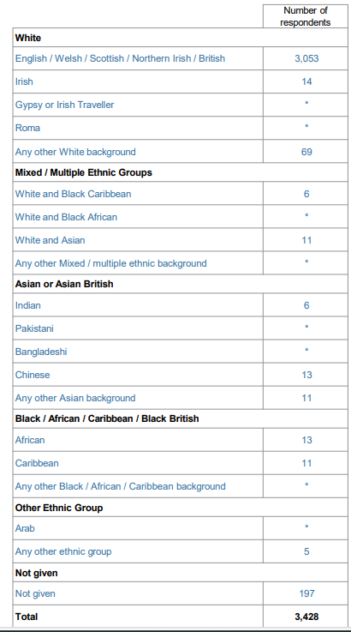
SWAG respondents by Ethnicity
91.4% (3136)
1.37% (54)
5.89% (202)

Slide 7
Skin
Total SWAG Skin responses: 177
(people with a SWAG post-code, who responded to the survey)
6 - answers supressed, as responses were <10
55 - a % score given as >10 respondents for that question
Caution: 2 trusts with no responses due to responses <10

Slide 8
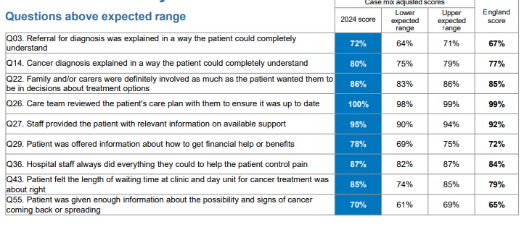
SWAG Summary
Q59 Overall patients average rating of care (0-10 scale) SWAG 2024 National score SWAG 2023
9.0 8.9 9.0
9 SWAG scores above Expected Range (none below the expected range in 2024) – all remaining scores within expected range

Slide 9
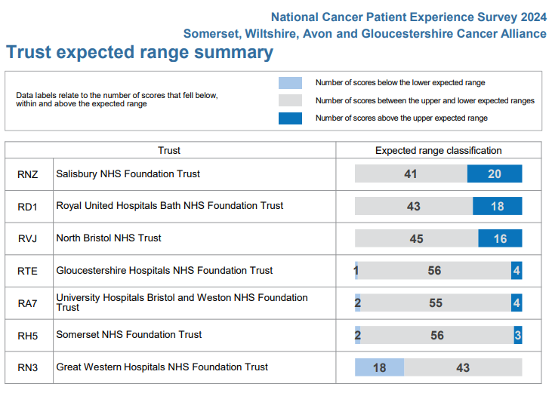
SWAG Trust Summary

Slide 10
Variations by tumour site
Comparison between tumour sites
Some significant variation in scores (e.g. >30%)
Significant variation in numbers of responses
Caution in making these comparisons and interpreting results

Slide 11
SWAG Skin lowest scores ≤ 60%
 | Question | SWAG | National average
50 | During treatment, the patient definitely got enough care and support at home from community or voluntary services | 52 | 53
51 | Patient definitely received the right amount of support from their GP practice during treatment. | 59 | 48
52 | Patient has had a cancer care review by GP practice | 22 | 23
53 | After treatment, the patient could definitely get enough emotional support at home from community or voluntary services | 29 | 34
3 less low scoring questions compared to 2023

Slide 12
SWAG Skin highest scores ≥ 90%
 | Question | SWAG | National average
5 | Patient received all the information needed about the diagnostic test in advance | 94 | 93
9 | Enough privacy was always given to the patient when receiving diagnostic test results | 95 | 95
15 | Patient was definitely told about their diagnosis in an appropriate plac | 91 | 86
17 | Patient has a main point of contact within the care team | 95 | 91
19 | Patient found the advice from the main person helpful or very useful | 95 | 96
25 | A member of the care team helped the patient create a care plan to address any needs or concerns | 94 | 94
26 | Care team reviewed the patients care plan with the to ensure it was up to date | 100 | 99
27 | Staff provided the patient with relevant information on available support | 98 | 92
36 | Hospital staff did all they could to help patient control pain | 96 | 84

Slide 13
SWAG Skin highest scores ≥ 90%
 | Question | SWAG | National
37 | Patient was always treated with dignity while in hospital | 94 | 88
38 | Patient received easy to understand information about what they should or should not do after leaving hospital | 94 | 87
41 | Beforehand patient always had enough understandable information about surgery | 90 | 90
46 | Patient was given information they could access about support in dealing with immediate side effects of treatment | 95 | 88
54 | The right amount of information and support was offered to the patient between final treatment and the follow up appointment | 92 | 81
56 | The whole care team worked well together | 97 | 90
57 | Administration of care was very good or good | 94 | 88
Additional 2 questions with higher scores compared to 2023

Slide 14
Patient comments
Patients were asked
Please tell us what you found to be positive about your experience of cancer care?
Please tell us how your experience of cancer care could have been better?
‘Patient comment’ feedback and analysis has been presented by topic, themes and sentiment
Patient comments are available in Trust level reports only.

Slide 15
Clinical Advisory Group - Next Steps
Discuss and agree SWAG Skin patient experience improvement priorities, including areas of lowest scores (Slide 11)
Next steps / timeline
Nominated lead
Recognition of areas of good practice
Consider / plan additional in-year skin-specific patient experience activity to gain further insight

