Slide 1
Tumour-Infiltrating Lymphocyte (TIL) therapy
South West Immunotherapy Group Meeting, Taunton, 19th November 2025
Andrew Furness MRCP PhD
Consultant Medical Oncologist
Solid Tumour Cellular Therapy Lead
The Royal Marsden NHS Foundation Trust
Team Leader and Clinical Lead
Centre for Translational Immunotherapy
The Institute of Cancer Research

Slide 2
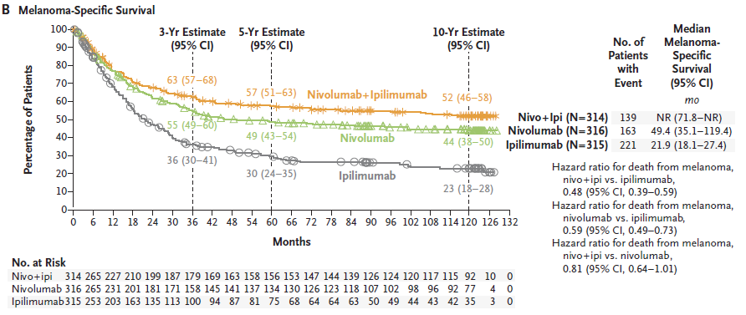
Beyond the Checkpoints…
Wolchok et al. N Engl J Med 2024
Notes:
Introduce ICI
Transformation of melanoma outcomes
What about the other 50%

Slide 3
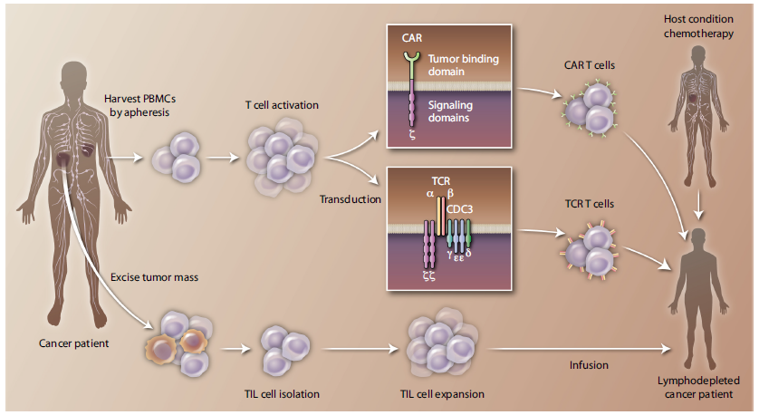
Methods of adoptive cellular therapy (ACT)
Lifileucel (melanoma), afamicel (sarcoma)
June, Riddell & Schumacher Sci Transl Med 2015

Slide 4
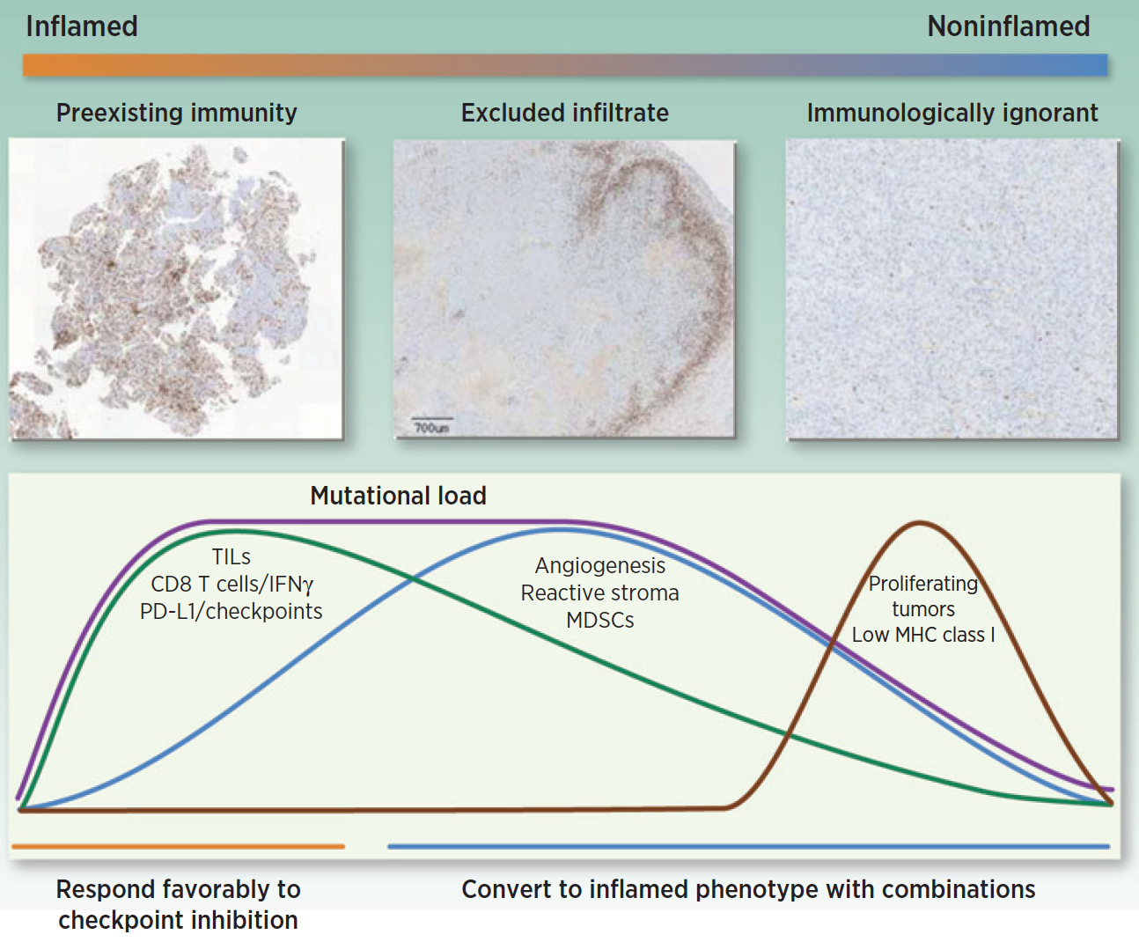
Selection of ACT method according to baseline TME
Hedge, Karanikas and Evers Clin. Cancer Res. 2016

Slide 5
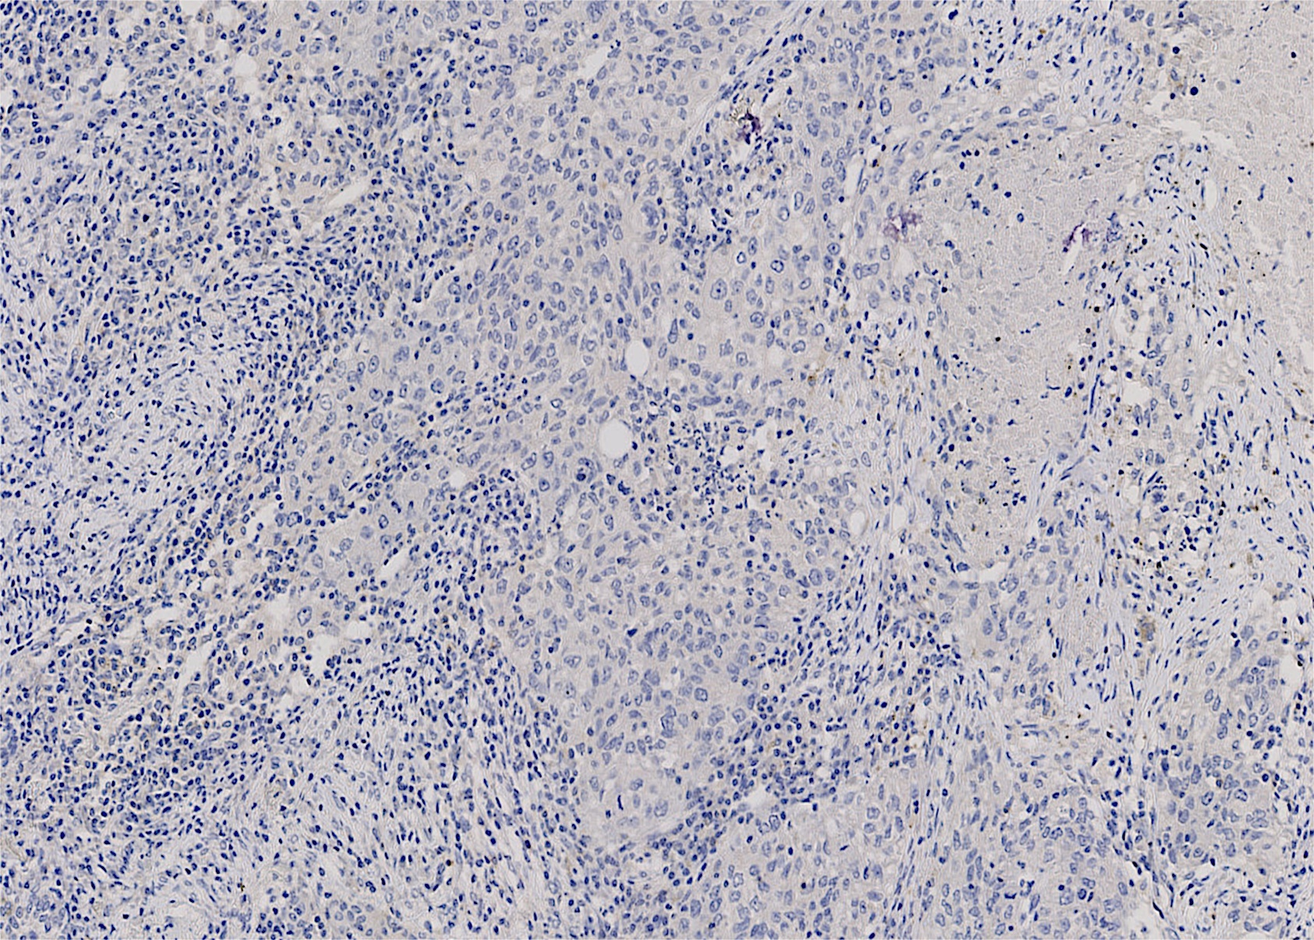
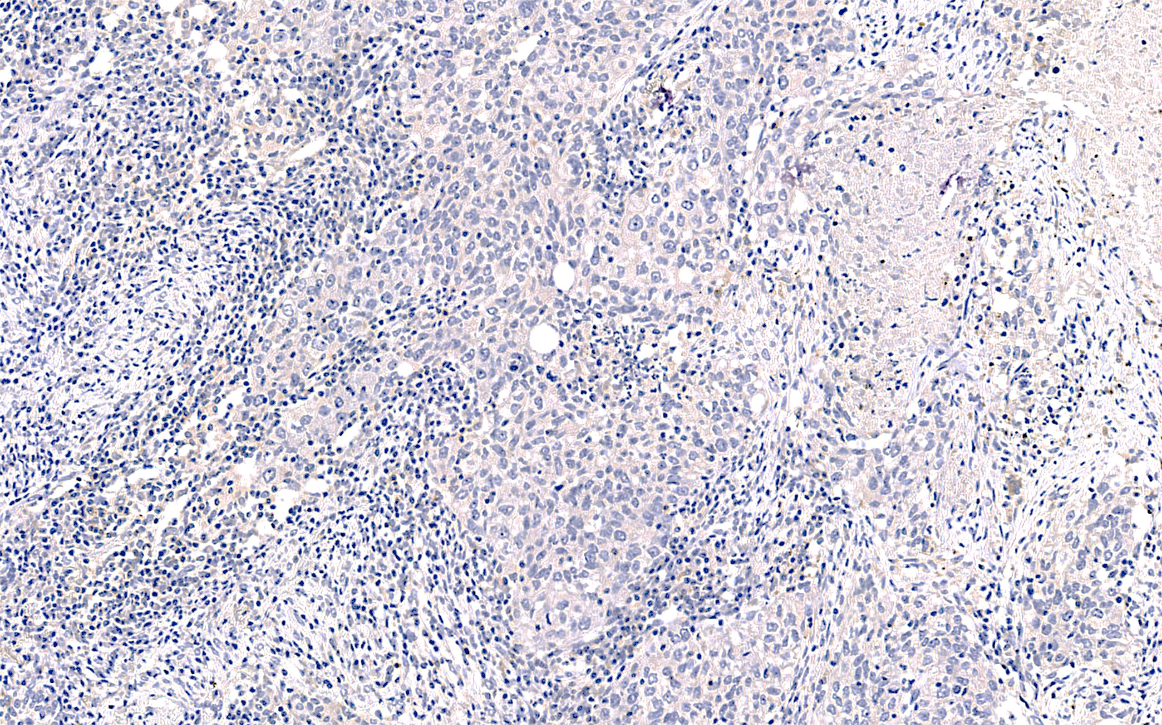
Exploiting the immunogenic, solid tumour TME
0
500uM
x10
Primary human NSCLC

Slide 6
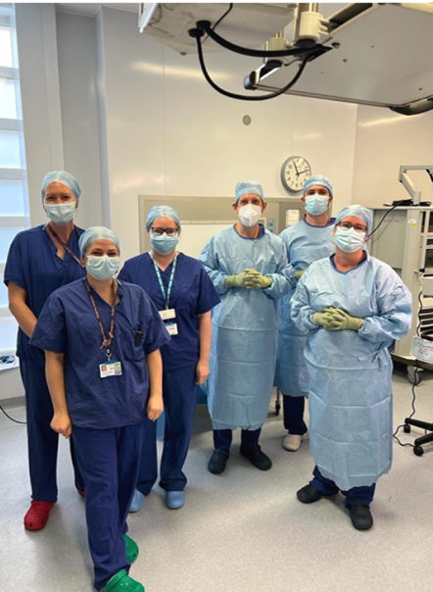
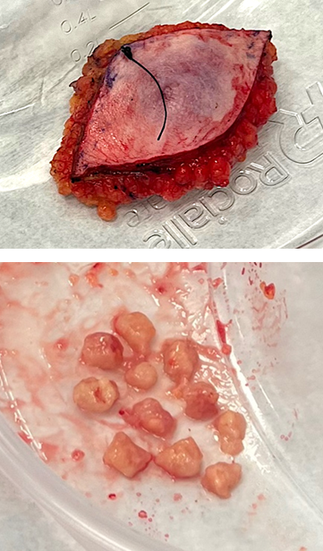
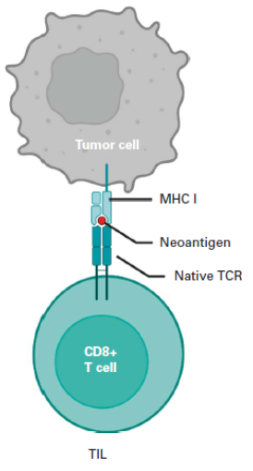
Tumour-infiltrating lymphocyte (TIL) therapy
Adapted from Olson and Odunsi J Clin Oncol 2023

Slide 7
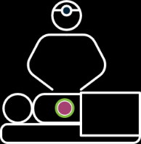

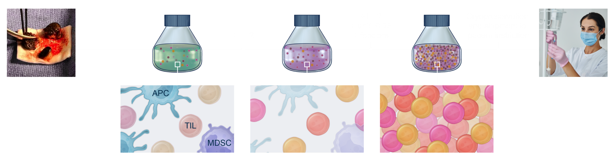
Lifileucel Manufacturing
Pre-REP Phase
REP Phase
Billions of TIL
TIL #
Tumor tissue procurement
Lifileucel is received and prepared for infusion
Tumor tissue is the starting material for lifileucel
Notes:
Speaker notes:
TIL from tumor tissue is surgically procured from the patient, and is shipped via overnight courier to an Iovance manufacturing facility
Pre-REP Manufacturing Phase: The tumor specimen is cut into fragments. IL-2 is added so that TIL thrive, while other cells die off.
REP Manufacturing Phase: IL-2, anti-CD3 mAb and irradiated peripheral blood mononuclear feeder cells are added to rejuvenate and amplify TIL to billions in number.
The final autologous cell therapy product of amplified and rejuvenated TIL is cryopreserved and shipped back to the center for patient infusion.

Slide 8
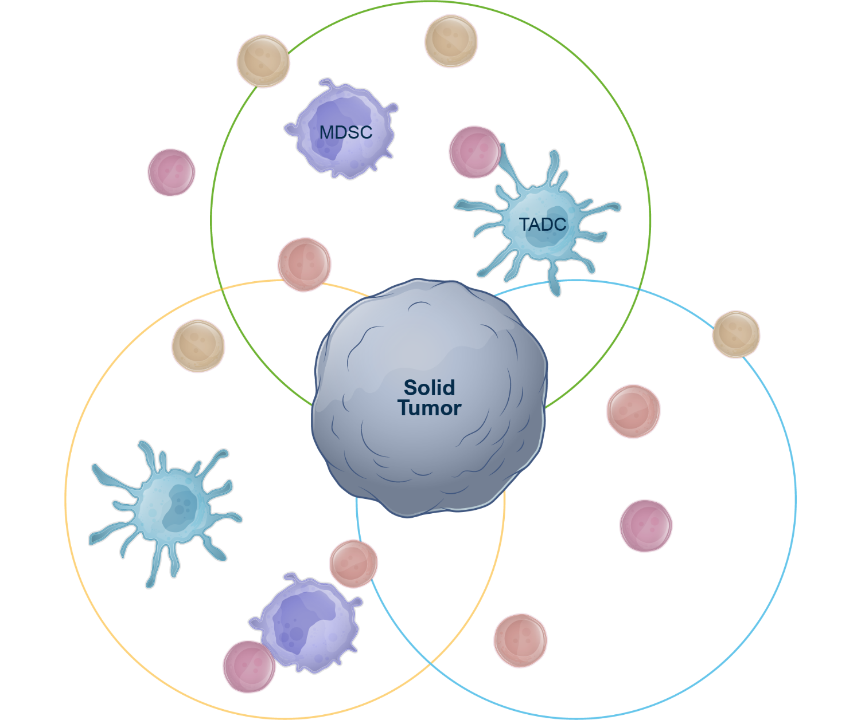






TIL Therapy Regimen is Infused into the Patient
STEP 4
TME
Step 3
Step 4
Step 5
Preparative Regimen
TIL Therapy Infusion
IL-2 Administration
STEP 3
STEP 5
Abbreviations: IL-2, interleukin 2; MDSC, myeloid-derived suppressor cell; TIL, tumor infiltrating lymphocytes.
Notes:
Speaker notes: Now, I’ll walk you through Steps 3 – 5 of the process. We’re back in the patient’s tumor microenvironment after the billions of cryopreserved TIL have been received by the center. The tumor is flourishing in this image, surrounded by its hostile tumor microenvironment.

Slide 9
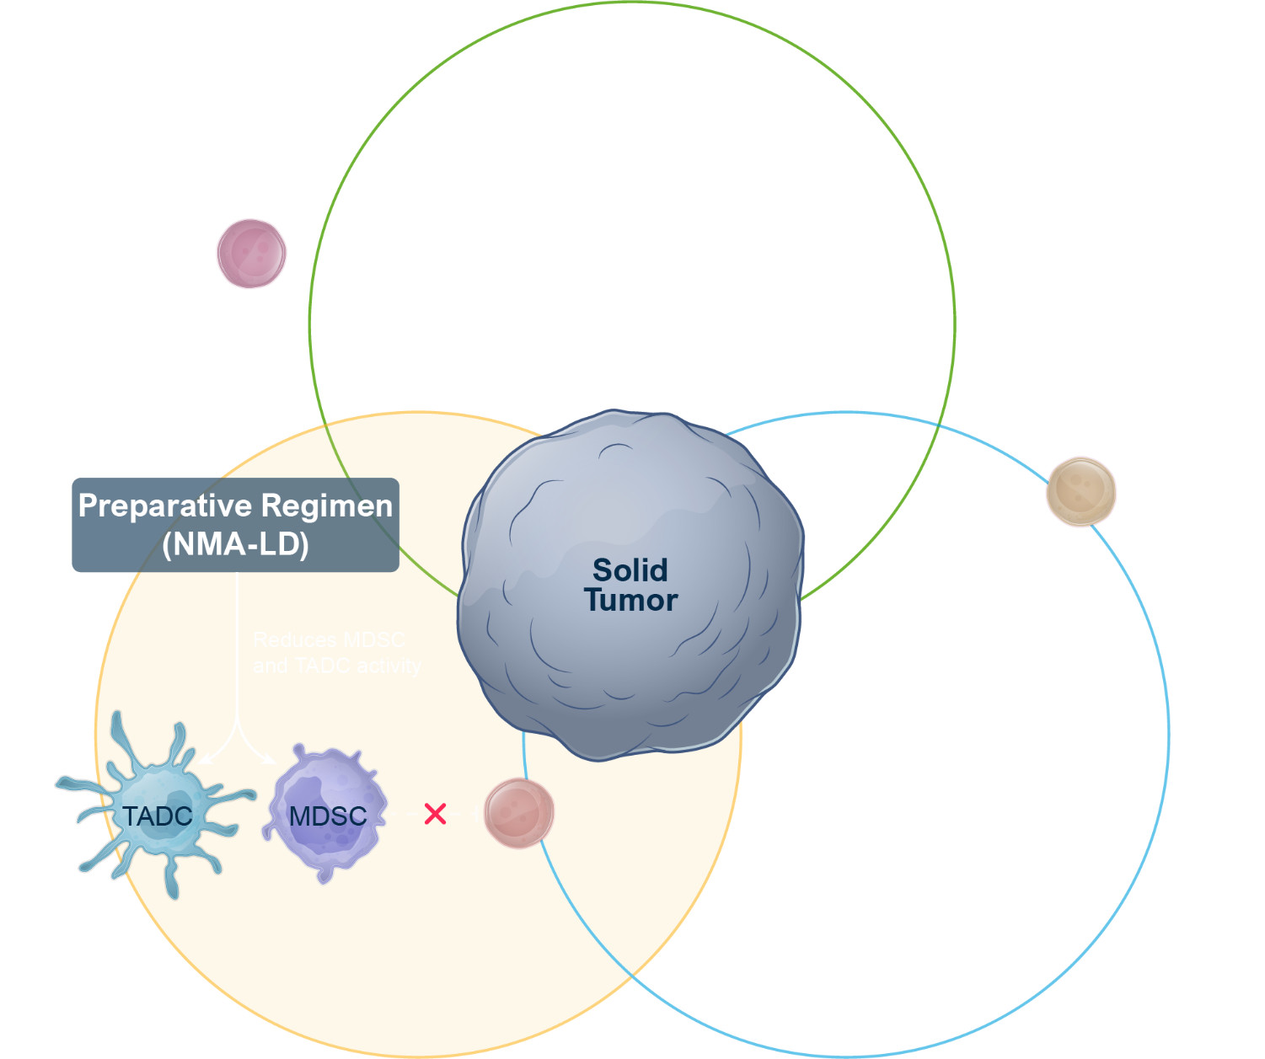
TIL Therapy Regimen is Infused into the Patient ⁽¹⁾
STEP 4
TME
Preparative regimen* (NMA-LD):
Reduces MDSC and TADC activity
Eliminates T cells from host to decrease “cytokine sink”
STEP 3
STEP 5
*Cyclophosphamide 60mg/kg for 2 days and fludarabine 25mg/m² for 5 days
Mechanism of Action visualization is based on preclinical in vitro and in vivo studies and observation in human disease.^{2,3}
Notes:
Speaker notes: The patient receives a preparative nonmyeloablative lymphodepletion regimen (NMA-LD) in order to reduce regulatory/suppressor T cells and eliminate T cells from host to decrease “cytokine sink”

Slide 10
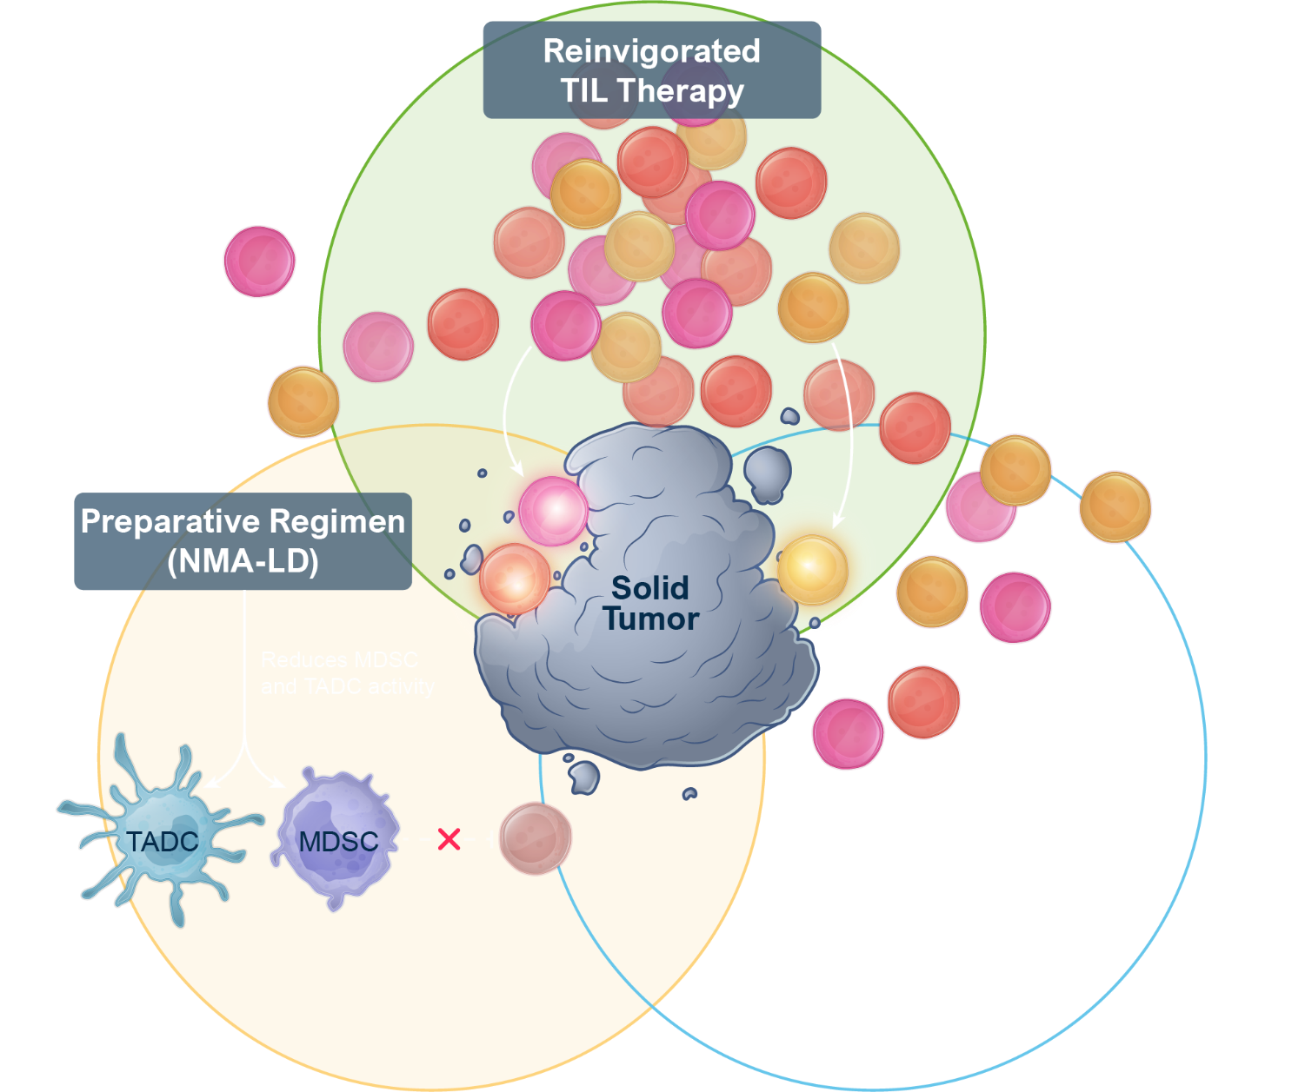
TIL Therapy Regimen is Infused into the Patient ⁽¹⁾
STEP 4
TME
Preparative regimen* (NMA-LD):
Reduces MDSC and TADC activity
Eliminates T cells from host to decrease “cytokine sink”
One-time TIL therapy is manufactured to:
Infuse billions of reinvigorated TIL
Replicate polyclonal nature of TIL that traffic to multiple TSAs
STEP 3
STEP 5
*Cyclophosphamide 60mg/kg for 2 days and fludarabine 25mg/m² for 5 days
Mechanism of Action visualization is based on preclinical in vitro and in vivo studies and observation in human disease.^{2,3}
Notes:
Speaker notes: TIL therapy is then infused (up to 4 bags) which can recognize a wide array of the patient’s TSAs across tumor sites

Slide 11
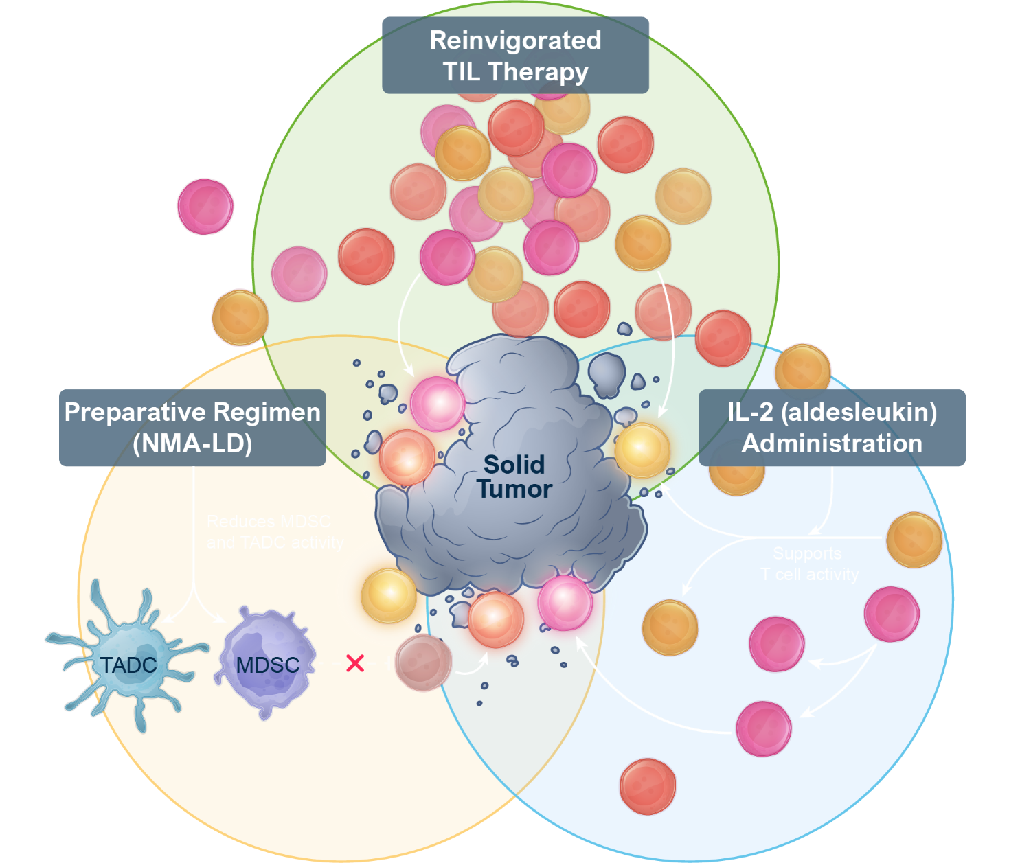

TIL Therapy Regimen is Infused into the Patient ⁽¹⁾
STEP 4
TME
Preparative regimen* (NMA-LD):
Reduces MDSC and TADC activity
Eliminates T cells from host to decrease “cytokine sink”
One-time TIL therapy is manufactured to:
Infuse billions of reinvigorated TIL
Replicate polyclonal nature of TIL that traffic to multiple TSAs
IL-2 (aldesleukin) administration:
Short course, high dose
Supports T-cell activity
STEP 3
STEP 5
*Cyclophosphamide 60mg/kg for 2 days and fludarabine 25mg/m² for 5 days
Mechanism of Action visualization is based on preclinical in vitro and in vivo studies and observation in human disease.^{2,3}
Notes:
Speaker notes: To support T-cell activity after the lifileucel infusion, the patient is administered a short-course of high-dose IL-2

Slide 12
C-144-01 Study Design
Phase 2, multicenter study to assess the efficacy and safety of autologous TIL (lifileucel) for treatment of patients with metastatic melanoma (NCT02360579)
Patient Population
Unresectable or metastatic melanoma treated with ≥1 prior systemic therapy including a PD-1–blocking antibody and, if BRAF V600 mutation positive, a BRAFi ± MEKi
Cohort 1 Non-cryopreserved TIL product (Gen 1)
N=30
Closed to enrollment
Cohort 2 Endpoints
Primary: Efficacy per investigator-assessed ORR using RECIST 1.1 response criteria
Secondary: Safety and additional parameters of efficacy
Key Eligibility Criteria
Radiographic confirmation of progression
One tumor lesion resectable for TIL generation (~1.5 cm in diameter) and ≥1 target tumor lesion for RECIST 1.1 response assessment
Age ≥18 years at the time of consent
ECOG performance status of 0–1
Methods
Patients were enrolled from April 2017 to January 2019 at 26 sites across the US and EU
Concomitant anticancer therapy was not permitted
Imaging-evaluable disease was required
All responses required confirmation
Data cutoff: 22 April 2021
Cohort 2
Cryopreserved TIL product (Gen 2)
N=60
Closed to enrollment
Cohort 3 TIL re-treatment N=10
Cohort 4 (Pivotal)
Cryopreserved TIL product (Gen 2)
N=75
Closed to enrollment
BRAFi, BRAF inhibitor; ECOG, Eastern Cooperative Oncology Group; MEKi, MEK inhibitor; ORR, objective response rate; PD-1, programmed cell death protein 1; RECIST, Response Evaluation Criteria in Solid Tumors; TIL, tumor infiltrating lymphocytes.

Slide 13
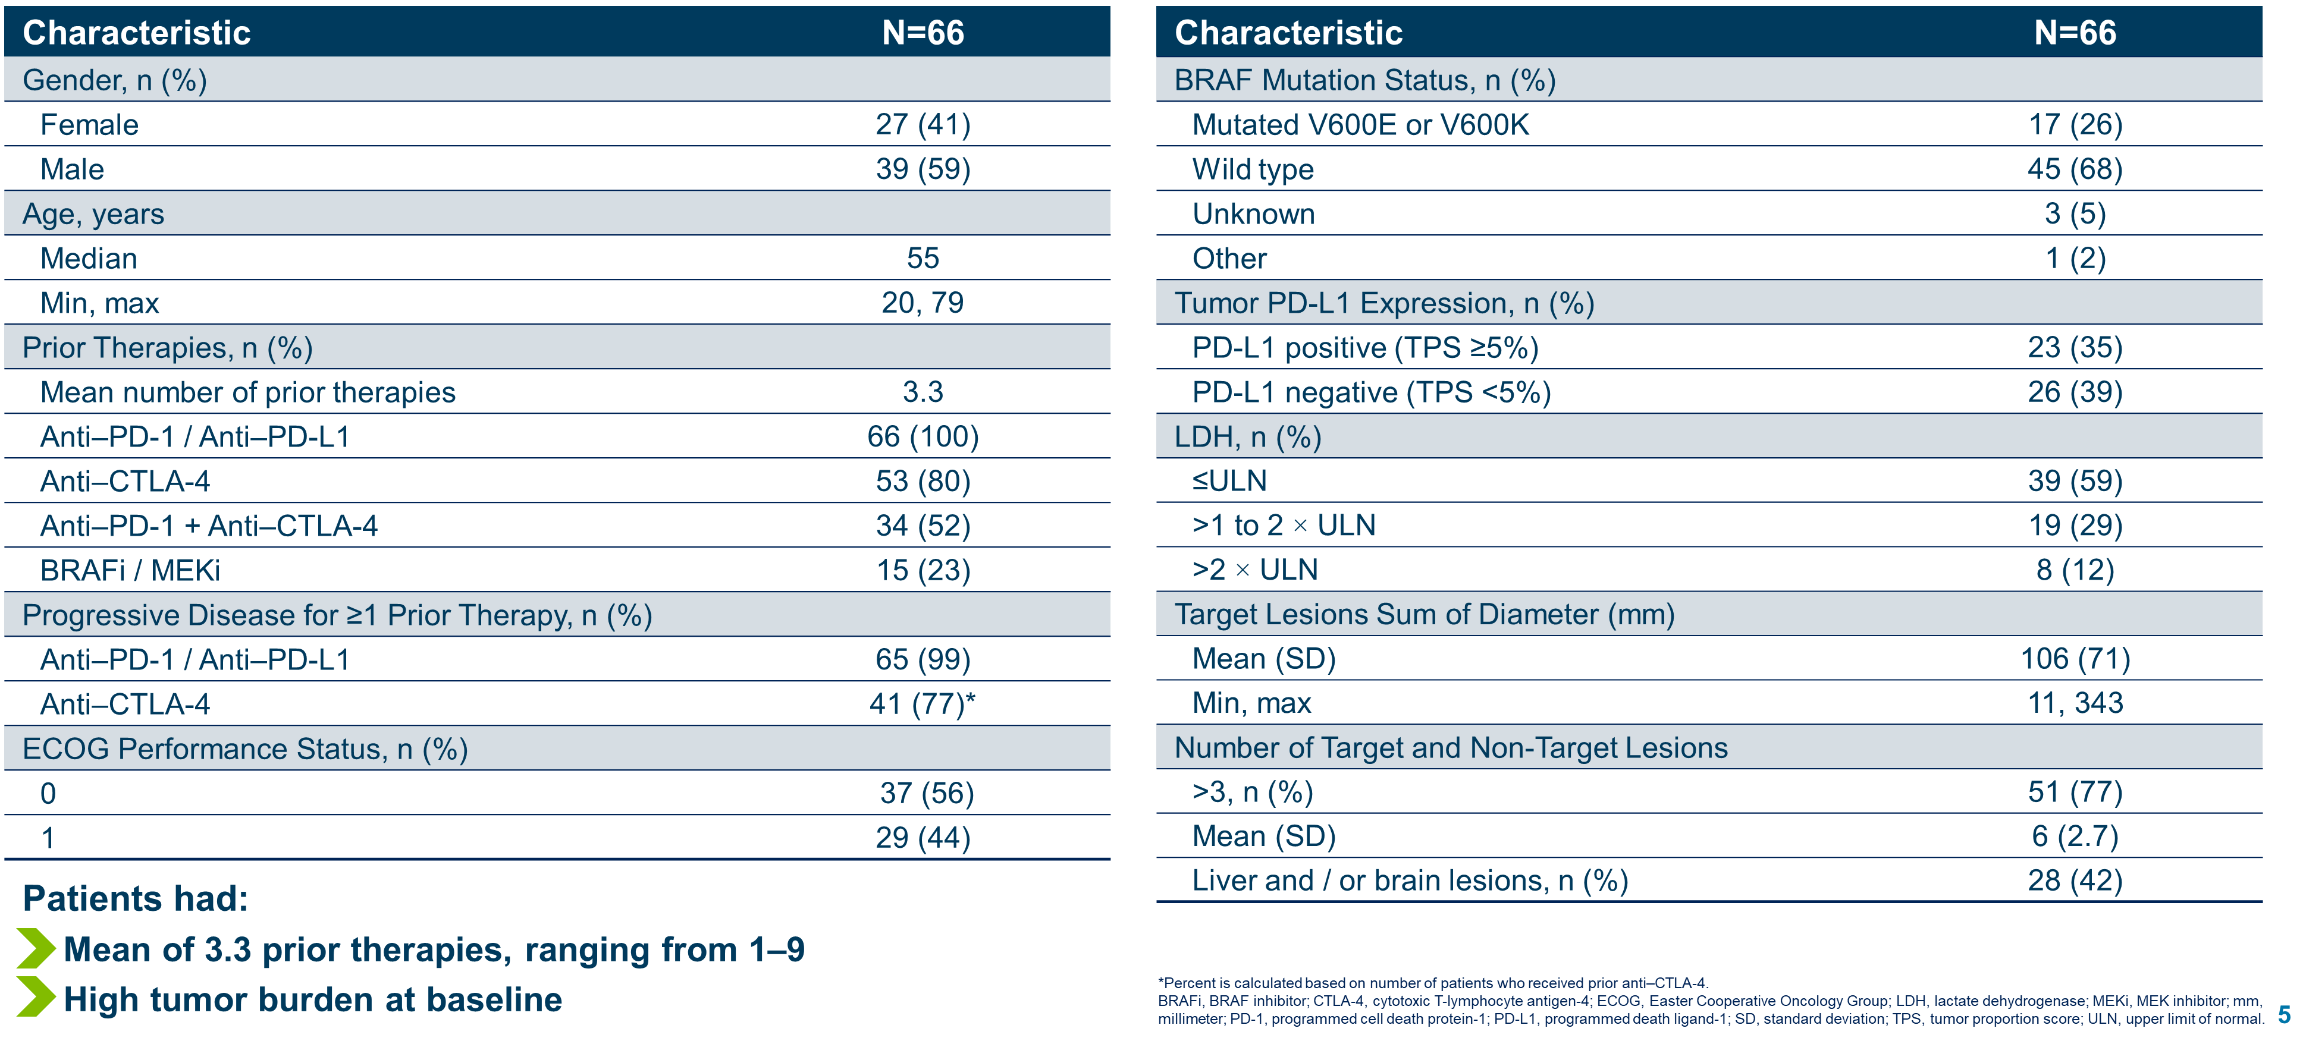
Baseline Patient Disease and Characteristics

Slide 14
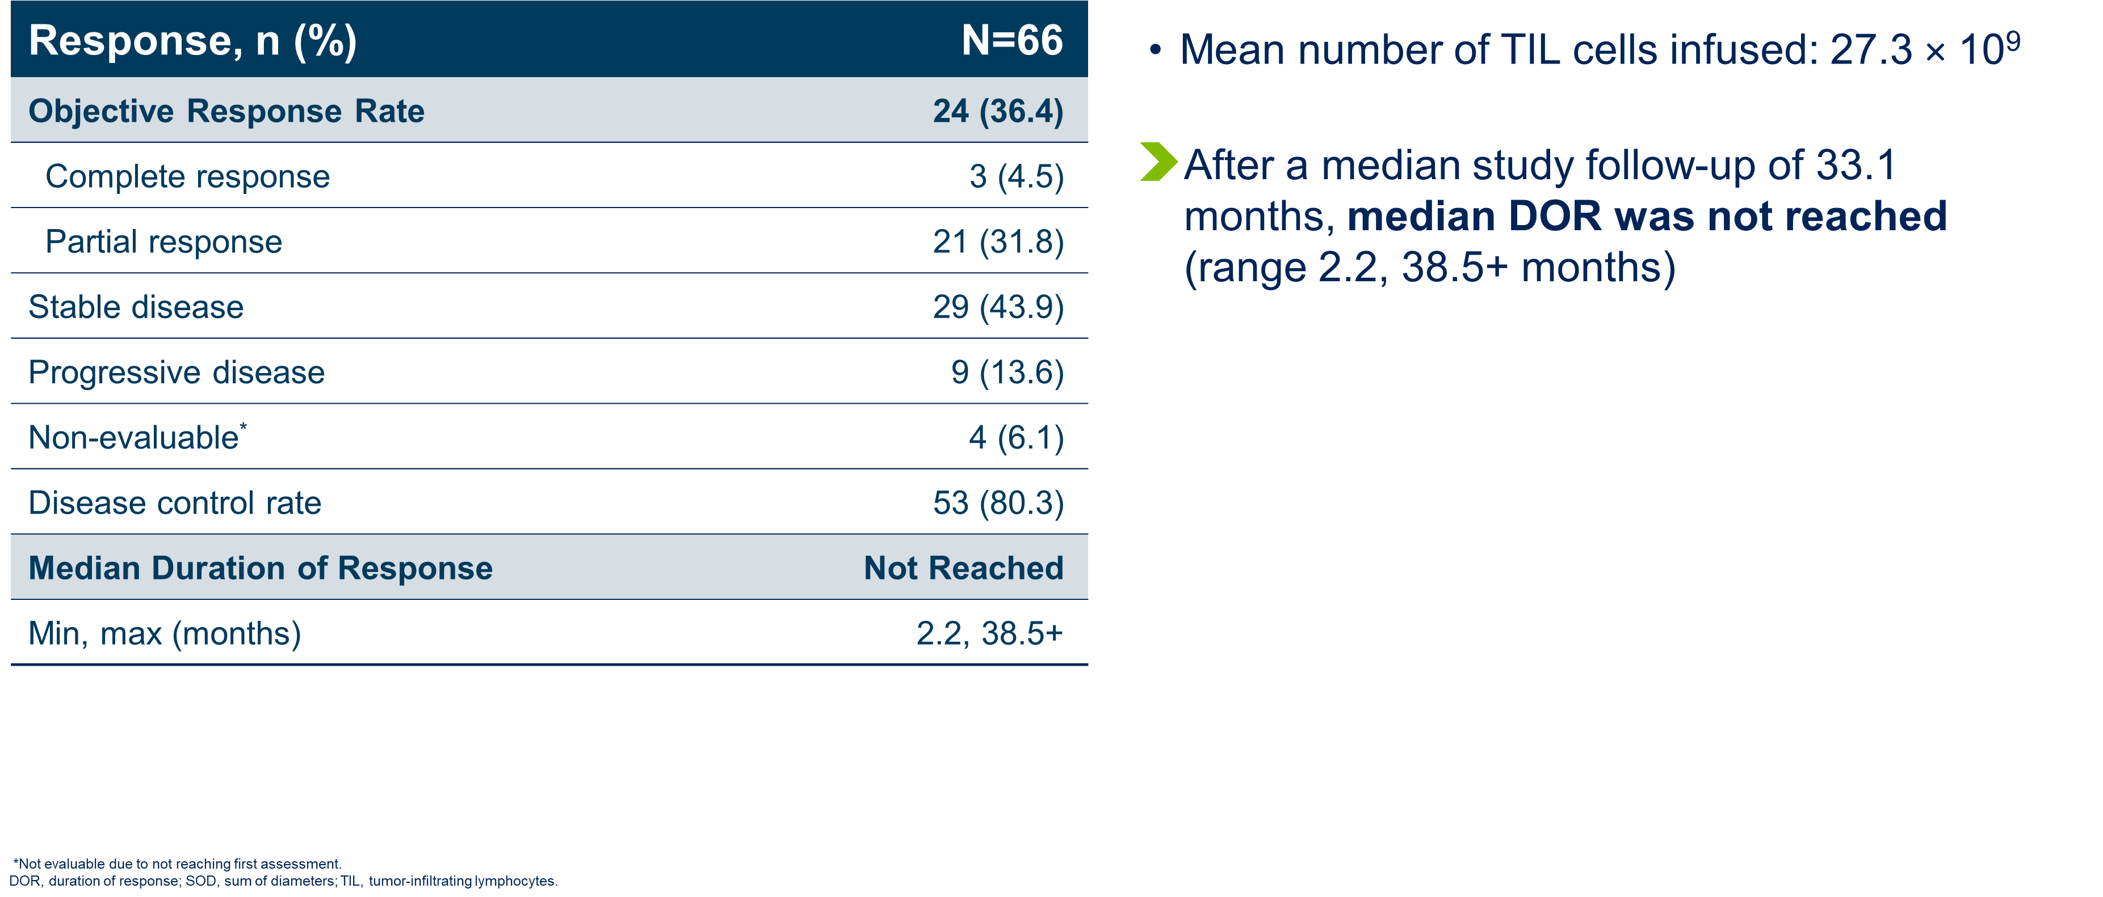
Objective Response Rate
Notes:
41% in primary refractory

Slide 15
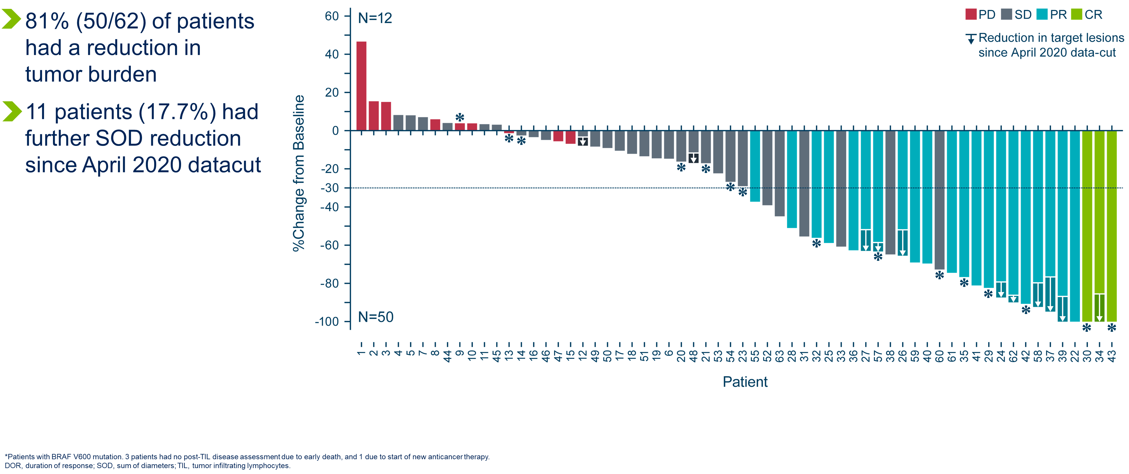
Best Overall Response

Slide 16
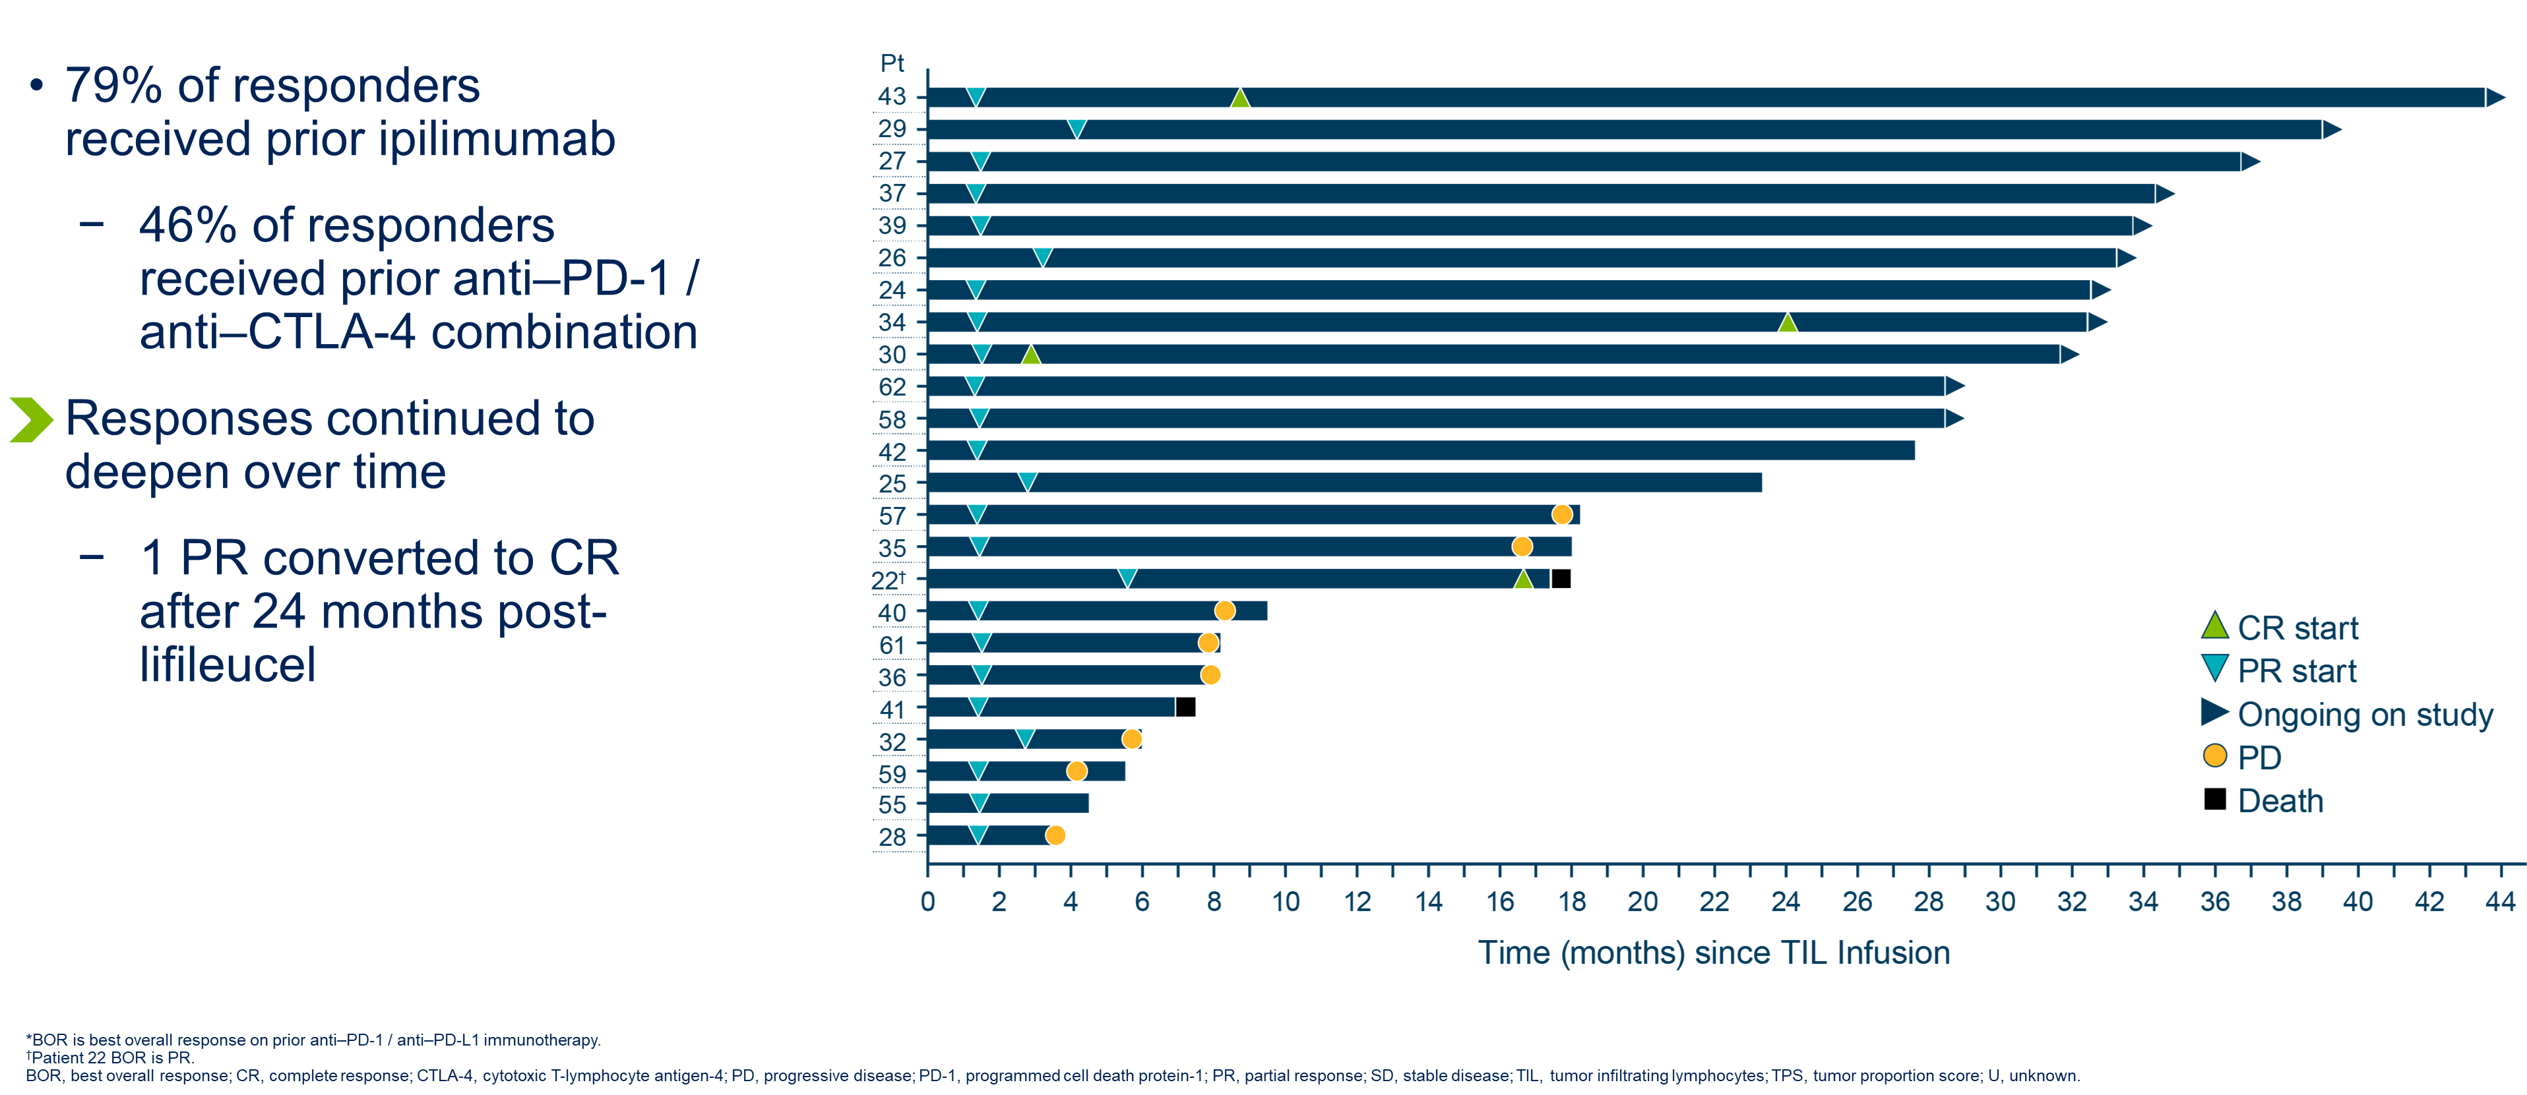
Time to Response for Evaluable Patients (PR or better)

Slide 17
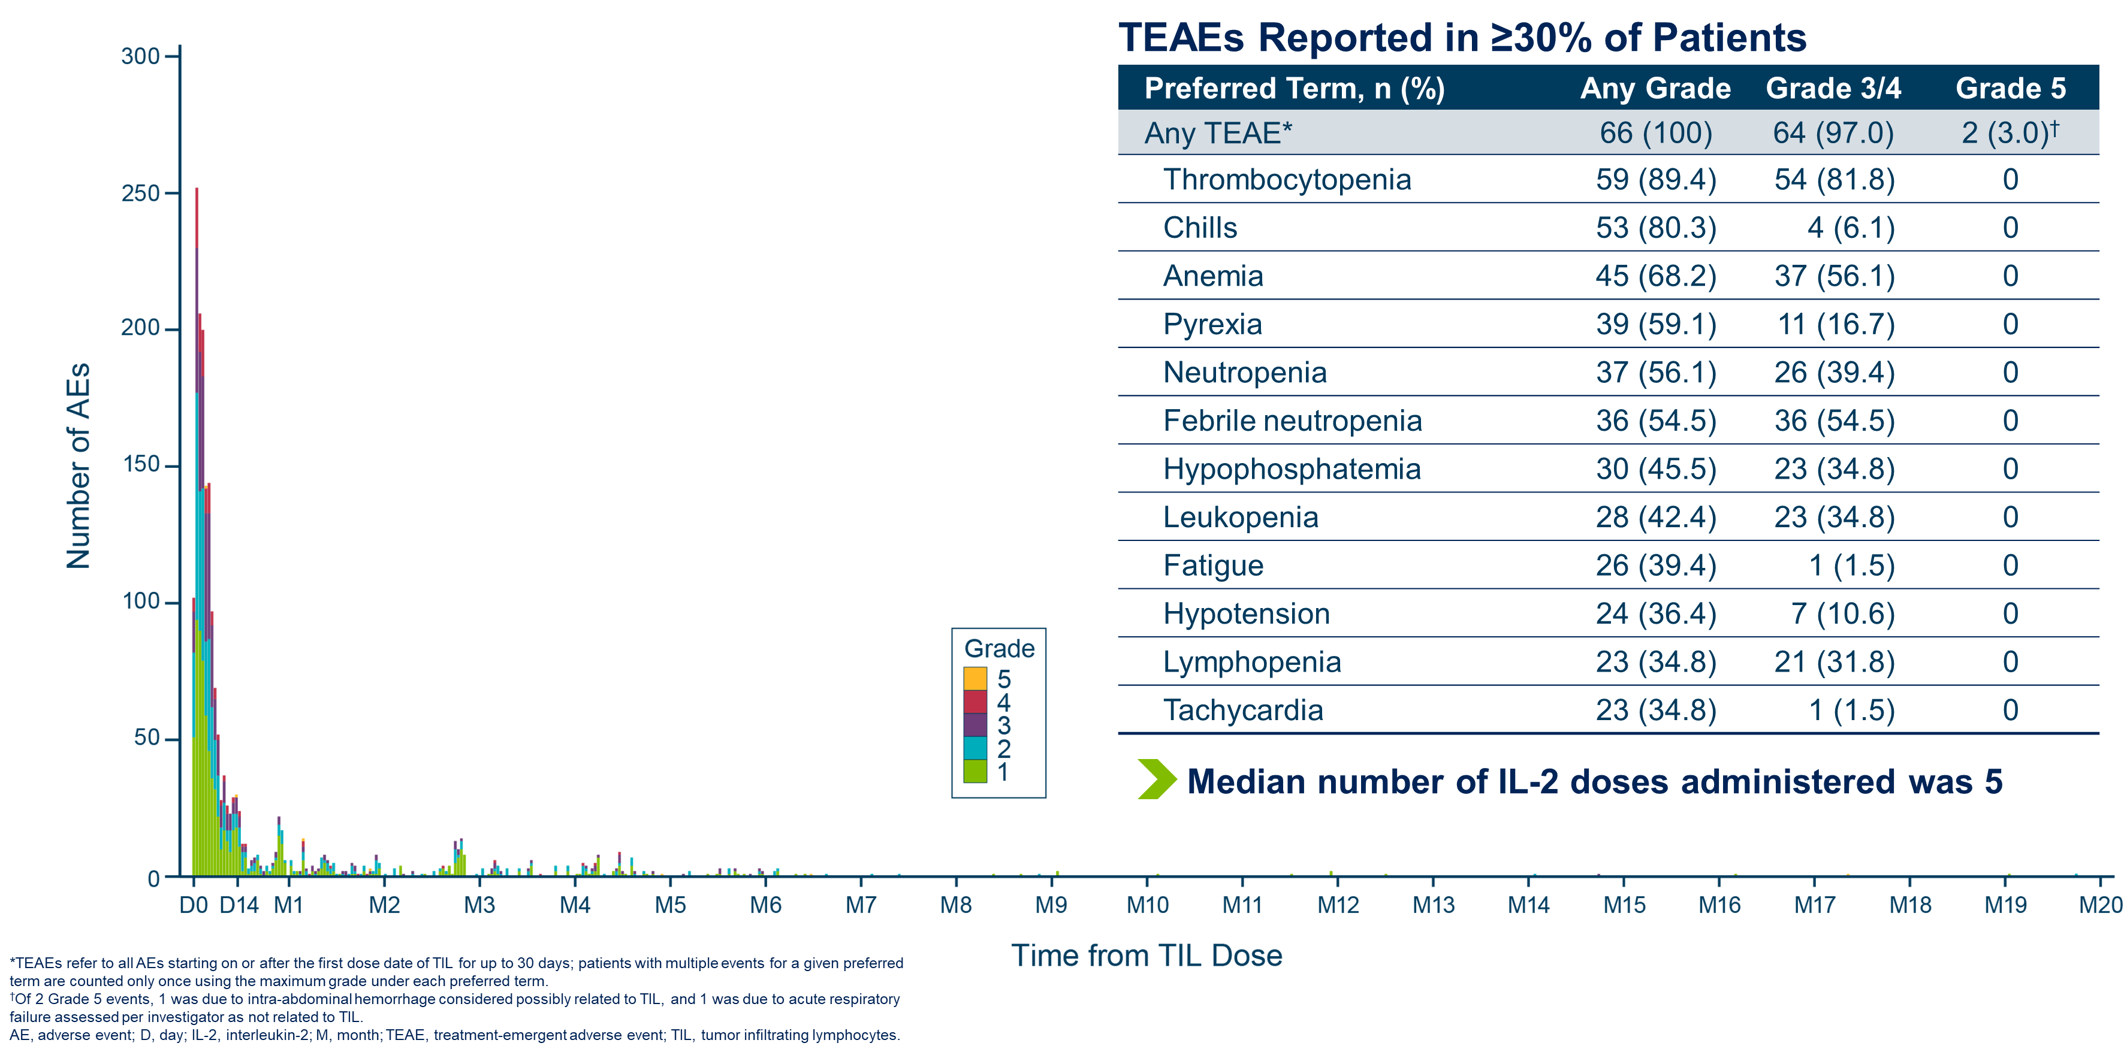
Safety

Slide 18
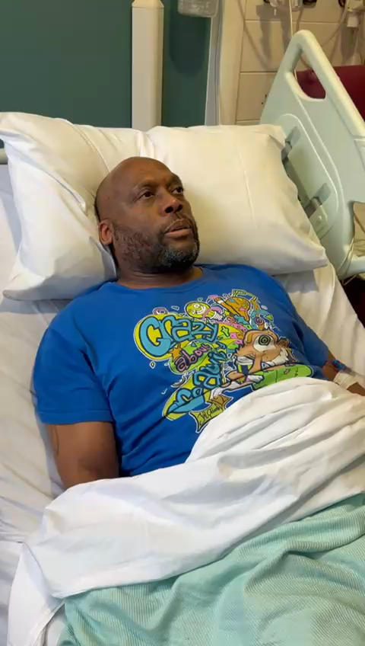
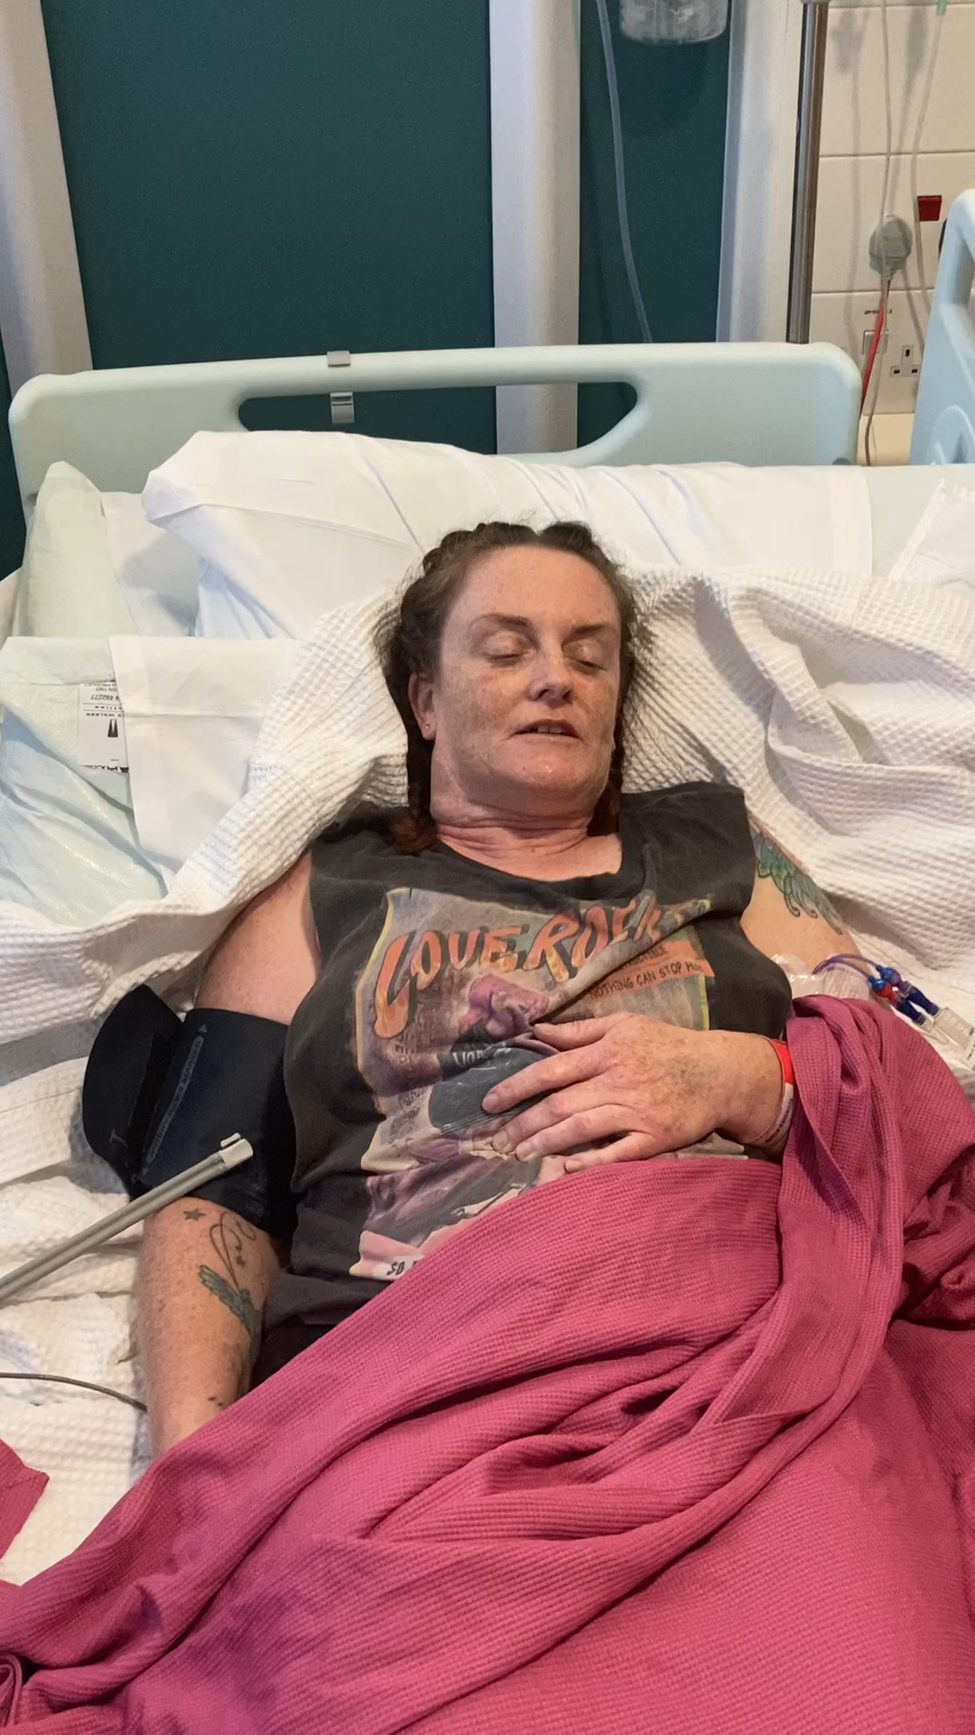
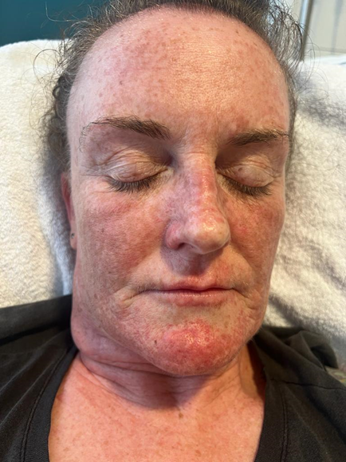
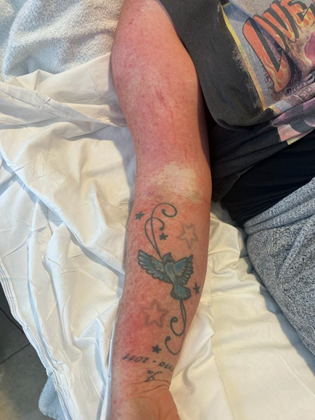
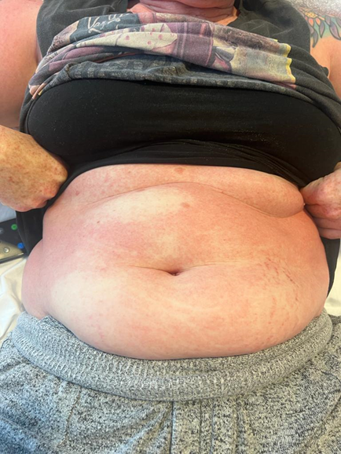
Safety

Slide 19
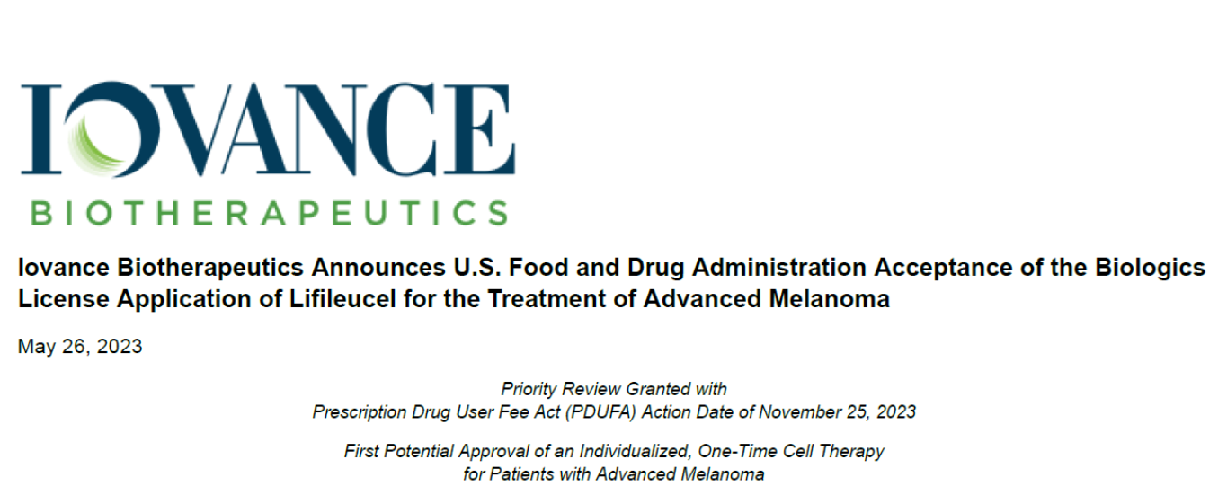
First licensed ‘one-off’ cellular therapy for solid tumours
Andrew J.S. Furness

Slide 20
Lifileucel in patients with advanced melanoma: 5-year outcomes of the C-144-01 study
Theresa Medina, MD¹, Jason A Chesney, MD, PhD², Harriet M Kluger, MD³, Omid Hamid, MD⁴, Eric D Whitman, MD⁵, Mike Cusnir, MD⁶, Sajeve A Thomas, MD⁷, Martin Wermke, MD⁸, Evidio Domingo-Musibay, MD⁹, Giao Q Phan, MD¹⁰, John M Kirkwood, MD¹¹, James Larkin, MD, PhD¹², Jeffrey Weber, MD, PhD¹³*, Friedrich Graf Finckenstein, MD¹⁴, Jeffrey Chou, MD, PhD¹⁴, Brian Gastman, MD¹⁴, Xiao Wu, PhD¹⁴, Rana Fiaz, MD¹⁴, Amod A Sarnaik, MD¹⁵
¹University of Colorado Cancer Center—Anschutz Medical Campus, Aurora, CO, USA; ²Brown Cancer Center, Louisville, KY, USA; ³Yale Cancer Center, New Haven, CT, USA; ⁴The Angeles Clinic and Research Institute, a Cedars Sinai Affiliate, Los Angeles, CA, USA; ⁵Atlantic Health System, Morristown, NJ, USA; ⁶Mount Sinai Medical Center, Miami Beach, FL, USA; ⁷AdventHealth Cancer Institute, Orlando, FL, USA; ⁸Technical University Dresden—NCT/UCC Early Clinical Trial Unit, Dresden, Germany; ⁹Allina Health Cancer Institute, Minneapolis, MN, USA; ¹⁰UConn Health/Neag Cancer Center, Farmington, CT, USA; ¹¹UPMC Hillman Cancer Center, Pittsburgh, PA, USA; ¹²The Royal Marsden Hospital NHS Foundation Trust, London, UK; ¹³Laura and Isaac Perlmutter Cancer Center, NYU Langone Medical Center, New York, NY, USA; ¹⁴Iovance Biotherapeutics, Inc., San Carlos, CA, USA; ¹⁵H. Lee Moffitt Cancer Center and Research Institute, Tampa, FL, USA
Theresa Medina, MD
*Deceased.
Theresa Medina, MD

Slide 21
Durable responses were observed with lifileucel
The ORR was 31.4% (complete response [CR], 5.9%; partial response [PR], 25.5%), and 79.3% of patients had a reduction in tumor burden
The median duration of IRC-assessed response was 36.5 months (95% CI: 8.3–NR)
31.3% (15/48) of responders completed the 5-year assessment with ongoing responses
Duration of Response
100
90
80
70
60
Remaining in response, %
50
40
30
20
10
0
0
3
6
9
12
15
18
21
24
27
30
33
36
39
42
45
48
51
54
57
60
Time since onset of response, mo
Patients at risk, n
48
38
30
27
26
24
21
20
19
17
16
16
16
15
15
15
15
15
13
5
0
CI, confidence interval; IRC, independent review committee; mo, months; NR, not reached; ORR, objective response rate.
Theresa Medina, MD
Notes:
Bullet 1: ^t4-rsp-irc-c2c4-fas p1AB
Bullet 2: ^t6-dor-irc-c2c4-fas
Figure: ^f2-dor-irc-c2c4-fas p1

Slide 22
Ongoing and deepening responses were observed
Percent Change From Baseline in Target Lesion SOD for Confirmed Responders
The longest duration of ongoing response was 58.7 months
Responses deepened over time
16 patients had stable disease that improved to PR or had achieved PR that improved to CR
As depicted by the red circles, 4 patients had a PR 1 year posttreatment that deepened to CR as late as 3 years after lifileucel infusion
Ongoing responses at year 3 were maintained through year 5
20
Best response
PR
CR
0
−20
−30
−40
Change from baseline, %
−60
−80
−100
BL
D42
D84
D126
M6
M9
M12
M15
M18
M21
M24
M27
M30
M33
M36
M39
M42
M45
M48
M51
M54
M57
M60
Visit
BL, baseline; CR, complete response; D, day; M, month; PR, partial response; SOD, sum of diameters.
Theresa Medina, MD
Notes:
Comment on CRs

Slide 23
Favorable overall survival outcomes were observed
The median OS for the total population was 13.9 months; the estimated 5-year OS rate was 19.7%
Overall Survival
100
90
80
70
60
Overall survival, %
50
40
30
20
10
0
0
3
6
9
12
15
18
21
24
27
30
33
36
39
42
45
48
51
54
57
60
Time since lifileucel infusion, mo
Patients at risk, n
153
134
111
94
78
68
61
52
49
47
46
44
41
35
33
32
32
32
32
21
5
mo, months; OS, overall survival.
Theresa Medina, MD
Notes:
Bullet: ^t7-os-c2c4-fas p1AB
Figure: ^f1-os-c2c4-fas

Slide 24
Adverse events were consistent with known safety profiles of NMA-LD and IL-2 administration
The incidence of AEs decreased rapidly within the first 2 weeks after lifileucel infusion, and no new or late-onset AEs related to lifileucel occurred
All patients experienced grade 3/4 cytopenia based on laboratory assessment from the start of NMA-LD up to 30 days after lifileucel infusion (day 0); most cases resolved to grade ≤2 by day 30 after lifileucel infusion
Most red blood cell and platelet transfusions occurred during the first 14 days after the initiation of NMA-LD
Prevalence of Laboratory-Assessed Grade 3/4 Cytopenias
100
mphopenia
L
y
90
Neutropenia
Leukopenia
80
Thrombocytopenia
A
70
nemia
60
50
Patients With Grade 3/4 Cytopenias, %
40
30
20
10
0
BL
D0
D28
W6
W12
W18
M6
M9
M12
M15
M18
M21
M24
Visit
Lifileucel Infusion
AE, adverse event; BL, baseline; D, day; IL-2, interleukin-2; M, month; NMA-LD, nonmyeloablative lymphodepletion; W, week.
Theresa Medina, MD
Notes:
Bullet 1: No annotation. Statement is inferred from the total safety data
Bullet 2: ^t-10-2-grade34-lb-unresolve-d30-c2c4-saf p1D
Bullet 3: ^t-10-2-grade34-lb-unresolve-d30-c2c4-saf p1A
Sub-bullet: ^SMR 2024 Cytopenia POS_FINAL p1C
Bullet 4: ^t3-platelet-rbc-c2c4-saf p1AB
Figure: SMR 2024 Cytopenia POS_FINAL – graph is a combined version of figures 1, 2, 3, 4, and 5 in poster

Slide 25
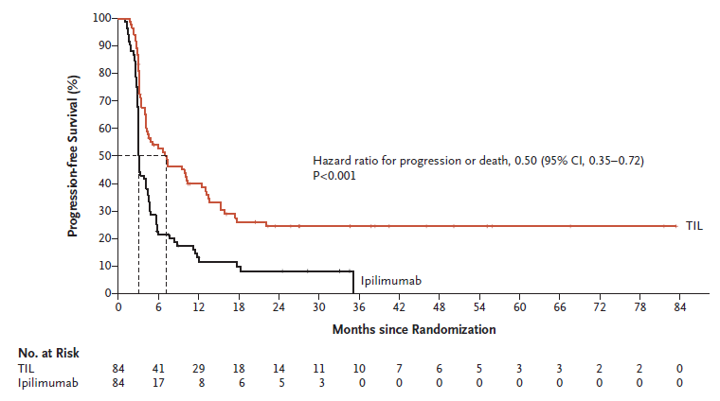
In-house manufactured ‘fresh’ polyclonal TIL therapy (randomised, phase III, NKI/Herlev)
TIL group:
ORR 49%
Median OS 25.8 months
1 prior line (excl. ipi.)
Baseline LDH ≤ 2xULN
Rohaan et al. N Engl J Med 2022

Slide 26
Efficacy and safety of lifileucel, an autologous tumor-infiltrating lymphocyte cell therapy, and pembrolizumab in patients with immune checkpoint inhibitor-naive unresectable or metastatic melanoma: updated results from IOV-COM-202 Cohort 1A
2024 ASCO Annual Meeting
May 31–June 4, 2024 | Chicago, IL, USA
Sajeve Thomas,¹ Helen Gogas,² Young Ki Hong,³ Gino K. In,⁴ Bernard Doger de Speville Uribe,⁵ Andrew J.S. Furness,⁶ Almudena Garcia Castano,⁷ Simon Häfliger,⁸ Kai He,⁹ Theresa Medina,¹⁰ Donald Lawrence,¹¹ Sylvia Lee,¹² Juan Martin-Liberal,¹³ Friedrich Graf Finckenstein,¹⁴ Brian Gastman,¹⁴ Jeffrey Chou,¹⁴ Rana Fiaz,¹⁴ Melissa Catlett,¹⁴ Guang Chen,¹⁴ Patrick Terheyden¹⁵
¹Orlando Health Cancer Institute, Orlando, FL, USA; ²Laiko General Hospital, School of Medicine, National and Kapodistrian University of Athens, Athens, Greece; ³Cooper University Hospital, Camden, NJ, USA; ⁴University of Southern California, Norris Comprehensive Cancer Center, Los Angeles, CA, USA; ⁵START Madrid Fundación Jiménez Díaz, Madrid, Spain; ⁶The Royal Marsden NHS Foundation Trust, London, UK; ⁷Hospital Universitario Marqués de Valdecilla, Santander, Spain; ⁸Inselspital, Bern University Hospital, Bern, Switzerland; ⁹James Cancer Center, The Ohio State University, Columbus, OH, USA; ¹⁰University of Colorado Cancer Center – Anschutz Medical Campus, Aurora, CO, USA; ¹¹Massachusetts General Hospital Cancer Center, Boston, MA, USA; ¹²Fred Hutchinson Cancer Center, Seattle, WA, USA; ¹³ICO L’Hospitalet – Hospital Duran i Reynals, Barcelona, Spain; ¹⁴Iovance Biotherapeutics, Inc., San Carlos, CA, USA; ¹⁵University of Lübeck, Lübeck, Germany
Notes:
Speaker Notes
Thanks to ASCO for inviting me to present, and to the session moderators, Drs Eroglu and Johnson, and the discussant, Dr Chandra
On behalf of my colleagues, I have the honor to present results from IOV-COM-202 cohort 1A of lifileucel and pembrolizumab in patients with immune checkpoint inhibitor-naive unresectable or metastatic melanoma

Slide 27
IOV-COM-202: Phase 2, Multicohort, Multicenter Study of Lifileucel + Pembrolizumab in Patients With Solid Tumors
Cohort 1A of IOV-COM-202 (NCT03645928) assesses the efficacy and safety of lifileucel + pembrolizumab in patients with ICI-naive unresectable or metastatic melanoma
Patients may have received BRAF/MEK inhibitor treatment if they are BRAF mutation positive
Eligible patients must have ≥1 resectable lesion (≥1.5-cm diameter) and ≥1 measurable lesion for response assessment per RECIST v1.1
Trial designed as a proof-of-concept study to support a registrational study in the frontline treatment setting
Treatment Schema
GMP Manufacturing
Enrollment/ Surgical Resection | Pembroª 1st dose | NMA-LD Day −7 to −6: CY Day −5 to −1: FLU | Lifileucel Infusion 1 dose Day 0 | IL-2 ≤6 doses Day 0 or 1 to Day 3 or 4 | Pembro Q3W or Q6Wª | Efficacy Follow-up
ªFirst administration of single-dose pembrolizumab IV 200 mg or 400 mg, followed by pembrolizumab IV 200 mg Q3W or 400 mg Q6W for 24 months or until disease progression or unacceptable toxicity.
CY, cyclophosphamide; EOA, end of assessment; FLU, fludarabine; GMP, Good Manufacturing Practice; ICI, immune checkpoint inhibitor; IL-2, interleukin-2; NMA-LD, nonmyeloablative lymphodepletion; pembro, pembrolizumab; Q3W, every 3 weeks; Q6W, every 6 weeks; RECIST, Response Evaluation Criteria in Solid Tumors.
Notes:
Speaker Notes
Cohort 1A of IOV-COM-202 enrolled ICI-naive pts with advanced melanoma
After enrollment, patients underwent surgery to obtain tumor for generation of autologous TIL
Patients received pembrolizumab, lymphodepletion, one infusion of lifileucel, followed by IL-2 and continued pembro

Slide 28
Efficacy
ORR was 65.2%; CR rate was 30.4%
Best Percentage Change From Baseline in Target Lesion SOD
Investigator-Assessed Response (RECIST v1.1)
20
Best Overall Response
PD
SD
PR
uCR*
CR
 | N=23
ORR, n (%) (95% CI) | 15 (65.2) (42.7, 83.6)
CR | 7 (30.4)
PR | 8 (34.8)
SD | 6 (26.1)
PD | 1 (4.3)
NE | 1 (4.3)
0
–20
–40
% Change From Baseline
–60
–80
All response-evaluable patients demonstrated regression of target lesions
–100
*
*
N=22ª
The two uCRs have been confirmed post-data cut
1A-21
1A-09
1A-02
1A-08
1A-17
1A-01
1A-11
1A-16
1A-18
1A-14
1A-04
1A-19
1A-15
1A-13
1A-12
1A-23^{b}
1A-05
1A-03
1A-06
1A-07
1A-20
1A-22
Patients
ªOne patient without a postdose tumor response assessment was not included. ^{b}Target lesion lymph node at baseline decreased by 50% is no longer pathological, and thus is shown here as -100% representing uCR. CI, confidence interval; CR, complete response; NE, not evaluated; ORR, objective response rate; PD, progressive disease; PR, partial response; RECIST, Response Evaluation Criteria in Solid Tumors; SD, stable disease; SOD, sum of diameters; uCR, unconfirmed complete response.
Notes:
Speaker Notes
The response we observed was unprecedented in this population:
ORR 65%
CR 30%
All evaluable patients (22 of 23) had tumor shrinkage
Details regarding 5 patients with a >30% SOD decrease but BOR of SD or PD: 4 pts with SD had PD following a PR, and 1 patient had PD at Day 42 due to new lesions.
For Dr. Thomas Use:
(1A-02) (BOR SD): PR Day 42 then PD due to TL, NTL, new lesion Day 84
(1A-10) (BOR SD): PR Day 42 then PD due to TL Day 84
(1A-16) (BOR SD): PR Day 42 then PD due to new lesion Day 84
(1A-19) (BOR SD): SD Day 42, PR Day 84 then PD due to new lesion Day 126
(1A-13) (BOR PD): PD due to new lesion Day 42

Slide 29
Efficacy
Lifileucel + pembrolizumab demonstrated durable and deepening responses
Time to Response and Time of Efficacy Assessment for Confirmed Responders (PR or Better)
Duration of Response
 | Responders (N=15/23)
mDOR, months (95% CI) | Not reached (NR) (16.8, NR)
DOR, n (%)
≥6 months | 11 (73.3)
≥12 months | 8 (53.3)
1A-03*†
1A-05
1A-06*
1A-07
1A-12‡
1A-01§
1A-14
Patients
1A-15
Median follow-up was 21.7 months
mDOR was NR
Median time to initial response was 2.6 months
10 of 15 responders (66.7%) continue on study with ongoing response and 3 additional patients (20%) discontinued follow-up while in response
1A-17
1A-18
1A-11†
CR start
1A-20
PR start
1A-22
Ongoing on study
1A-04¶
Progression
1A-23
Pembrolizumab dosing
0
2
4
6
8
10
12
14
16
18
20
22
24
26
28
30
32
34
36
38
40
42
44
46
48
50
52
54
56
58
Time (months) Since Lifileucel Infusion
*CR start based on PET/CT showing no FDG uptake in all lesions and subsequently confirmed per RECIST 1.1. †Patient withdrew consent during assessment phase while still in response. ‡Discontinued from study while in response to continue pembrolizumab off-study. §Discontinued due to disease progression of new lesion. ¶Discontinued due to disease progression of non-target lesion.
CI, confidence interval; CR, complete response; DOR, duration of response; mDOR, median duration of response; (FDG) fluorodeoxyglucose; NR, not reached; PR, partial response.
Notes:
Speaker Notes
At almost 22 months of follow-up, median DOR was not reached
8 patients had DOR >12 months
The great majority of responders continue on study with ongoing response

Slide 30
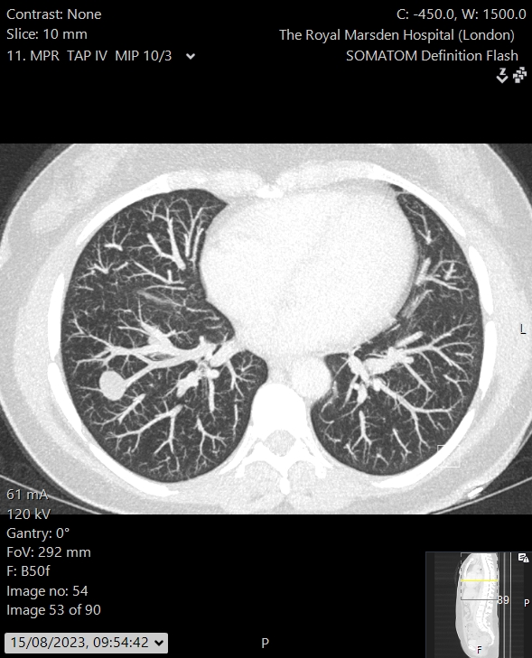
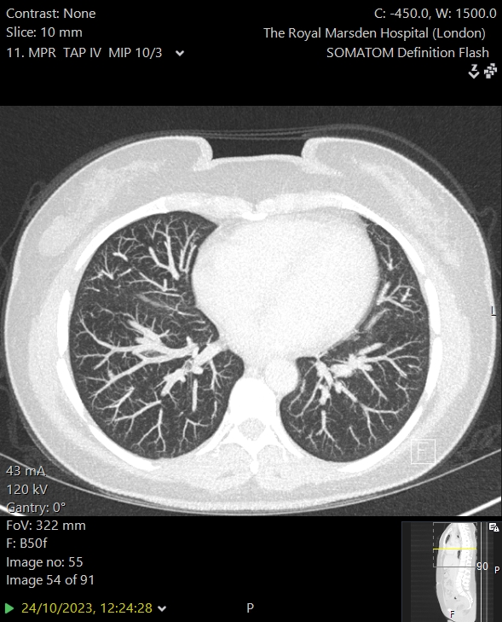
Baseline
Week 6
Images shared with informed patient consent
Notes:
Discuss all 3 patients.

Slide 31
TILVANCE-301 Global Phase 3 and Confirmatory Trial
Randomized, multicenter study with optional crossover to Iifileucel (NCT05727904)
Patient Population
Unresectable or metastatic melanoma; no prior therapy for metastatic disease
N=670
59 active sites in U.S., Europe, Australia, Canada
>50 additional sites committed
Study Design
Dual primary endpoints: ORR & PFS
Interim analysis on ORR
Final analysis on PFS
Registrational for frontline melanoma
Confirmatory for full approval of lifileucel in post-anti-PD-1 melanoma in the US
Arm A: lifileucel plus pembrolizumab*
Long-term follow up
1:1 Randomization
Arm B:
pembrolizumab alone*
Option to crossover to lifileucel after BIRC-confirmed PD
*Pembrolizumab in both arms is started at the same time after randomization.
BIRC=blinded independent review committee; ORR=objective response rate; PD=progressive disease; PD-1=programmed cell death protein-1; PFS=progression free survival
Notes:
We have seen promising data from a small cohort of patients in our IOV-COM-202 basket study suggesting that the response rate with lifileucel and pembrolizumab in ICI naïve melanoma patients may improve responses and complete response more than what might be expected with pembrolizumab alone. This is also consistent with prior observations from the NCI that suggested that responses to TIL were improved in patients who had received less prior treatment with ICI or BRAF/MEK inhibitors.
The TILVANCE-301 trial aims to compare lifileucel plus pembrolizumab versus pembrolizumab alone in patients with previously untreated unresectable or metastatic melanoma. This is a global study across numerous countries and regions.
Patients who are randomized to the pembrolizumab arm have the option to cross over to receive lifileucel. There are dual primary endpoints of objective response rate and progression free survival. If successful, this study would not only be registrational for frontline melanoma but be confirmatory for full approval of lifileucel for melanoma in the post-anti-PD1 setting.

Slide 32
Methods of adoptive cellular therapy
June, Riddell & Schumacher Sci Transl Med 2015
Notes:
OPTIMISE HOST-PRODUCT-ACTIVITY POST TRANSFER

Slide 33
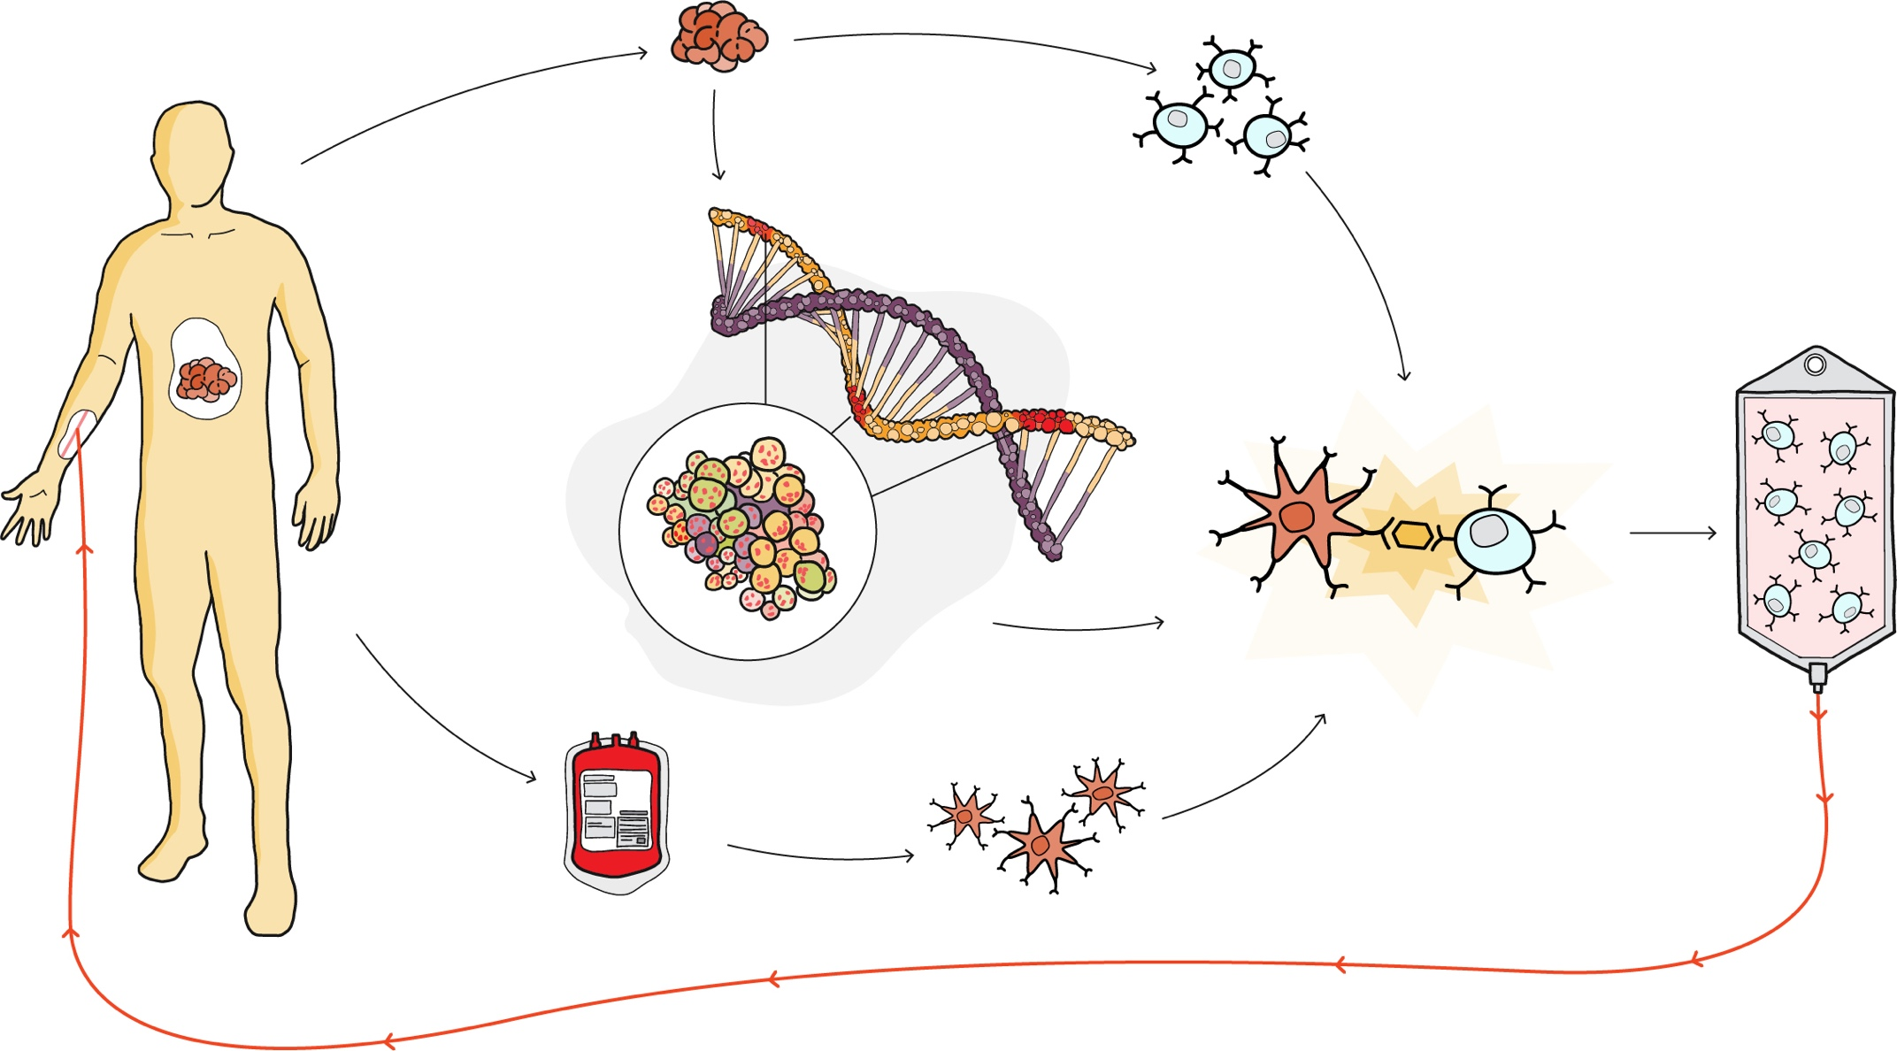
Precision TIL therapy targeting clonal neoantigens
TUMOR
T cells
Clonal Neoantigen T cell (cNeT) product
Genomic analysis identifies targets present on all tumor cells
Selective expansion of just T cells which target clonal neoantigens
Reinfuse
Expansion of T cells under more natural physiological conditions
BLOOD
Dendritic Cells
Cartoon courtesy of Achilles Therapeutics

Slide 34
Achilles Therapeutics - 0ngoing phase I/IIa studies
Advanced non-small cell lung cancer (Stage III-Stage IV)
Open-label
Recurrent or metastatic malignant melanoma
Open-label
CHIRON
THETIS
40 patients with advanced unresectable or metastatic NSCLC
Never-smokers and EGFR/ALK/Ros-1 mutations excluded
cNeT monotherapy
Evaluating safety, tolerability and activity (RECIST)
Ongoing at 6 UK sites, plan to expand up to a further 5 US sites and up to 8 EU sites in 2021
50 patients with metastatic or recurrent melanoma (including CPI combo cohort)
Acral, uveal and mucosal melanoma excluded
cNeT monotherapy and combination with PD-1
Evaluating safety, tolerability and activity (RECIST)
Ongoing at 3 UK sites, trial applications in the EU planned for 2021
IND submitted in 2020 to enable expansion to US sites in 2022

Slide 35
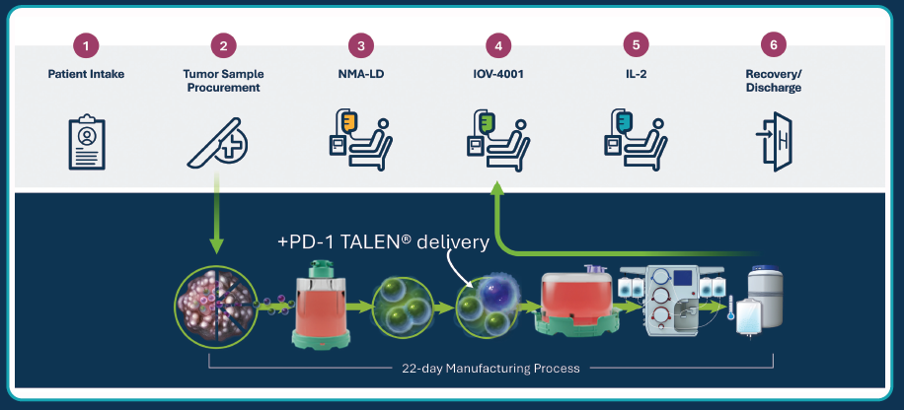
PD-1 receptor knock-out (KO) TIL therapy (IOV-4001)
Slide courtesy of Dr Allison Betof Warner and Iovance Biotherapeutics
Andrew J.S. Furness

Slide 36
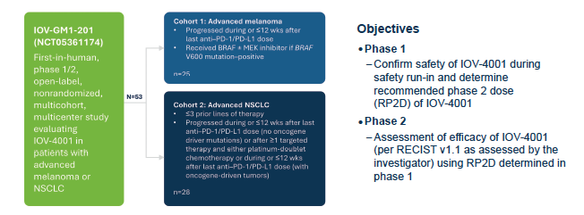
IOV-GM1-201 study of PD-1 KO TIL therapy in NSCLC and advanced melanoma (NCT05361174)
Slide courtesy of Dr Allison Betof Warner and Iovance Biotherapeutics
Andrew J.S. Furness

Slide 37
IL-15-engineered TIL therapy (cytoTIL15, OBX-115)
Slide courtesy of Allison Betof Warner and Obsidian Therapeutics
Andrew J.S. Furness

Slide 38
First-in-class IL-15-engineered TIL therapy (cytoTIL15, OBX-115)
Slide courtesy of Allison Betof Warner and ObsidianTherapeutics
Andrew J.S. Furness

Slide 39
Reflections on progress to date
Tip of the iceberg for TIL therapy but perhaps still only relevant to a subset of solid tumours?
It’s tough-going/not for all - careful patient selection required; supported by planned National MDT
Attractive to use earlier (also based on U.S. RWD) - patient selection challenging in absence of biomarkers of response/resistance to both TIL therapy and immune checkpoint inhibitors
Room for optimisation of ‘conditioning’ including focus on systemic ‘immune fitness’
Long-term sequelae/survivorship issues
MHRA decision expected ‘early’ 2026

Slide 40
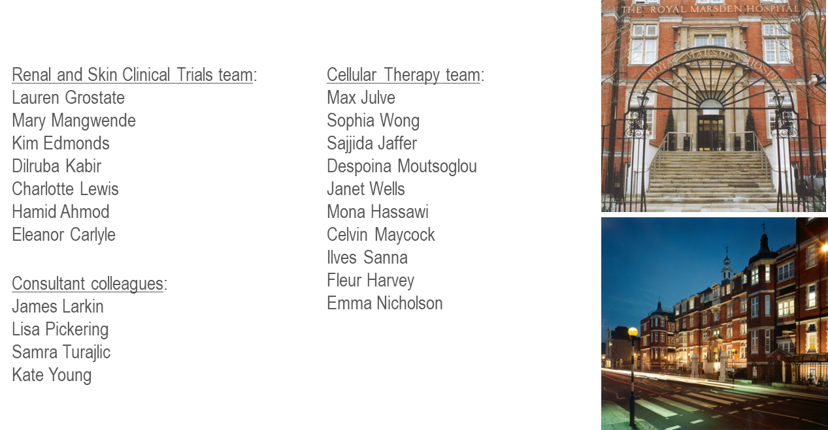
Team Cell Therapy
Wiltshaw ward: Kieron French (Charge Nurse)
Patricia Oliviera (Sister)
Research Nurses:
Lauren Grostate
Mary Mangwende
Kim Edmonds
Clinical Research Fellow: Dr Max Julve
Dr Jenny Thomas
Cell Therapy Clinical Nurse Specialists:
Celvin Maycock
Rose Ellard
Trial Co-Ordinators/Managers:
Dilruba Kabir
Hamid Ahmod
Charlotte Lewis
Clinical Research Operations Managers:
Sajjida Jaffer
Ellie Carlisle
Apheresis Unit: Crischi Magsipoc
Francesca Zamperetti
Cell Therapy Lab:
Janet Wells
Mona Hassawi
Despoina Motsoglou
Helen MacDonald
Critical Care Unit: Dr Sham Jhanji
Dr Vimal Grover
Dr Pascale Gruber
Biomedical Research Centre:
Carmel Keyzor
Monica Ritco Vonsovici
Jane Lawrence
Consultant Colleagues: Dr Emma Nicholson
Prof. James Larkin
Prof. Samra Turajlic
Dr Lisa Pickering
Dr Kate Young
Associated groups:
Cell Therapy Steering Group
Cell Therapy Governance Group
Genetic Modification Safety Committee

