Slide 1


TYA Cancer Care in the
South West
Claire Harrison, Claire Burney
TCT Lead Teenage and Young Adult Cancer Nurse CYTA ODN, Consultant Haematology BHOC

Slide 2
TYA Cancer: Treatment Considerations
Biology
Age and maturity
Transition from paediatrics to adult care
Adherence
Mental Health, neurodiversity and LD
Future fertility
Late effects

Slide 3
Cancer in Teenagers and Young Adults
Pathologically, not a ‘speciality’ in its own right - diagnoses are evolving from ‘typically’ paediatric to ‘typically’ adult
Unique support needs - clinical and psychological
Not just ‘big’ children or ‘small’ adults
Model of care continues to evolve to meet needs

Slide 4

Dr Rachel Dommett - Clinical Director
Claire Harrison - TCT Lead TYA Cancer Nurse
Helen Morris - Children's Lead Nurse
Amanda Saunders - CTYA ODN Manager
Stef Craig - Network Support Manager

Slide 5
TYA patients across SW TYA Network
109
New patients April 24-25
New patients by referring hospital
Age at diagnosis

Slide 6
Cancer Type

Slide 7
NHSE TYA Service Specifications
May 2023
Teenage and young adult cancer services – principal treatment centre
Teenage and young adult cancer services – designated hospital
Teenage and young adult cancer services – network specification
NHS commissioning » Children and young people’s cancer service portfolio (england.nhs.uk)

Slide 8
TYA Cancer Priorities and Aims
Improve experience of care, to improve outcomes
Develop and implement integrated and timely joint care across the network, simplifying pathways and transitions between services
Improve transition
Ensure every patient has access to specialist expertise
Provide appropriate support
Increase participation in clinical trials
Increase participation in tumour banking
Embed genomic medicine within TYA cancer services

Slide 9
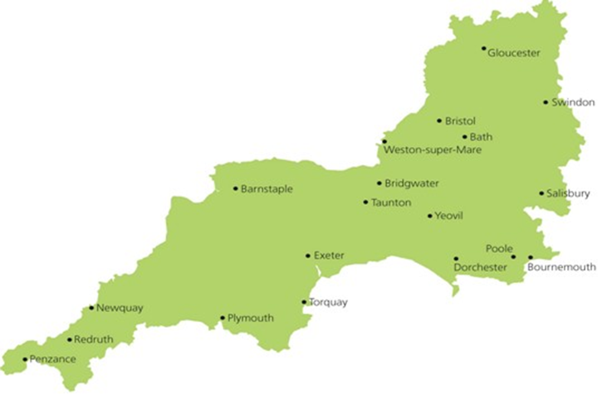


TYA Services in the South West
Bristol
Jax Hulbert
Clare Lewis-Norman
James Dean
Liz Allison
YSC Charlie Wadman
TYA PTC
UHBW & NBT
Cheltenham + Gloucester
Meg Wilsher
11 TYA CNS’ + 1 YSC
PTC
Taunton
Rules Coles
Bath
Jax Hulbert
Claire Lewis-Norman
James Dean
YSC Charlie Wadman
Truro
Nicola Clapson
Exeter
Lorraine Beddard Sophie Poulton
6 Designated Hospitals
Plymouth
Hannah Heayn
Lucy Figg

Slide 10
NHSE Service Specification
Model of Care Requirements
16-18 years
Each teenager with a suspected diagnosis of cancer must be referred to the TYA PTC for diagnosis and agreement of a treatment plan
The TYA PTC will also deliver most of the care and will co-ordinate referral to supra-network services and local specialist cancer services for specific treatments not provided by the TYA PTC

Slide 11
TYA Services in the South West 16-18 yo
Bristol
16+ Adults
TYA PTC
UHBW & NBT
Cheltenham + Gloucester
16-18 Paeds
Taunton
16-18 yo paeds
PTC
Bath
16-18 paeds
Truro
16-18 yo paeds
Exeter
16-18 yo paeds
6 Designated Hospitals
Plymouth

Slide 12
NHSE Service Specification
Model of Care Requirements
19-24 years
Each young adult must be referred to either a TYA PTC or TYA DH for diagnosis and agreement of a treatment plan, having been offered a choice of the two
The choice must be documented in the TYA MDaT referral proforma
The relevant service will also deliver most of the care and will co-ordinate referral to supra-network services and local specialist services for specific treatments not available within the service

Slide 13
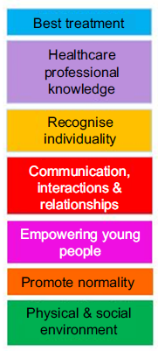
Age Appropriate
Care
Access to expertise​
Access to peers​
Culture & Facilities

Slide 14
TYA South West Model of Care
Most 16 – 17 year olds are treated at the TYA PTC with or without shared/joint care, in age appropriate facilities throughout the region
All 18 – 24 should be offered choice of treatment at a TYA PTC, or remain in a TYA Designated Hospital (DH)
Mandatory referral to TYA SW MDaT (Multi Disciplinary Advisory Team)
Financial implications – travel and accommodation
Access to clinical trials limited
Transition

Slide 15
TYA Referral Process
Transfer care to BHOC, UHBW
New diagnosis aged 16-24
Remain locally
Place of care determined
Joint Care
Service offer leaflet
Mandatory referral to
TYA MDaT
Young person declines support
CNS team invited to
MDaT discussion
TYA team will contact CNS team to confirm consent to contact
TYA team offer of support

Slide 16
NHSE Service Specification
TYA MDaT
Each teenager and young adult, irrespective of where treatment is delivered, must be discussed in the TYA multi-disciplinary advisory team (MDaT) meeting which is hosted by the TYA PTC
The purpose of the TYA MDaT is to
  review the treatment plan made by the site-specific MDTs
  ensure that each person:
(i) is offered the choice of participating in appropriate clinical trials
(ii) has their holistic needs identified and met

Slide 17
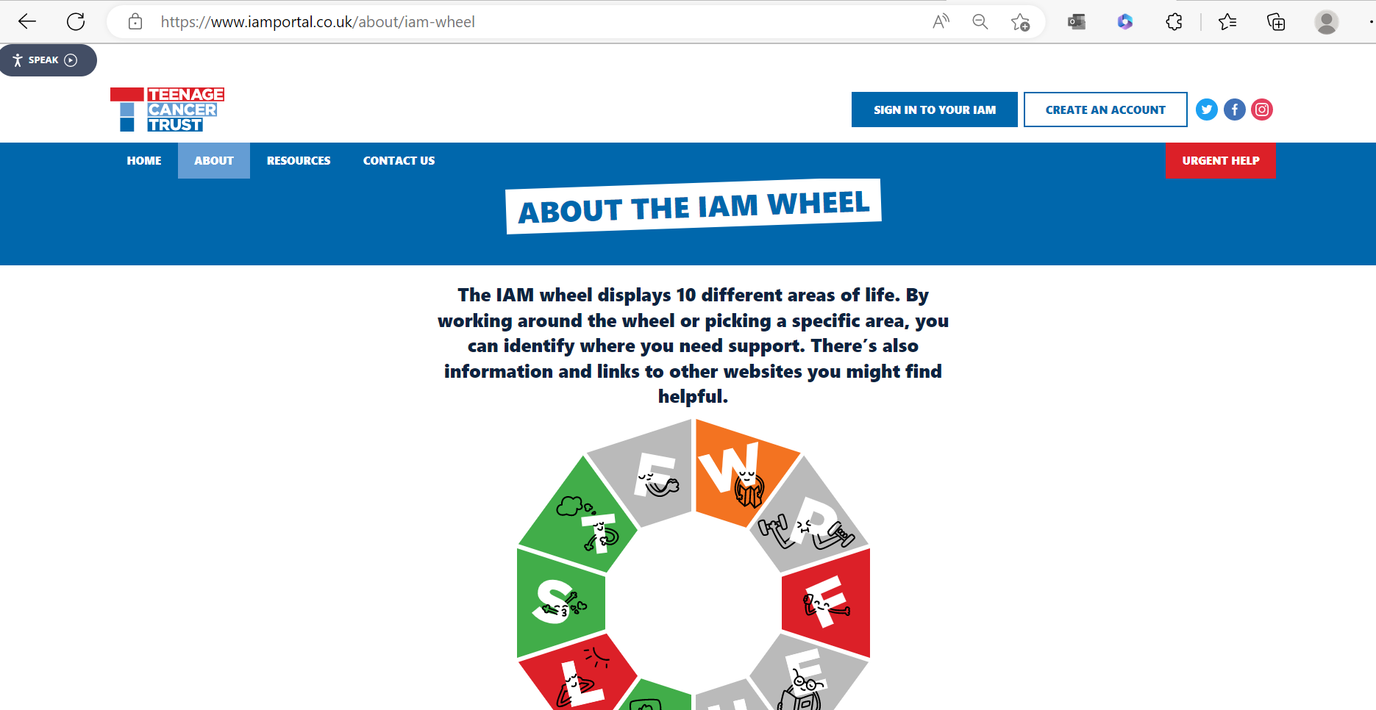
IAM eHNA Assessment Tool
www.iamportal.co.uk

Slide 18
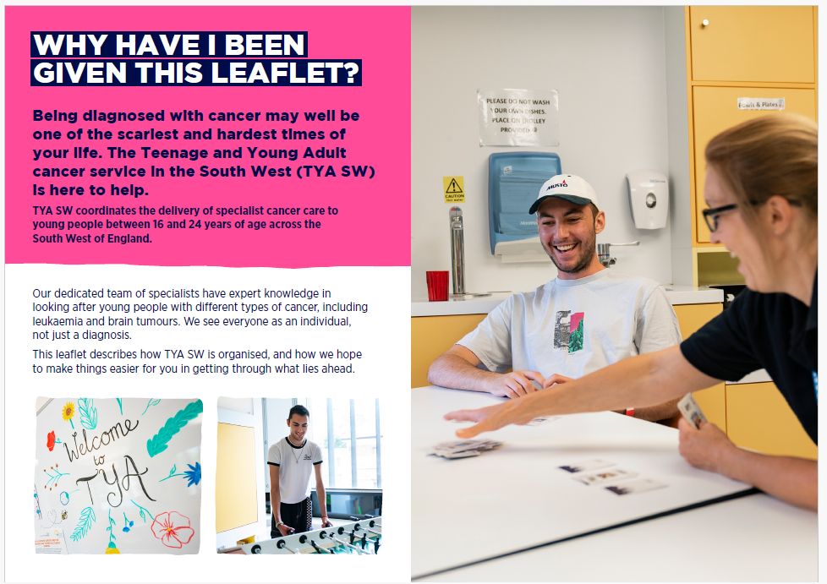

Southwest TYA Cancer Service Leaflet

Slide 19
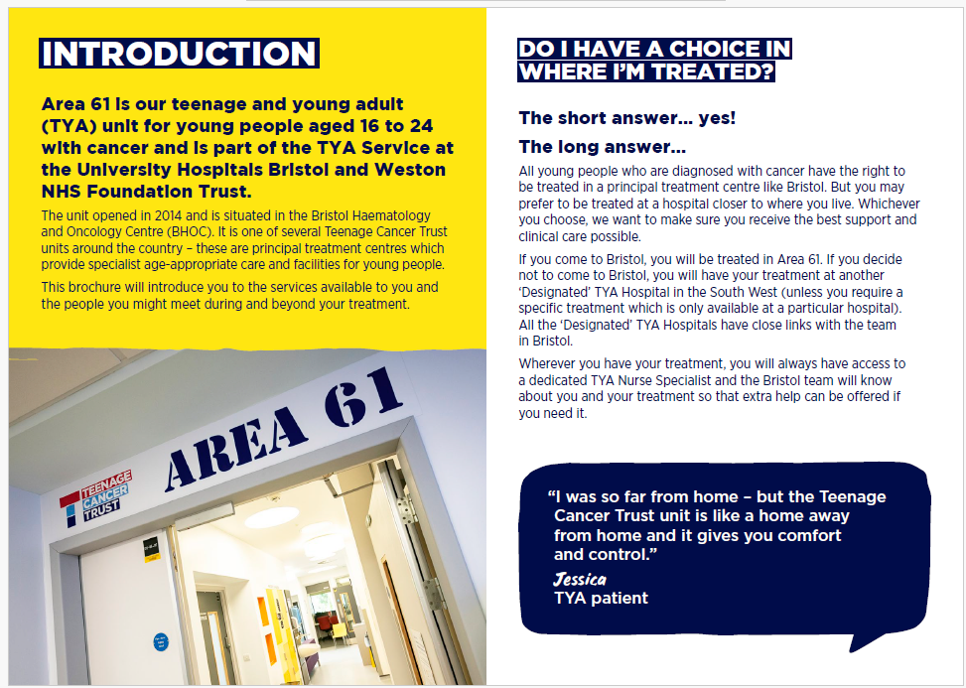

Area 61 TYA Unit Leaflet

Slide 20
Teenage Cancer trust
TYA Unit Video Tour
https://vimeo.com/891071038/7cc887597f?share=copy

Slide 21
Any questions?
How are the pathways working for your teams and any areas for improvement across the region?
Any other TYA support that would be helpful?

