Slide 1


National Cancer Patient Experience Survey Results (2024)
Southwest Academic Gynae-Oncology Group for education (SWAGGER) SWAG Business Meeting
Friday 28th November 2024

Slide 2
NCPES Introduction
Annual survey, commissioned & managed by NHS England (since 2010)
  new design for 2021, therefore break in series data
  2021 / 2022 / 2023/2024 year on year comparison
Picker - responsible for designing, running & analysing the survey
Designed to:
Monitor progress in cancer care
Provide information to drive local quality improvements
Assist commissioners and providers of cancer care
Inform the work various charities and stakeholder groups, supporting cancer patients

Slide 3
NCPES Methodology
Provider survey samples
  Adults (16 and over), with a confirmed diagnosis of cancer
  Discharged from NHS Trust (after an inpatient or day-case attendance for cancer related treatment) in April, May and June 2024.
Survey fieldwork Oct. 2024 – Feb. 2025
Reports published July 2025 (National, Alliance, Trust).

Slide 4
Cancer Alliance report
Report reflects experience of people referred from within CA footprint (not all those treated by that CA’s Providers)
‘referring’ CA report - based on patient home postcodes
According to ONS postcode mapping

Slide 5
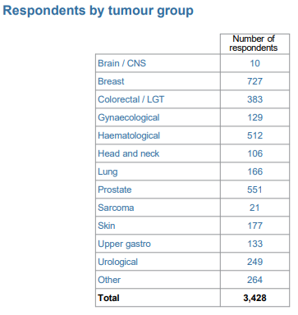
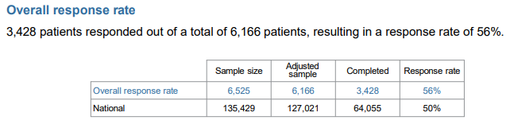
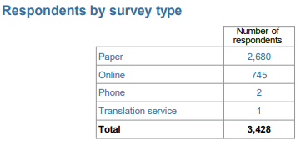
NCPES SWAG responses

Slide 6
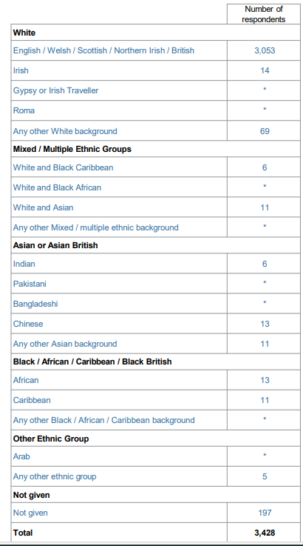

SWAG respondents by Ethnicity
91.4% (3136)
1.37% (54)
5.89% (202)

Slide 7
Gynaecology
Total SWAG Gynaecology responses:129
(people with a SWAG post-code, who responded to the survey)
2 - answers supressed, as responses were <10 (hormone therapy)
57 - a % score given as >10 respondents for that question

Slide 8
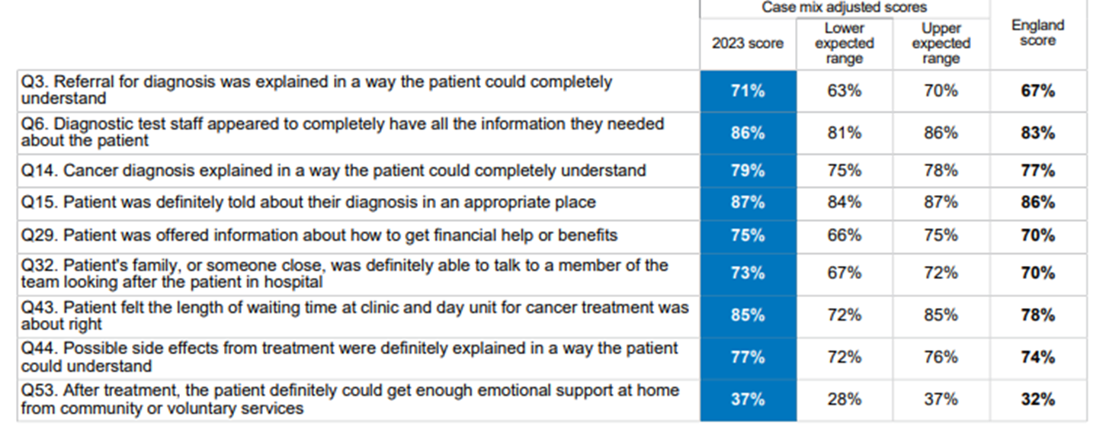
SWAG Summary
Q59 Overall patients average rating of care (0-10 scale) SWAG 2024 England Score SWAG 2023
9.0 8.9 9.0
9 SWAG scores above Expected Range (none below the expected range in 2023) – all remaining scores within expected range

Slide 9
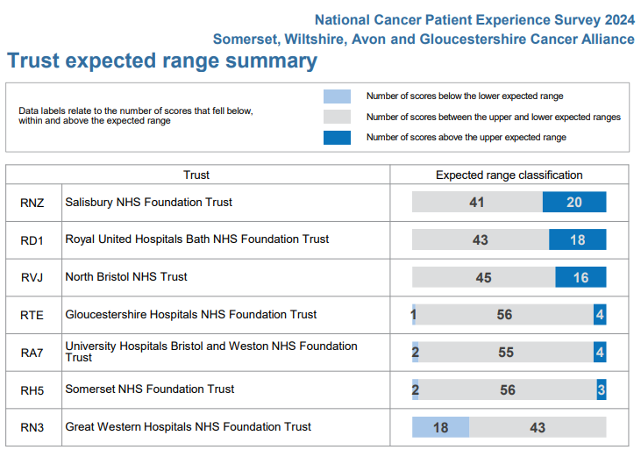
SWAG Trust Summary

Slide 10
Variations by tumour site
Comparison between tumour sites
  Some significant variation in scores (e.g. >30%)
  Significant variation in numbers of responses
  Caution in making these comparisons and interpreting results
NCPES discussion at SWAG Clinical Advisory Groups (CAGs) and local clinical teams / MDTs
Alliance, ICS and Trust level scrutiny and pathway planning

Slide 11
SWAG Gynaecology lowest scores ≤ 60%
 | Question | SWAG | England average
50 | During treatment, the patient definitely got enough care and support at home from community or voluntary services | 45 | 53
51 | Patient definitely received the right amount of support from their GP practice during treatment. | 49 | 48
52 | Patient has had a cancer care review by GP practice | 21 | 23
53 | After treatment, the patient could definitely get enough emotional support at home from community or voluntary services | 38 | 34
58 | Cancer research opportunities were discussed with patient | 57 | 46

Slide 12
SWAG Gynaecology highest scores ≥ 90%
 | Question | SWAG | England average
5 | Patient received all the information needed about the diagnostic test in advance | 94 | 93
9 | Enough privacy was always given to the patient when receiving diagnostic test results | 94 | 95
16 | Patient was told they could go back later for more information about their diagnosis | 92 | 85
17 | Patient has a main point of contact within the care team | 90 | 91
19 | Patient found the advice from the main person helpful or very useful | 95 | 96
20 | Treatment options were explained in a way the patient could completely understand | 92 | 83
25 | A member of the care team helped the patient create a care plan to address any needs or concerns | 96 | 94
26 | Care team reviewed the patients care plan with the to ensure it was up to date | 100 | 99
27 | Staff provided the patient with relevant information on available support | 95 | 92

Slide 13
SWAG Gynaecology highest scores ≥ 90%
 | Question | SWAG | England Average
41 | Beforehand patient always had enough understandable information about immunotherapy | 93 | 84
42 | Patient completely had enough understandable information about their response to immunotherapy | 93 | 81
46 | Patient was given information they could access about support in dealing with immediate side effects of treatment | 90 | 88
56 | The whole care team worked well together | 94 | 90
57 | Administration of care was very good or good | 91 | 88
59 | Patients average rating of care scored from very poor to very good | 9.1 | 8.9

Slide 14
Patient comments
Patients were asked
  Please tell us what you found to be positive about your experience of cancer care?
  Please tell us how your experience of cancer care could have been better?
‘Patient comment’ feedback and analysis has been presented by topic, themes and sentiment
Patient comments are available in Trust level reports only.

Slide 15
Clinical Advisory Group - Next Steps
Discuss and agree SWAG Gynaecology patient experience improvement priorities, including areas of lowest scores Next steps / timeline
  Nominated lead
Recognition of areas of good practice
Consider / plan additional in-year skin-specific patient experience activity to gain further insight

