Slide 1

One stop myeloma diagnosis pathway at the RUH:
Presentation of initial audit and patient feedback.
Dr Angie Habgood (Haematology SpR) & Dr Sarah Mitchard (Haematology SHO)
Dr Jo Crowe (Haematology Consultant)

Slide 2

RUH myeloma standard clinic pathway
Referral
Triage
Clinic
BMAT
+/- PET CT
Treatment/
Active monitoring
+/- PET CT
Clinic
MDT*
6 steps from referral to treatment/active monitoring
Each step in the pathway has a waiting time
* Depending on clinical urgency, MDT may happen in conjunction with clinic and commencement of treatment

Slide 3

RUH myeloma one stop pathway
Clinic, PET CT and BMAT on same day
Treatment/Active monitoring
Referral
Triage
MDT*
Clinic
4 steps from referral to treatment/active monitoring
All investigations take place on the day of first clinic assessment
* Depending on clinical urgency, MDT may happen in conjunction with clinic and commencement of treatment

Slide 4
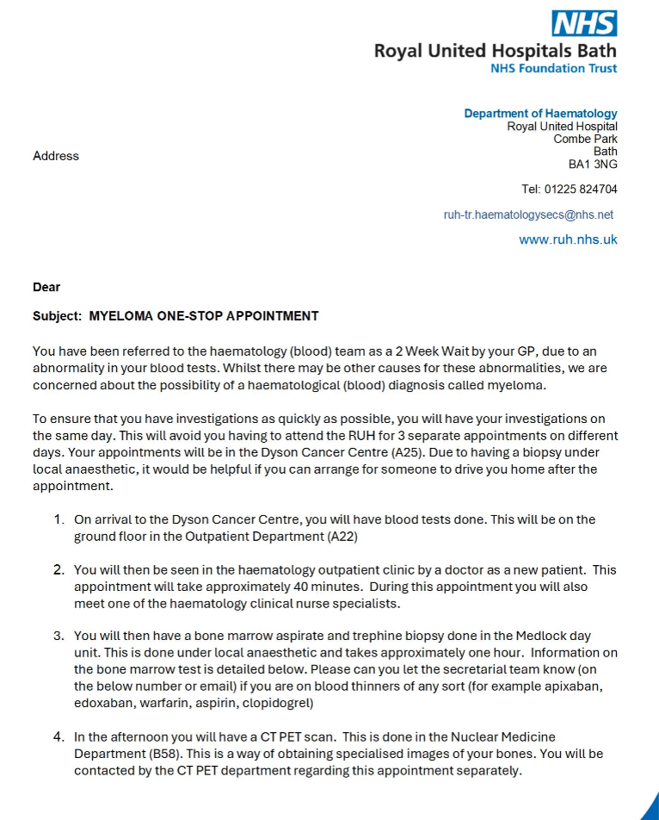
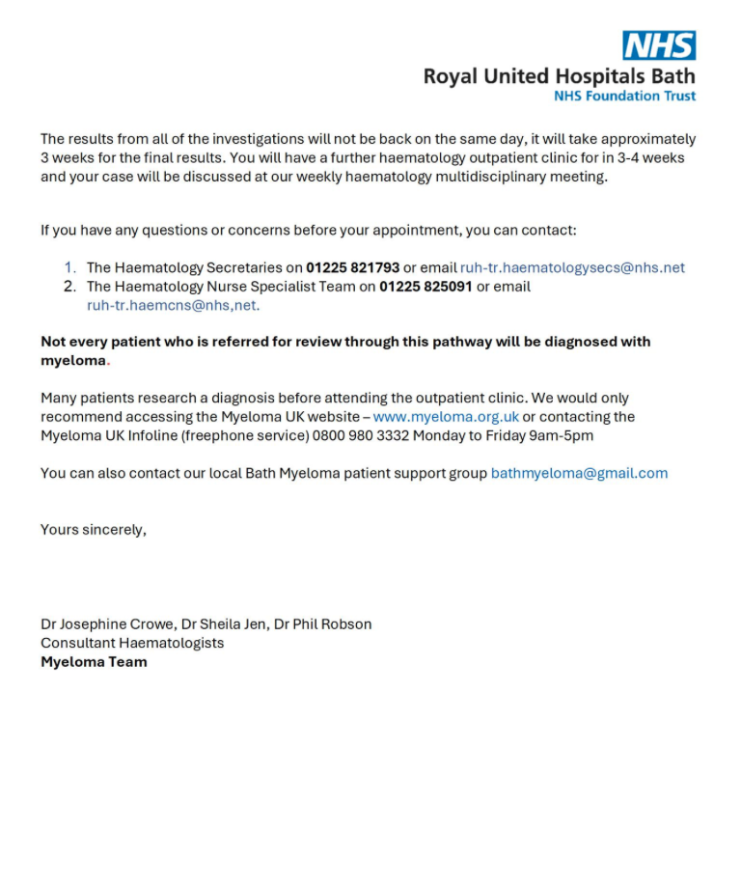
Patient appointment letter
Copies available to view

Slide 5
Audit of data:
Standard vs one stop pathway
Are we achieving our aims?
Data collection from standard and ‘one stop’ pathway with a focus on :
Time from triage to bone marrow aspirate and trephine (BMAT) procedure
Time from triage to PET CT scan
Time from triage to patient receiving diagnosis
Time from triage to day one of treatment/active monitoring if applicable (i.e. multiple myeloma confirmed)
We also took the opportunity to look at other data for future improvement work eg:
Time from BMAT to report authorised
To check whether important cytogenetic information from the BMAT was sufficient to risk stratify patients and guide prognosis and treatment

Slide 6
Analysis of pathway time points:
Standard 2WW Pathway (results in days)
 | Average | Median
Triage to clinic | 10.1 | 6.0
Triage to BMAT | 36.1 | 23.0
Time from BMAT to report | 12.1 | 12.0
Triage to PET-CT | 43.1 | 32.0
Triage to diagnosis | 64.2 | 61.0
Referral to treatment/active monitoring | 76.5 | 68.5
One Stop Pathway (results in days)
 | Average | Median | Median
Triage to clinic | 10.6 | 12.5 | 12.5
Triage to BMAT | 11.6 | 13.5 | 13.5
Time from BMAT to report | 18.6 | 17 | 17
Triage to PET-CT | 10.8 | 11 | 11
Triage to diagnosis | 34.6 |  | 36.0
Referral to treatment /active monitoring | 38 | 48 | 48

Slide 7
Myeloma one stop clinic significantly reduced the time from triage to BMAT and PET CT*
*Two patients in One Stop pathway did not have PET-CT (therefore mean values not identical)

Slide 8
Myeloma one stop clinic reduced the time from triage to patients being told their diagnosis.

Slide 9
Myeloma one stop clinic therefore reduced the overall time from referral to treatment/active monitoring

Slide 10
There are delays from BMAT procedure to authorised report* in both pathways
*Trephine biopsies are not reported at RUH (outsourced)

Slide 11
Patient experience:
Patient feedback questionnaire
Are we achieving our aims?
We worked with our Patient Experience team to try to get feedback from patients on their treatment pathway.
Questionnaire for patients attending clinic during June – Aug 2025
Targeted those who were included in audit (identified via hospital number)
Included standard and one-stop pathway patients
Asked about their experience of appointments and diagnosis
Also took the opportunity to get feedback on other cancer survey measures
Total of 28 questionnaires distributed

Slide 12
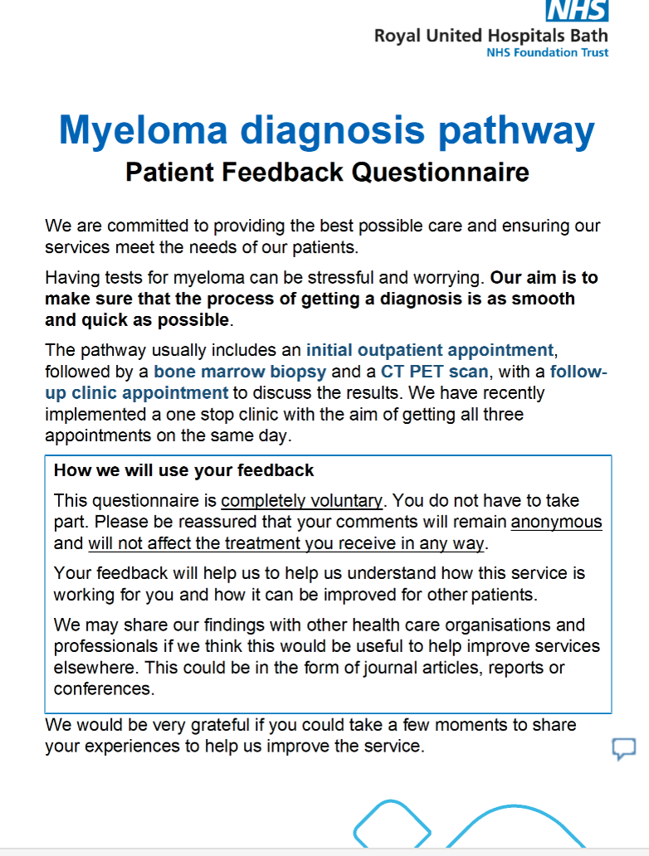
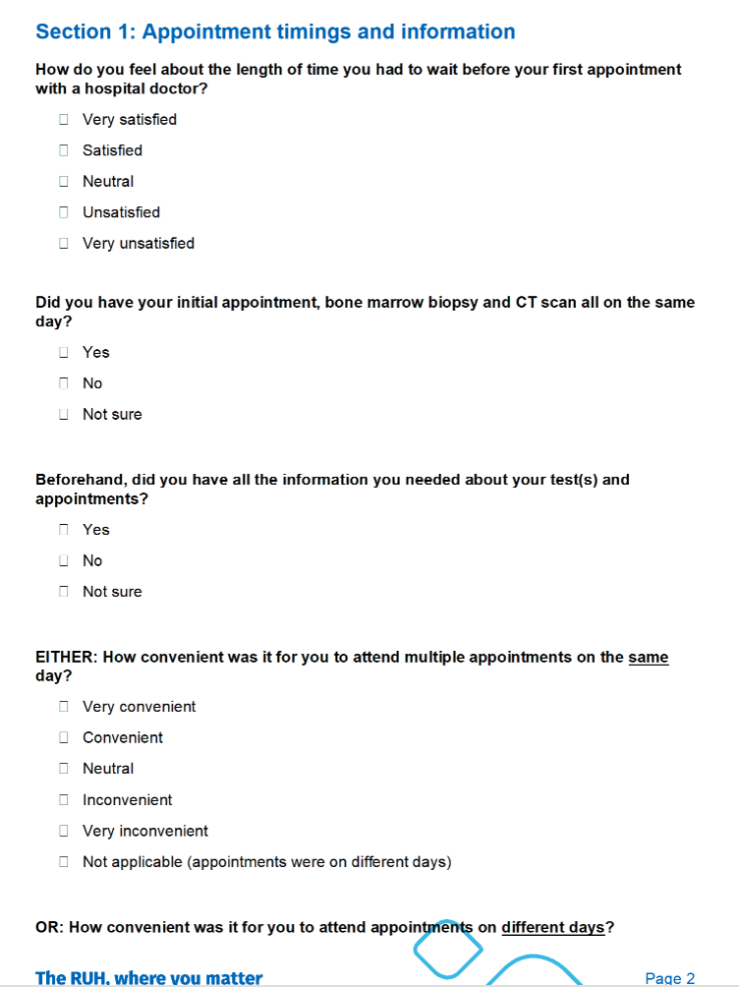
Patient feedback questionnaire
Copies of full questionnaire available to view

Slide 13
Patient feedback questionnaire
Patients identified from original data set
Any patient who had F2F appointment in June/Jul/Aug 2025
Given out by reception staff
Anonymous (tear off front sheet – no patient identifiers)
No clinician involvement
Limitations:
Reasonable response rate but still small number of replies
Those who were part of standard pathway had their diagnosis many months previously (patients were in different stages of their myeloma monitoring/treatment)
Summary of patient feedback questionnaire
Number of questionnaires distributed | 28 |  | Number of standard pathway responses | 8
Number returned | 12 |  | Number of one stop pathway responses | 4
Response rate | 43%

Slide 14
Patients were generally reassured by the timing of their appointments

Slide 15
Patients would generally prefer to have all appointments on one day

Slide 16
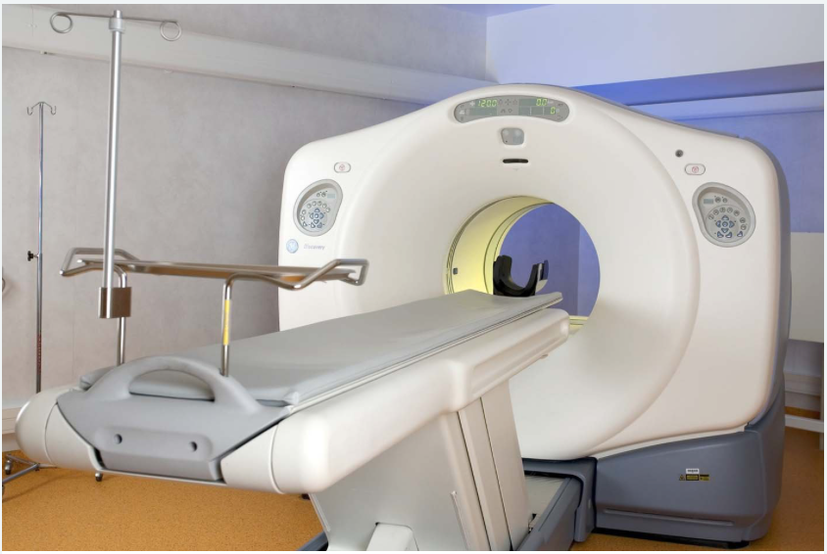
We also asked whether they had all the information they needed about their tests and appointments:
Standard pathway
One-stop pathway

Slide 17
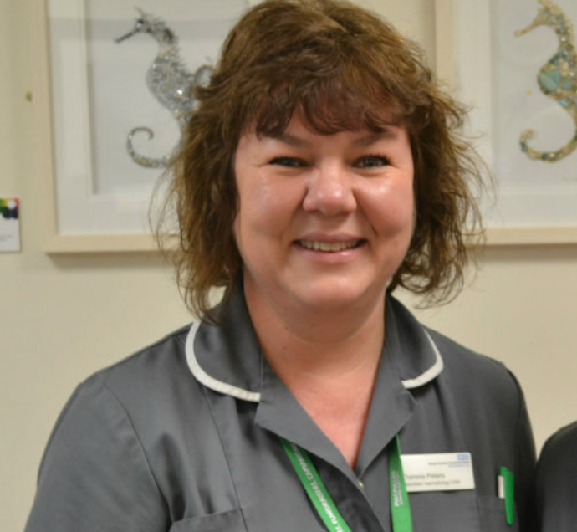
And whether they met one of our CNS nurses:
Standard pathway
One-stop pathway

Slide 18
Key findings and plans for further improvement
The main aims of the one stop myeloma pathway are being met:
Significantly reduces time from triage to BMAT and PET CT
Reduces time from triage to day one of treatment/active monitoring
Patients are generally reassured to have all appointments in one day and most would prefer this
There are still improvements to make with our service overall (both pathways):
Triaging – plan to introduce new SOP and make use of iStopMM tool
Reporting times on bone marrow trephines
Cytogenetic information
Communication and information to patients
Could we improve 2WW referral pathway by having additional BMAT on same day (without the PET-CT)?

