Slide 1


Study proposal: A Retrospective Review to Identify Clinical and Sub-clinical Prognostic Markers of ICI-Myocarditis
Dr Jessica Ball, ACF medical oncology, BHOC
Dr Francesca Bartoli-Leonard, Post-doc, UoB
jessica.ball@uhbw.nhs.uk

Slide 2
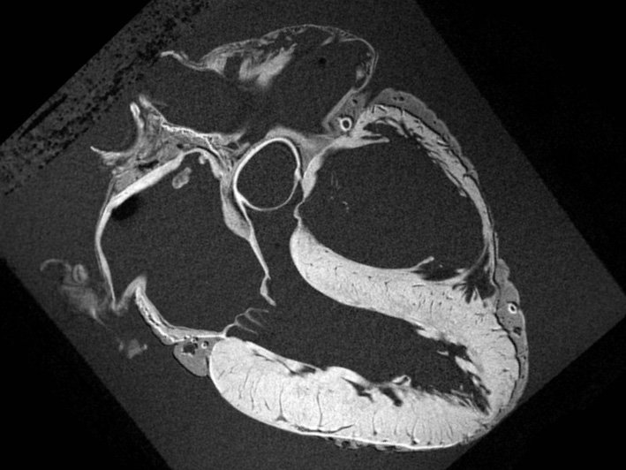

Aims:
A Retrospective Review to Identify Clinical and Sub-clinical Prognostic Markers of ICI-Myocarditis
To identify clinical and sub-clinical prognostic markers of ICI-Myocarditis
Descriptive comparison of cMRI findings in ICI-M vs. viral myocarditis where current diagnostic criterion may exclude potential ICI-M patients
Identify novel prognostic markers for ICI-M using cMRI and biochemical markers in our real-world cohort
jessica.ball@uhbw.nhs.uk

Slide 3
A Retrospective Review to Identify Clinical and Sub-clinical Prognostic Markers of ICI-Myocarditis
Questions, comments, suggestions?
Would your centre like to be involved?
Please get in touch
jessica.ball@uhbw.nhs.uk
Notes:
Already overwhelmed y the support that we are getting and willingness to collaborate on this.

