Slide 1
SWAG High Grade Lymphoma Audit 2024 –
Initial results from Gloucester
Will Hann, Arya Balraj, Rory McCulloch
Notes:
Into to self and project
Lisa Lowry, Trudy Gale

Slide 2
Aims of the audit
Audit adherence to 31 and 62 day targets
Identify [recurrent and fixable] causes of delays
Possible sources of delays:
  Biopsies
    Delay getting initial biopsy
    Reporting delays
    Insufficient/repeated biopsies (eg, core then excision biopsy)
  Imaging (and reporting)
  Clinic capacity
Notes:
Want to identify delays in repeatable and actionable pathways

Slide 3
Methodology
Inclusion
  Aged >18
  All sources of referrals
  Newly diagnosed with High Grade NHL (ICD-10 coded) in 2024
Exclusion criteria
  Diagnosis and treatment took place outside of NHS
  Diagnosis occurred before auditing period

Slide 4
Case finding
26 patients with relevant ICD-10 codes between Jan and Apr 2024
  8 low grade
  2 treated in other trusts
  Leaving 16 high grade lymphomas
Histological diagnoses
  9 x DLBCL
  3 x Burkitt’s
  2 x HG BCL NOS
  1 x Angioimmunoblastic T cell lymphoma
  1 x Peripheral T cell lymphoma NEC
Notes:
Fewer cases than expected ?quiet after Christmas

Slide 5
Cancer Pathway Targets
16 high grade lymphomas
  3 palliated
  2 treated surgically
  11 treated with chemotherapy
73% adherence to 62 day target
    3 missed 62 day target (referral -> treatment)
      Orchidectomy, then needed ENT biopsy after PET scan
      Breast lump, then needed colonoscopy after PET scan to exclude 2nd cancer
      Neck lump FNA non-diagnostic, then needed excision biopsy
91% adherence to 31 day target
Notes:
Orchidectomy 102 days and missed 31 day target
Breast lump 82 days
Neck lump 91 days

Slide 6
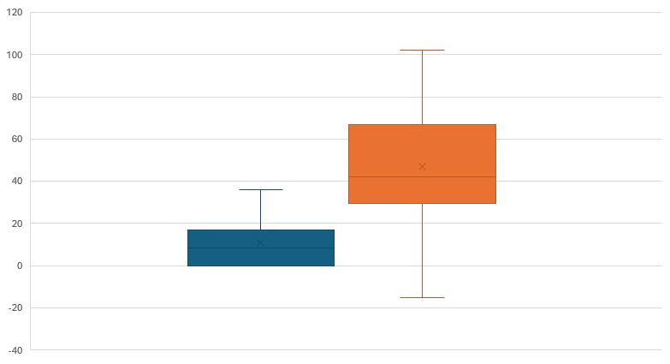
Cancer waiting times targets
Days
DTT -> treatment
Referral -> treatment
Notes:
Apologies for axes
IQR for 31 day target was 0-18 days with median 9 days
IQR for 62 day target was 30-63 days with median 43 days

Slide 7
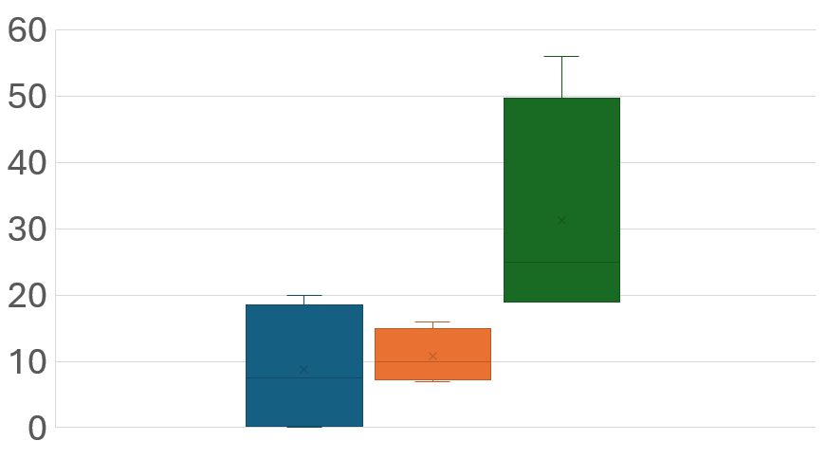
Biopsy delays
Days
Request -> Biopsy
Biopsy -> authorised report
Biopsy -> initial report
Notes:
IQR time from request to biopsy – 1-19 days, median 9 days
Median time from biopsy to initial MDT oral report 11 days with IQR 8-15 days
Authorised reports much later – are we missing info when making treatment decisions? No pathway to automatically check these
Large spread in these data – relies heavily on context
- Longer delays for ENT and breast biopsies, whilst immediate biopsies are due to emergency presentations – highlights first problem – heterogeneity of presentations of HGL. Who is performing these biopsies?

Slide 8
Source of referral:
  4 x ED acute abdomen “A&E”
  2 x endoscopic biopsies for GI bleeds “Other specialties – GI”
  1 x renal PTLD “Other specialties – renal”
  3 x breast clinic
  2 x resp EBUS
  1 x max fax “GP”
  1 x ENT neck lump clinic
  1 x GP referral with cytopenias
  1 x testicular mass resection
Notes:
Very few of routine lymphadenopathy referrals turn our to have HG lymphoma - no patients diagnosed from groin masses in this period

Slide 9
Biopsy teams
4 x IR biopsy (intrabdominal)
3 x breast clinic
2 x endoscopic biopsy
2 x bronch then EBUS
1 x ENT biopsy
1 x maxfax biopsy
1 x bone marrow
1 x orchidectomy (followed by tongue biopsy)
1 x bowel resection (then CR)
Notes:
Wide variety of teams performing biopsies – difficult to identify trends in delays without a very large cohort of patients – prohibitively time consuming

Slide 10
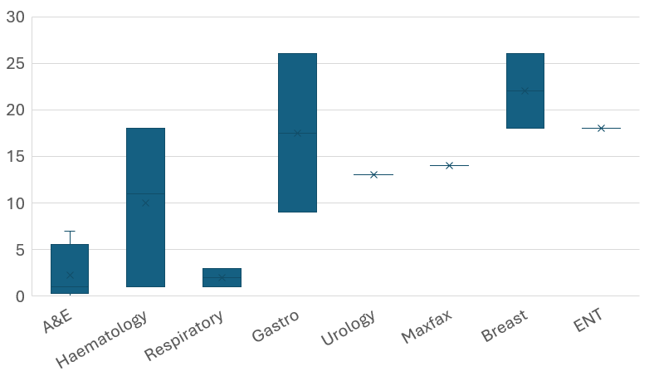
Time to first review by specialty
Days
Notes:
Vaguely interesting, but not very informative when trying to find trends

Slide 11
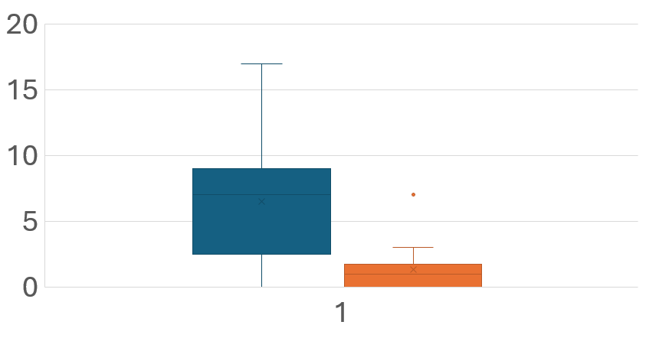
Imaging
Days
Request -> Scan
Scan -> Report
Notes:
Median time from request to imaging 7 days with IQR of 3-9 days
Median report turnaround time 2 days
Skewed by small numbers and mixed modalities – need to collect modalities, or focus on PET
A few had localised imaging, then CT NCAP, then PET
A lot of presentations are MUO

Slide 12
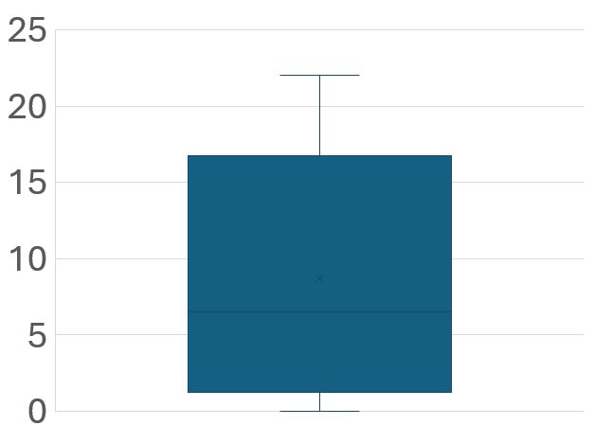
Haem referral -> first seen
Days
Notes:
Median time to haematology review 8 days (generally after PET and MDT discussion)

Slide 13
Conclusions:
Wide variety of diagnostic pathways – difficult to spot trends
  Limit to certain pathways - maxfax, ENT, breast clinic, groin nodes, ?mediastinal biopsies
Longest delays result from need for additional biopsies (reasonable) and repeated/inadequate biopsies (?potentially preventable)
  Add types of biopsy, whether repeats required, and why (e.g. core then excision)
Median 7 days to get imaging, and 2 days to report
  Specify imaging modality, or limit analysis to PET
Significant delays in getting authorised biopsy reports
  Should we be relying on verbal MDT reports? How often are we missing information?
Time from initial referral to first appointment varies by specialty
  Specify the initial receiving specialty, and which team performing biopsy
Notes:
Limiting pathways would allow us to extend timeframe
Are we duplicating other department’s audits (eg, pathology report turnaround time)
Very small proportion of the LN ?lymphoma patients reviewed in MDT turned out to have lymphoma - ?core biopsies causing delays by swamping department

Slide 14
Additional slides:

Slide 15
Patient selection
Dates and diagnosis codes given to BI unit
  26 newly diagnosed patients Jan-Apr 2024
    2 diagnosed and treated outside the trust
    8 low grade lymphomas
    16 high grade lymphomas
MDT notes reviewed for same period:
  14 high grade lymphomas identified
    2 missing as died in hospital before making it to MDT
    No additional cases not captured by BI unit
Notes:
“Oth & unsp types non-Hodgkin's B-cell lymphoma uns”
Smaller number than expected. NB, 100 cases throughout the year – I suspect this was a quiet period

Slide 16
What happened in the cases with missed targets?
GP referral to breast clinic
  26/7 to breast clinic
  8/7 to report
  3/7 to haem referral
  7/7 to haem appointment
  4/7 to CT NCAP report
  16/7 to PET report (identified lower colon lump ?solid Ca)
  18/7 for colonoscopy report
  3/7 to first treatment
Total 85 days referral -> treatment

Slide 17
What happened in the cases with missed targets?
GP referral to neck lump clinic
  18/7 to neck lump clinic and FNA
  4/7 to FNA report
  20/7 to excision biopsy
  16/7 to biopsy report
  3/7 to haem referral
  2/7 to haem appointment
  17/7 to PET
  14/7 to start treatment
Total 91 days referral -> treatment

Slide 18
What happened in the cases with missed targets?
GP referral with testicle lump
  14/7 to urology review
  11/7 to orchidectomy
  25/7 to pathology report (DLBCL)
  4/7 later referred to haem
  6/7 to haem appointment
  7/7 to PET scan + report (tonsillar involvement requiring ENT biopsy)
  30/7 to tongue biopsy
  13/7 to preliminary biopsy report by which point had started presumptive R-CHOP 8/7 prior
Total 102 days referral -> treatment
36 days DTT -> treatment

Slide 19
Suggestions:
Changes to audit
  Which pathways to include - maxfax, ENT, breast clinic, groin nodes, ?mediastinal biopsies
  Specify imaging modality, or just look at PET scans
  Add types of biopsy, whether repeats required, and why (e.g. core then excision)
  Extend to 12 months
  Should we treat interim MDT pathology reports as acceptable, or only authorised reports?
  Are we duplicating other departments’ reporting audits?
  Include the specialty receiving the initial referral

