Slide 1
Gynaecological Oncology Research Update for SWAGGER
Research Update
Claire Matthews
28/11/2025

Slide 2
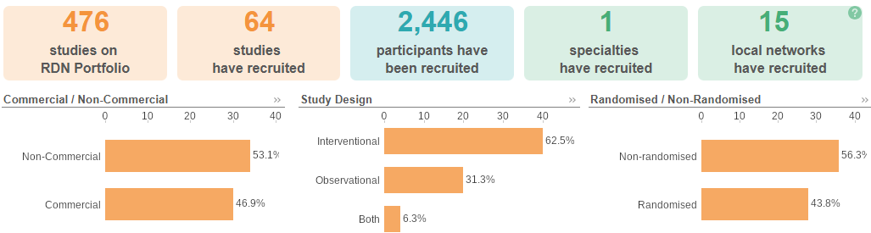
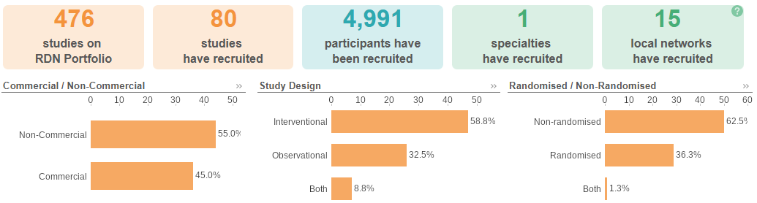
National Gynae Cancer Research Recruitment
Apr 25 - Nov 25
Apr 24 - Mar 25
Source: ODP All Portfolio

Slide 3
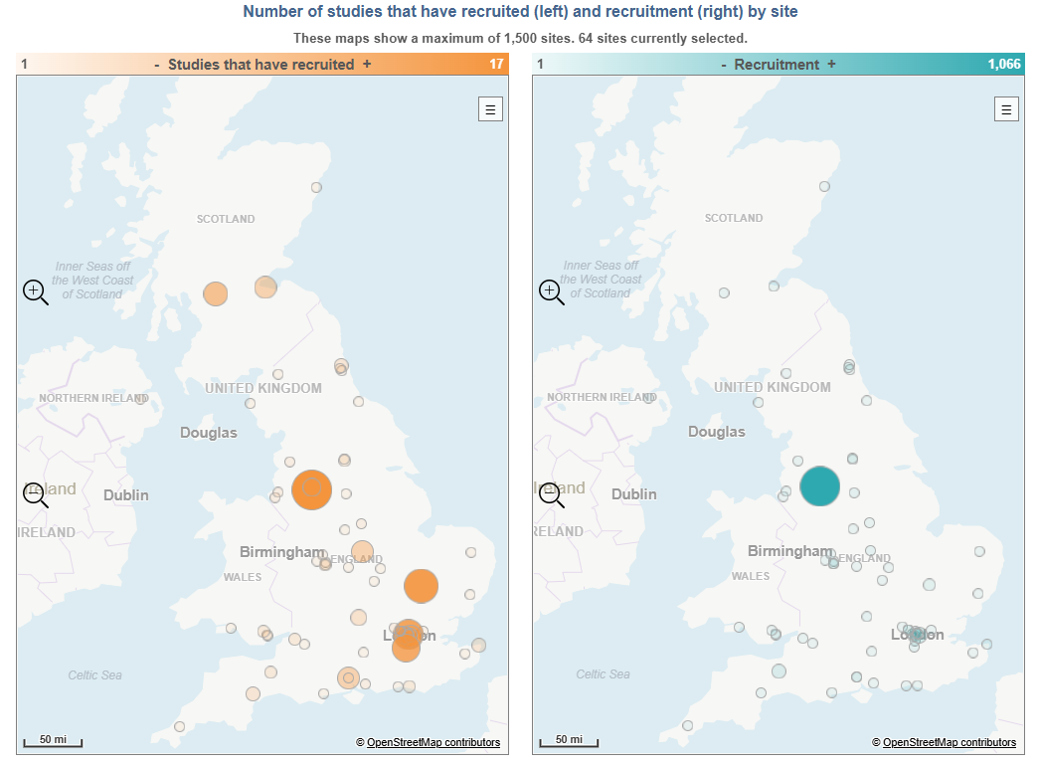
Research Activity by Site 2025/2026

Slide 4
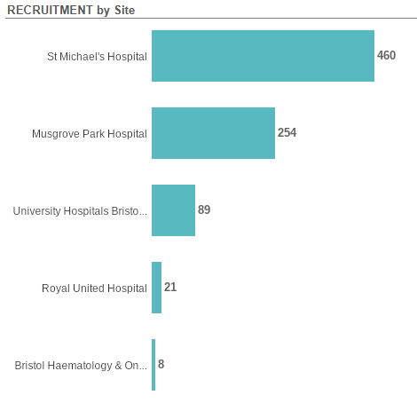
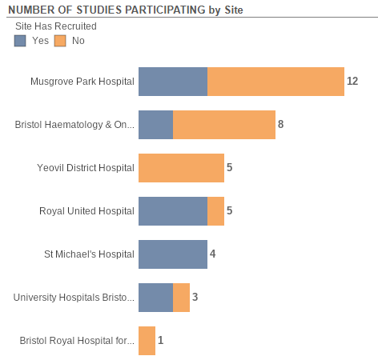

Slide 5
Studies Open in SWAG Region
CPMS | Short Name | Sites | Opening | Closure | Sample Size Eng | Eng Recruits
67534 | BNT323-01 | BHOC | 01/09/2025 | 30/09/2027 | 55 | 0
66441 | Attitudes to Gynae Oncology Care Location - GRACEFUL | Musgrove | 13/03/2025 | 08/02/2029 | 550 | 246
60413 | EPS101-10-02 | BHOC | 22/08/2024 | 01/07/2026 | 39 | 4
57783 | DETECT-2 | St Michael's, Musgrove | 24/04/2024 | 30/11/2026 | 732 | 255
55713 | PICCOS | BHOC, RUH | 18/01/2024 | 30/04/2026 | 0 | 8
54479 | Patient-Derived Organoids for Ovarian Cancer Drug Screening | St Michael's | 19/05/2023 | 30/09/2025 | 20 | 16
52784 | ACTOv | RUH | 10/03/2023 | 28/02/2027 | 70 | 23
47749 | VALTIVE1 | BHOC, RUH, Musgrove | 09/02/2021 | 31/01/2026 | 267 | 216
42436 | ATARI | RUH | 25/11/2019 | 30/04/2026 | 94 | 69
39196 | PROTECTOR | RUH | 01/11/2018 | 31/07/2030 | 2340 | 1,149

Slide 6
Studies In set-up/under consideration in SWAG Region
CPMS | Short Name | Title | Opening | Closure | Sample S Eng | Site
70769 | MAESTRA 2 | A Phase 3, Randomized, Open-Label Study of INCB123667 Versus Investigator's Choice of Chemotherapy in Participants With Platinum Resistant Ovarian Cancer With Cyclin E1 Overexpression | 04/05/26 | 20/03/28 | 22 | Musgrove
66567 | Destiny Endometrial01 | DESTINY-Endometrial01: An Open-Label, Sponsor-Blinded, Randomized, Controlled, Multicenter, Phase III Study of Trastuzumab Deruxtecan (T-DXd) Plus Rilvegostomig or Pembrolizumab vs Chemotherapy Plus Pembrolizumab as First-Line Therapy of HER2-Expressing (IHC 3+/2+), Mismatch Repair Proficient (pMMR), Primary Advanced or Recurrent Endometrial Cancer | 19/10/25 | 30/11/27 | 30 | RUH
66124 | DESTINY - Ovarian01 | A Phase 3, Open-label, Multicenter, Randomized Trial of Trastuzumab Deruxtecan with Bevacizumab Versus Bevacizumab Monotherapy as First-line Maintenance Therapy in HER2-Expressing Ovarian Cancer | 22/09/25 | 17/07/27 | 10 | Cheltenham
64069 | GCT1184-02 | A Phase 3 Randomized, Open-label Study of RinatabartSesutecan (Rina-S) versus Treatment of Investigator's Choice (IC) in Patients with Platinum Resistant Ovarian Cancer | 31/03/26 | 12/10/26 | 2 | Cheltenham
61528 | DS600-109 | A Phase 2/3, Multicenter, Randomized Study of Raludotatug Deruxtecan (R-DXd), a CDH6-directed Antibody-drug Conjugate, in Subjects with Platinum-resistant, High-grade Ovarian, Primary Peritoneal, or Fallopian Tube Cancer | 25/08/25 | 14/03/27 | 23 | RUH
56029 | Rainbo Orange Nsmp | Refining Adjuvant treatment IN endometrial cancer Based On molecular features (RAINBO) No Specific Molecular Profile (NSMO) - ORANGE Trial | 31/10/25 | 30/09/29 | 230 | Musgrove
Data cut: 20/03/2025
Source: ODP All Portfolio

Slide 7


Be Part of Research is a UK-wide service that helps people find and take part in health and care research across nearly every health condition.
A resource for:
patients or their families keen to get involved in research
Researchers looking for target population for research
https://bepartofresearch.nihr.ac.uk/

Slide 8
Key messages for patients
Be Part of Research makes it easier than ever to find and take part in health and care research.
Simply sign up online and choose the areas of research you’re interested in.
You’ll then be matched to suitable studies and sent clear information about what’s involved and how you can take part.
The decision on whether to take part is always yours.

Slide 9

Associate Principal Investigator
Scheme
Six month in-work training opportunity, providing practical experience for healthcare professionals starting their research career.
People who would not normally have the opportunity to take part in clinical research in their day to day role have the chance to experience what it means to work on and deliver a NIHR portfolio trial under the mentorship of an enthusiastic Local PI.
CIs working with a CTU can register their study on the scheme
https://www.nihr.ac.uk/health-and-care-professionals/career-development/associate-principal-investigator-scheme.htm

Slide 10

Principal Investigator Pipeline Programme
(PIPP)
Overview
Research delivery nurses, midwives and AHPs
12 to 18 months
Free if you’re eligible
Live virtual lessons, online learning and hands-on experience
Cohort 5 applications open in April 2026, approx 60 places
Please email nursingandmidwifery@nihr.ac.uk for more information
https://www.nihr.ac.uk/career-development/clinical-research-courses-and-support/principal-investigator-pipeline-programme

Slide 11
NIHR ODP https://odp.nihr.ac.uk/
Open data platform. Data on performance across whole RDN, including all specialty areas
NIHR Be Part of Research https://bepartofresearch.nihr.ac.uk/
See which studies are open across the country
Find a Clinical Research Study (ODP) http://csg.ncri.org.uk/portfolio/portfolio-maps/
Search for a study to fit criteria. Good for horizon scanning, eligibility criteria

Slide 12
RRDN Contacts
swc.rrdn@nihr.ac.uk
Study Support Service Manager: claire.matthews@nihr.ac.uk
CAG Research Lead: rebecca.bowen3@nhs.net

