Slide 1
Sarcoma referral pathway

Slide 2
Referral timeline
Referral received by Cancer Services
CNS triage
Diagnosis
Treatment plan/Management
MDT discussion
Direct to US biopsy or MRI
Clinic review
Investigations
Reject
MDT advised CT/PET/MRI
Sarcoma team management
Benign/ discharge to referrer
9/10 within 2days.
Max. 4 days
May be discharged without OPA

Slide 3
Triaging Actions
Plastics last 10 high grade referrals
MRI- 3
Biopsy- 5
OPA- 4
MDT discussion- 10

Slide 4

Referral to Sarcoma Service contact
CNS Contact on average 2days (20)
  Range 0- 9days (0-182)
  OPA on average 10days (15.2)
    Range 4-22days (4-56)

Slide 5
Patient | Referral to CNS contact (days) | Referral to OPA (days)
a | 0 | 8
b | 1 | 7
c | 0 | 4
d | 1 | 19
e | 9 | 13
f | 0 | 4
g | 182 | 56
h | 5 | 12
i | 2 | 7
j | 0 | 22

Slide 6
Faster to Diagnosis targets
Days from referral to diagnosis
22
21
4
19
13
6
182
26
35
22
Met 28day FTD target in 8/10
Average 19days (35)
Range 4- 35 days (4-182)

Slide 7
Days from diagnosis to first treatment.
a | 13 | surgery
b | 29 | surgery
c | 18 | surgery
d | 22 | RT
e | 54 | surgery
f | 10 | surgery
g | 50 | surgery
h | 13 | surgery
i | 28 | RT
j | 31 | chemo
Average 27 days
Range 10-54

Slide 8
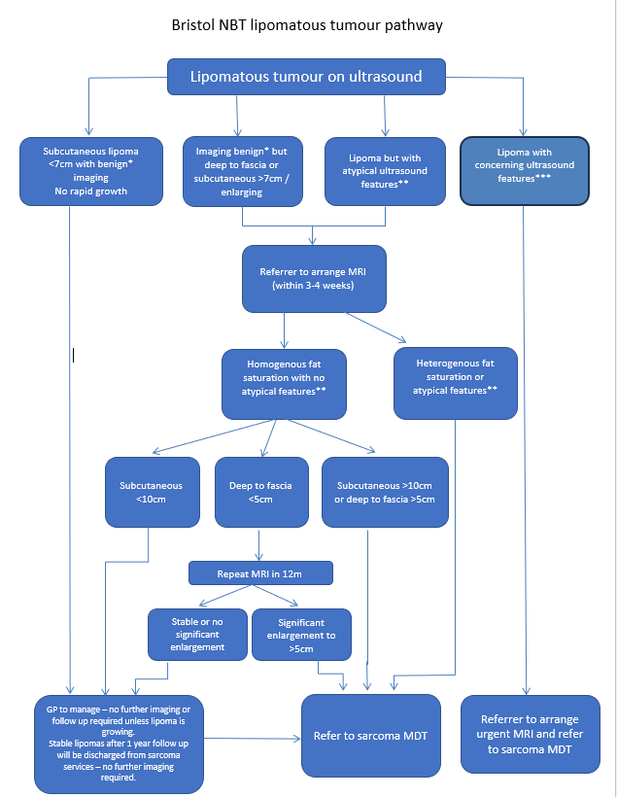
Lipomatous tumour pathway developed by Sarcoma radiologist (BR), updated to minimise unnecessary referrals to the Sarcoma MDT at North Bristol Trust, while ensuring patient safety and maintaining appropriate clinical care.
Hosted by Remedy, agreement by whole SWAG region.
Simplifies the triaging of fatty masses for CNS team.
CNS GP training 23/10/25

