Slide 1

National Cancer Patient Experience Survey Results (2024)
Head and Neck Cancer - Clinical Advisory Group
Tuesday 23rd September 2025

Slide 2
NCPES Introduction
Annual survey, commissioned by NHS England (since 2010)
Break in series data with pandemic
new design in 2021, therefore four years of comparable data now 2021 - 2024
Picker - responsible for designing, running & analysing the survey
Designed to:
Monitor progress in cancer care
Provide information to drive local quality improvements
Assist commissioners and providers of cancer care
Inform the work various charities and stakeholder groups, supporting cancer patients

Slide 3
NCPES Methodology
Provider survey samples
Adults (16 and over), with a confirmed diagnosis of cancer
Discharged from NHS Trust (after an inpatient or day-case attendance for cancer related treatment) in April, May and June 2024.
Survey fieldwork Oct. 2024 – Feb. 2025
Reports published July 2025 (National, Alliance, ICB and Trust)

Slide 4
Cancer Alliance report
Report reflects experience of people referred from within CA footprint (not all those treated by that CA’s Providers)
‘referring’ CA report - based on patient home postcodes
According to ONS postcode mapping

Slide 5
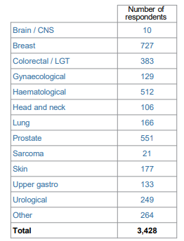
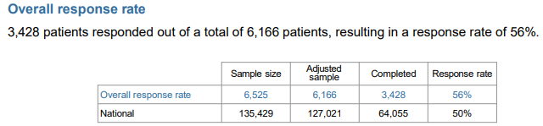
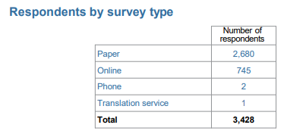
Total NCPES SWAG responses

Slide 6
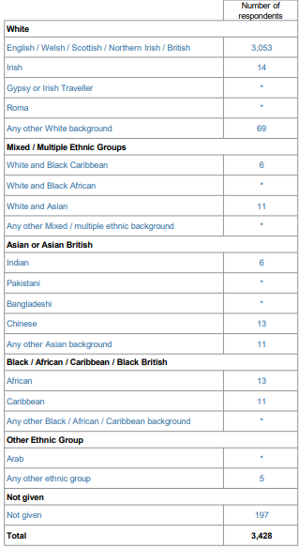
All SWAG respondents by Ethnicity
89%
91% (3122)
2 % (76)
6%
* Number supressed as <5 respondents

Slide 7
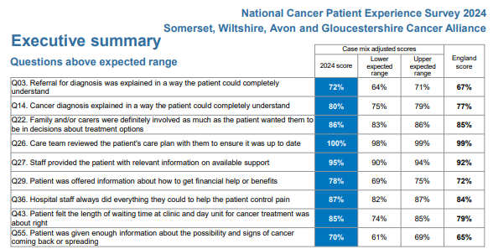
SWAG Summary
9 questions were above the expected range (all others were in line with the national average)
SWAG overall ‘rating of care’ 9.0
(national average 8.9)
SWAG Head and Neck overall ‘rating of care’ 9.1

Slide 8
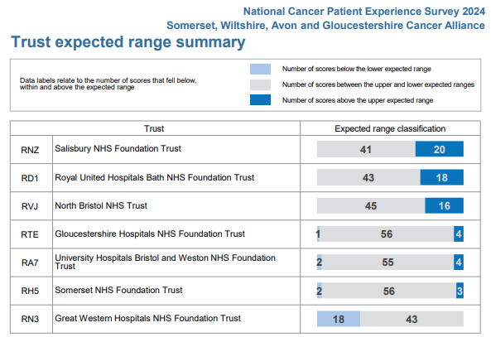
Trust Summary

Slide 9
Head and Neck responses
Total Head and Neck respondents in the SWAG report: 106
People ‘’referred’ with a SWAG postcode, who responded to the survey
Individual Trusts reports | respondents
University Hospitals Bristol and Weston NHS FT | 34
Gloucestershire Hospitals NHS FT | *
Somerset NHS FT | 35
Royal United Hospital Bath NHS FT | *
Salisbury NHS FT | *
North Bristol NHS Trust | 1
TOTAL: | 70
* <10 respondents for the Trust, therefore no results given for H&N

Slide 10
SWAG Head and Neck highest scores 19 ≥ 90% (slide 1 of 2) - one of the most ≥ 90% scores of all SWAG tumour sites
 | Question | H&N SWAG | SWAG score | National average
5 | Patient received all the information needed about the diagnostic test in advance | 93 | 94 | 93
9 | Enough privacy was always given to the patient when receiving diagnostic test results | 96 | 96 | 95
17 | Patient had a main point of contact within the care team | 94 | 90 | 91
18 | Patient found it very or quite easy to contact their main contact person | 90 | 85 | 85
19 | Patient found advice from main contact person was very or quite helpful | 97 | 97 | 96
20 | Treatment options were explained in a way the patient could completely understand | 90 | 85 | 83
25 | A member of their care team helped the patient create a care plan to address any needs or concerns | 96 | 94 | 94
26 | Care team reviewed the patient's care plan with them to ensure it was up to date | 100 | 100 | 99
27 | Staff provided the patient with relevant information on available support | 94 | 95 | 92
37 | Patient was always treated with respect and dignity while in hospital | 92 | 88 | 88

Slide 11
SWAG Head and Neck highest scores ≥ 90% (slide 2 of 2)
 | Question | H&N SWAG | SWAG score | National average
38 | Patient received easily understandable information about what they should or should not do after leaving hospital | 96 | 89 | 87
41¹ | Beforehand patient completely had enough understandable information about surgery | 91 | 91 | 90
41³ | Beforehand patient completely had enough understandable information about radiotherapy | 92 | 88 | 89
41⁵ | Beforehand patient completely had enough understandable information about immunotherapy | 100 | 83 | 84
42³ | Patient completely had enough understandable information about their response to radiotherapy | 90 | 86 | 85
42⁵ | Patient completely had enough understandable information about their response to immunotherapy | 92 | 79 | 81
46 | Patient was given information that they could access about support in dealing with immediate side effects from treatment | 96 | 90 | 88
54 | The right amount of information and support was offered to the patient between final treatment and the follow up appointment | 93 | 82 | 81
56 | The whole care team worked well together | 91 | 91 | 90

Slide 12
SWAG Head and Neck lowest scores ≤ 70%
 | Question | H&N SWAG | SWAG average | National average
23 | Patient could get further advice from a different healthcare professional before making decisions about their treatment options | 70 | 60 | 58
29 | Patient was offered information about how to get financial help or benefits | 69 | 78 | 72
51 | Patient definitely received the right amount of support from their GP practice during treatment | 44 | 50 | 48
52 | Patient has had a review of cancer care by GP practice | 21 | 22 | 23
53 | After treatment, the patient definitely could get enough emotional support at home from community or voluntary services | 43 | 37 | 34
58 | Cancer research opportunities were discussed with patient | 41 | 45 | 46

Slide 13
Patient comments
Patients were asked
Please tell us what you found to be positive about your experience of cancer care?
Please tell us how your experience of cancer care could have been better?
Patient comments are available in Trust level reports, presented in topics, themes and sentiment.
This year for the first time, SWAG has received a ‘comments’ report, a summary will be presented at the next SWAG delivery group.

Slide 14
Clinical Advisory Group - Next Steps
Discuss and agree SWAG Head and Neck patient experience improvement priorities, including areas of lowest scores (slide 12)
to be collated and fed back to SWAG Cancer Board
Next steps / timeline
Nominated lead
Recognition of areas of good practice, including:
Access to main contact
Explanation of treatment options
Hospital discharge information
Support and information about immunotherapy treatment and response
Consider additional in-year Head and Neck-specific patient experience / engagement activity to gain further insight

