Slide 1
Evaluating Diagnostic Pathways for ENT Head and Neck Cancers: A Retrospective Review of Urgent Suspected Cancer Referrals
Paris Bruno
Joseph Yapp
Oliver Dale
Tamas Schiszler
Soudeh Chegini

Slide 2
H&N USC pathway
220,000+ referrals per year
3% cancer
50-70% stage 4 diagnosis
Late referrals acknowledged
What happens in between?

Slide 3
Retrospective Review of USC ENT Referrals (Apr 2023–Apr 2024)
6936 H&N USC referrals
Included all USC ENT referrals (Apr 2023–Apr 2024)
Careflow clinics
Remove repeats (142)
GA biopsy from bluespier
Category 5&7 USS neck, CT neck/larynx, MRI neck
Buisiness intelligence

Slide 4
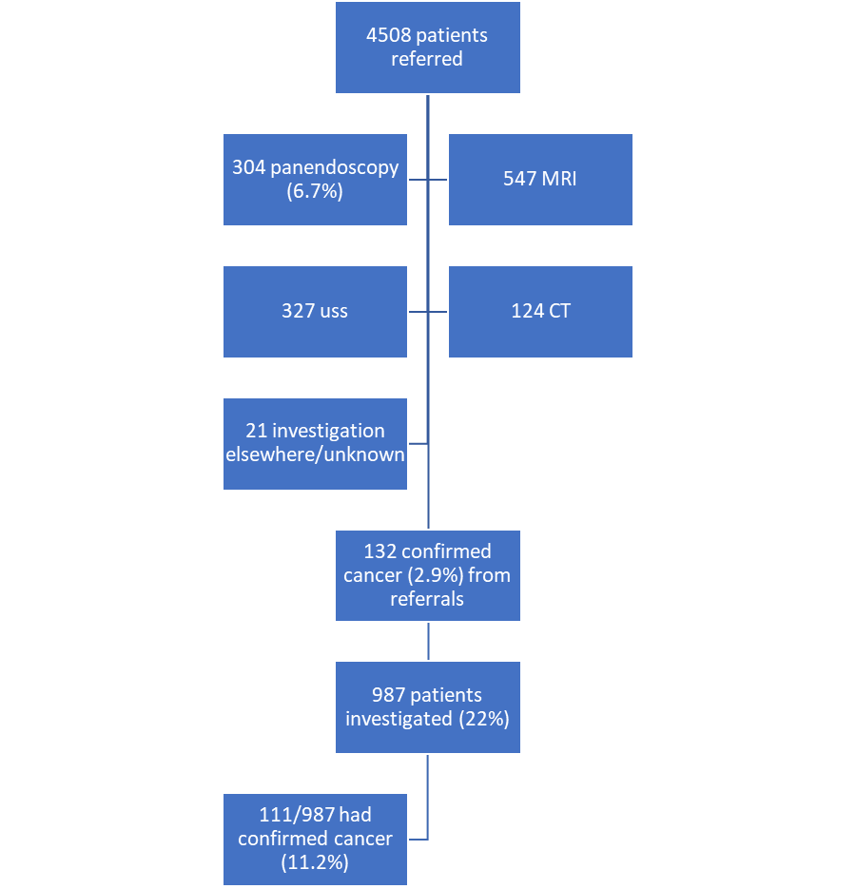

Slide 5
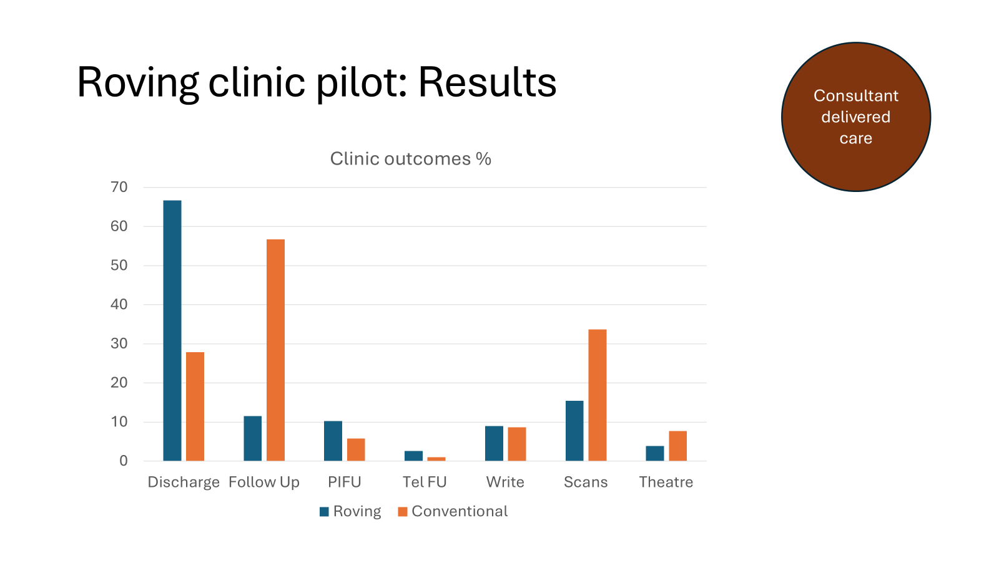

Slide 6
GA biopsy
304 patients had GA biopsy 6.7%
Confirmed cancer: 63 (21%)
Days after USC clinic | patient number
1-7 | 7
8-14 | 14
15-21 | 30
22-28 | 52
29-35 | 53
>36 | 136

Slide 7
Scans
Scan | How many performed | How many had MDT discussion | Confirmed cancer | Total no. Of scans | %
Uss neck | <14days since 2ww=49pts (15%) 15-56 days after 2ww=258 pts (79%) >57 days after 2ww=20 (6%) | 71 | 53 | 327 | 16%
Ct | <14days since 2ww=50pts (40%) 15-56 days after 2ww=68 pts (55%) >57 days after 2ww=6 (5%) 43 ct larynx, 84 ct neck/chest/abdo | 76 | 49 | 124 | 40%
Mri | <14 days since 2ww=239pts (44%) 15-56 days after 2ww=179 pts (33%) >57 days after 2ww=129 (24%) All MRI neck | 123 | 48 | 547 | 9%
Any investigation (USS/CT/MRI/GA biopsy) | 1351 987 patients |  | 111 21 had no Investigation |  | 11.2%

Slide 8
Conclusion

