Slide 1
SWAG Network Head & Neck Cancer Clinical Advisory Group
Research Update
Claire Matthews & David Rea
23/03/2025

Slide 2
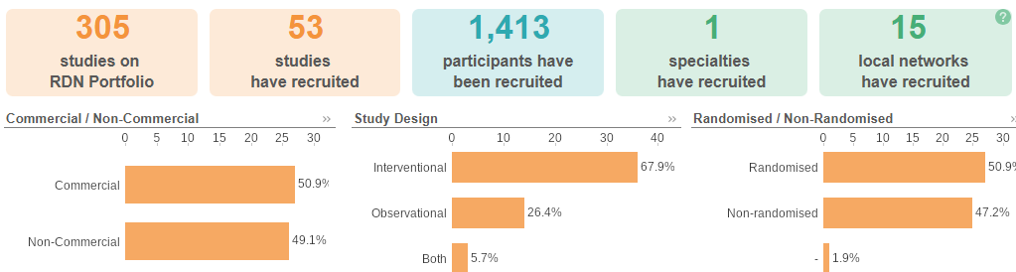
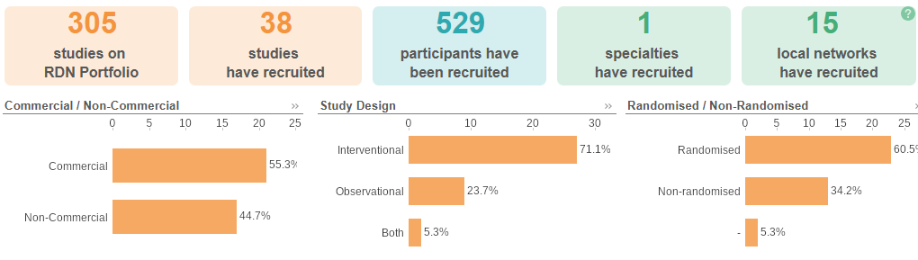
National H&N Cancer Research Recruitment
Apr 24 - Mar 25
Apr 25 - Sep 25
Data cut: 22/09/2025
Source: ODP All Portfolio

Slide 3
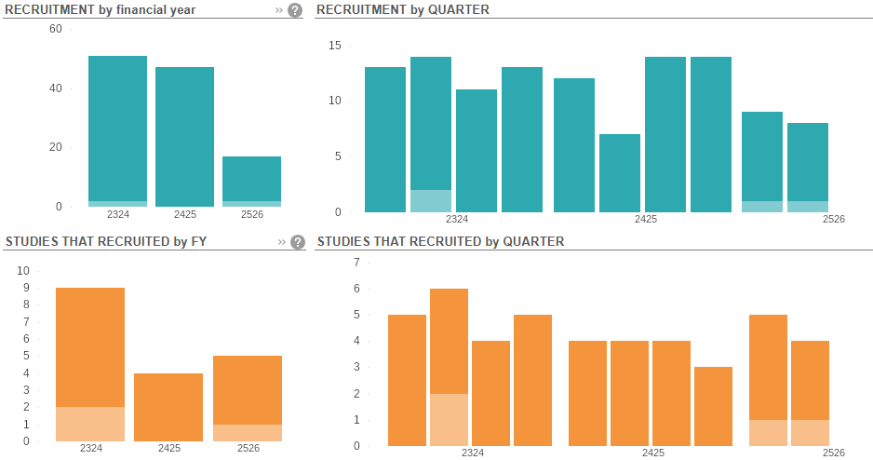
SWAG region H&N Cancer Research Recruitment
Data cut 022/09/2025
Source: ODP All Portfolio

Slide 4
Open Studies in SWAG region
CPMS ID | Short Name | Studies | Opening | Closure | Sample Size Eng | Eng Recruits
60674 | MCLA-158-CL03 | Musgrove | 14/02/2025 | 31/08/2026 | 50 | 10
58218 | JADE | Chelt | 01/11/2024 | 04/05/2026 | 15 | 8
58043 | Getting Recovery Right After Neck Dissection for Head and Neck Cancer | Musgrove | 09/05/2025 | 01/07/2026 | 390 | 50
57396 | eVOLVE HNSCC | Musgrove | 23/04/2024 | 30/09/2027 | 57 | 9
56569 | PROTIS | Chelt (in setup), BHOC (in setup) | 16/09/2024 | 01/04/2029 | 256 | 11
53806 | RAPTOR | Glos (In set up), UoB DH (In setup) (no change since Jan) | 25/04/2023 | 08/01/2026 | 90 | 68
50360 | PETNECK 2 - Feasibility Study and RCT, Version 1.0, 10-May-2021 | RUH, BRI, Chelt | 14/02/2022 | 31/03/2026 | 623 | 515
48988 | HoT | BRI, RUH, Somerset | 13/12/2021 | 31/07/2028 | 344 | 191
44418 | INSPIRE | BHOC | 13/05/2020 | 31/03/2026 | 120 | 114
Data cut 16/09/2025
Source: ODP All Portfolio

Slide 5
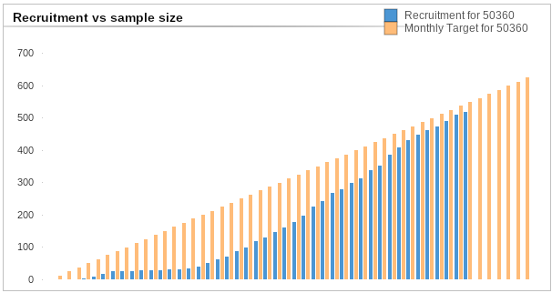
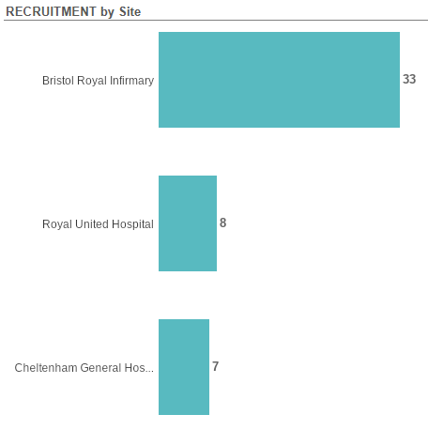
PETNECK 2
Target 32
Target 5
Target 10
Planned closure 31/03/2026 following an extension
Data cut 17/01/2025
Source: ODP All Portfolio
CPMS ID: 50360

Slide 6
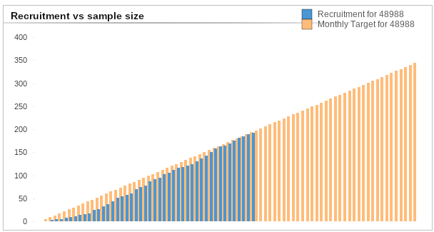
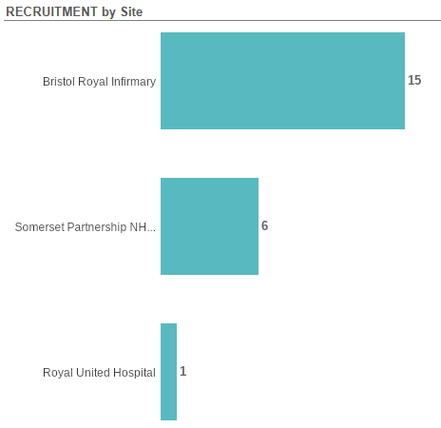
HoT
Target 30
Target 32
Target 16
End date extended to 31/07/2028 due to slower than expected recruitment
Data cut 17/01/2025
Source: ODP All Portfolio
CPMS ID: 48988

Slide 7
Studies in set-up/under consideration in SWAG region
PF-08046054: A Randomized, Phase 3, Open-Label Study To Evaluate Pdl1v (Pf-08046054) In Combination With Pembrolizumab Vs Pembrolizumab Monotherapy In Adult Participants With First-Line Recurrent Or Metastatic Head And Neck Squamous Cell Carcinoma That Is Programmed Cell Death Ligand 1 Positive.
Sites: BHOC, Musgrove, Salisbury Opening 23/09/2025 Closing 29/12/2027, Pfizer Inc.
EVEREST-HN-4: EVolution of a patiEnt-REported symptom-based risk stratification sySTem to redesign the suspected Head and Neck cancer referral pathway (EVEREST-HN) Feasibility Study
Sites: Musgrove, Yeovil Opening 01/12/2025 Closing 08/06/2026 Eng Target 3430 The Royal Marsden Nhs Foundation Trust
Data cut 17/01/2025
Source: ODP All Portfolio

Slide 8
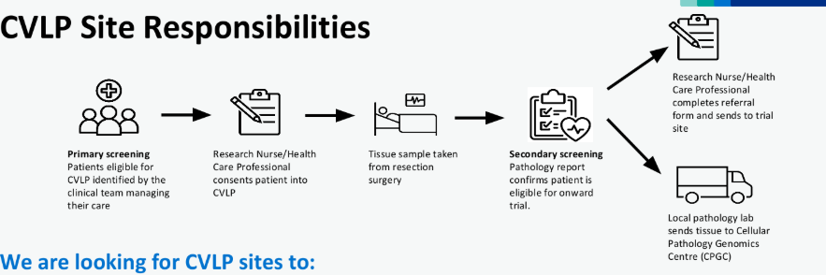
Cancer Vaccine Studies and CVLP
CVLP aims to establish the feasibility of pathways for patients with cancer to access cancer vaccine trials.
CVLP is investigating the optimum process for patients, across multiple cancer types, to receive personalised cancer vaccines by enrolment in the CVLP
Currently supporting two cancer vaccine trials:
BNT113-01 Head & Neck Squamous Cell Carcinoma
The SCOPE trial Advanced Melanoma

Slide 9
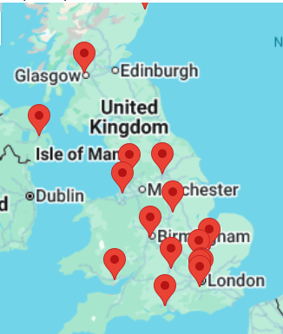
CVLP / BNT113-01 (Head & Neck Squamous Cell Carcinoma) – 6 patients have consented to the CVLP trial for BNT113-01. Gloucestershire consented their first CVLP/BNT113 patient in August
BNT113-01 Sites
This study is accessible through the following CVLP sites:
Mid & South Essex NHS Foundation Trust
Gloucestershire Hospitals NHS Foundation Trust
University Hospitals Coventry & Warwickshire NHS Trust
University Hospitals Dorset NHS Foundation Trust
Royal United Hospitals Bath NHS Foundation Trust
Hull University Teaching Hospitals NHS Trust
Bedfordshire Hospitals NHS Foundation Trust
Royal Surrey NHS Foundation Trust
Royal Berkshire NHS Foundation Trust
United Lincolnshire Teaching Hospials NHS Trust
York and Scarborough Teaching Hospitals NHS Foundation Trust
Royal Free London NHS Foundation Trust (North Middlesex)

Slide 10
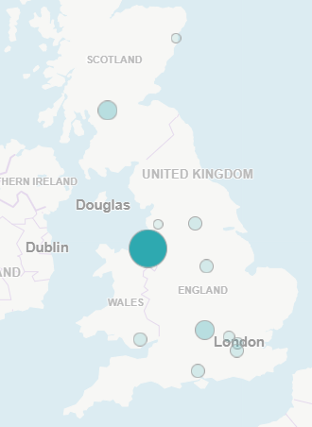
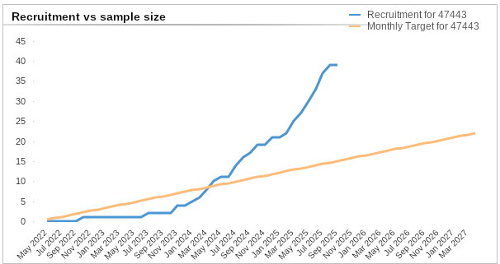
BNT113-01 A Phase 2 study of BNT113 in HPV16+ HNSCC patients expressing PD-L1 (47443)

Slide 11


Be Part of Research is a UK-wide service that helps people find and take part in health and care research across nearly every health condition.
A resource for:
patients or their families keen to get involved in research
Researchers looking for target population for research
https://bepartofresearch.nihr.ac.uk/
Data cut
Source: ODP All Portfolio

Slide 12
Key messages for patients
Be Part of Research makes it easier than ever to find and take part in health and care research.
Simply sign up online and choose the areas of research you’re interested in.
You’ll then be matched to suitable studies and sent clear information about what’s involved and how you can take part.
The decision on whether to take part is always yours.

Slide 13

Associate Principal Investigator
Scheme
Six month in-work training opportunity, providing practical experience for healthcare professionals starting their research career.
People who would not normally have the opportunity to take part in clinical research in their day to day role have the chance to experience what it means to work on and deliver a NIHR portfolio trial under the mentorship of an enthusiastic Local PI.
CIs working with a CTU can register their study on the scheme
https://www.nihr.ac.uk/health-and-care-professionals/career-development/associate-principal-investigator-scheme.htm

Slide 14

Principal Investigator Pipeline Programme
(PIPP)
Overview
Research delivery nurses or midwives
12 to 18 months
Free if you’re eligible
Live virtual lessons, online learning and hands-on experience
Cohort 4 started in September 2025
Please email nursingandmidwifery@nihr.ac.uk for more information
https://www.nihr.ac.uk/career-development/clinical-research-courses-and-support/principal-investigator-pipeline-programme

Slide 15
NIHR Qlik Cloud https://rdn.uk.qlikcloud.com/
Data on performance across whole RDN, including all specialty areas
NIHR Be Part of Research https://bepartofresearch.nihr.ac.uk/
See which studies are open across the country
Find a Clinical Research Study https://sense.odp.nihr.ac.uk/public/sense/app/27f93da6-3ea4-404a-afce-24cfe1c613c8/sheet/d96836f0-c98b-4ee2-9991-351f5a2c659f/state/analysis
Search for a study to fit criteria. Good for horizon scanning, eligibility criteria

Slide 16
RRDN Contacts
swc.rrdn@nihr.ac.uk
Study Support Service Manager: claire.matthews@nihr.ac.uk
CAG Research Lead: sarah.hargreaves@uhbw.nhs.uk

