Slide 1

H&N CAG Sept 2025
Notes:
The RCR consensus process was initially developed in 2016 to help reduce variation in UK radiotherapy practice. The Head and Neck cancer consensus statements were released in 2022 to serve as a stimulus for Head and Neck cancer teams to review their existing radiotherapy service
They were adopted nationally in parallel with the relevant National Institute for Health and Care Excellence (NICE) guidance.

Slide 2
4.0 Adjuvant contralateral neck irradiation following surgery for oral tongue cancer for patients planned for postoperative ipsilateral radiotherapy
Published 2022
Notes:
Cancer of the oral tongue has been associated with a worse prognosis compared with other oral cavity subsites.
Postoperative radiotherapy (PORT) after a curative surgical resection may improve survival.
However, the PORT treatment volume and the extent of inclusion of the surgical bed and elective regions has not been consistently defined.
This topic considers when the PORT volume should be extended to the surgically undissected clinical (cN0) and radiological (rN0) lymph node-negative contralateral neck in the scenario that ipsilateral PORT is planned to the operated bed

Slide 3
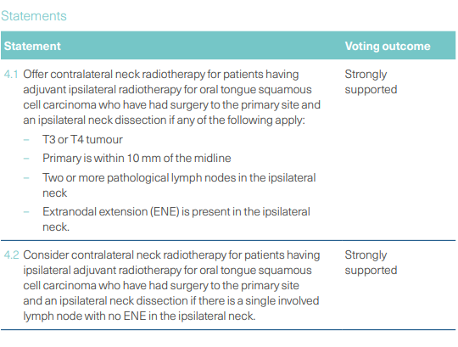
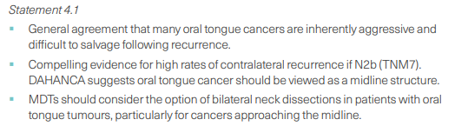
Notes:
Contralateral neck radiotherapy in the case of the undissected c/rN0 neck may result in overtreatment of patients and there is debate as to whether it impacts disease recurrence or survival.
But itrs reasonalbe to consider because, low survival for patients with regional recurrent disease
=> possibility of PORT might change disease outcome
When a decision has been made to deliver ipsilateral PORT, delivering PORT to the undissected c/rN0 contralateral neck is based upon the pathological features of the primary cancer and ipsilateral nodal disease, which are thought to be indicators of occult contralateral disease and hence risk of contralateral lymph node recurrence

Slide 4
Full background notes
Vergeer et al carried out a retrospective review of well-lateralised oral tongue cancers receiving surgery with ipsilateral radiotherapy.
Increasing volume of ipsilateral nodal disease predicted the risk of CLNR at five years; risk of contralateral recurrence
PN0 1%
pN1/pN2a 12%
pN2b 27%

Slide 5
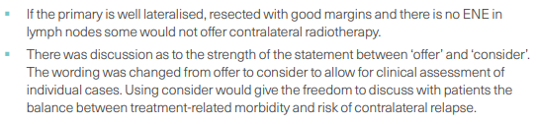

Slide 6

Full background notes
When considering N1 (single lymph node disease), contralateral failure rates of up to 12% have been reported.
This raises the possibility that patients with any ipsilateral nodal disease may benefit from bilateral PORT. The risk of CLNR is due to the bilateral lymph drainage of oral cancers, which was reported by the Sentinel European Node Trial (SENT) as 12% in early (T1–2) lateralised disease

Slide 7
Full background notes
rcr-publications_head-and-neck-cancer-rcr-consensus-statements__february-2022.pdf

