Slide 1
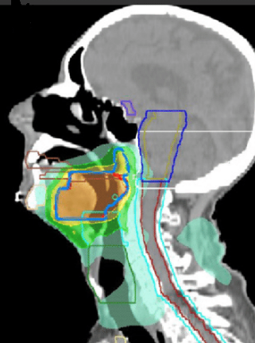
Impact of Joint Peer Review with a Specialist Radiologist in Head and Neck Cancer Radiotherapy Planning
Consultants: Drs Matt Beasley, George Casswell, Sarah Hargreaves
Registrars: Drs Mani Periasamy, Amalia Stavropoulos

Slide 2

Background 1
Quality of contouring of head and neck cancer affects clinical outcomes in terms of:
Treatment success/failure
Toxicity of normal tissues
Inter-clinician contouring can vary significantly even in standardised head and neck cancer trials.
Royal College of Radiologists (RCR) guidance (2017) recommends prospective contour peer review for quality assurance.
Two previously conducted prospective series of skull base, central nervous system, and radically treated head and neck cancer patient with a neuroradiologist review have led to changes in 47% and 55% of plans with 32% classified as “major” and 14% as “minor.”
Source:

Slide 3
Background 2
All radical head and neck cancer radiotherapy plans are presented by the responsible clinicians to their peers at the Peer Review Meeting to obtain feedback for the purpose of improving plans and quality assurance.
Every Tuesday afternoon from 15:00 until 16:00.
Hybrid format:
BHOC Level 2 radiotherapy department peer review meeting room
Microsoft Teams
Attended by:
BHOC Head and Neck Oncology consultants and registrars
RUH Head and Neck Oncology consultants and registrars
UHBW head and neck consultant radiologist and registrars

Slide 4
Aim of project
To assess the impact of a joint peer review meeting with specialist radiology presence on head and neck cancer radiotherapy planning.

Slide 5
Methods
Prospective data collection during the head and neck peer review meeting from May until September 2024.
Data entered on to an Excel spreadsheet.
Data collected on the following:
Patient name and hospital number
Presenting centre (BHOC, RUH) and presenting clinician
Primary site of tumour and staging
Treatment intent (radical, adjuvant, palliative)
Whether the radiologist was present during the case presentation
Any changes made to plan (yes or no)
Major/minor change
Changes to GTV (gross tumour volume)
Changes to CTV (clinical tumour volume)
Changes to OARs (organs at risk)
Whether the changes were directed by the radiologist
If no volume changes made, whether the radiologist provided reassurance

Slide 6
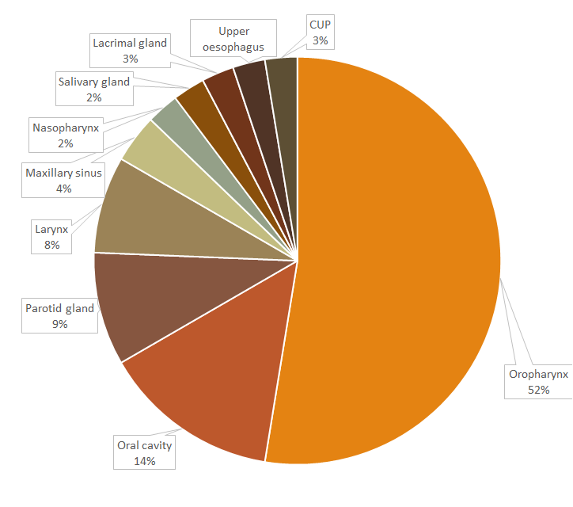
Results – number of cases and tumour type
Tumour type | Number (percentage)
Oropharynx | 41 (52%)
Oral cavity | 11 (14%)
Parotid gland | 7 (9%)
Larynx | 6 (8%)
Maxillary sinus | 3 (4%)
Nasopharynx | 2 (2.5%)
Salivary gland | 2 (2.5%)
Lacrimal gland | 2 (2.5%)
Upper oesophagus | 2 (2.5%)
Cancer unknown primary | 2 (2.5%)
Hypopharynx | 1 (1.5%)
Total | 79

Slide 7
Results - treatment intent
Treatment Intent | Number (percentage)
Primary | 52 (66%)
Adjuvant (post-operative) | 24 (30%)
Palliative | 3 (4%)
Total | 79

Slide 8
Results – major changes to GTV
Minor change (yes/no) | Number of plans | Changes guided by radiologist
Yes | 10 (13%) | 5 (50%)
No | 69 (87%) | n/a
Major change to GTV | Number of plans | Changes guided by radiologist
Yes | 27 (34%) | 19 (70%)
No | 52 (66%) | n/a
Major change to CTV | Number of plans | Changes guided by radiologist
Yes | 25 (32%) | 10 (40%)
No | 54 (68%) | n/a

Slide 9
Results – radiology reassurance
Radiology input | Number of plans (n=66)
Plans changed | 34 (52%)
Major plan changes | 29 (44%)
Reassurance only, without change | 24 (36%)
*58 out of 66 plans (88%) benefitted from radiology input.

Slide 10
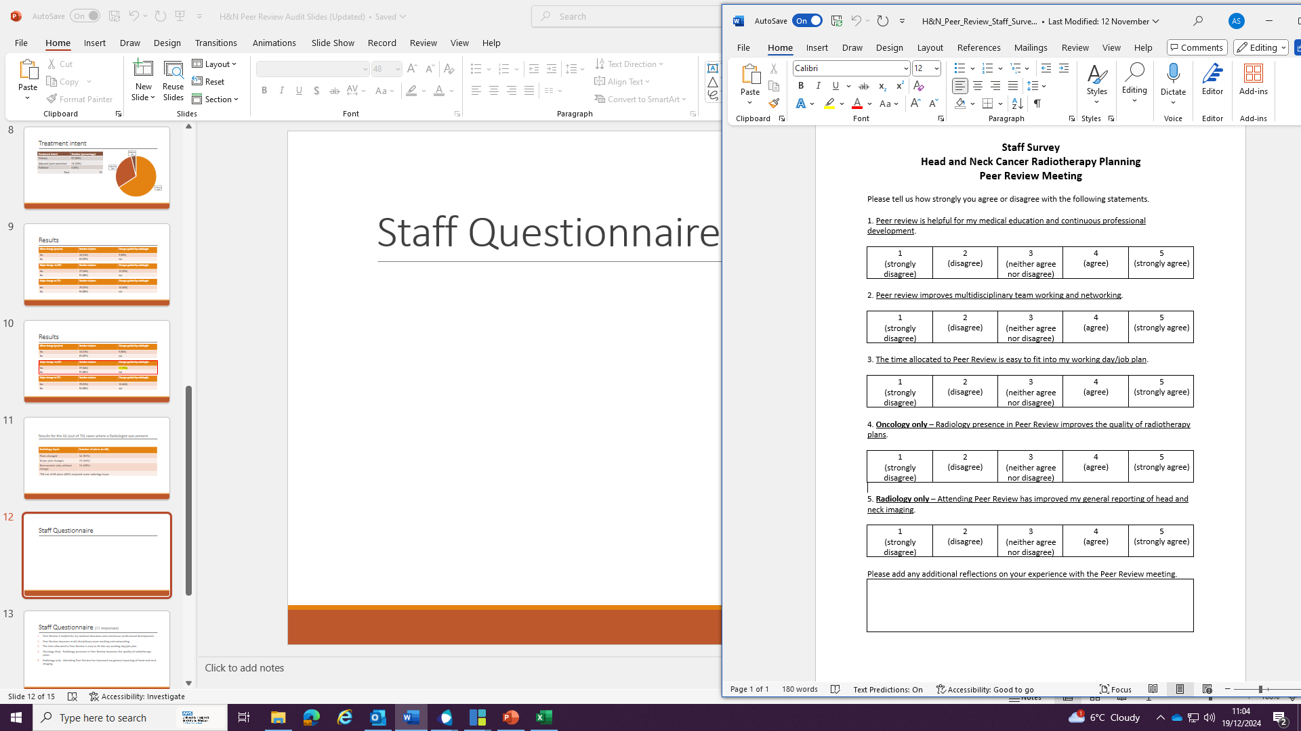
Staff Questionnaire
11 responses received.
4 responses from radiologists.
7 responses from oncologists.
Responses from both BHOC and RUH.

Slide 11
Staff Questionnaire Results
Result: 4.5 / 5.0

Slide 12
Result: 4.8 / 5.0
Result: 4.1 / 5.0

Slide 13
Result: 5.0 / 5.0
Result: 3.75 / 5.0

Slide 14
Oncologists’ Feedback
H&N peer review is enhanced by input from all 5 COs. It is an excellent teaching and training opportunity for CO trainees. I find it supportive with all members I hope able to voice opinions/ask questions/challenge decisions without judgement. More recently the presence of a H&N radiologist has been incredibly helpful when reviewing complex volumes and indeterminate findings on imaging. I have time allocated in job plan which is at the expense of SPA highlighting the priority I place on this.
Peer review increases patient safety and gives the trust medico-legal protection as a radiotherapy planning error much less likely with radiology helping to check tumour volumes.
Peer review meeting has helped boost my confidence in H&N contouring.
Clinical oncology trainees get very little structed/formal radiology training which is critical for our radiotherapy planning development. Having a radiologist presence in this meeting is really valuable for our education as it allows us to ask questions and get teaching.

Slide 15
Radiologists’ Feedback
I think having a regular meeting is useful rather than ad hoc reviews and has improved my understanding of the planning process and helped with my reporting as now know more about the oncology side.
I find the meeting really useful in understanding what oncology need to know from us (radiology). Therefore it informs our reporting.
I enjoy the meeting and interacting with my clinical colleagues. Interesting to see how my reports translate into focal areas needing consideration for treatment.
In my view, radiology should receive the cases in advance. It may be difficult at times to just quickly delineate malignancies, especially the challenging cases, in which the help of radiology would be most valuable.

Slide 16
Conclusions
There is a Quality and Safety benefit of radiology presence in peer review meeting for head and neck cancer radiotherapy.
Over a 5-month period, 29 (44%) cases had clinically significant/major change to plan guided by a radiologist which improved their chance of cure.
Introducing this change would require 0.25 PA consultant radiologist time per week.

Slide 17

References

Slide 18
Case example
48-yo lady
2021: Diagnosed with right parotid gland acinic cell carcinoma.
Treated with surgery alone.
2024: New trigeminal nerve pain.
MRI: recurrent disease with perineural invasion.
Consented for radiotherapy.
During H&N Peer Review meeting, radiologist highlighted that imaging and clinical picture inconsistent. Decision made to not treat with radiotherapy and instead repeat the MRI.
Follow-up MRI demonstrated improved appearances consistent with resolved dental infection.

