Slide 1
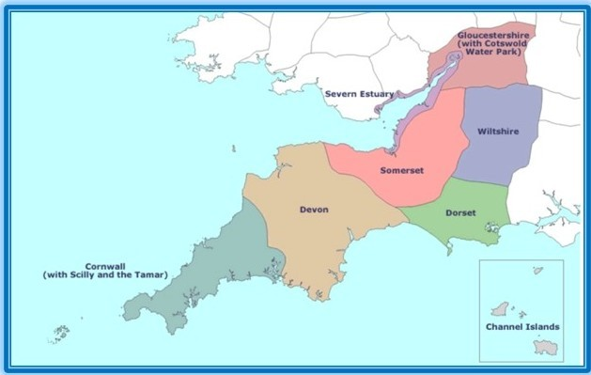
South West Region MDT Standard of Care outcomes?
Miss Lucy Simmons

Slide 2
MDT Outcomes
MDT’s increasing burden on time and staff with growing numbers for discussion week on week.
SOC’s may streamline discussions
Several SW centres using some SOC’s
Would it be possible to put together a working group to discuss and potentially agree Standard of Care outcomes to be used to Streamline our MDT’s?

Slide 3
Agreed SOC’s in other regions
North East London

Slide 4
Agreed SoC for Urology MDT (Barts, Homerton and BHR)
Condition | Group | Defined Patient Factors | Defined Pathology Factors | Defined Treatment Factors
Prostate Cancer | No prostate cancer on biopsy and low index of suspicion of missed lesion | All patients | MRI PIRADS 1–3, PSAD <0.15 and benign biopsy; No BRCA2 | Discharge with personalised PSA threshold for re-referral
 | Low risk (CPG1) in well patients | PS0, ASA 1–2 life expectancy >10 years no BRCA2 | PSA <10 and clinical/radiological T1T2 and ISUP Group 1. Biopsy and MRI concordant. | Active surveillance preferred; active treatment possible.
Bladder Cancer | Benign bladder lesions | All patients | Normal bladder, inflammation or other non-cancerous lesions not otherwise specified below | Discharge
 |  |  | Benign lesions with risk of recurrence or malignant potential e.g. PUNLMP, inverted papilloma, intestinal metaplasia, keratinising squamous metaplasia | Follow-up as per local protocol
 | Low-risk non-muscle invasive bladder cancer | PS0, ASA 1–2 life expectancy >10 years no Lynch syndrome | Urothelial carcinoma and solitary and <3 cm and low grade/ G1 and pTa | Flexible cystoscopy at 3 and 12 months, with follow up as per local policy
Renal Cysts | Benign renal cyst (Bozniak 1 and 2) | All patients | Bozniak 1-2 on initial report by internal uro-radiologist | Discharge. No surveillance
Renal Cysts | Benign renal cyst (Bozniak 2F) | All patients | Bozniak 2F on initial report by internal uro-radiologist | Initial discussion at MDT meeting Yearly scan for 5 years If no significant change, not for MDT review Discharge if no change after 5 years
Any cancer | Previous MDT discussion | Reviewed and agreed, previously. | Reviewed and agreed, previously. | Based on previous discussion. Review outstanding investigations. Action the decision accordingly.
Prostate cancer | Patient on active surveillance pathway | Reviewed and agreed, previously. | Reviewed and agreed, previously. | Decision on biopsy and target planning as per local protocol.
 | Post RALP and/or EBRT |  | PSA is <0.1 post RALP, or <2 post EBRT, or <0.2 post RALP and EBRT. | PSA surveillance (If PSA above these thresholds, needs face to face review)

Slide 5
SW SOC’s
Bath
Exeter
Taunton
?others

Slide 6
Royal United Hospital SOC Outcomes
Condition | Group | Defined Patient Factors | Defined Pathology Factors | Defined Treatment Factors
Prostate Cancer | CPG 1 prostate cancer | Patient under 70 years PS0, ASA 1–2 life expectancy >10 years no BRCA2 Gleason 6 (prognostic score 1) AND PSA < 10 ng/ml AND stage T1-T2 | Gleason 6 (prognostic score 1) AND PSA < 10 ng/ml AND stage T1-T2 | Offer low risk active surveillance (but discuss all options for information in case of future disease progression) No staging required Active Surveillance with 3 monthly PSA for 1 year, then 6 monthly PSAs for 2 years, then annual PSA. For MRI at 2 and 5 years. Consider repeat biopsy for MRI progression or PSA density of greater than 0.2. If stable after 5 years discharge to GP, annual PSA monitoring with personalised PSA re-referral level
Prostate Cancer | CPG 1 prostate cancer | Patient >70 years Gleason 6 (prognostic score 1) AND PSA < 10 ng/ml AND stage T1-T2 | Gleason 6 (prognostic score 1) AND PSA < 10 ng/ml AND stage T1-T2 | Recommend surveillance with PSA alone via PSA tracker. No staging required. For 6/12 PSA, with defined recall to clinic PSA level (Pre-meet urologist to define recall PSA)
Prostate Cancer | CPG 2 prostate cancer | Fit for radical treatment if progresses | Gleason 3+4 = 7 (prognostic score 2) OR PSA 10-20 ng/ml AND stage T1-T2 | Discuss all options, recommend standard active surveillance, no staging required
Prostate Cancer | Post RARP SOC |  | R0 resection No operative complications | To be followed up in CNS clinic For PSA surveillance

Slide 7
Royal United Hospital SOC Outcomes
Condition | Group | Defined Patient Factors | Defined Pathology Factors | Defined Treatment Factors
Testicular Cancer | Post orchidectomy | All post Orchidectomy patients |  | To be booked for CNS clinic 2/52 post op. Referred/to be referred to UHB Testicular MDT (LJF)
Bladder Cancer | For low risk surveillance solitary G1 or G2 pTa TCC <3cm | Fit for active treatment PS0, ASA 1–2 life expectancy >10 years no Lynch syndrome | solitary G1 or G2 pTa TCC <3cm | For flexi in 3 and 12 months and consider discharge if clear.
Bladder Cancer | Intermediate risk non-muscle invasive bladder cancer | Fit for active treatment PS0, ASA 1–2 life expectancy >10 years no Lynch syndrome |  | For MMC x6. Then flexible cystoscopy at 3, 9 and 18 months and thereafter annually. Discharge at 5 years.
Bladder Cancer | High risk superficial bladder cancer G3 Ta/T1 or CIS | Fit for active treatment PS0, ASA 1–2 life expectancy >10 years no Lynch syndrome |  | For staging CT Chest/IVU. Offer induction BCG x6. Discuss cystectomy for information. Consider repeat TURBT at 6/52. For flexible cystoscopy 3 monthly for 2 years, then 6 monthly for 2 years, then annually. For MDT review at 10 years, to consider discharge

Slide 8
Royal United Hospital SOC Outcomes
Condition | Group | Defined Patient Factors | Defined Pathology Factors | Defined Treatment Factors
Testicular Cancer | Post orchidectomy | All post Orchidectomy patients |  | To be booked for CNS clinic 2/52 post op. Referred/to be referred to UHB Testicular MDT (LJF)
Bladder Cancer | For low risk surveillance solitary G1 or G2 pTa TCC <3cm | Fit for active treatment PS0, ASA 1–2 life expectancy >10 years no Lynch syndrome | solitary G1 or G2 pTa TCC <3cm | For flexi in 3 and 12 months and consider discharge if clear.
Bladder Cancer | Intermediate risk non-muscle invasive bladder cancer | Fit for active treatment PS0, ASA 1–2 life expectancy >10 years no Lynch syndrome |  | For MMC x6. Then flexible cystoscopy at 3, 9 and 18 months and thereafter annually. Discharge at 5 years.
Bladder Cancer | High risk superficial bladder cancer G3 Ta/T1 or CIS | Fit for active treatment PS0, ASA 1–2 life expectancy >10 years no Lynch syndrome |  | For staging CT Chest/IVU. Offer induction BCG x6. Discuss cystectomy for information. Consider repeat TURBT at 6/52. For flexible cystoscopy 3 monthly for 2 years, then 6 monthly for 2 years, then annually. For MDT review at 10 years, to consider discharge

Slide 9
Royal United Hospital SOC Outcomes
Condition | Group | Defined Patient Factors | Defined Pathology Factors | Defined Treatment Factors
Renal Cysts

Slide 10
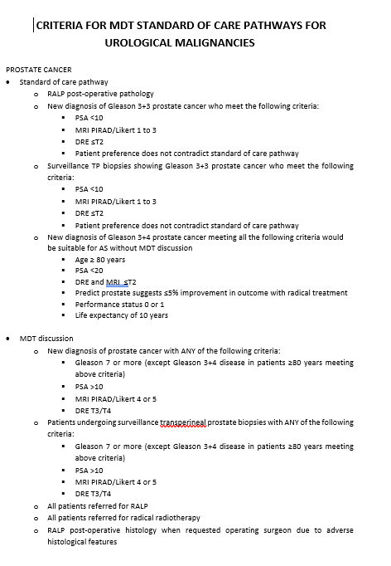
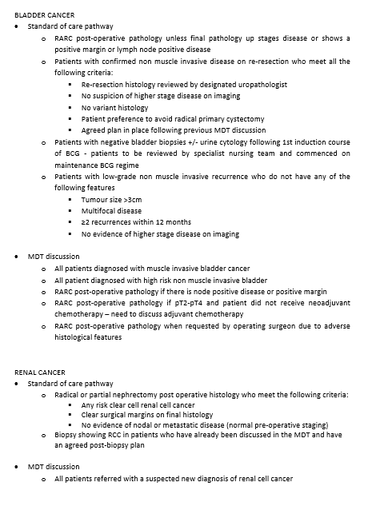
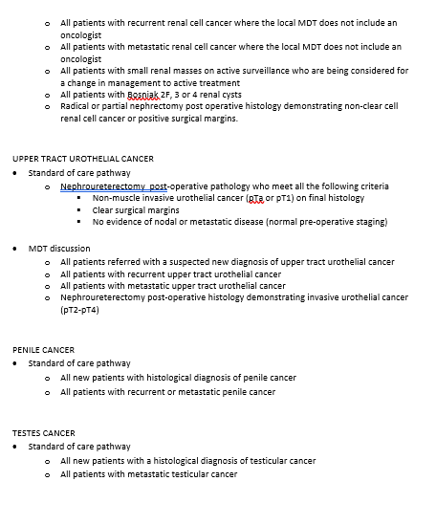
RD&E and Taunton

Slide 11
Thanks

