Slide 1
SWAGGER
Dr Helen Winter SWAG CD
13 Dec 2024
Connecting and Empowering the Delivery of Cancer Care Across SWAG Communities

Slide 2
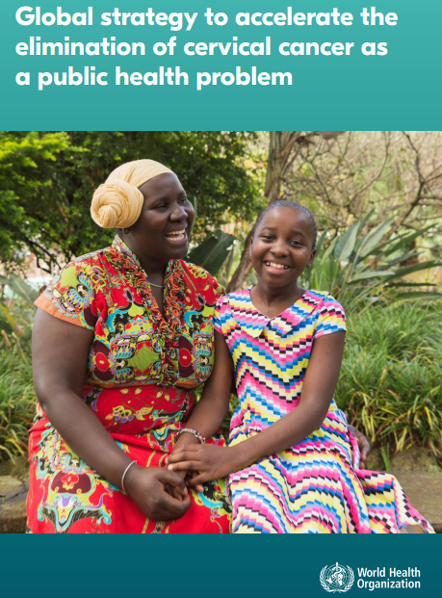
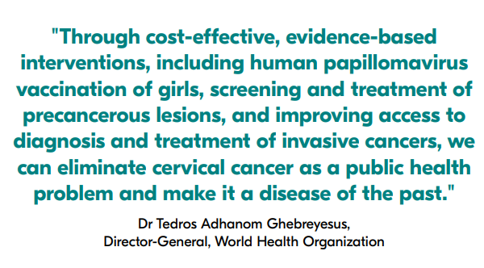
WHO Global Strategy to Eliminate Cervical Cancer
Source: WHO 2020, Global strategy to accelerate the elimination of cervical cancer as a public health problem
Notes:
In 2020, WHO launched a Global Strategy to Accelerate the Elimination of Cervical Cancer and 194 countries resolved to eliminate a cancer for the first time and WHO launched the Global strategy to eliminate cervical cancer as a public health problem with a global Day of Action for Cervical Cancer Elimination. Today follows the WHO Cervical Cancer Elimination Day of Action 2024 on Sunday the 17th November. Sources for notes:
Cervical Cancer Elimination Day of Action 2024

Slide 3
Event Agenda
 | Time | Title | Speaker
Welcome Teas & Coffees – sign up to workshop tables
1 | 10:00 | Welcome and introductions | Justin Varney-Bennett Regional Director of Public Health, DHSC / NHSE
2 | 10:10 | Pillar 2: Cervical Screening | Philippa Pearmain and Alison Cowie Consultant in Public Health / Cervical Screening Senior Clinical Lead, Head of Cervical Screening
3 | 10:30 | Pillar 1: Cervical Cancer Prevention – HPV Vaccination | Sharif Ismail Consultant Epidemiologist, UKHSA HPV lead
4 | 11:00 | South West Call to Action | Justin Varney-Bennett Regional Director of Public Health, DHSC / NHSE
11:30 – 20-minute Coffee Break
5 | 11:50 | Pillar 3: Timely Treatment - Cervical Cancer Treatment | John Rennison Clinical Chair, Peninsular Cancer Alliance
6 | 12:20 | National Cervical Cancer Elimination Plan | Kasia Olszewska Strategy and Policy Manager, NHSE Vaccination and Screening Directorate
7 | 12:30 | Service User feedback on Cervical Screening in Somerset | Carly Jackson Somerset ICB
12:45 – 1 hour LUNCH – find your workshop tables
8 | 13:45 | Introduction to Workshop and Q&A | NHSE South West Vaccination and Screening Team (VaST) Members
9 | 14:00 | Cervical Cancer Elimination Strategy Stakeholder Workshop | All Meeting Members
15:00 – 10-minute Coffee Break
10 | 15:10 | Cervical Cancer Elimination Strategy Stakeholder Workshop | All Meeting Members
11 | 15:50 | Thank you & Closing statement | NHSE South West VaST Members
16:00 CLOSE

Slide 4
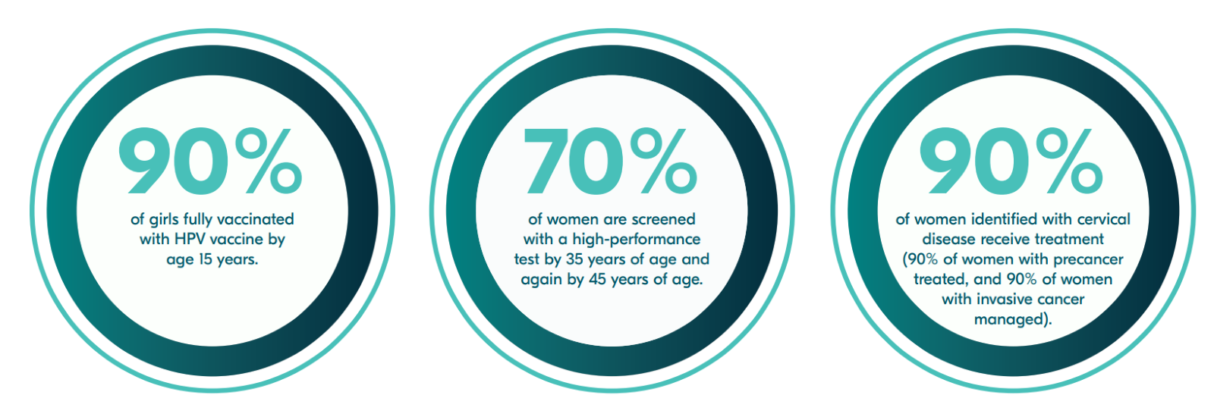
SW Cervical cancer elimination strategy
2020 WHO launched a Global Strategy to Accelerate the Elimination of Cervical Cancer
2023 NHS England pledged to eliminate cervical cancer by 2040 through the adoption of the WHO Strategy
2024 SW VaST preparation of the SW Cervical Cancer Elimination Strategy started
Dr Justin Varney-Bennett
Regional Director of Public Health
Sharif Ismail
Consultant Epidemiologist,
UKHSA HPV lead
Philippa Pearmain & Alison Cowie
Consultant in Public Health / Cervical Screening Senior Clinical Lead

Slide 5
Eliminating cervical cancer in the South West by 2040
Case for change
Acknowledgement to London for sharing their strategy
More than 2 women die every day from cervical cancer in the UK (4 in some areas of deprivation the SW), but 99.8% of cases are preventable,
The South West has a higher cervical cancer incidence rate than England (9.8 vs 9.4 per 100,000).​
To eliminate cervical cancer, we need to lower the incidence to < 4 per 100,000.
Over the next 5 years, the South West will:
increase HPV vaccination rates to at least 90% for boys and girls
halt the decline in cervical screening rates and increase the screening rate to at least 70% in the 25-49 cohort
ensure at least 90% of women diagnosed with cervical disease receive treatment.
This will enable us to meet the screening and vaccination targets by 2030 and eliminate cervical cancer in the South West by 2040.
Notes:
This slide highlights the case for change in the South West
The 5 year data. (2016-2020) used in this slide shows that 2 women die of cerical cancer in the UK every day, but in some most deprived areas in SW this is as high as 4. This is one reason why the South West has a higher cervical cancer incident rate than the England average. We need to have less than 4 per 100,000 in order to be considered as eliminating cervical cancer. As a small % of cervical cancers are not caused by HPV, there will still be some cervical cancers diagnosed after we meet the targets set out in the 3 pillars.
Over the next 5 years, we in the South West will increase HPV vaccine rates in both boys and girls. We know boys are protected against other HPV causing cancers so it is important they are vaccinated. We will increase coverage of cervical screening to achieve and exceed 70% coverage and ensure 90% of diagnosed cervical cancers are treated in a timely way. By achieving these by 2030, we will be able to eliminate cervical cancer by 2040.
This is an exciting time knowing that in the South West we have begun the journey to eliminate cervical cancer

Slide 6
In the SW, the strategy is more than achieving the 3 pillars..
Understand what is preventing engagement with HPV vaccination, cervical screening and timely treatment
Talk to the individuals themselves
Understand what is preventing access to HPV vaccination, cervical screening and timely treatment
Talk to the individuals themselves
Understand from the experts what is happening in the pathways, learning from them and working together to strengthen the pathways
Getting the right data and in a timely way
Reasonable deprivation data but very limited data on the protected characteristics
Getting those who are vaccinated to encourage their relatives/friends who are not vaccinated and are over 25 to attend for their cervical screen

Slide 7
Next Steps
Information from today will be gathered and shared to inform the development of the South West Cervical Cancer Elimination Strategy
Working groups will be organised & initiated
Await the publication of the National Strategy to inform action
1, 3, & 5 year goals will be agreed & set
Launch event in March 2025

Slide 8
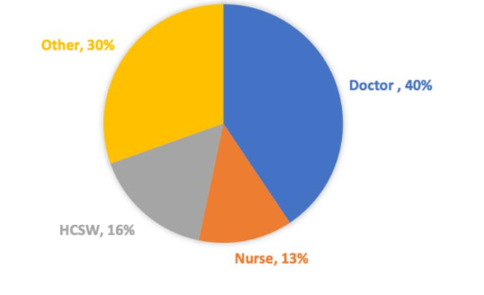
Cervical screening for our staff
Survey data from the 23rd of January 2023 until the 23rd of February 2023. 56 participants
Six participants had not been invited to attend for a smear test at the time of surveying and thus were excluded from our analysis. Most participants were aged 24-34 (59%, Table 1) and all identified as females with the same gender as assigned at birth. Forty percent of participants (20/50) were doctors, but several other professions were represented in our data including nurses, allied health professionals and those with administrative and managerial roles at WGH Dr Isabelle Wood and Dr Eva Larkai

Slide 9
What barriers have you experienced booking and attending your cervical screening?
'I’m currently on a waiting list with my GP, every time they call me to try and book my appointment I am at work, around colleagues, with a patient or not able to answer the phone. It’s a difficult and embarrassing conversation to have infront of people.'
'My GP releases smear appointments that are always during working hours, because of staffing levels taking time out of work to go is really difficult'
'I am unable to book a test without taking time off of work because of what my GP has available to me'
'Needed to go for LLETZ and colposcopy on different occasions and had to prove this with my appointment letter to take time out of work. Would have preferred not to have to share these very personal details.'
'My smear is two years overdue because my GP says they don't have the capacity and it's making me very anxious'

Slide 11
In Exeter and Barnstaple we have been offering an evening drop in screening clinics for a number of years The clinics are well attended and popular Higher proportion of attenders are overdue screening by more than 5 years The positive cytology rate is higher than baseline screening levels

Slide 12
Reason for attendance
Reason Provided | Total number of patients
Convenience | 269
No GP appointments | 139
GP unsuccessful | 19
Works at GP surgery | 4
Prefers coming here | 9
Other reasons | 25
No reason given | 9
473 attended for screening
Feedback 100% positive
Time of clinic is good for most attendees
High attendance of NHS staff
Since clinic started 2 cancers detected – both early and successfully treated
Reason Provided | Total number of patients
Convenience | 269
No GP appointments | 139
GP unsuccessful | 19
Works at GP surgery | 4
Prefers coming here | 9
Other reasons | 25
No reason given | 9

Slide 13
Rota commitments
“Busy rota pattern makes difficult to find time to book” “I don't have time to fit in with my shifts, particularly because I have issues with transport” “Time taken to get to GP and back to hospital so had to change appointment to after work” “I am unable to book a test without taking time off of work” “Work rota. Minimal times to attend” “Always working hours only appointments, practice is a distance from work” “Yes rota pressures” “GP timings and when I have annual leave booked”
Communication Barriers
“Poor communication from GP” “Just being able to phone to make the appointment is difficult as they are so busy” “Getting through to actually book an appointment without being on hold for a long time” “I’m currently on a waiting list, every time they call me to try and book my appointment I am at work, around colleagues or patients or not able to answer the phone. It’s a difficult conversation to have Infront of people sometimes”
Issues getting appointments
“Cancellations” “Long waiting appointment and telephone” “Fitting in between shifts as appointments not available” “Booking GP appointment at time outside of working hours” “Always working hours only appointments, practice is a distance from work” “GP timings and when I have annual leave booked” “Appointment time availability”
Other personal barriers “Needed to go for LLETZ and colposcopy on different occasions and had to prove this with my appointment letter. Would have preferred not to have to share these personal details” “Irregular periods” “Pain” “Pregnancy/6 months following birth”

Slide 14
Cervical screening for our staff
Lets make this a reality for all NHS and Social Care Staff
Thanks to Drs Isabelle Wood & Eva Larkai
Rajvinder Dhillon & Becky Handley
All ther colleagues providing care for our staff

