Slide 1
SWAG Network Urological Cancer
Clinical Advisory Group
Research Update
Claire Matthews
26/06/2025

Slide 2
National Urological Cancer Research Recruitment
Apr 24 - Mar 25
Apr 25 - Jun 25
Data cut 25/06/2025
Source: ODP All Portfolio

Slide 3
Open Prostate Cancer Studies (SWAG Region)
CPMS ID | Short Name | Sites in region | Opening | Closure | Sample Size Eng | Eng Recruits
54997 | ArtemisPRO | Yeovil | 16/01/2024 | 30/05/2025 | 50 | 45
32051 | BARCODE 2 | Yeovil (PIC) | 25/05/2017 | 30/09/2025 | 450 | 313
54481 | CAAA617D12302: [177Lu]Lu-PSMA-617 in Oligometastatic Prostate Cancer | BHOC | 05/12/2024 | 30/03/2026 | 17 | 0
48496 | Diagnostic Accuracy of LI-MRI vs mp-MRI in Prostate Cancer (CLIMATE) | NBT | 31/03/2022 | 31/08/2026 | 602 | 381
63289 | ELIPSE | Chelt (in setup), NBT | 30/09/2024 | 31/08/2026 | 0 | 129
52871 | IP7-PACIFIC | NBT recruitment on hold | 03/10/2022 | 01/02/2026 | 3600 | 1,238
51837 | OSCAR | Musgrove, Yeovil | 01/03/2022 | 01/09/2031 | 0 | 854
52562 | PACE-NODES | Chelt. | 05/09/2022 | 30/09/2025 | 1038 | 1,036
48429 | PEARLS | Musgrove | 24/06/2021 | 30/09/2027 | 750 | 427
62335 | POINTER-PC | Musgrove | 14/01/2025 | 01/07/2028 | 432 | 7
40158 | Precision medicine in a prostate cancer genetic risk clinic | St Michaels's (PIC) | 04/03/2019 | 31/12/2025 | 2000 | 2,000
52937 | TAPS02 | NBT | 24/04/2023 | 01/07/2027 | 399 | 42
16408 | The PROFILE Study | BHOC (PIC) | 06/02/2015 | 31/12/2025 | 1500 | 1,402
60178 | Treatment and Adherence Support for Minorities (TRANSFORM) | UHBW | 08/07/2024 | 01/11/2025 | 200 | 165
47442 | Urine Biomarkers for detecting prostate cancer | Salisbury | 01/12/2020 | 31/12/2029 | 4000 | 1,586

Slide 4
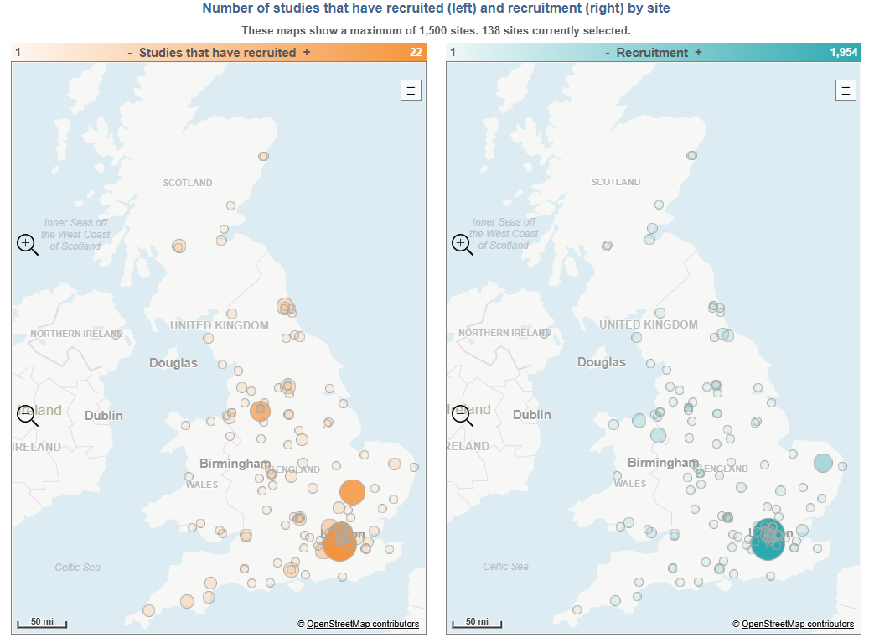
National Prostate Cancer Research Recruitment
72 studies currently open nationwide.
28 Commercial
45 Non-commercial
Full list available here: National open prostate cancer studies June 25
Data cut 25/062025
Source: ODP All Portfolio

Slide 5
Open Bladder Cancer Studies
Other Urological Cancer Studies
CPMS ID | Short Name | Sites in region | Opening | Closure | Sample Size Eng | Eng Recruits
50666 | DISCUS | Musgrove | 16/12/2021 | 30/06/2026 | 173 | 65
58705 | Duravelo-2 | BHOC | 27/06/2024 | 31/08/2026 | 30 | 23
60694 | MoonRISe-1 | NBT | 17/05/2024 | 10/06/2028 | 30 | 16
CPMS ID | Subspecialty | Short Name | Sites in region | Opening | Closure | Sample Size Eng | Eng Recruits
48297 | Lung Cancer | E²-RADIatE (EORTC 1811) | Somerset | 15/09/2021 | 01/03/2026 | 60 | 72
39433 | Lung Cancer | ICI Genetics | Musgrove, (UHBW suspended) | 12/04/2019 | 30/09/2025 | 3100 | 2,775
54260 | Breast Cancer | LION | RUH | 08/05/2024 | 10/04/2026 | 89 | 15
43756 | Skin Cancer | MITRE | RUH, Somerset, BHOC | 08/07/2020 | 28/02/2026 | 1296 | 324
50169 | Renal Cancer | REFINE | RUH, Musgrove | 25/05/2022 | 31/12/2025 | 96 | 40
33372 | Testicular Cancer | UK P3BEP Trial | BHOC, BRHC | 05/05/2017 | 31/12/2026 | 85 | 78
Data cut 24/06/2025
Source: ODP All Portfolio

Slide 6
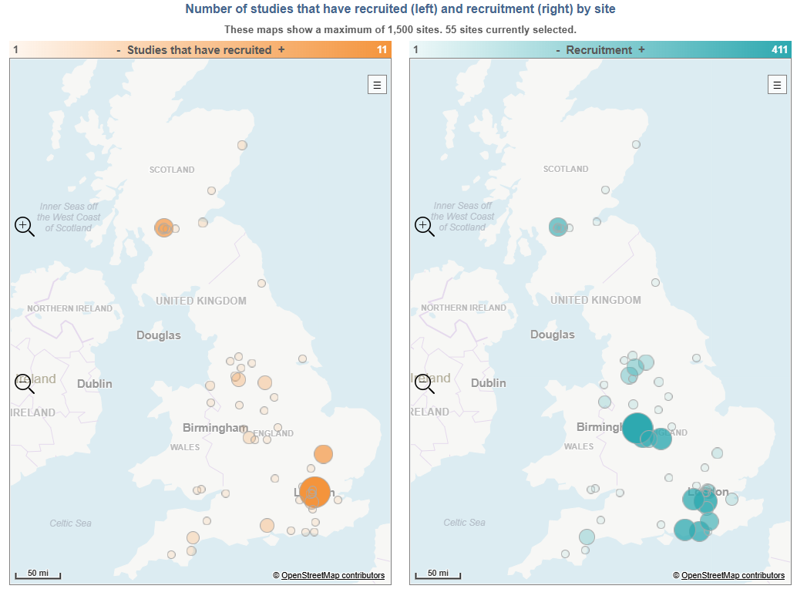
National Bladder Cancer Research Recruitment
37 studies currently open nationwide.
17 Commercial
20 Non-commercial
Full list available here:
National open bladder cancer studies June 25
Data cut 25/062025
Source: ODP All Portfolio

Slide 7
Studies in set-up/under consideration in SWAG region
CPMS ID | Commercial Study | Primary Subspecialty | sites | Short Name | Phase | Planned Opening | Planned Closure | Sample Size Eng | Sponsor
67159 | Comm | Bladder Cancer | Salisbury, Musgrove | Intravesical BCG + ALT-803 (N-803) in Patients With NMIBC | II | 16/06/2025 | 17/12/2029 | 50 | ImmunityBio, Inc
66842 | Comm | Bladder Cancer | Salisbury | LUNAR | I/II | 01/06/2025 | 31/12/2026 | 2 | Ferring Pharmaceuticals Limited
66432 | Comm | Prostate Cancer | BHOC | Evaluation of Lutetium (177Lu) rhPSMA-10.1 injection in men with mCRPC | I/II | 03/07/2025 | 01/02/2026 | 16 | Blue Earth Therapeutics Limited
66284 | Comm | Bladder Cancer | Salisbury, Musgrove, Yeovil | CAVE | N/A | 27/06/2025 | 27/06/2025 | 200 | ENTIA LTD
60390 | Comm | Testicular Cancer | Musgrove, BHOC | BNT211-02- BIONTECH- TESTICULAR CANCER-4781/0067 | II | 30/11/2025 | 10/06/2026 | - | BioNTech SE
60146 | Non-Comm | Prostate Cancer | Musgrove, Yeovil, NBT | Understanding Prostate Cancer Stigma in Black Men (DESTIGMATISE) V1.0 | N/A | 01/03/2025 | 28/02/2030 | 453 | University of Hull
58251 | Non-Comm | Prostate Cancer | Musgrove | AVIDITY | III | 01/06/2025 | 01/06/2027 | 1100 | Imperial College of Science, Technology and Medicine
55197 | Non-Comm | Bladder Cancer | NBT, Chelt | HIVEC - HEAT | III | 01/07/2025 | 01/07/2027 | 208 | University of Leicester
53292 | Comm | Bladder Cancer | Musgrove, Yeovil, Salisbury, RUH | R392101 | III | 01/06/2025 | 31/12/2025 | 20 | Fidia Farmaceutici S.P.A.
Data cut 25/062025
Source: ODP All Portfolio

Slide 8
Be Part of Research https://bepartofresearch.nihr.ac.uk/

Slide 9
Campaign objectives
Primary objective:
Increase number of people registered with Be Part of Research by 300% over an 18-24 month period
Secondary objectives:
Increase volunteers from under-represented demographics
Black ethnicities: 1.9% increase (2.1% to ONS: 4.0%)
Asian ethnicities: 3.4% increase (5.9% to ONS: 9.3%)
18-24 age bracket by 3.4% (4.9% to ONS: 8.3%)

Slide 10
Key messages
Be Part of Research makes it easier than ever to find and take part in health and care research.
Simply sign up online and choose the areas of research you’re interested in.
You’ll then be matched to suitable studies and sent clear information about what’s involved and how you can take part.
The decision on whether to take part is always yours.

Slide 11
Leaflets https://bepartofresearch.nihr.ac.uk/researchers-and-health-and-care-professionals/

Slide 12
Print posters: 5 designs

Slide 13
Associate Principal Investigator
Scheme
Six month in-work training opportunity, providing practical experience for healthcare professionals starting their research career.
People who would not normally have the opportunity to take part in clinical research in their day to day role have the chance to experience what it means to work on and deliver a NIHR portfolio trial under the mentorship of an enthusiastic Local PI.
CIs working with a CTU can register their study on the scheme
https://www.nihr.ac.uk/health-and-care-professionals/career-development/associate-principal-investigator-scheme.htm

Slide 14
Principal Investigator Pipeline Programme
(PIPP)
Overview
Research delivery nurses or midwives
12 to 18 months
Free if you’re eligible
Live virtual lessons, online learning and hands-on experience
Cohort 4 applications open at the end of March 2025
Please email nursingandmidwifery@nihr.ac.uk for more information
https://www.nihr.ac.uk/career-development/clinical-research-courses-and-support/principal-investigator-pipeline-programme

Slide 15
NIHR ODP https://odp.nihr.ac.uk/
Open data platform. Data on performance across whole RDN, including all specialty areas
NIHR Be Part of Research https://bepartofresearch.nihr.ac.uk/
See which studies are open across the country
Find a Clinical Research Study (ODP) http://csg.ncri.org.uk/portfolio/portfolio-maps/
Search for a study to fit criteria. Good for horizon scanning, eligibility criteria

Slide 16
RRDN Contacts
swc.rrdn@nihr.ac.uk
Study Support Service Manager: claire.matthews@nihr.ac.uk
CAG Research Lead: amit.bahl@uhbw.nhs.uk

