Slide 1
SWAG Network Skin Cancer
Clinical Advisory Group
Research Update
Claire Matthews
18/06/2025

Slide 2
National Recruitment to Skin Cancer Studies
Apr 2024 - Mar 2025
Apr 2025 - Jun 2025
Data cut 10/06/2025
Source: ODP All Portfolio

Slide 3
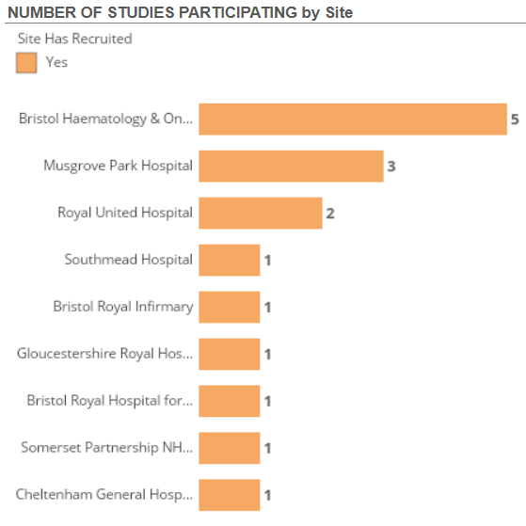
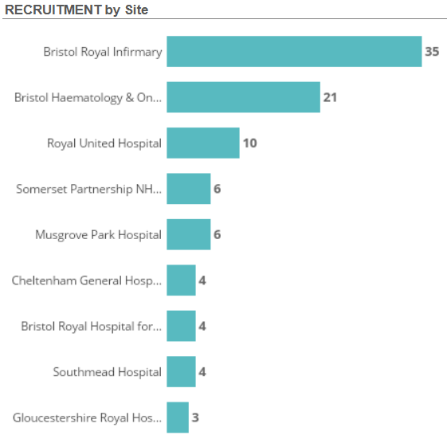
Studies and Recruitment by site Apr 2024 - present
Data cut 10/06/2025
Source: ODP All Portfolio

Slide 4
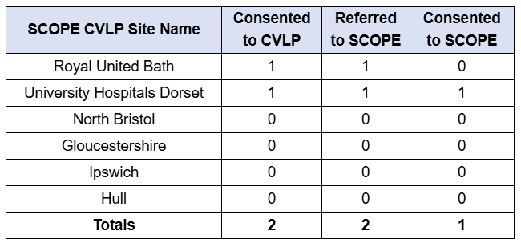
CVLP & Cancer Vaccine trials
From CVLP June Newsletter:
CVLP / SCOPE (Advanced Melanoma) – 2 patients have consented to the CVLP trial for SCOPE, with one of these participants HLA-matched. This is a great milestone as HLA-matched patients are typically more challenging to recruit. We would like to congratulate Dorset and Bath on consenting these patients.

Slide 5
CPMS ID | Short Name | Sites | Study Opened | Planned Closure | Sample Size Eng | Eng Recruits
58643 | DETECTION-2 | RUH | 27/11/2024 | 31/12/2025 | 40 | 21
56560 | The RESCUE Study | Musgrove | 08/09/2023 | 30/04/2026 | 350 | 198
55753 | Mobilize Trial | Musgrove, Yeovil | 24/08/2023 | 28/10/2025 | 25 | 28
55631 | UKKCC Skin Cancer Atlas v1.0 | NBT, Glos | 01/09/2023 | 01/03/2026 | 30 | 15
55144 | Fianlimab + Cemiplimab Versus Pembrolizumab In Patients With Completely Resected High-Risk melanoma | Musgrove | 15/11/2023 | 03/03/2025 | 10 | 10
54772 | IMPACT | BHOC | 28/09/2023 | 30/04/2027 | 35 | 28
52188 | Phase 3: Fianlimab (Regn3767, Anti-Lag-3) + Cemiplimab Vs Pembrolizumab In Patients With Melanoma | BHOC | 14/02/2023 | 13/04/2030 | 26 | 8
50634 | MyMelanoma: An Accessible Resource Melanoma Cohort Study | Yeovil | 01/09/2022 | 31/08/2027 | 17,150 | 1,469
50169 | REFINE | Musgrove, Yeovil | 25/05/2022 | 31/12/2025 | 96 | 40
44146 | Melanoma Wide Excision Trial - MelMarT-II | NBT | 18/08/2020 | 31/12/2025 | 750 | 566
43756 | MITRE | Som Part, RUH, BHOC | 08/07/2020 | 28/02/2026 | 1296 | 333
40068 | The SCOPE Study (cancer vaccine study) | Musgrove | 19/08/2019 | 31/12/2025 | 130 | 83
38748 | Observational Study of Melanoma Patients Treated with IMLYGIC® | Glos, Musgrove | 22/01/2019 | 31/08/2032 | 104* | 55
36774 | Long and Short-Term effects of Standard-of-Care treatments for Cancer | NBT | 13/05/2020 | 31/10/2026 | 250 | 98
SWAG Open Studies
Data cut 05/11/2024
Source: ODP All Portfolio

Slide 6
SWAG region In Setup Skin Cancer Studies
CPMS ID | Commercial Study | Short Name | Title | Planned Opening | Planned Closure | Sample Size Eng | Sponsor | Sites
62742 | Non-Comm | PerceIVe | Power of liquid biopsy tracking in immunotherapy treated stage III and IV melanoma (PerceIVe) | 12/05/2025 | 01/01/2028 | 100 | THE ROYAL MARSDEN NHS FOUNDATION TRUST | RUH
Data cut 11/06/2025
Source: ODP All Portfolio

Slide 7
Be Part of Research

Slide 8
Campaign objectives
Primary objective:
Increase number of people registered with Be Part of Research by 300% over an 18-24 month period
Secondary objectives:
Increase volunteers from under-represented demographics
Black ethnicities: 1.9% increase (2.1% to ONS: 4.0%)
Asian ethnicities: 3.4% increase (5.9% to ONS: 9.3%)
18-24 age bracket by 3.4% (4.9% to ONS: 8.3%)

Slide 9
Key messages
Be Part of Research makes it easier than ever to find and take part in health and care research.
Simply sign up online and choose the areas of research you’re interested in.
You’ll then be matched to suitable studies and sent clear information about what’s involved and how you can take part.
The decision on whether to take part is always yours.

Slide 10
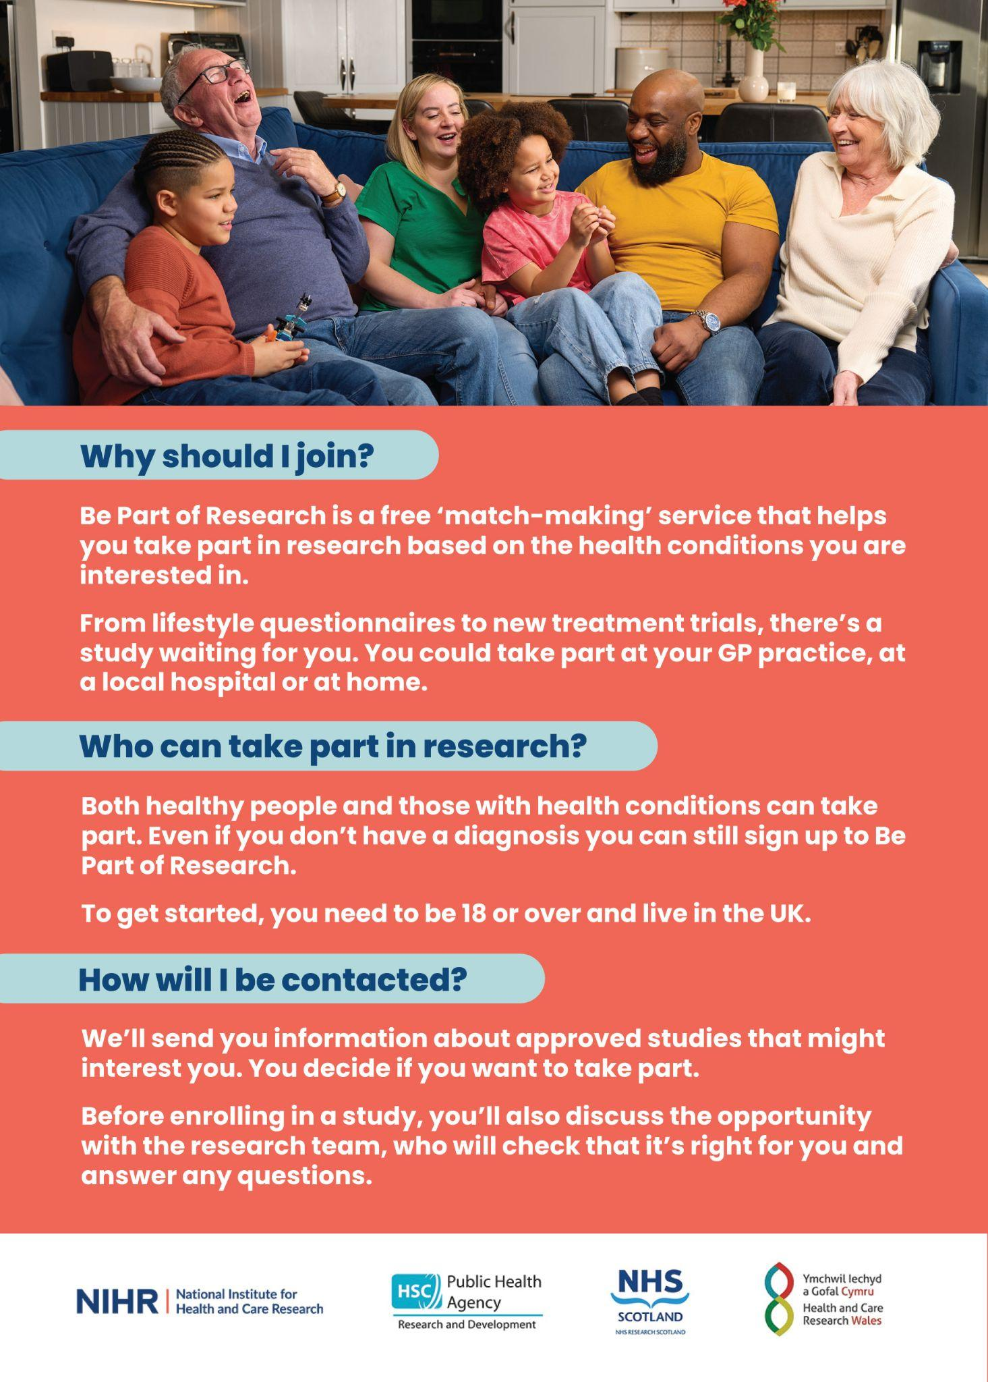
Leaflets

Slide 11
Print posters: 5 designs

Slide 12
Associate Principal Investigator
Scheme
Six month in-work training opportunity, providing practical experience for healthcare professionals starting their research career.
People who would not normally have the opportunity to take part in clinical research in their day to day role have the chance to experience what it means to work on and deliver a NIHR portfolio trial under the mentorship of an enthusiastic Local PI.
CIs working with a CTU can register their study on the scheme
https://www.nihr.ac.uk/health-and-care-professionals/career-development/associate-principal-investigator-scheme.htm

Slide 13
Principal Investigator Pipeline Programme
(PIPP)
Overview
Research delivery nurses or midwives
12 to 18 months
Free if you’re eligible
Live virtual lessons, online learning and hands-on experience
Cohort 4 applications are now closed
Please email nursingandmidwifery@nihr.ac.uk for more information
https://www.nihr.ac.uk/career-development/clinical-research-courses-and-support/principal-investigator-pipeline-programme

Slide 14
NIHR ODP https://odp.nihr.ac.uk/
Open data platform. Data on performance across whole RDN, including all specialty areas
NIHR Be Part of Research https://bepartofresearch.nihr.ac.uk/
See which studies are open across the country
Find a Clinical Research Study (ODP) http://csg.ncri.org.uk/portfolio/portfolio-maps/
Search for a study to fit criteria. Good for horizon scanning, eligibility criteria

Slide 15
RRDN Contacts
swc.rrdn@nihr.ac.uk
Study Support Service Manager: claire.matthews@nihr.ac.uk
CAG Research Lead: christopher.herbert@uhbw.nhs.uk

