Slide 1
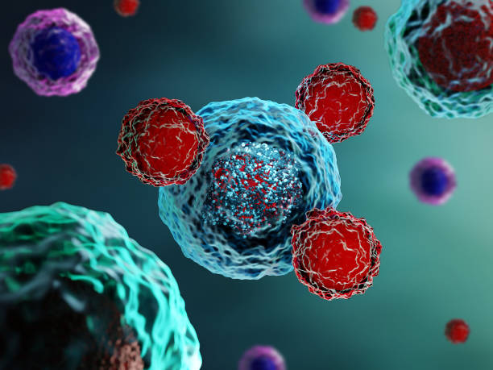
Immunotherapy and Rheumatology – an update
Dr Andrew Allard
Consultant Rheumatologist
SWIG
June 2025

Slide 2
Disclosures
I have received sponsorship, grant funding or speaker’s fees from the following:
Abbvie, Bristol Myers Squibb, Eli Lilly, Novartis, Pfizer, Roche, UCB.

Slide 3
Overview
Review of guidelines
Local experience
Local pathways
Common questions
REACT study

Slide 4
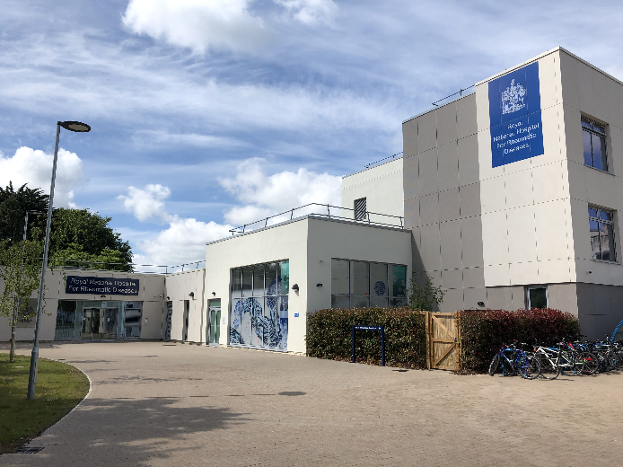
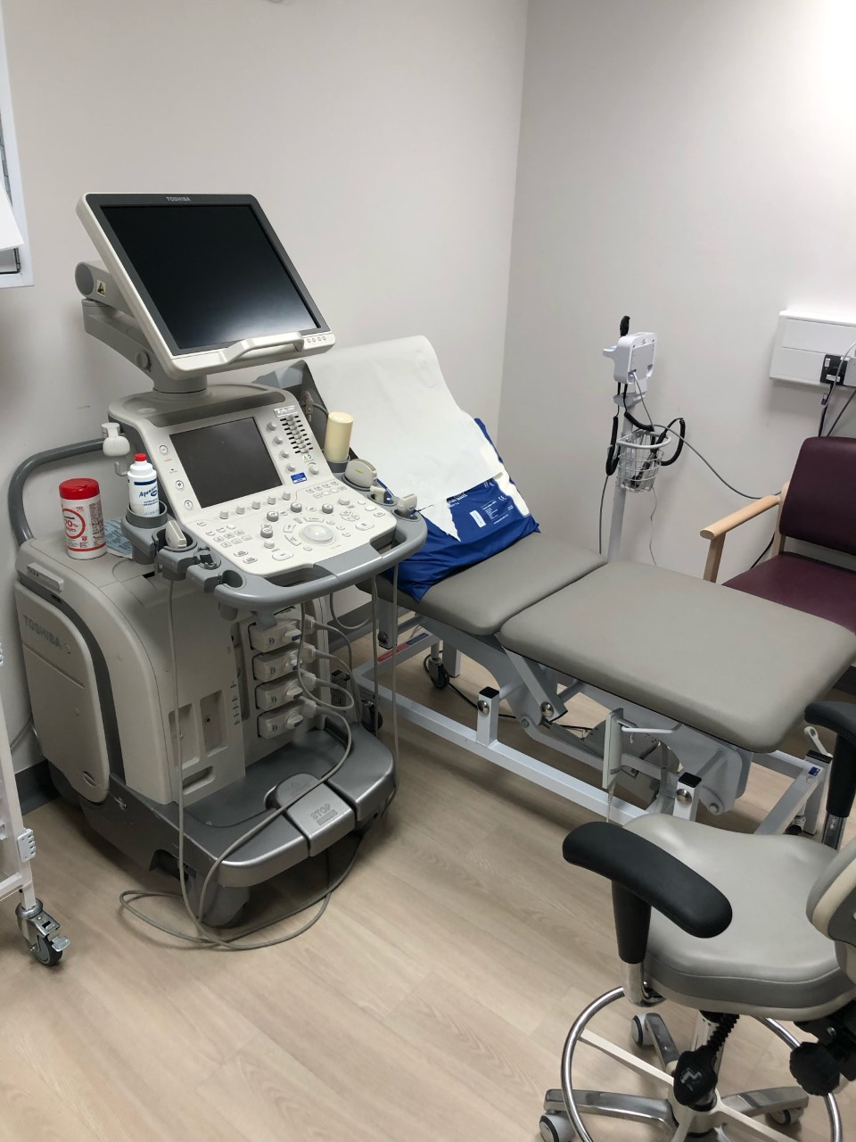
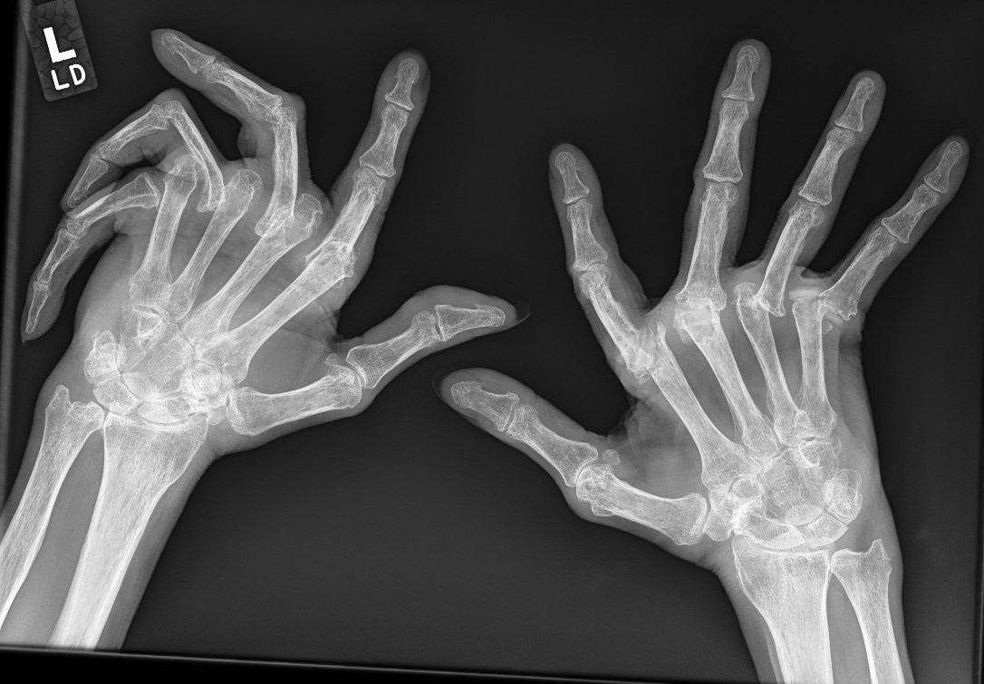
About me…

Slide 5
Background
The use of immune check point inhibitors (ICIs) to treat a range of malignancies continues to gather pace!
ICIs comprise of antibodies developed to target immune checkpoints including CTLA-4, PD-1, and PD-L1
Newer targets including anti-LAG3
Approximately 10% (1–43% for arthralgia) of patients receiving ICIs develop a rheumatic musculoskeletal immune-related adverse event (irAE)
Arthralgia, myalgia, sicca symptoms
Inflammatory arthritis
PMR-like syndromes, myositis, vasculitis, PsA, RS3PE, sarcoidosis, scleroderma, cutaneous lupus
Reporting of rheumatic irAEs is challenging
Identification of true irAE versus paraneoplastic phenomena
Non-inflammatory versus inflammatory symptoms
Some clinical trials haven’t always reported rheumatic irAEs as a distinct adverse outcome or only report severe events

Slide 6
Guidelines

Slide 7
Guidelines
European Society of Medical Oncology 2017 (2022 update)
American Society of Clinical Oncology 2018 (2021 update)
The National Comprehensive Cancer Network 2020
Society for Immunotherapy of Cancer 2021
European League Against Rheumatism 2021

Slide 8
Guidelines
European Society of Medical Oncology 2017 (2022 update)
American Society of Clinical Oncology 2018 (2021 update)
The National Comprehensive Cancer Network 2020
Society for Immunotherapy of Cancer 2021
European League Against Rheumatism 2021

Slide 9
Guidelines - updates
ESMO 2022 update more detailed and in line with ASCO guidance
How to investigate and approach initial treatment
Advice on steroid dosing and potential DMARDs to consider
Specific guidance on inflammatory arthritis, PMR like syndromes and myositis.
Advocate referral to rheumatology as early as grade 2 disease
Further guidance including Sicca symptoms and acknowledgement of rarer rheumatological presentations

Slide 10
Guidelines - EULAR

Slide 11
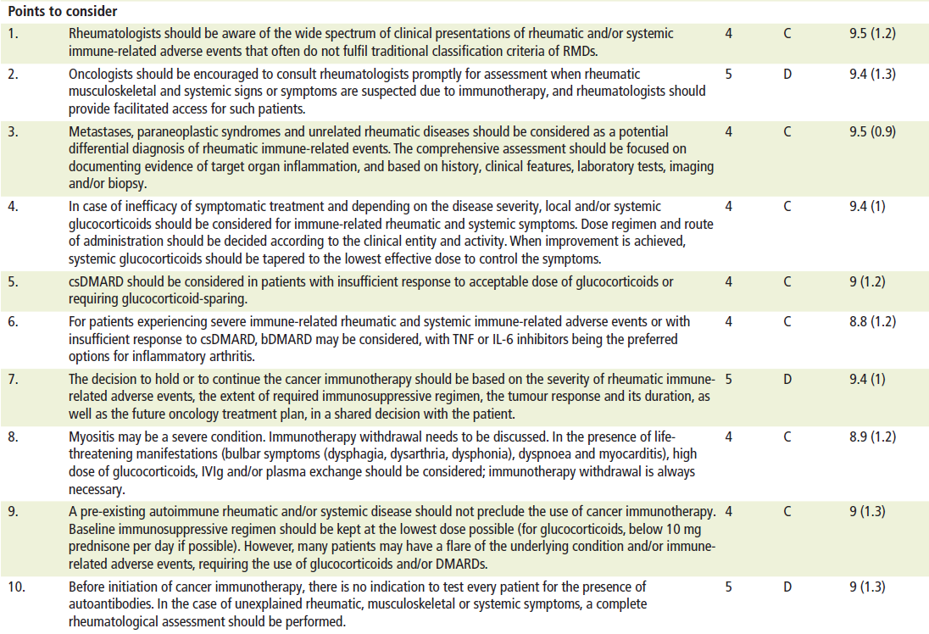
Guidelines - EULAR

Slide 12
The Bath experience to date

Slide 13
The Bath Experience – “early” days
Retrospective Cohort analysis Aug 2016-Dec 2023
636 patients identified as having initiated ICI Aug 2016-Dec 2022
78 excluded from subsequent analysis
Routine clinical data was analysed until Dec 2023, 6 months post discontinuation of ICI or patient death (whichever occurred first)
43/558 reported as having developed rheumatic adverse event (7.7%)
25/43 within 6 months and 35/43 within 12 months of initiating ICI
32/43 arthralgia; 22/43 reported to have objective evidence of synovitis
18/43 referred to rheumatology
Ho et al. BSR 2025

Slide 14
The Bath Experience – “early” days
Retrospective Cohort analysis Aug 2016-Dec 2023
Treatments:
3/43 received csDMARDs
2/43 due to commence bDMARD but aborted
1 due to disease progression
1 due to patient concerns regarding cancer risks
32/43 received systemic steroids
Average total cumulative dose equivalent to prednisolone 2367mg
Average daily dose equivalent to prednisolone 11.2mg
Ho et al. BSR 2025

Slide 15
The Bath Experience – the present
Oncology (as of July 2023)
>750 patients on CPI therapy (>310 Lung, >190 Melanoma, >70 Bladder >40 H&N)
<20 Renal, UGI, Gynaecology (Pembro), Breast (Pembro and Chemo), Liver (Atezo and Bev) and a few others
Arthralgia and sicca symptoms common
Occasional myalgia
1 case of PMR-like syndrome, Sjogren’s and sarcoidosis

Slide 16
The Bath Experience – the present
Rheumatology
~15-20 cases of inflammatory arthritis
1 case of confirmed Raynauds
1 case of suspected APLS/SLE
1 case of systemic sclerosis/inflammatory arthritis overlap
Flares of established rheumatic disease
Evidence suggests around 50% of RA patients flare on commencing ICI (25–64% for other rheumatic conditions)
Approximately 80% continue ICI
Regionally a few cases of myositis, a case of large vessel vasculitis and a further case of systemic sclerosis

Slide 17
The Bath Experience – the present
Local pathways
Direct communication between oncology and named rheumatologist
Patients referred urgently and triaged either to Early Inflammatory Arthritis pathway or urgent Connective Tissue Disease clinic appointment
Patients seen within 3 weeks of referral
Local referral treatment guidelines and pathway established to assist referral decisions
Based on existing guidelines

Slide 18
Local pathways

Slide 19
Local Pathway - 2023
Developed in collaboration with oncology
Guidance around definitions, investigation, treatment and referral for:
Inflammatory Arthritis
Polymyalgia Rheumatica like Syndromes
Myositis
Further guidance for:
Other connective tissue disease presentations
Management of Sicca symptoms
How to refer

Slide 20
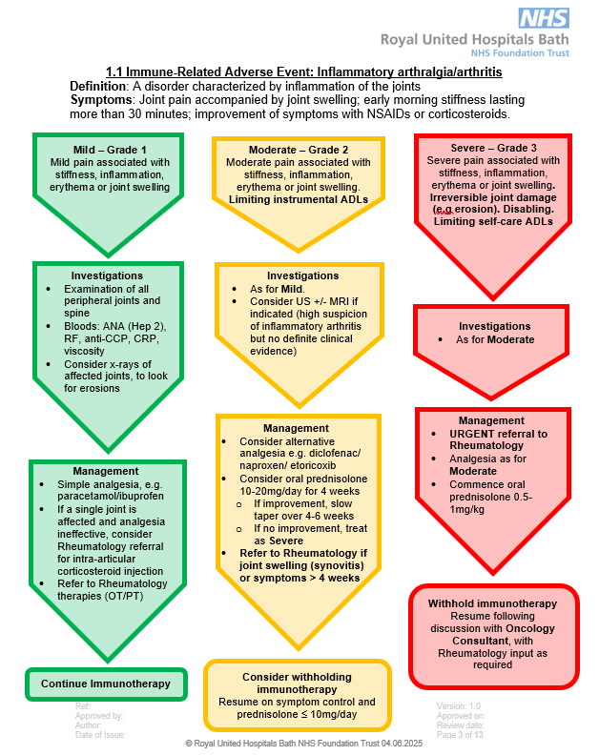
Local Pathway

Slide 21
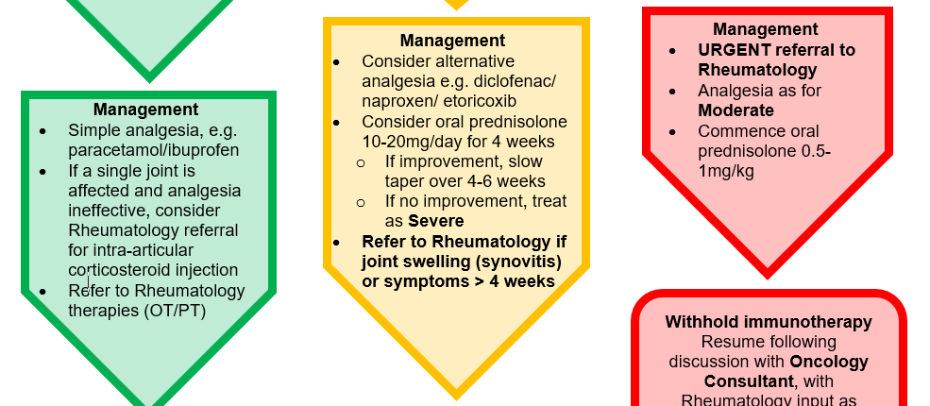
Local Pathway – when to refer?
i.e. any patient with inflammatory arthritis as a toxicity, especially if not responding to treatment.

Slide 22
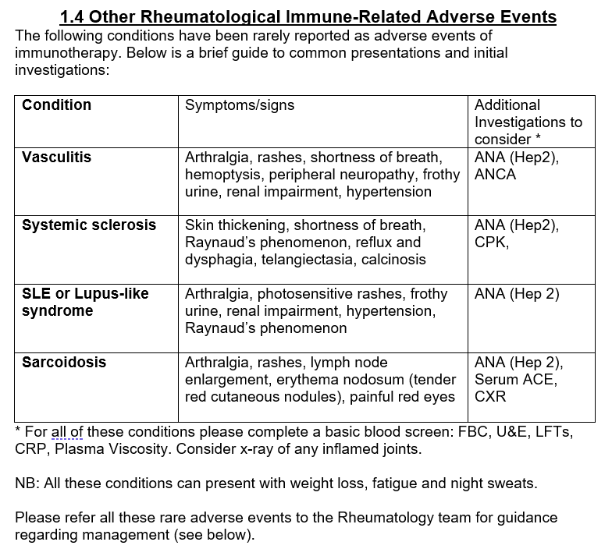
Local Pathway

Slide 23
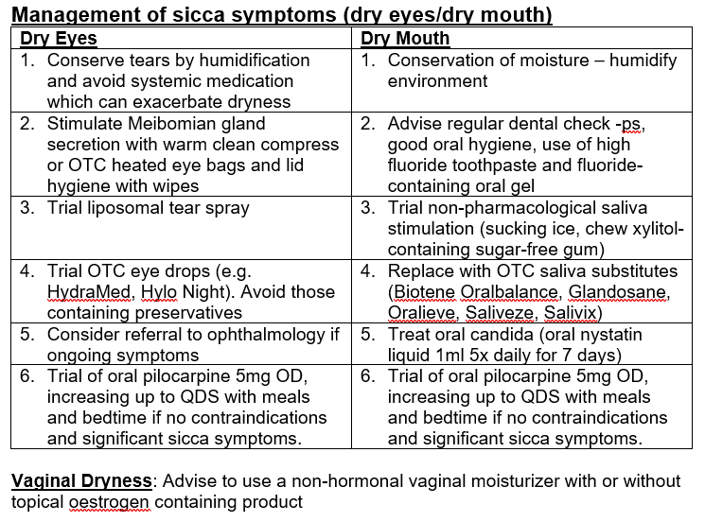
Local Pathway

Slide 24
Common Questions

Slide 25
Common questions for rheumatology
Arthralgia vs arthritis – i.e. what tests to do?
Bone health?
Treatment?

Slide 26
What tests to do?
No need to test antibody status pre ICI treatment (EULAR 2021)
Exception is ACh-R and anti-striated muscle Abs in known thymoma
In patients with suspected ICI rheumatic disease antibody testing may have diagnostic value (but often seronegative)
Imaging to confirm is helpful
XR – in the acute setting mostly helpful to exclude other causes
US/MRI – confirm synovitis/myositis etc
PET CT – has a role where cause/focus unclear

Slide 27
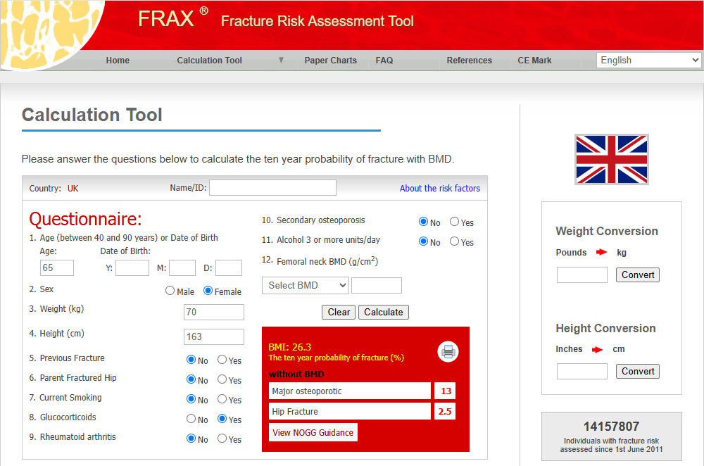
Bone health?

Slide 28
Bone health?

Slide 29
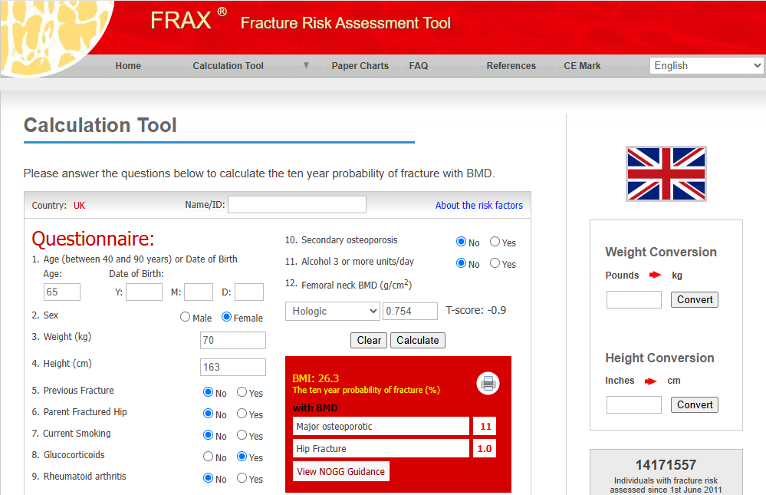
Bone health?

Slide 30
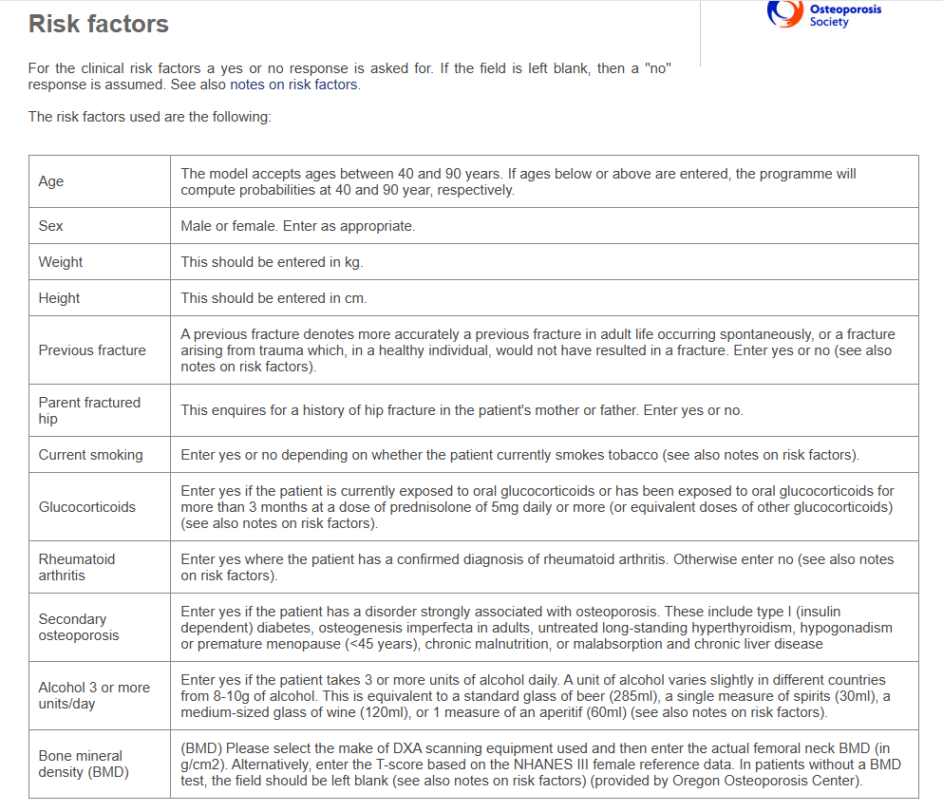
Bone health?

Slide 31
Bone health?

Slide 32
Treatment?
?
Assess for synovitis
Steroids
csDMARDs
bDMARDs
Clinical
Radiological
Blood tests
Trial NSAID?
PO Prednisolone 20–30mg
IM methyl-prednisolone 80–120mg
IA methyl-prednisolone
IV methyl-prednisolone 500–1000mg
Methotrexate
Sulfasalazine
Hydroxy-chloroquine
Anti-TNF
Tocilizumab

Slide 33
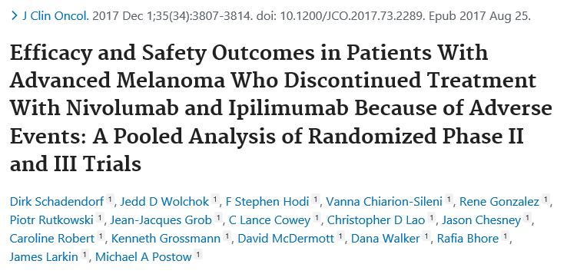
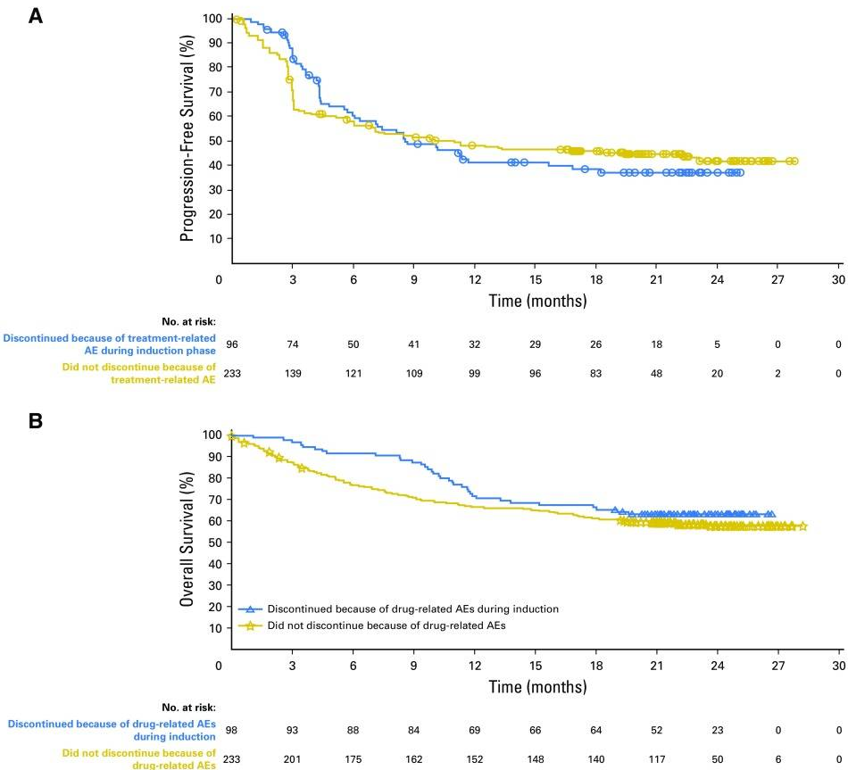
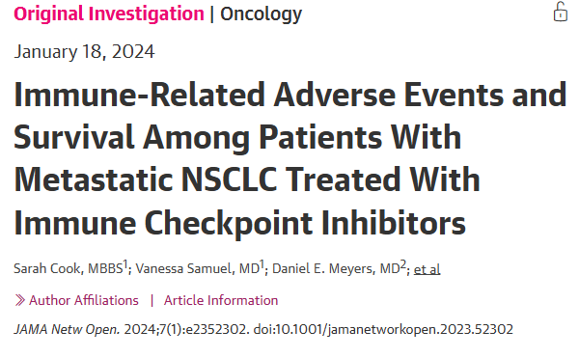
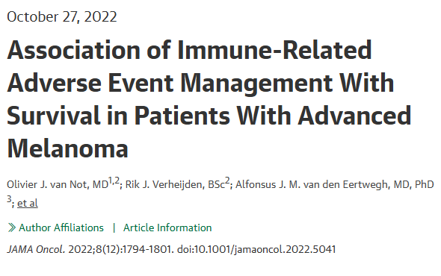
Treatment?
Impaired immunosurveillance vs need for Immune suppression

Slide 34
Treatment?
Increasing confidence in DMARDs
– get off steroids asap
Increasing survival duration:
- Implications of long-term steroids?
Avoid DMARDs
Toxicity settles on completion of immunotherapy:
- Prednsiolone <10mg?

Slide 35
REACT study

Slide 36
REACT
REmission induction of Arthritis caused by Cancer ImmunoTherapy (REACT):
a randomised, multicentre, trial to guide initial therapy for checkpoint inhibitor (CPI) induced arthritis (CI: Prof B Fisher, Birmingham)
South-West centre – RNHRD (RUH) in Bath (PI: Dr Andrew Allard)

Slide 37
REACT
Anti-TNF (adalimumab) vs standard care
Adalimumab 40mg s/c injections every 2 weeks
Recruitment target: 10 patients from the South-West
Primary Objective: To compare the proportion of patients in glucocorticoid-free ICI-IA remission at 24 weeks.

Slide 38
REACT
Secondary Objectives:
Time to ICI-IA remission
Proportion of patients in drug free remission at 48 weeks
Cumulative exposure of patients to immunosuppressive therapies
ICI-IA disease activity assessment
Quality of life assessment
Other irAE assessment
Adverse events assessment attributable to ICI-IA interventions
Cancer outcomes

Slide 39
REACT
Exploratory Objectives:
Evaluate composite arthritis disease activity scores
Assess the overall burden of IrAEs
Evaluate the overall arthritis and cancer outcome in a patient-centred integrated analysis
Report pregnancy outcomes in the event any pregnancies occur during the trial

Slide 40
REACT
Inclusion criteria
Able to consent to and engage with the requirements of the trial
Age >18yrs
Inflammatory arthritis with at least one clinically swollen joint at screening
Treated with ICI (ongoing or last dose within 12 weeks of onset of IA)
Two treating physicians agree initiation of systemic steroids would be appropriate management (one must have expertise in management of IA)

Slide 41
REACT
Exclusion criteria
Steroids for more than 2 weeks prior to enrolment (except hydrocortisone for adrenal insufficiency)
Pre-existing IA
New onset IA not considered to be triggered by ICI
Active or latent TB, HIV or Hepatitis C; or other infections considered contra-indicated to anti-TNF
latent TB treated by appropriate chemophrophylaxis may be considered according to local guidelines
Previous demyelinating disorder

Slide 42
REACT
Exclusion criteria
Hypersensitivity to adalimumab (or preparation excipients)
Medical, surgical or psychiatric conditions that may jeopardise the participant or their participation in the trial
Moderate to severe heart failure (NYHA III/IV)
Concurrent use of other biologic or targeted synthetic agents (i.e. JAKi)
Live vaccine <4 weeks prior to first dose of trial drug
Concurrent infection
Known ocular herpes simplex

Slide 43
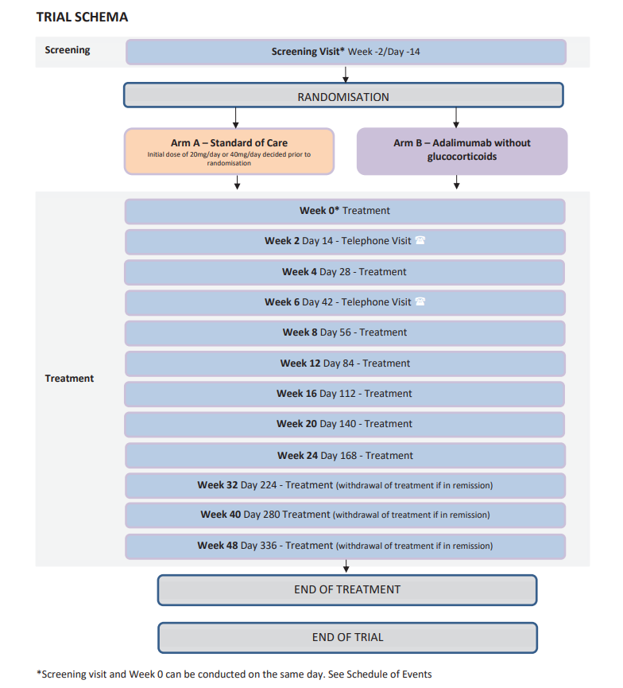
REACT

Slide 44
REACT
What does it mean for the patient?
48 week Trial
Monthly visits in person for first 6 months
Bi-monthly in person visits for second 6 months
Access to the research department if concerns at any time
Attempt to withdraw ICI-IA treatment at 6 months if in remission
Adalimumab arm may have to revert to standard care at 12 months before being allowed to continue no anti-TNF – this will be discussed at the outset

Slide 45
REACT

Slide 46
REACT
How to refer:
Email referral:
andrew.allard@nhs.net
amy.harrison36@nhs.net
ruh-tr.RNHRDresearch@nhs.net
Key messages:
Please refer patients!
Please don’t start steroids if at all possible (we will see the patients quickly)
If unsure please reach out and we will guide

Slide 47
Questions?
?
?
?
?
?
?
?
?
?
?
?
?
?

Slide 48
References
Kostine M et al. EULAR points to consider for the diagnosis and management of rheumatic immune-related adverse events due to cancer immunotherapy with checkpoint inhibitors. Ann Rheum Dis. 2021 Jan;80(1):36-48.
Haanen J et al. Management of toxicities from immunotherapy: ESMO Clinical Practice Guidelines for diagnosis, treatment and follow-up. Ann Oncol. 2017 Jul 1;28(suppl_4):119-142.
Brahmer J et al. Management of Immune-Related Adverse Events in Patients Treated With Immune Checkpoint Inhibitor Therapy: American Society of Clinical Oncology Clinical Practice Guideline. J clin Oncol. 2018 Jun 10;36(17):1714-1768.
Brahmer J et al. Society for Immunotherapy of Cancer (SITC) clinical practice guideline on immune checkpoint inhibitor-related adverse events. J Imunother Caancer. 2021. Jun;9(6):e002435.
Thompson J et al. NCCN Guidelines Insights: Management of Immunotherapy-Related Toxicities, Version 1.2020. J Natrl Comp Cancer Netw. 2020 Mar;18(3):230-241
Martins F et al. Adverse effects of immune-checkpoint inhibitors: epidemiology, management and surveillance. Nat Rev Clin Oncol. 2019. 16, pages 563–580
Draghi A et al. Differential effects of corticosteroids and anti-TNF on tumor-specific immune responses: implications for the management of irAEs. Int J Cancer. 2019;145:1408–13.
Arbour KC et al. Impact of baseline steroids on efficacy of programmed cell death-1 and programmed Death-Ligand 1 blockade in patients with non-small- cell lung cancer. J Clin Oncol. 2018;36:2872–8.
Leipe J et al. Characteristics and treatment of new onset arthritis after checkpoint inhibitor therapy. RMD Open. 2018. Aug 17;4(2):e000714.
Schadendorf et al. Efficacy and Safety Outcomes in Patients With Advanced Melanoma Who Discontinued Treatment With Nivolumab and Ipilimumab Because of Adverse Events: A Pooled Analysis of Randomized Phase II and III Trials. J Clin Oncol. 2017. Dec 1;35(34):3807-3814.
Hussein A et al. Relatlimab and Nivolumab versus Nivolumab in Untreated Advanced Melanoma. N Engl J Med. 2022 Jan 6; 386(1):24-34.
McKinley B et al. Early discontinuation of immune checkpoint inhibitor therapy prior to disease progression in patients with metastatic non-small cell lung cancer: a survival analysis. Front Oncol. 2024 Jun 2021:14:1417175.
Cook et al. Immune-related adverse events and survival among patients with metastatic NSCLS treted with immune checkpoint inhibitors. JAMA Netw Open. 2024 Jan 2;7 (1):e2352302.
Van Not et al. Association of immune-related adverse event management with survival in aptients with advanced melanoma. JAMA Oncol. 2022 Dec 1;8(12): 1794-1801.

