Slide 1

Somerset, Wiltshire, Avon and Gloucestershire (SWAG) Cancer Services
National Cancer Patient Experience Survey Results (2023)
OG Clinical Advisory Group
Friday 20th June 2025

Slide 2
NCPES Introduction
Annual survey, commissioned & managed by NHS England (since 2010)
new design for 2021, therefore break in series data
2021 / 2022 / 2023 year on year comparison
Picker - responsible for designing, running & analysing the survey
Designed to:
Monitor progress in cancer care
Provide information to drive local quality improvements
Assist commissioners and providers of cancer care
Inform the work various charities and stakeholder groups, supporting cancer patients

Slide 3
NCPES Methodology
Provider survey samples
Adults (16 and over), with a confirmed diagnosis of cancer
Discharged from NHS Trust (after an inpatient or day-case attendance for cancer related treatment) in April, May and June 2023.
Survey fieldwork Oct. 2023 – Feb. 2024
Reports published July 2024 (National, Alliance, Trust).
ICB and interactive online reports delayed until 2025 (due to limited NHS E resource).

Slide 4
Cancer Alliance report
Report reflects experience of people referred from within CA footprint (not all those treated by that CA’s Providers)
‘referring’ CA report - based on patient home postcodes
According to ONS postcode mapping

Slide 5
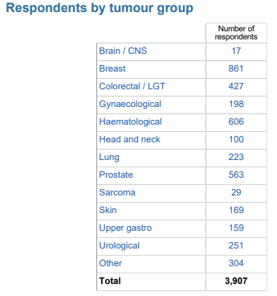
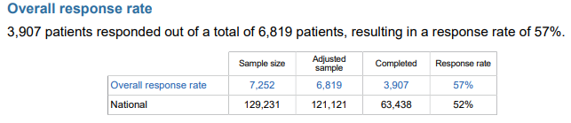
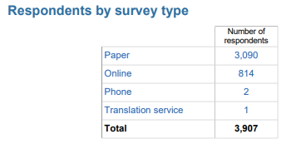
NCPES SWAG responses

Slide 6
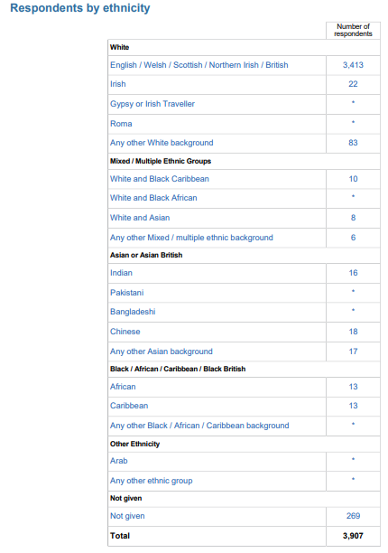
All SWAG respondents by Ethnicity
89%
90 % (3518)
2% (83)
7% (269)

Slide 7
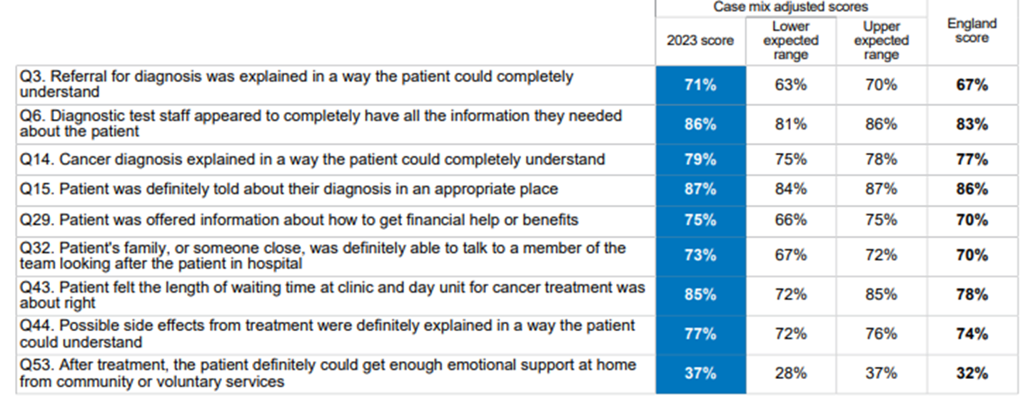
SWAG Summary
9 SWAG scores above Expected Range (none below the expected range in 2023) – all remaining scores within expected range

Slide 8
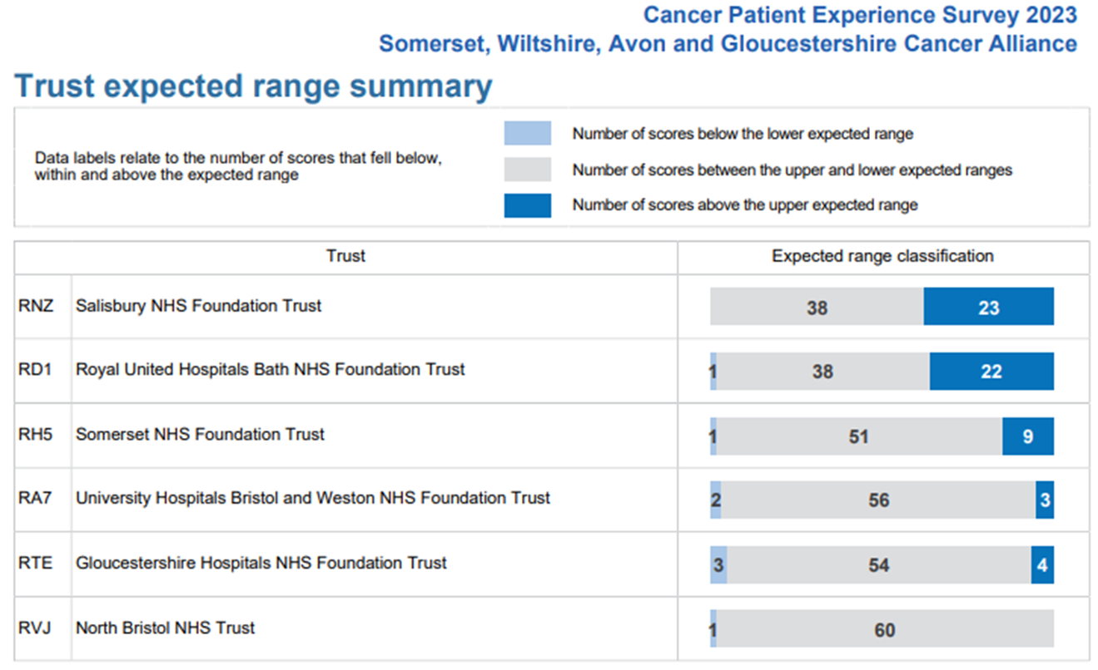
SWAG Trust Summary

Slide 9
Variations by tumour site
Comparison between tumour sites
Some significant variation in scores (e.g. >30%)
Significant variation in numbers of responses
Caution in making these comparisons and interpreting results
NCPES discussion at SWAG Clinical Advisory Groups (CAGs) and local clinical teams / MDTs
Alliance, ICS and Trust level scrutiny and pathway planning

Slide 10
Key driver questions
Question 28. Patient definitely got the right level of support for their overall health and well being from hospital staff (or = 4.27)
Question 56. The whole care team worked well together (or = 3.94)
Question 57. Administration of care was ‘very good’ or ‘good’ (or = 4.79)

Slide 11
Key Driver Questions for 2023

Slide 12
SWAG Skin lowest scores ≤ 60%
 | Question | SWAG | National average
23 | Patient could get further advice from a different healthcare professional before making decisions about treatment options | 54 | 60
47 | Patient felt possible long-term side effects were definitely explained in a way they could understand in advance of their treatment | 59 | 62
48 | Patient was definitely able to discuss options for managing the impact of any long-term side effects | 58 | 56
51 | Patient definitely received the right amount of support from their GP practice during treatment | 54 | 50
52 | Patient has had a review of cancer care by GP practice | 26 | 22
53 | After treatment, the patient definitely could get enough emotional support at home from community or voluntary services | 37 | 37
58 | Cancer research opportunities were discussed with patient | 40 | 43

Slide 13
SWAG Skin highest scores ≥ 90%
 | Question | SWAG | National average
5 | Patient received all the information needed about the diagnostic test in advance | 94 | 93
9 | Enough privacy was always given to the patient when receiving diagnostic test results | 98 | 95
19 | Patient found the advice from the main person helpful or very useful | 98 | 96
25 | A member of the care team helped the patient create a care plan to address any needs or concerns | 94 | 94
26 | Care team reviewed the patients care plan with the to ensure it was up to date | 100 | 99
27 | Staff provided the patient with relevant information on available support | 91 | 92
41.1 | Beforehand patient completely had enough understandable information about surgery | 91 | 90
42.1 | Patient completely had enough understandable information about their response to surgery | 91 | 88

Slide 14
Patient comments
Patients were asked
Please tell us what you found to be positive about your experience of cancer care?
Please tell us how your experience of cancer care could have been better?
‘Patient comment’ feedback and analysis has been presented by topic, themes and sentiment
Patient comments are available in Trust and ICB level reports only.

Slide 15
Clinical Advisory Group - Next Steps
Discuss and agree SWAG OG patient experience improvement priorities, including areas of lowest scores (Slide 11)
Next steps / timeline
Nominated lead
Recognition of areas of good practice
Consider / plan additional in-year skin-specific patient experience activity to gain further insight

