Slide 1
The Skin Cancer Research Fund (SCaRF)
Jon Pleat
Trustee & Deputy-Chair
Registered charity number 284582

Slide 2
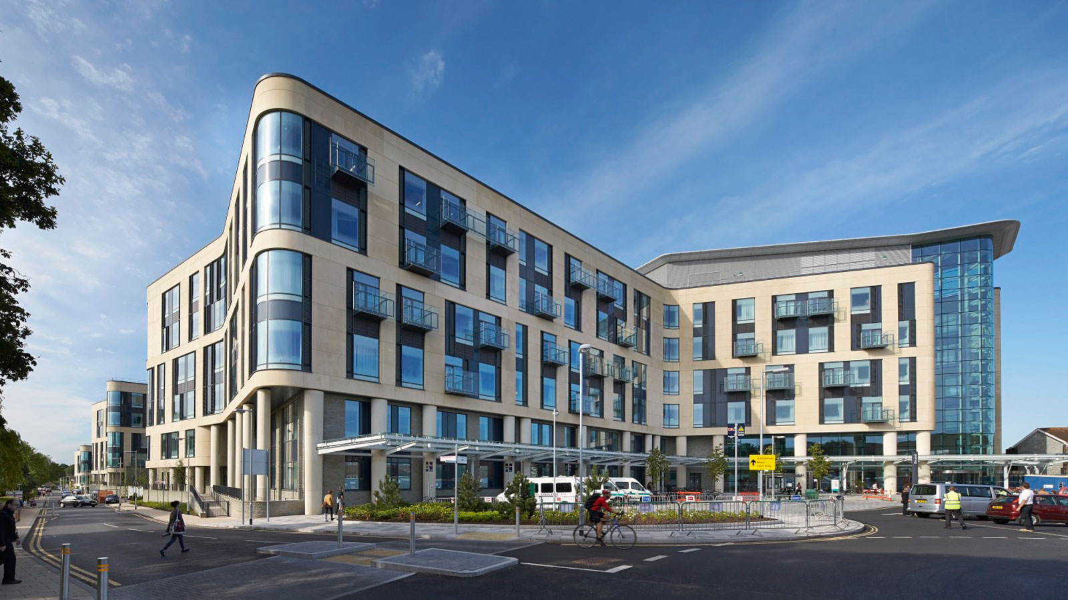
Route map
our aims
history of the charity
who we are
what we do
who we have supported
the future

Slide 3
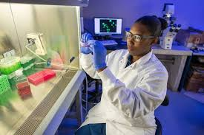
SCaRF’s aims
promote research into skin cancer
its causes
prevention
treatment
raise awareness of skin cancer through education
in so doing, reduce the number of new cases and burden of disease
prudent financial stewardship

Slide 4
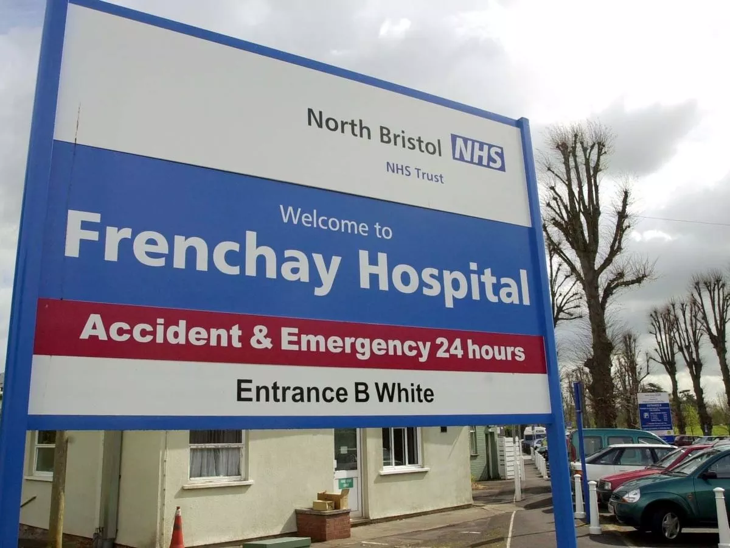
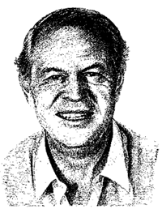
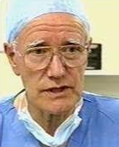
Tony Hancock
Dennis Bodenham
Ronald Hiles

Slide 5
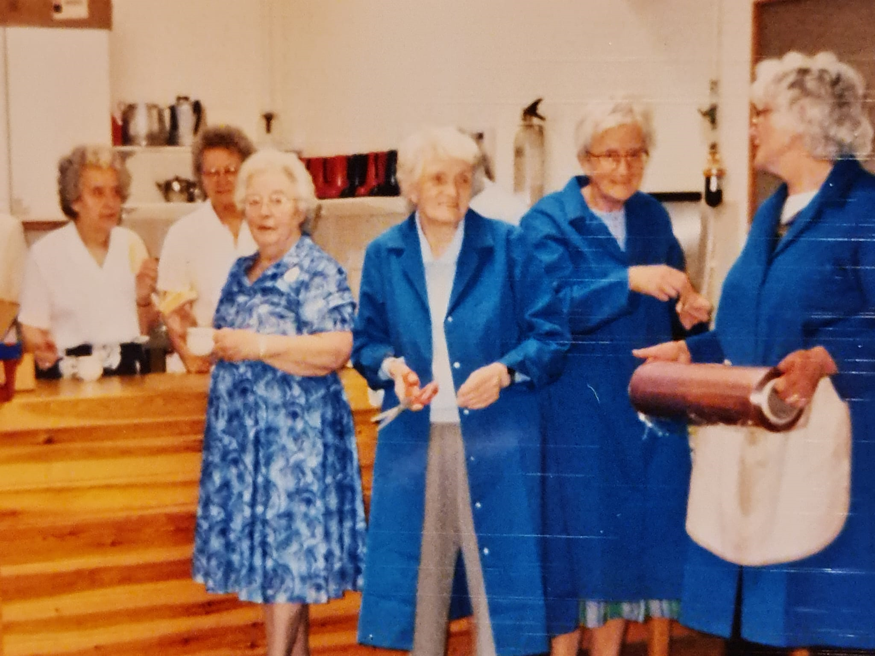
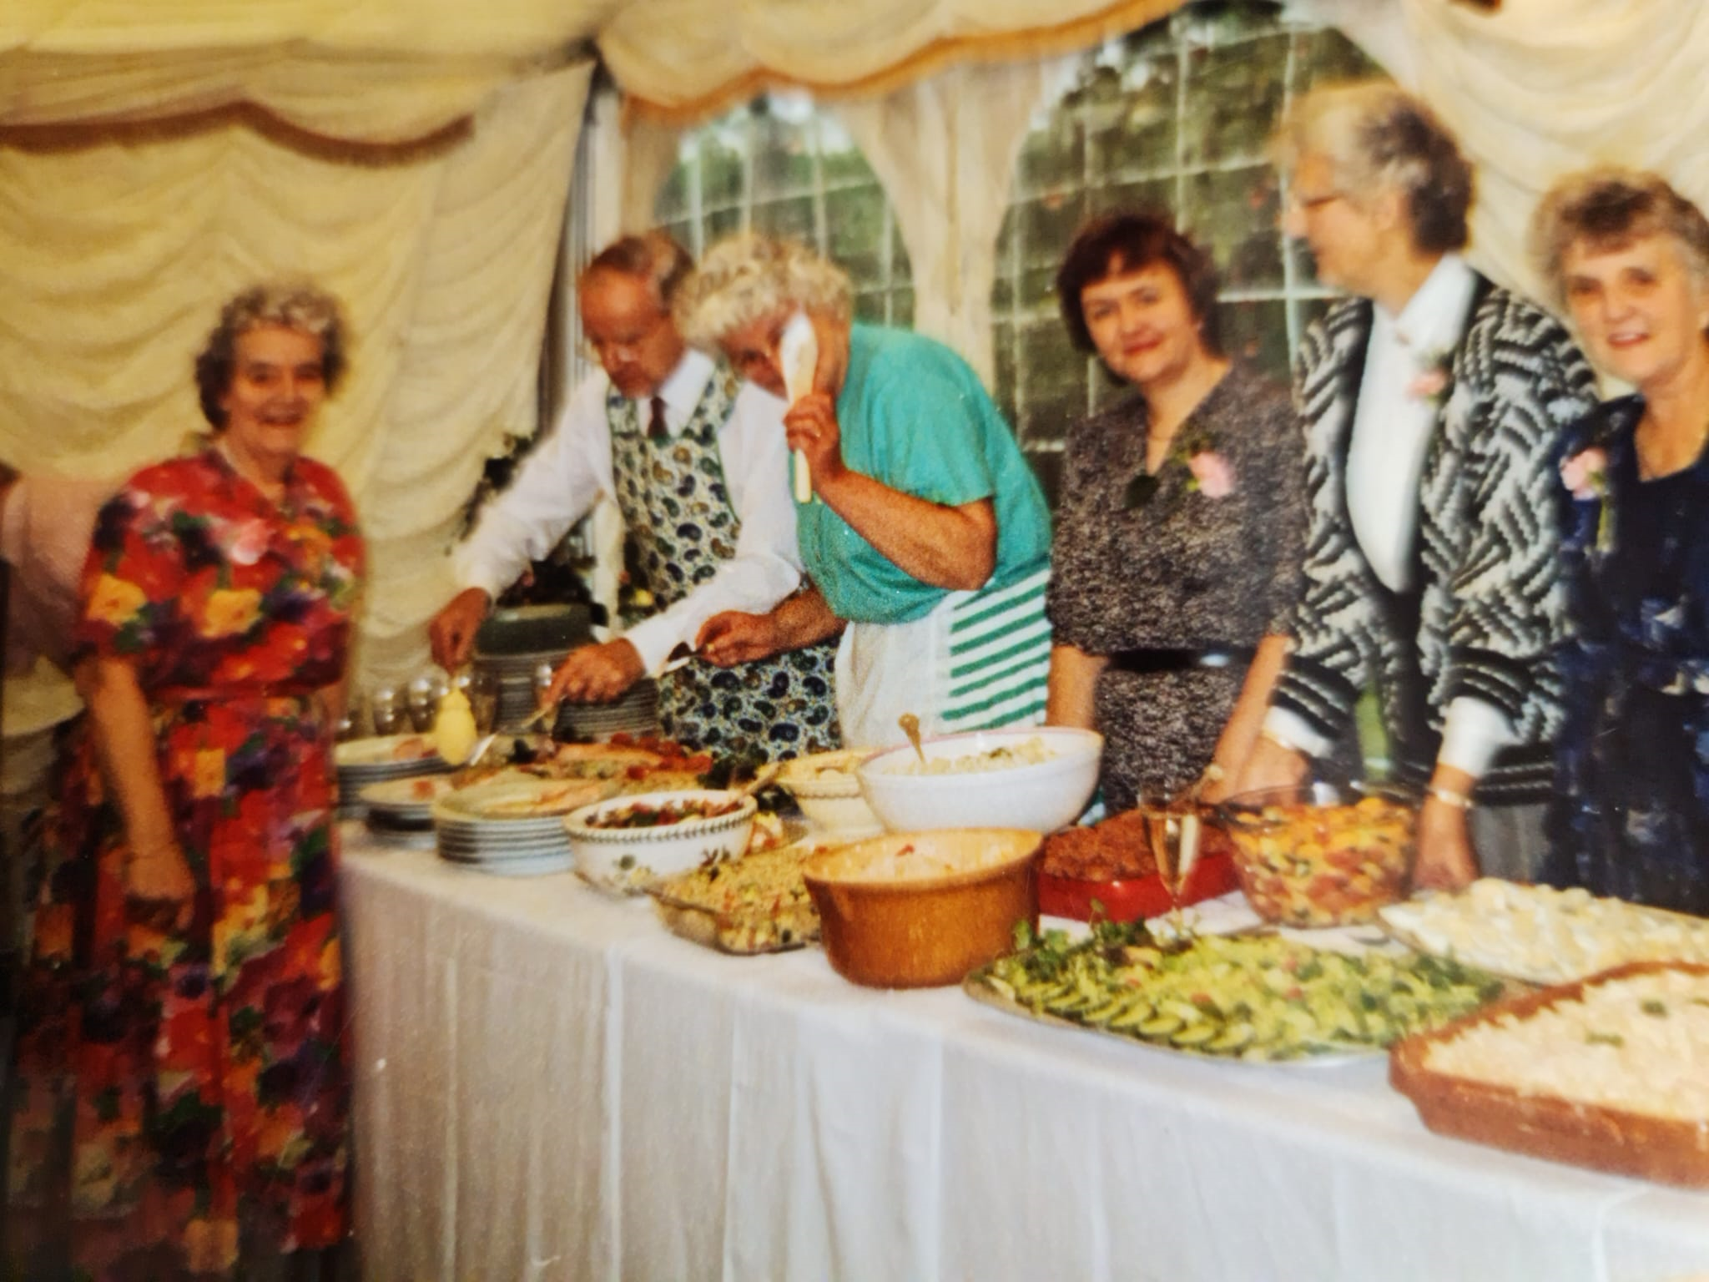
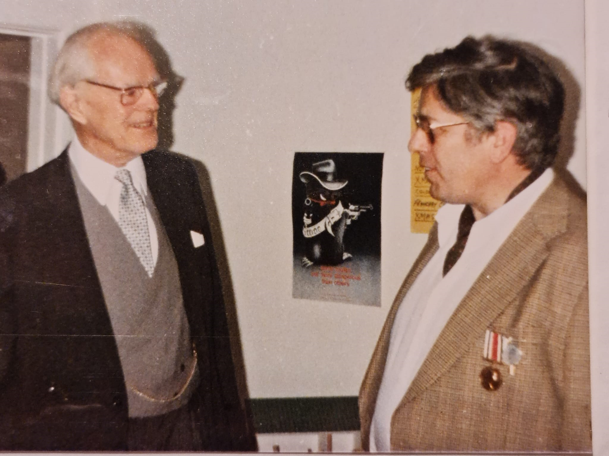
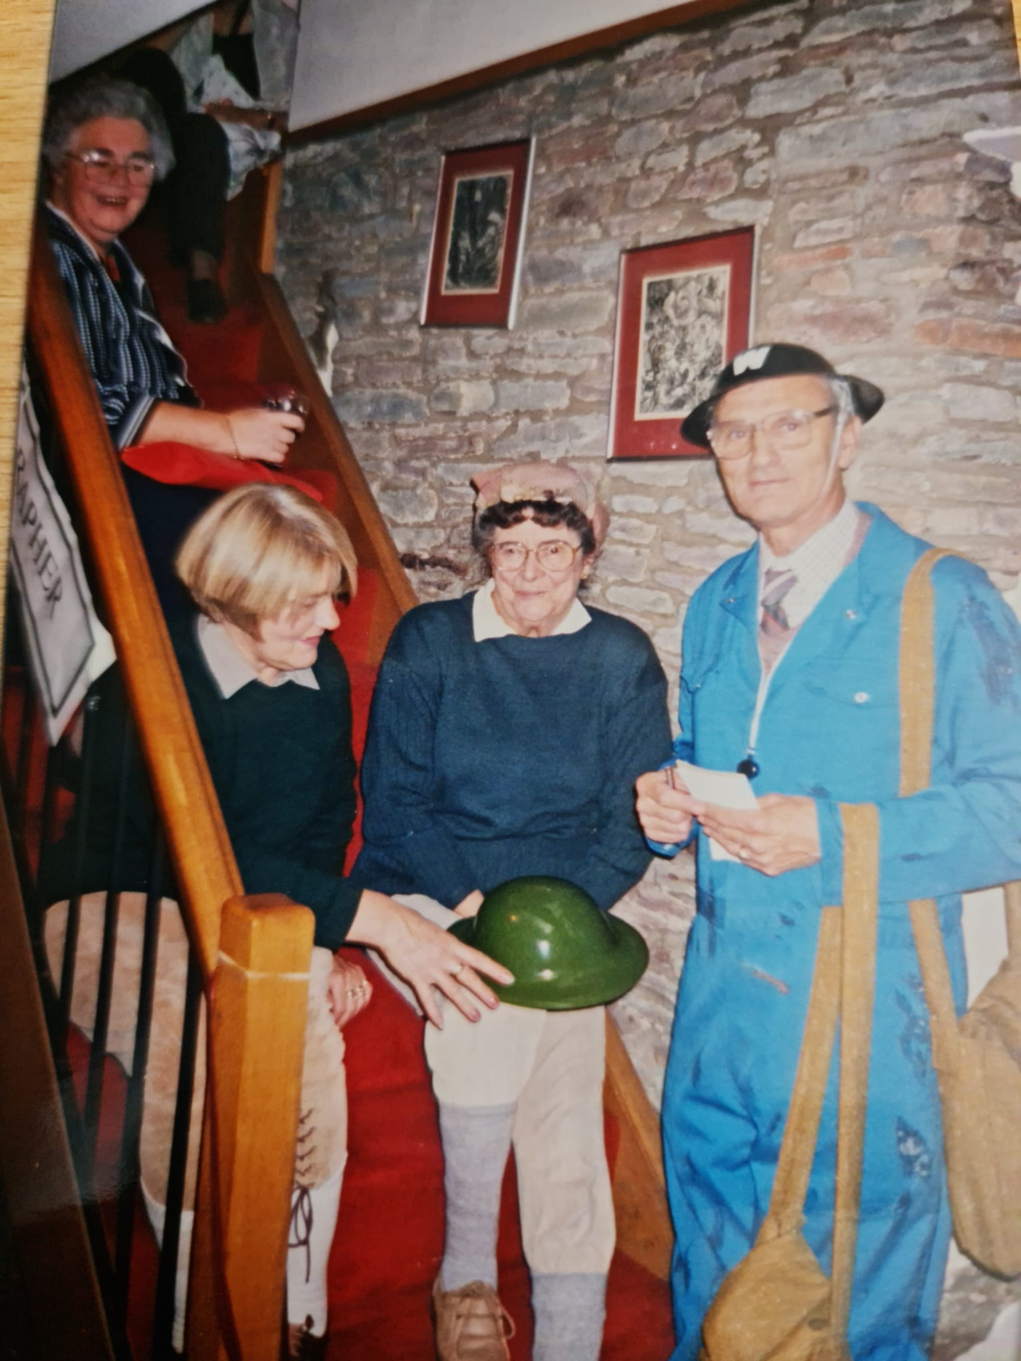
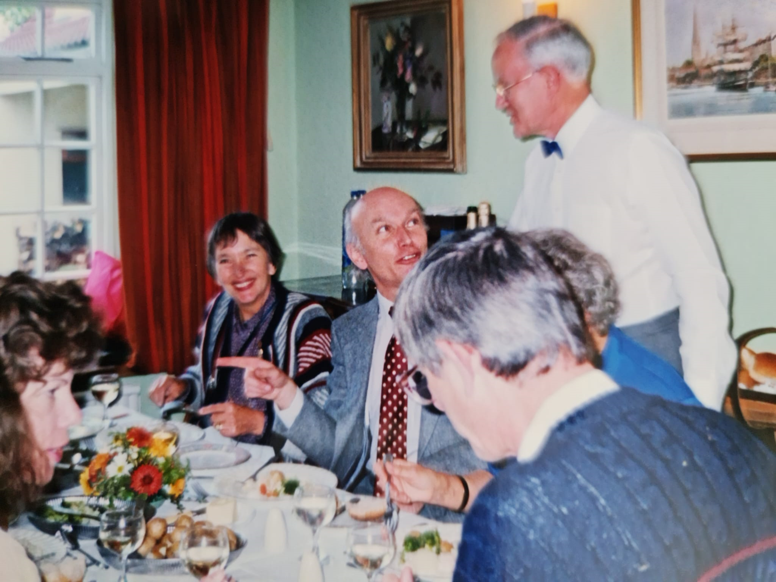

Slide 6
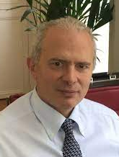
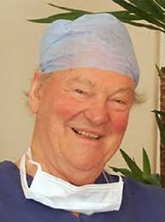
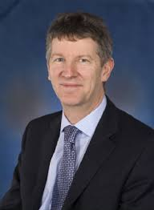
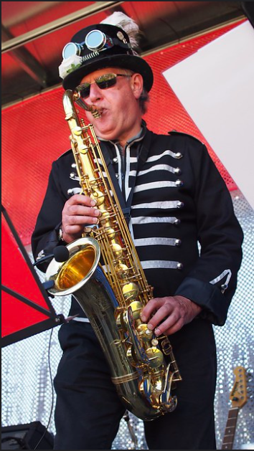
Antonio Orlando
Paul Townsend
John Kenealey
Howard Rigby
Notes:
Established 1979
· During 1979 a Fund was established to support cancer research at Frenchay Hospital, in memory of Maureen Hancock, who died as a result of malignant melanoma, leaving a husband (Tony) and young family.
· During the 1980s it was agreed that a formal charity be established, and in 1982 a formal deed was produced, and from this the SCaRF constitution was agreed – this was approved by the Charity Commissioners on the 13 May 1987, and the Skin Cancer Research Fund (SCaRF) was formally adopted as a “Charitable Trust” - registered under the charity number 284582.
· Tony Hancock remains an active trustee of the charity and contributes regularly on matters related to the governance of it. It is interesting to note, that when the charity was formed, Tony commented that he could not envisage it still going strong after thirty years, because surely by then a cure would have been found, and cancer would no longer be the dreadful disease it once was – unfortunately this is not the case!

Slide 7
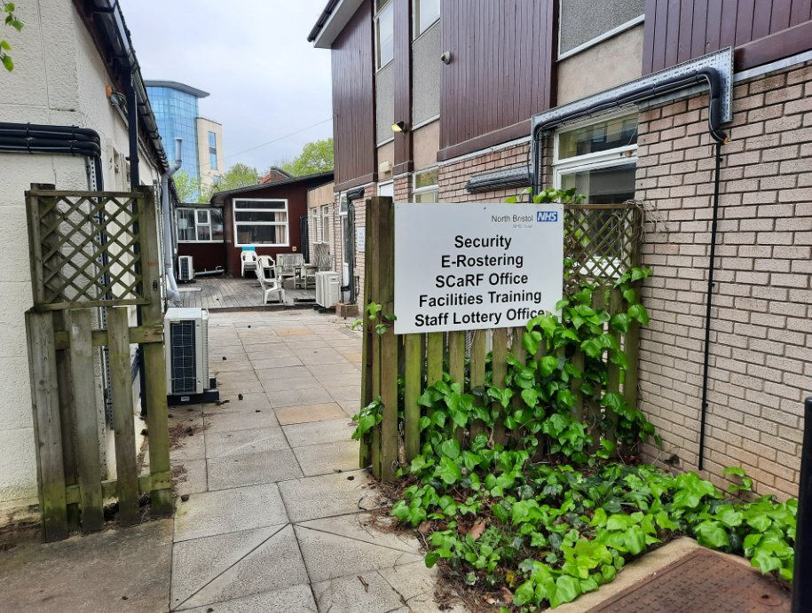
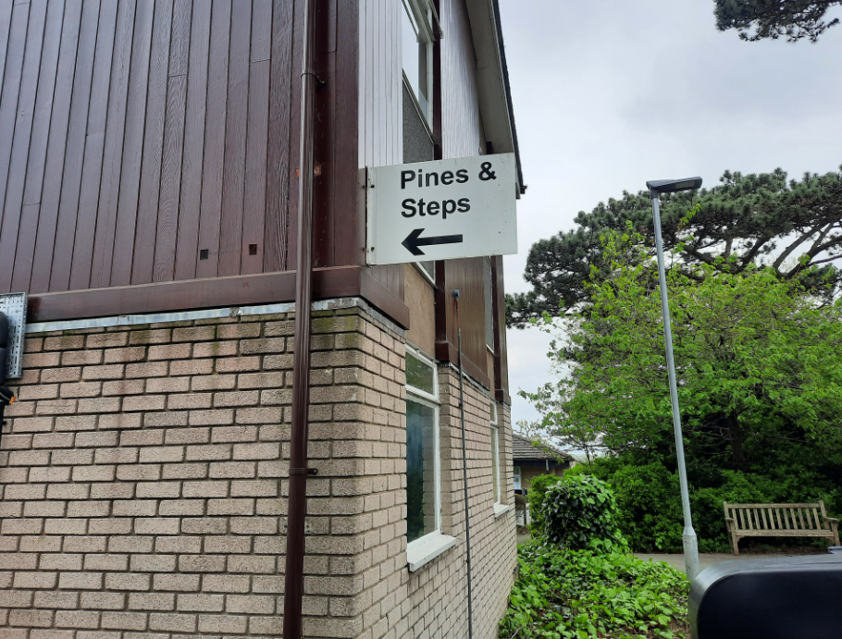
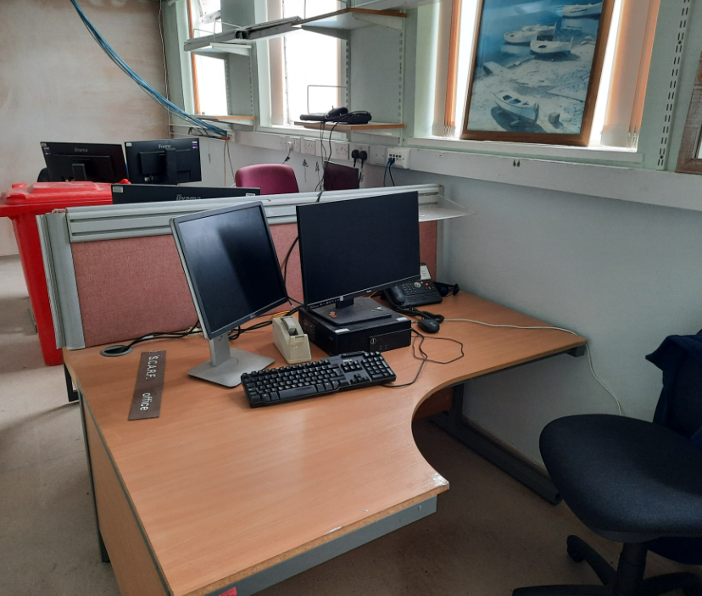
Who are SCaRF?
a national charity under the umbrella of North Bristol NHS Trust
Administrator: Mr Stephen Hollyman
Patron: The Lord Mayor, RtHon Councillor Paul Goggin
Trustees:
Mr Ben McGinn (Chairman)
Mr Andrew Wilkinson
Mr Dean Fuidge
Mrs Lynda Knowles
Dr Katherine Finucane
Dr Helen Audrain
Ms Amanda McAusland
Mr Jon Pleat
Scientific Advisory Committee:
Professor Paul Martin
Dr Yi Feng
Social Media Fellow: Rebecca Iau
Independent auditor: TD&Company, Chartered Accountants
Notes:
Lyn is Macmillan Skin Cancer specialist nurse

Slide 8
What does SCaRF do? Research
Call for proposals
Project idea submitted
Independently assessed and scored by SAC
Recommendation approved by trustees
Grant administered
Dissemination of results
we support national projects
biannual grant awards
competitively awarded
independently assessed
pump priming grants £1-5k
larger project grants up to £20k
initial results leading to bigger grants by NIHR, Wellcome Trust, MRC, etc

Slide 9
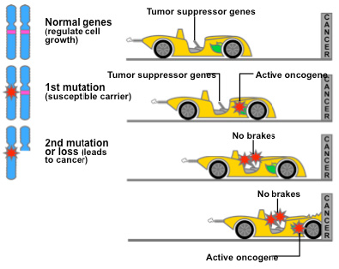
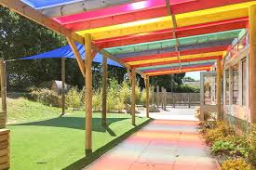
Past research projects
South West melanoma database
identifying melanoma oncogenes
testing drugs in vitro to treat melanoma
mechanisms of resistance to immunotherapy drugs used to treat advanced melanoma
teaching patients to examine their lymph node basins
Schools Playground Shade Competition – sun awareness in primary schools
Notes:
A further payment of £10,000 was made to University of Nottingham as part of a three year programme entitles Generation of endogenous soluble PDI as a potential therapeutic strategy for treatment of metastatic melanoma". The Trustees considered a funding application from Dr Cross and Mr R Pritchard Jones the University of Liverpool "The role of VEGF signalling and ERK5 activity in vemurafenib resistant melanoma progression" Vermurafenib is one of the new generation of drugs available for treatment of metastatic melanoma utilising the body's own mechanisms to combat the disease. Unfortunately the beneficial effects can wear of and the drug ceases to be effective. T

Slide 10
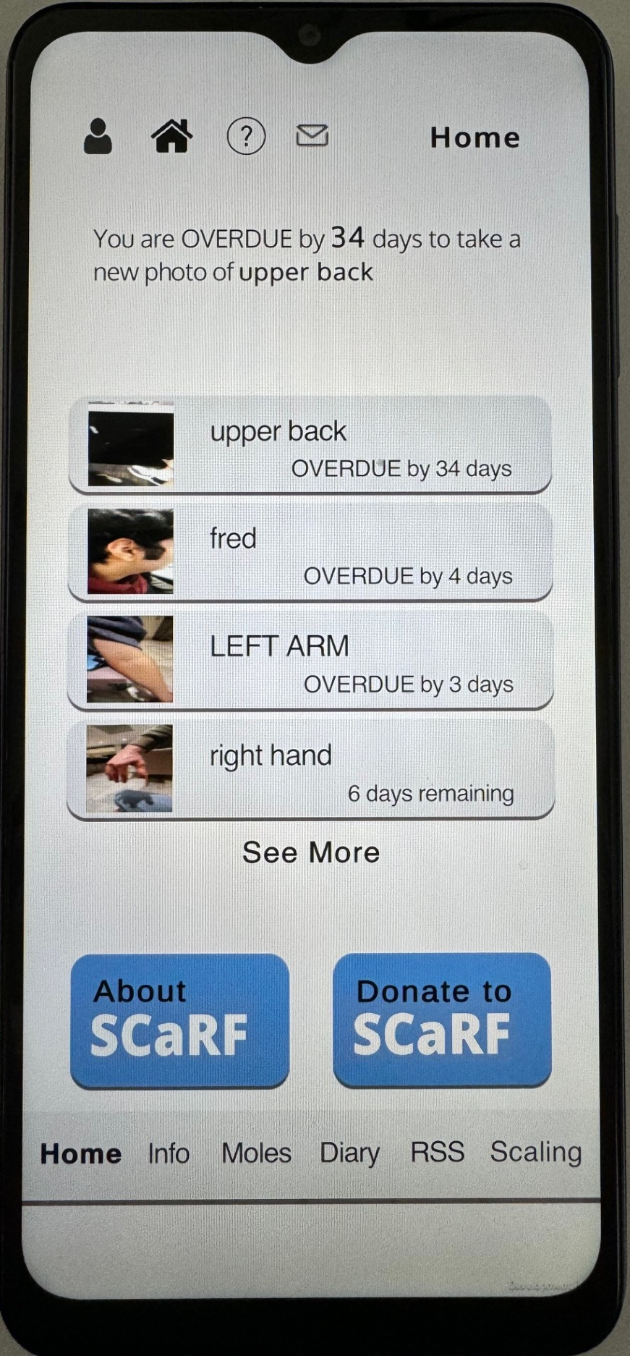
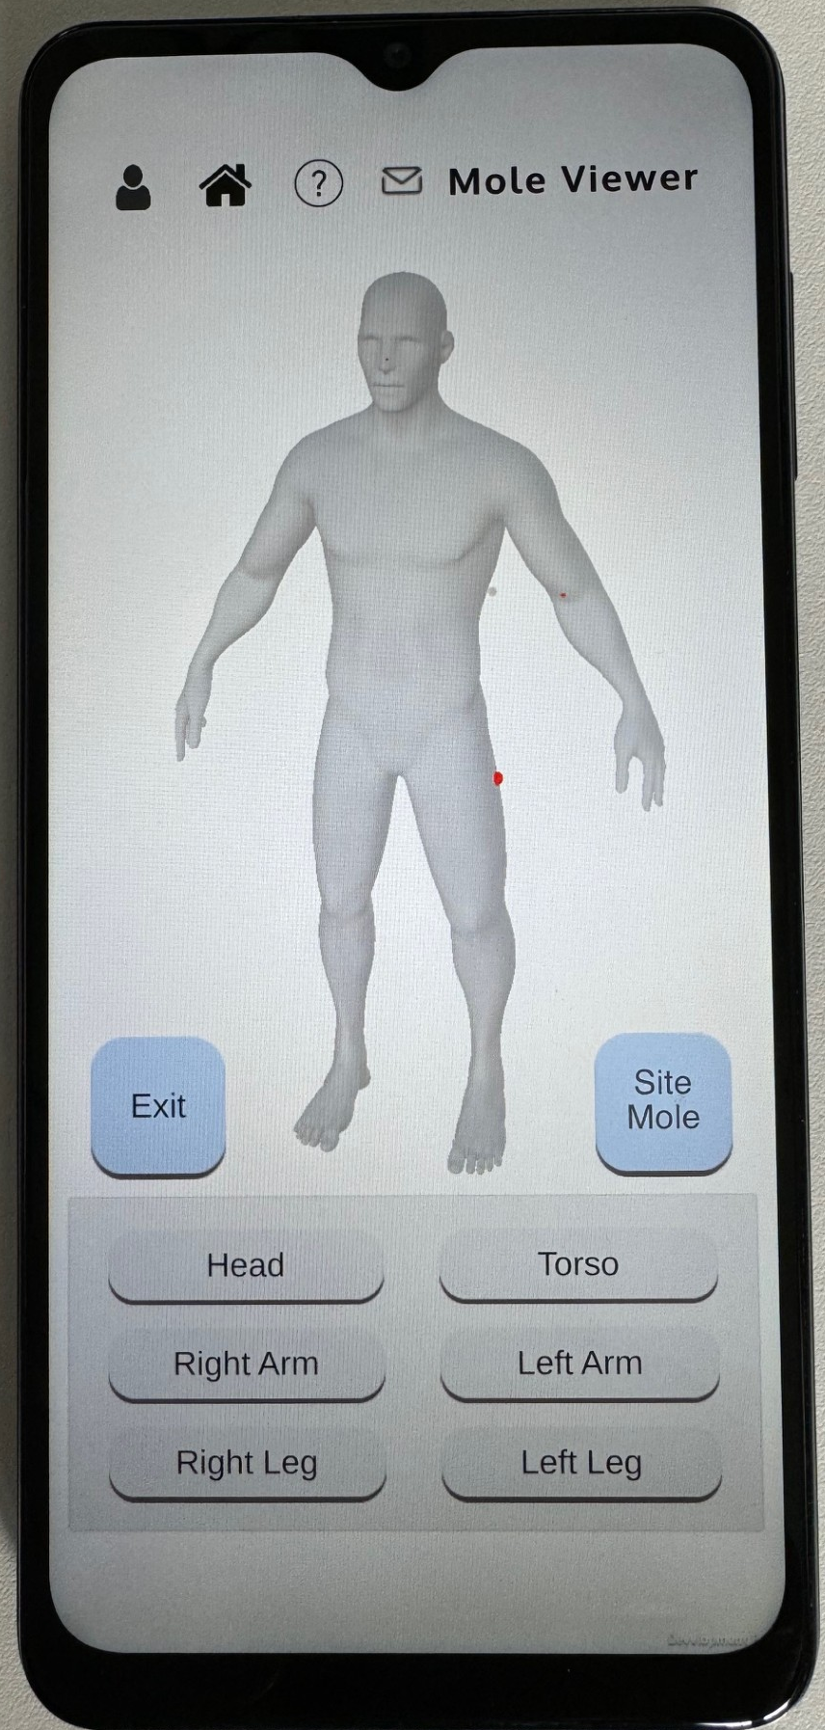
SCaRF’s role to educate
sun sense and skin lesion change:
6th form and college evenings
companies eg Airbus, MoD
charity events
social media fellow
supporting skin cancer courses
mobile App with the University of Bristol Department of Computer Science

Slide 11
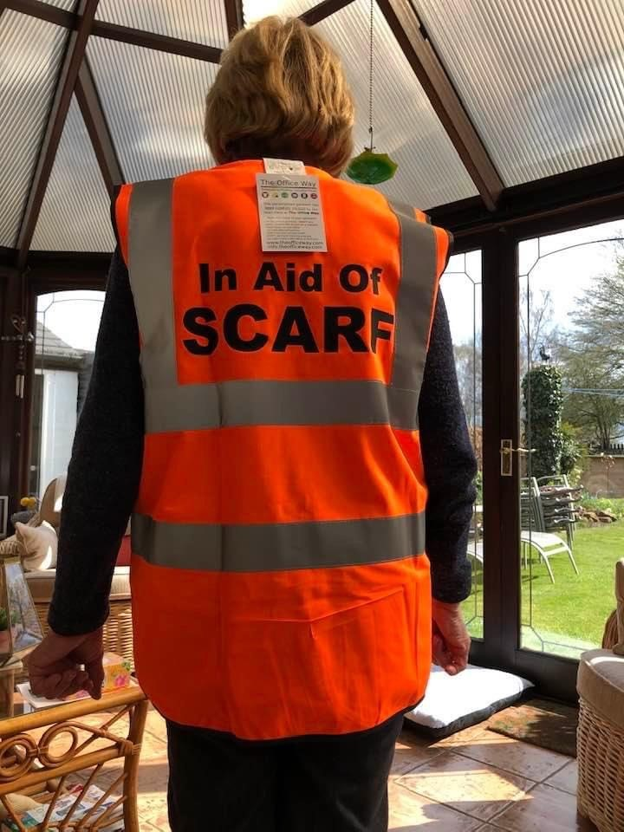
How do we raise funds?
Approximately £1.7m raised over 45 years
one exceptional fund raiser!
Notes:
John Murray died 19years ago annual golf day Llanwern golf club near Newport young father

Slide 12
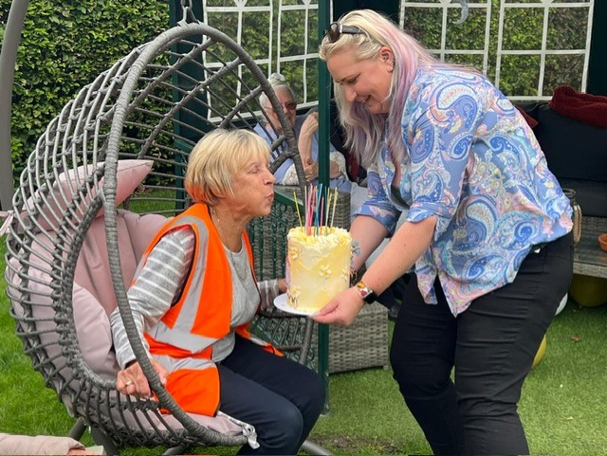
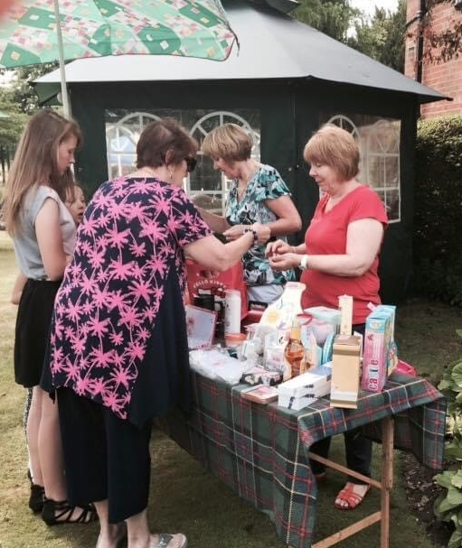
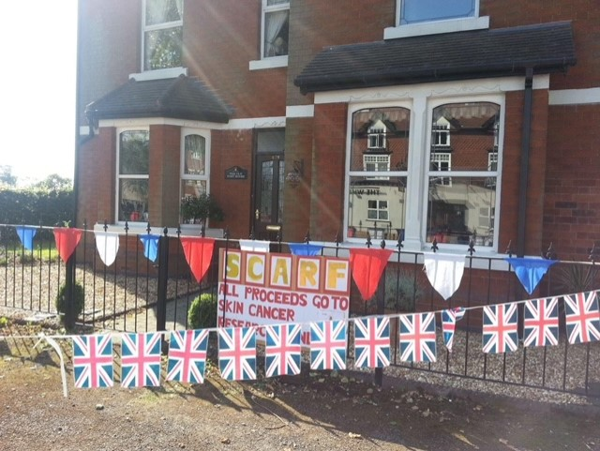
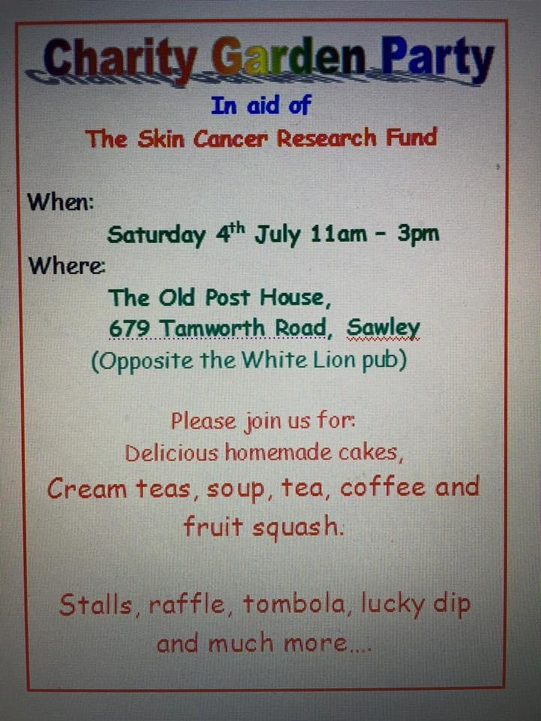
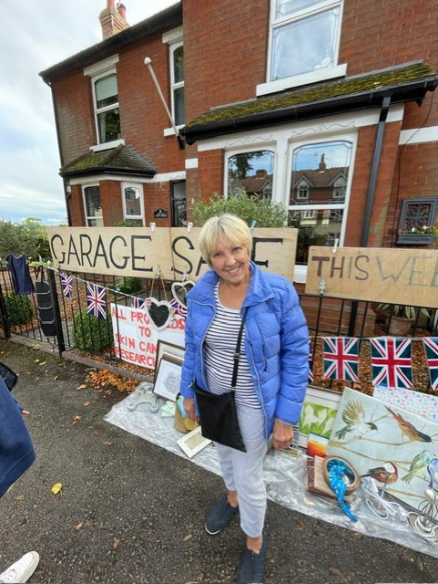
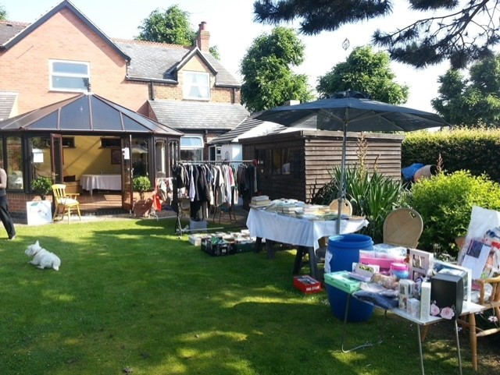
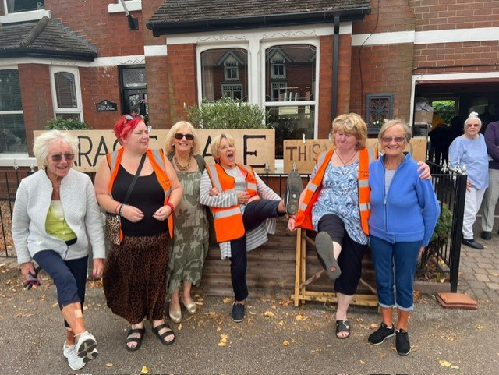
How do we raise funds?
Notes:
John Murray died 19years ago annual golf day Llanwern golf club near Newport young father
Kathleen England

Slide 13
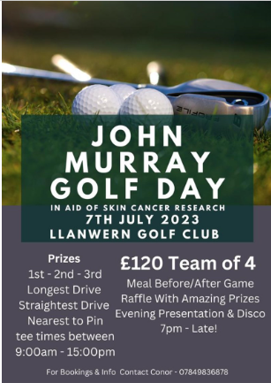
How do we raise funds?
fundraising activities
voluntary donations
investment income
Notes:
John Murray died 19years ago annual golf day Llanwern golf club near Newport young father

Slide 14
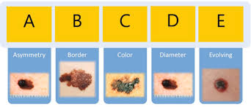
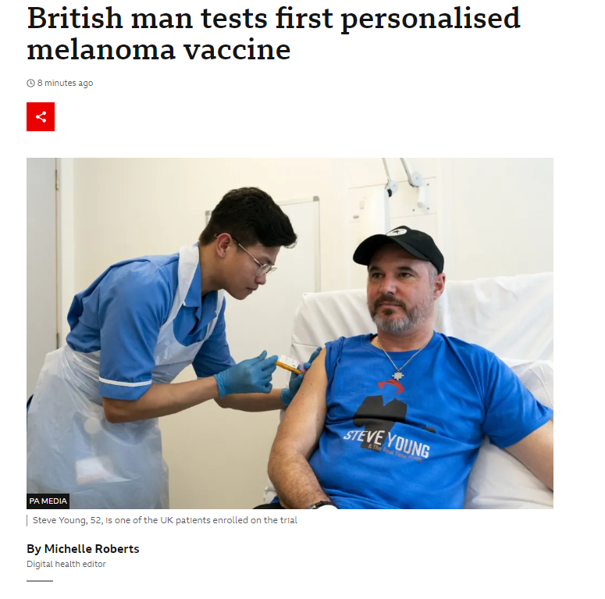
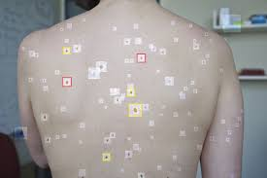
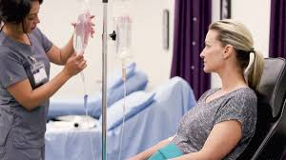
The future
better prevention
earlier detection
definitive treatment
less than 2% of our funds
go on overheads

Slide 15
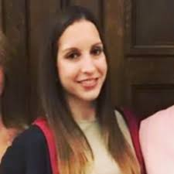
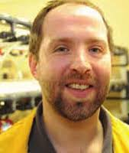
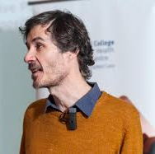
Current projects
Ms PennyLouise Hever, Kings College London
Dr Adam Hurlstone, University of Manchester
Dr Sylvain Ladame, Imperial College London
Notes:
A project that centred around the CAR-T cells which have already revolutionised the treatment of B-cell malignancies. In essence, CAR-T cells are normal immune cells that are adapted to recognise and target cells which are exhibiting antigen malignant change. The supported PhD student is developing CAR-T cell therapeutics that target CD146, an antigen on the surface of cancer cells, as a potential treatment for skin cancer.
The proposal is to use CRISPR (a means of genetic engineering) technology to swap the mouse domain CD146 with human CD 146. In this way, it is hoped that a model will be created that will give rapid and powerful insights into how melanoma cells develop and can be targeted with the immune system.
What are the aims and objectives of this project? The core aim of our research project is to demonstrate how sampling and targeted molecular analysis of skin interstitial fluid (IF) can improve the diagnosis of skin cancer in a timely and non-invasive manner through a low-cost and point-of-care skin patch. This multidisciplinary project will develop and exploit new technologies to better sample, isolate and analyse nucleic acid biomarkers from skin IF in both mouse models and human skin samples to identify cancer-specific molecular signatures. It will also lead to the design, engineering and testing of new technologies and devices capable of detecting these signatures in a painless and non-invasive manner that could be implemented in clinic. Herein, we propose to develop hydrogel-coated MN patches to sample and characterise the composition of skin IF from both animal models and human skin samples with a yet never achieved spatial and temporal resolution. Our study will involve a systematic study of skin IF composition where devices will be engineered to sample and capture specific nucleic acid species for subsequent off-patch analysis (Aims 1), and a targeted analysis of specific nucleic acids of interest (tissue endogenous and tumour-derived, preidentified in the literature or identified as part of Aim 1) for longitudinal, near real-time, on-patch monitoring (Aim 2). It is noteworthy than both aims are interrelated but not interdependen
Desmoplastic melanoma (DM) is a unique and incongruent variant of cutaneous melanoma, and as such the optimal management has been unclear. Recent investigation into its genetics, histology and clinical course has led to evolution in clinical management over the past five years. It requires specific management strategies, and current published melanoma guidelines fail to address these. Dr Hever proposed an international, multi-centre retrospective cohort study, designed to evaluate management of desmoplastic melanoma and outcomes in the UK, Australia, and the USA.
The primary objectives of our study are being used to determine:
1) The incidence of DM in cohorts from the UK, USA and Australia.
2) sentinel lymph node (a means of assessing the spread of melanoma) positivity rates in DM
3) Rates of recurrence following removal with standard surgical margins.
4) The efficacy of adjuvant therapies including post-operative radiotherapy and systemic adjuvant therapies.
The secondary objective of this study was to develop a best practice guideline for the management of DM.

Slide 16
How can you help?
fund raising
volunteer:
trustee
scientific advisor
submit research applications for our grants

Slide 17
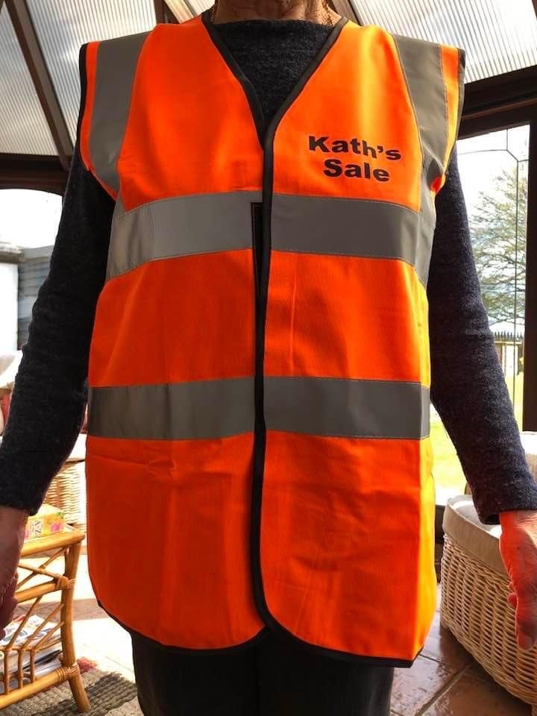
Thank you
jonathon.pleat@nbt.nhs.uk

