Slide 1
PSA Guidance in Primary Care
Urological Cancer Clinical Advisory Group
Thursday 26th June 2025

Slide 2
How should I assess a person with suspected prostate cancer? (NICE, April 2025)
Most people with prostate cancer are asymptomatic.
Suspect prostate cancer in men who have any of the following symptoms that are unexplained:
Lower back or bone pain
Lethargy
Erectile dysfunction
Visible haematuria
Anorexia/weight loss.

Slide 3
Offer a digital rectal examination (DRE)
DRE allows assessment of the prostate for signs of prostate cancer (a hard gland, sometimes with palpable nodules) or benign enlargement (smooth, firm, enlarged gland)
It is important to note that the DRE sensitivity for prostate cancer has been shown to be very poor in the absence of a raised prostatic-specific antigen test
Note that a gland that feels normal does not exclude a tumour.

Slide 4
Consider prostate-specific antigen (PSA) testing
Before offering PSA testing, provide appropriate information and advice to enable the person to make an informed choice about testing. This should include information on the benefits and limitations of PSA testing, in addition to relevant decision aids and online sources of information.
If appropriate, arrange testing.
A normal PSA level ranges from 0–4 nanograms/mL. However, the upper level of normal may vary according to age and race.
PSA testing should not be offered to asymptomatic people.

Slide 5
Suspected Cancer Pathway Referral
Refer the person using a suspected cancer pathway referral (for an appointment within 2 weeks) if their prostate feels malignant on DRE.
Consider referring a person with possible symptoms of prostate cancer using a suspected cancer pathway referral (for an appointment within 2 weeks) if their PSA level is above the threshold for their age in Table 3. Take into account the person's preferences and any comorbidities when making the decision.
Secondary care assessment for people with suspected prostate cancer may include:
A prostate biopsy — to confirm or exclude the diagnosis.
Imaging — to assess the stage of the prostate cancer.

Slide 6
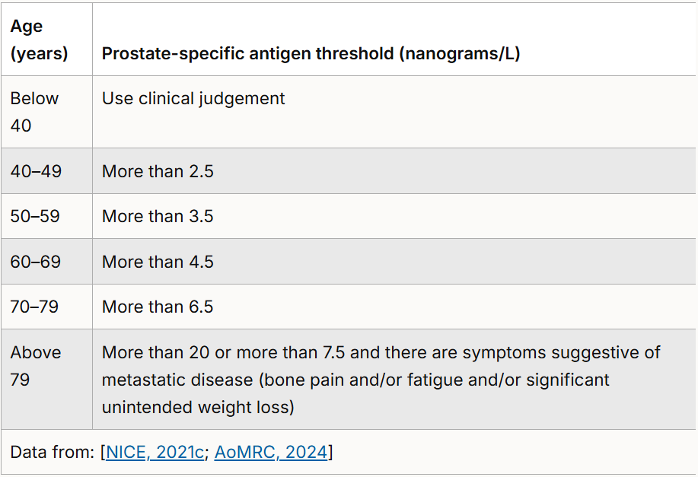
Age-specific PSA thresholds for people with possible symptoms of prostate cancer.

Slide 7
PSA Testing
In those men above the age of 79 if the initial PSA test is 7.5-20ng/L and there are no symptoms suggestive of metastatic disease repeat the PSA once after 6 months.
After repeating PSA refer via a suspected cancer pathway if any of the following occur:
There are symptoms suggestive of metastatic disease.
The PSA level has risen above 20.
The PSA has more than doubled and the patient has a performance status of 0 or 1.
If patients do not fit any of these criteria but there are concerns, seek appropriate support using 'advice and guidance' mechanisms.

Slide 8
The aim of PSA testing is to detect early prostate cancer when treatment can be offered that may cure cancer or extend life.
It is not usually recommended for asymptomatic men with less than 10 years’ life expectancy. NICE recommend active surveillance for people who are in Cambridge Prognostic Group 1 (CPG). It may also be offered to men in CPG 2 who have localized prostate cancer
Most men will have a PSA level less than 3 nanograms/mL. About 3 in 4 men with a raised PSA level (3 nanograms/mL or higher) will not have cancer. Around 15% of men with a normal PSA do have cancer
A PSA test will not distinguish between aggressive tumours (which are at an early stage but will develop quickly) and those which are not. Further tests may provide valuable information.

Slide 9
PSA testing should be:
Considered in men with suspected prostate cancer.
Offered to men older than 50 years of age who request a PSA test.
Before a PSA test, people should not have:
An active urinary infection or within previous 6 weeks.
Ejaculated in previous 48 hours.
Exercised vigorously, for example cycling, in the previous 48 hours.
Had a urological intervention such as prostate biopsy in previous 6 weeks.
After taking blood for PSA testing:
The specimen must reach the laboratory within 16 hours.

Slide 10
Information and advice on prostate-specific antigen (PSA) testing
Before offering prostate-specific antigen (PSA) testing, appropriate information should be provided to enable the person make an informed choice about testing.
Benefits of PSA testing include:
Early detection — PSA testing may lead to prostate cancer being detected before symptoms develop.
Early treatment or entry into an active surveillance programme — detecting prostate cancer early before it progresses to cause morbidity or limit life expectancy.
Limitations and risks of PSA testing include:
False-negative PSA tests — about 15% of people with a normal PSA level (less than 3 nanograms/mL) may have prostate cancer, and 2% will have high-grade cancer. However, it is not known what proportion of these cancers become clinically evident.
False-positive PSA tests — about 75% of people with a raised PSA level (3 nanograms/mL or higher) have a negative prostate biopsy.
Unnecessary investigation — a false positive PSA test may lead to invasive investigations, such as prostate biopsy, and there may be adverse effects (for example bleeding or infection).
Unnecessary treatment — slow-growing tumours are common and may not cause any symptoms or shorten life. Some tested men may therefore face unnecessary diagnosis (overdiagnosis) of prostate cancer, as well as associated anxiety, medical tests, and treatments with adverse effects.
There is a particular risk of over-diagnosing and overtreating prostatic cancer in men over the age of 79 where the prevalence is highest but the proportion of cancers which are clinically significant is lowest. For many patients in this group although they may have prostatic cancer it will not cause symptoms or impact their life expectancy. Tests and treatment may cause additional risks and anxiety.
The Public Health England (PHE) patient information sheet PSA testing and prostate cancer: advice for well men aged 50 and over summarizes the potential benefits and risks of PSA testing.

Slide 11
Feedback from Primary Care
PSA as an unfunded screening programme in Primary Care. One off screening is generally accepted, but then repeat screens and the time interval for this and the uncertainty about actual overall benefit is a challenge
PSA monitoring/active surveillance is unfunded and is a significant ask of practices to manage recall of these patients.

