Slide 1
SWAG Network Oesophago-gastric (OG) Cancer
Clinical Advisory Group
Research Update
Claire Matthews & Sharath Gangadhara

Slide 2
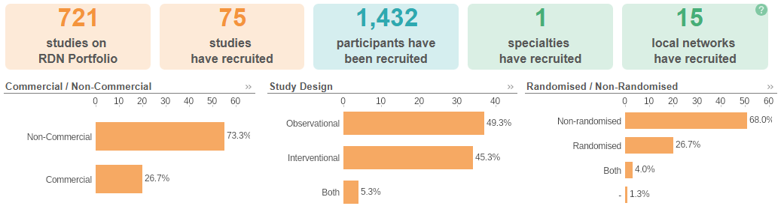
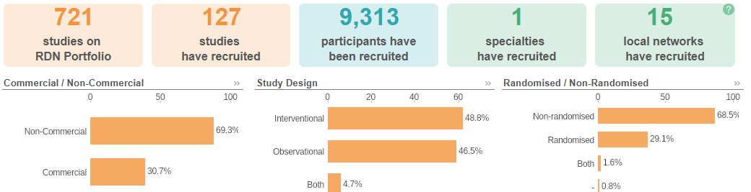
National Recruitment to Upper GI Cancer Studies
Apr 25 - Jun 25
Apr 24 - Mar 25

Slide 3
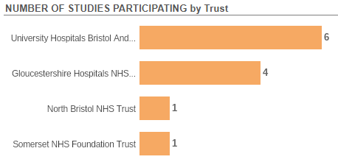
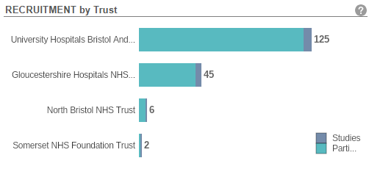
Recruitment to Upper GI Cancer Studies SWAG Region Apr 2024 - June 25

Slide 4
SWAG Sites Open - OG Cancer studies
CPMS ID | Short Name | Sites | Open | Planned Closure | Sample Size Eng | Eng Recruits
55905 | Surveillance After Resection of Oesophageal aNd Gastric cancer trial | UHBW, SOM | 09/06/2023 | 31/10/2025 | 800 | 577
55713 | PICCOS | UHBW, RUH, SOM, SAL | 18/01/2024 | 30/04/2026 | 0 | 5
54679 | VALUE | SOM | 22/05/2024 | 31/12/2025* | 150 | 44
54168 | Gastric Platform Study | SOM | 01/09/2023 | 30/06/2025* | 6 | 6
51510 | MX39897: Registry in patients profiled with NGS | UHBW, SOM, GHFT | 12/05/2023 | 31/12/2026 | 100 | 216
45162 | MOSAICC STUDY | GHFT, SAL | 18/08/2020 | 30/06/2025* | 460 | 346
44579 | DESTINY-Gastric 03 | UHBW | 15/07/2021 | 30/06/2025* | 9 (290) | 13
8880 | OCCAMS: Multicentre Study Determining Predictive Biomarkers & Targets for Oesophageal Adenocarcinoma | GHFT | 19/07/2010 | 31/03/2026 | 5000 | 4,032

Slide 5
SWAG region In Setup OG Cancer Studies
CPMS | Short Name | Planned Opening | Planned Closure | Sample Size UK | Sponsor | CI Name | Sites
63445 | Phase 1 study of GSK5733584 in advanced Solid Tumours | 27/09/2024 | 25/04/2025 | 18 | GLAXOSMITHKLINE RESEARCH & DEVELOPMENT LIMITED | - | UHBW, GWH, NBT
65751 | A Study of Zolbetuximab Together with Pembrolizumab and Chemotherapy in Adults with Gastric Cancer | 21/05/2025 | 01/03/2028 | 16 | Astellas Pharma Europe BV |  | UHBW
59351 | ROSE | 01/11/2024 | 15/01/2026 | 206 | UHBW | Kerry Avery | UHBW
63295 | M24-977 - AndroMETa-GEA-977 | 30/04/2025 | 30/11/2026 | 20 | ABBVIE INC. |  | UHBW, SOM, GWH

Slide 6
Topics for discussion
OG Trials open in the Network
Other Targeted Platform trials open- DETERMINE
ASCO 2025 – Gastro-oesophageal- What is making headlines?

Slide 7

Multi-centre, open-label, two-arm, parallel design, superiority Randomised Controlled Trial.
The study aims to determine whether intensive surveillance after completing curatively intended treatment improves survival and health-related quality of life in patients with oesophageal or gastric cancer.
The SARONG study will recruit adults (aged 16 years or over) receiving surgical resection for curatively intended treatment of oesophageal or gastric cancer with or without neoadjuvant/adjuvant chemo(radio)therapy/ immunotherapy.
Participant will be randomised to either standard of care or intense surveillance intensive surveillance (including radiological scans (chest and abdomen) and clinical review) every 6 months for 36 months post-randomisation along with an endoscopy at 12 months post-randomisation.
952 patients (476 in each of two trial arms) will be recruited over a period of 32 months from approximately 24 sites in the UK.

Slide 8
ROSE-Reporting Outcomes and Symptoms Electronically after surgery
206 patients undergoing surgery for oesophago-gastric cancer at six NHS hospitals in England.
Patients will be randomly placed in one of two groups. Patients in the ‘ROSE tool’ group will be asked to report their symptoms using an electronic (online/web-based) information tool while also receiving their usual care.
Depending on the seriousness of reported symptoms, the ROSE tool will provide information about how to manage these symptoms and/or inform them to contact their healthcare team.
Patients in the ‘usual care’ group will receive their usual clinical care and will not use the ROSE tool to complete the symptom-report questionnaire or to receive symptom management information.

Slide 9
Pressurised IntraPeritoneal Aerosolised Chemotherapy (PIPAC) in the management of cancers of the colon, ovary and stomach: a randomised controlled phase II trial of efficacy in peritoneal metastases (PICCOS)
Inclusion Criteria
Visible measurable peritoneal lesion(s) on computerised tomography (CT) imaging
PM from histologically proven primary adenocarcinoma (any subtype) of stomach or Siewert
type 3 gastro-oesophageal junction tumour
Any Human Epidermal Growth Factor Receptor 2 (HER2) status or Combined Positive Score (CPS)
Exclusion criteria
Extra-peritoneal metastases (with the exception of retroperitoneal lymph nodes)
Prior systemic anti-cancer therapy, radiotherapy or surgery for stomach cancer
Gastric or duodenal stent in-situ
Gastro-oesophageal junction Siewert Type 1 or Type 2 tumour
Symptoms and/or radiology suggestive of impending and/or current bowel obstruction
Uncontrolled and persistent ascites

Slide 10
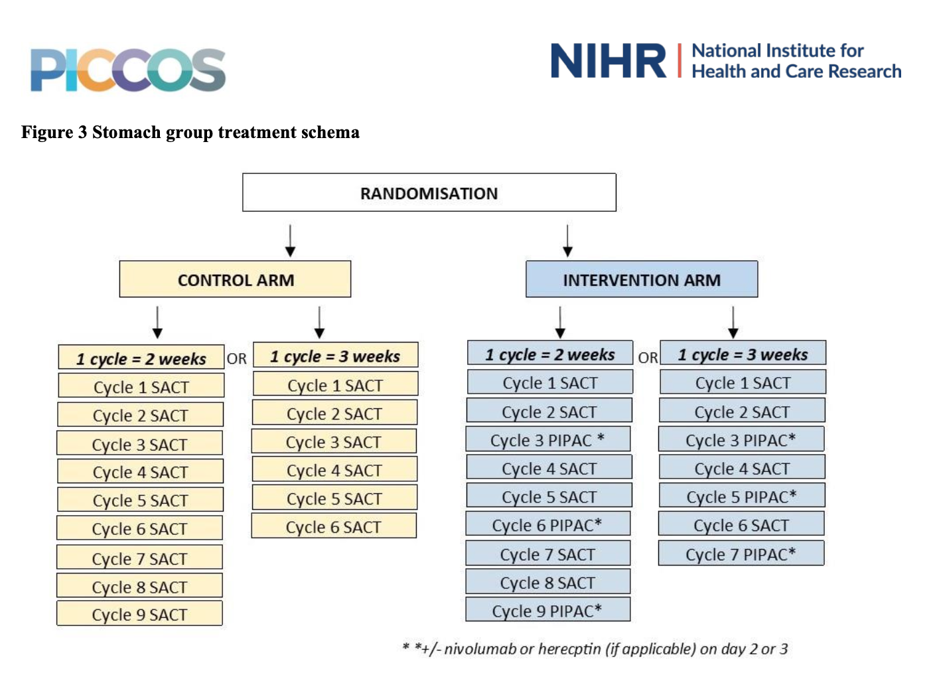

Slide 11
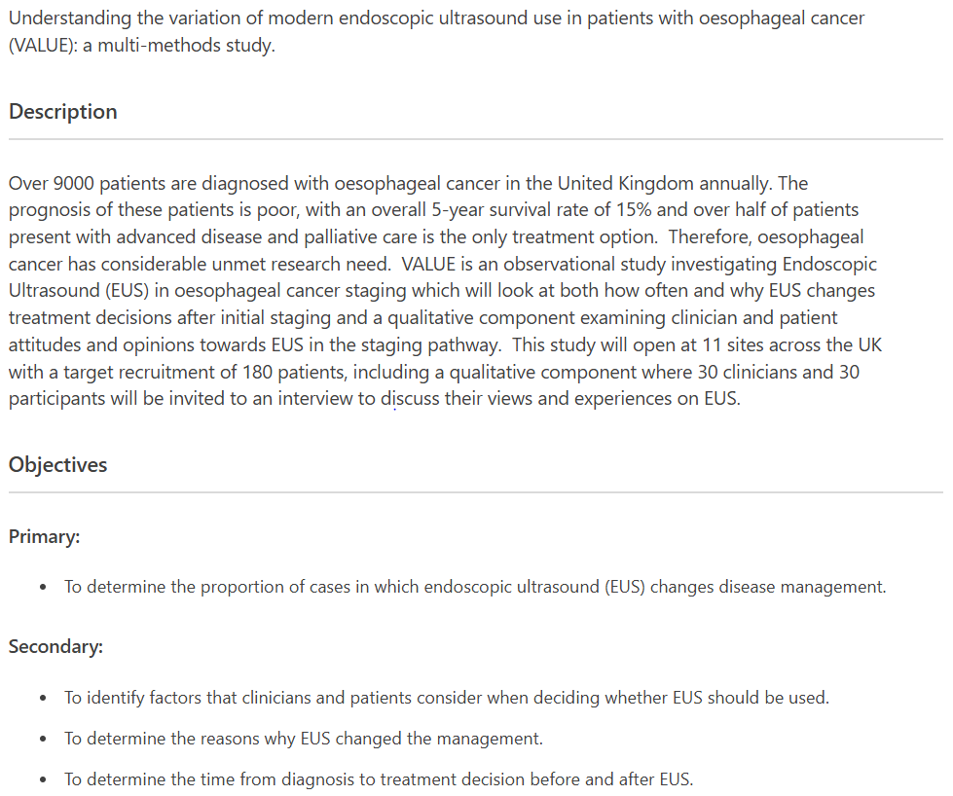

Slide 12
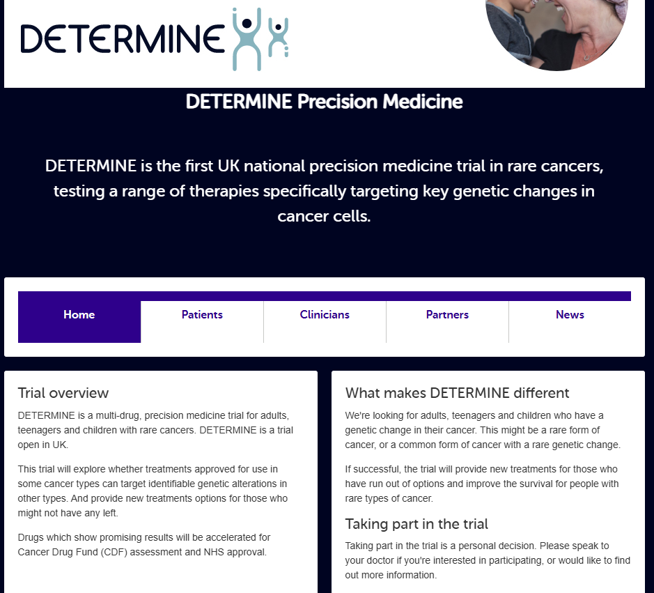
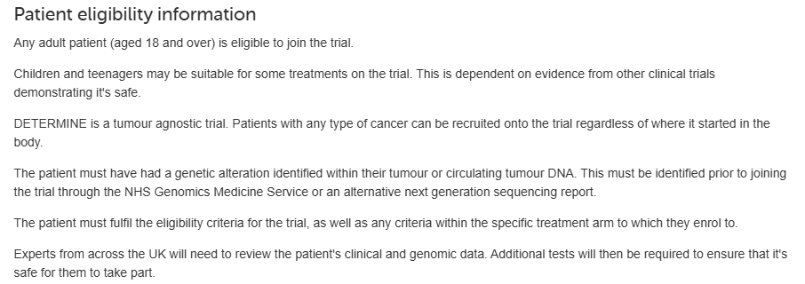

Slide 13
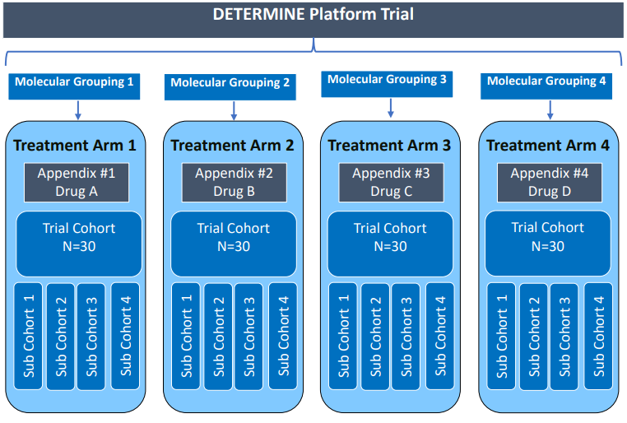

Slide 14
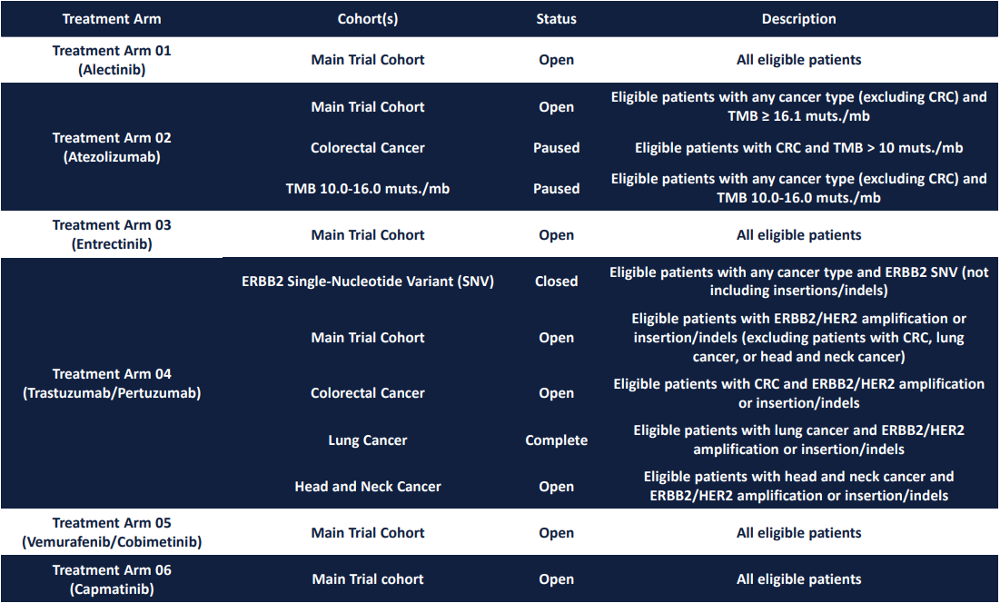

Slide 15
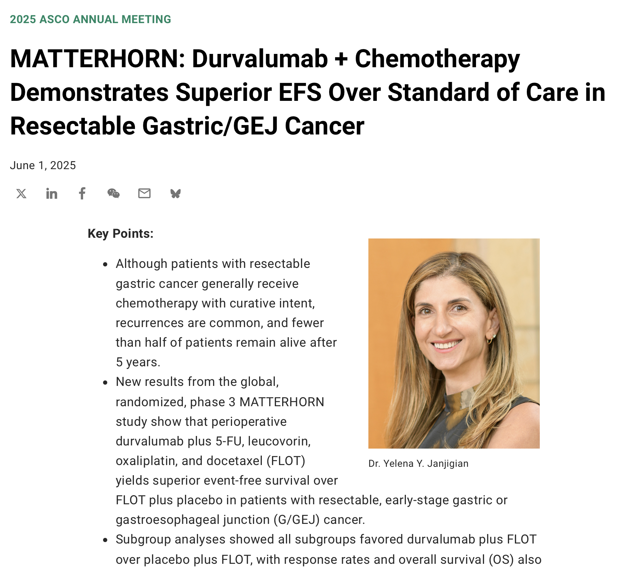

Slide 16
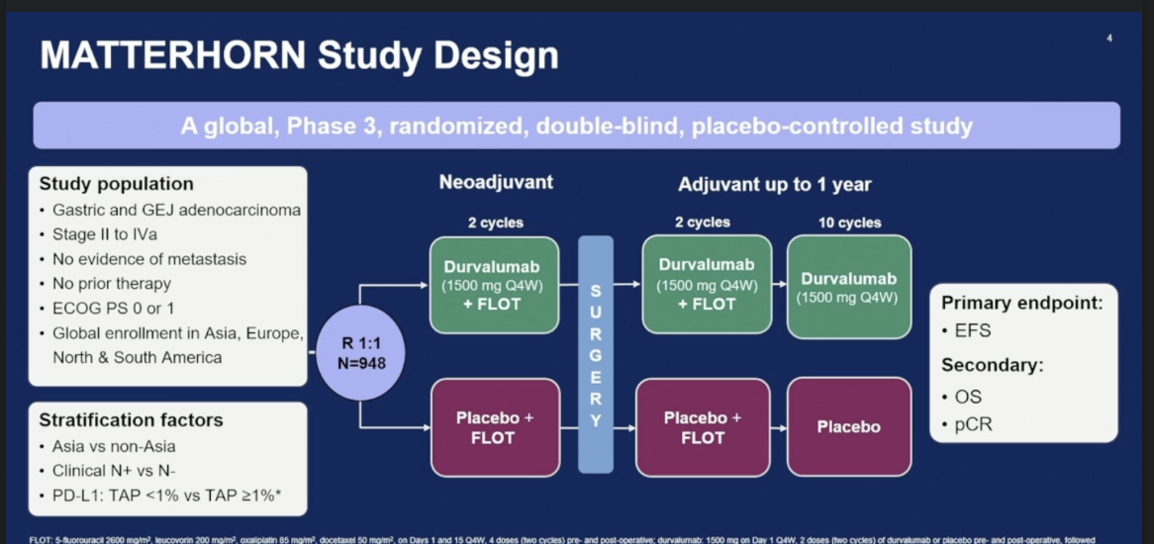

Slide 17
MATTERHORN trial
Primary endpoint is EFS, defined as time from randomization until the date of one of the following events (whichever occurred first):
  RECIST progression that precludes surgery or requires non-protocol therapy during the neoadjuvant period;
  RECIST progression/recurrence during the adjuvant period;
  non-RECIST progression that precludes surgery or requires non-protocol therapy during the neoadjuvant period or discovered during surgery;
  progression/recurrence confirmed by biopsy post-surgery;
  or death due to any cause.
Secondary endpoints include pCR rate, defined as the proportion of patients who have no detectable cancer cells in resected tumour tissue following neoadjuvant therapy, and OS.

Slide 18
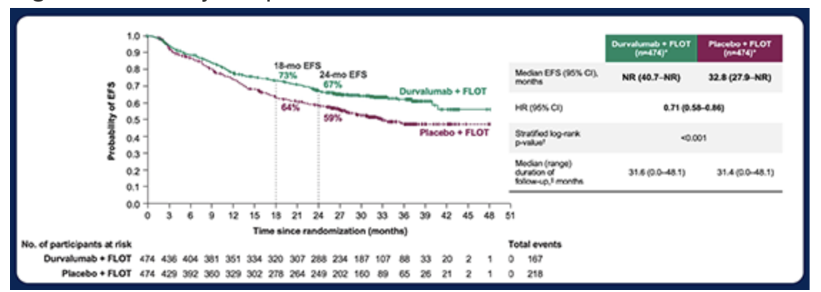

Slide 19
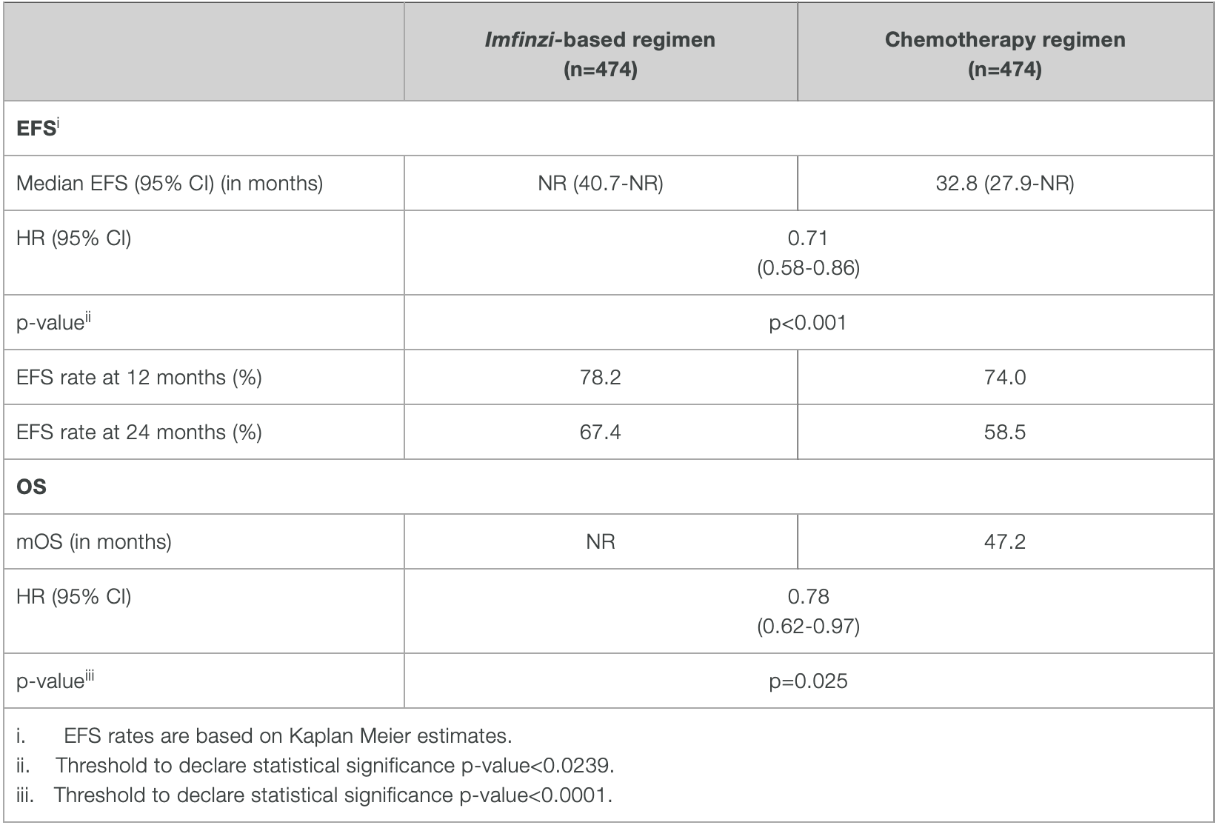
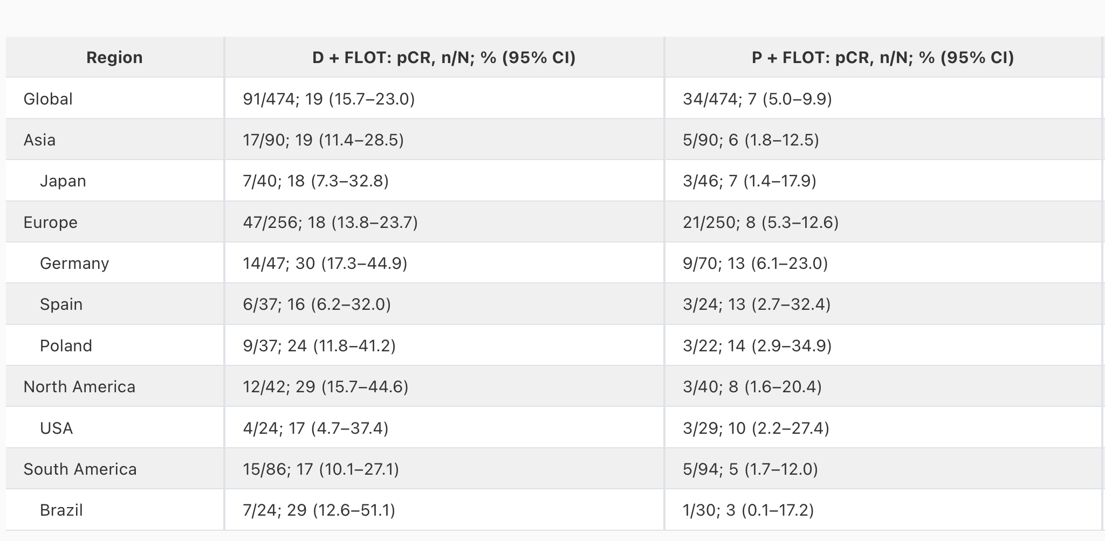
Summary of results: MATTERHORN

Slide 20
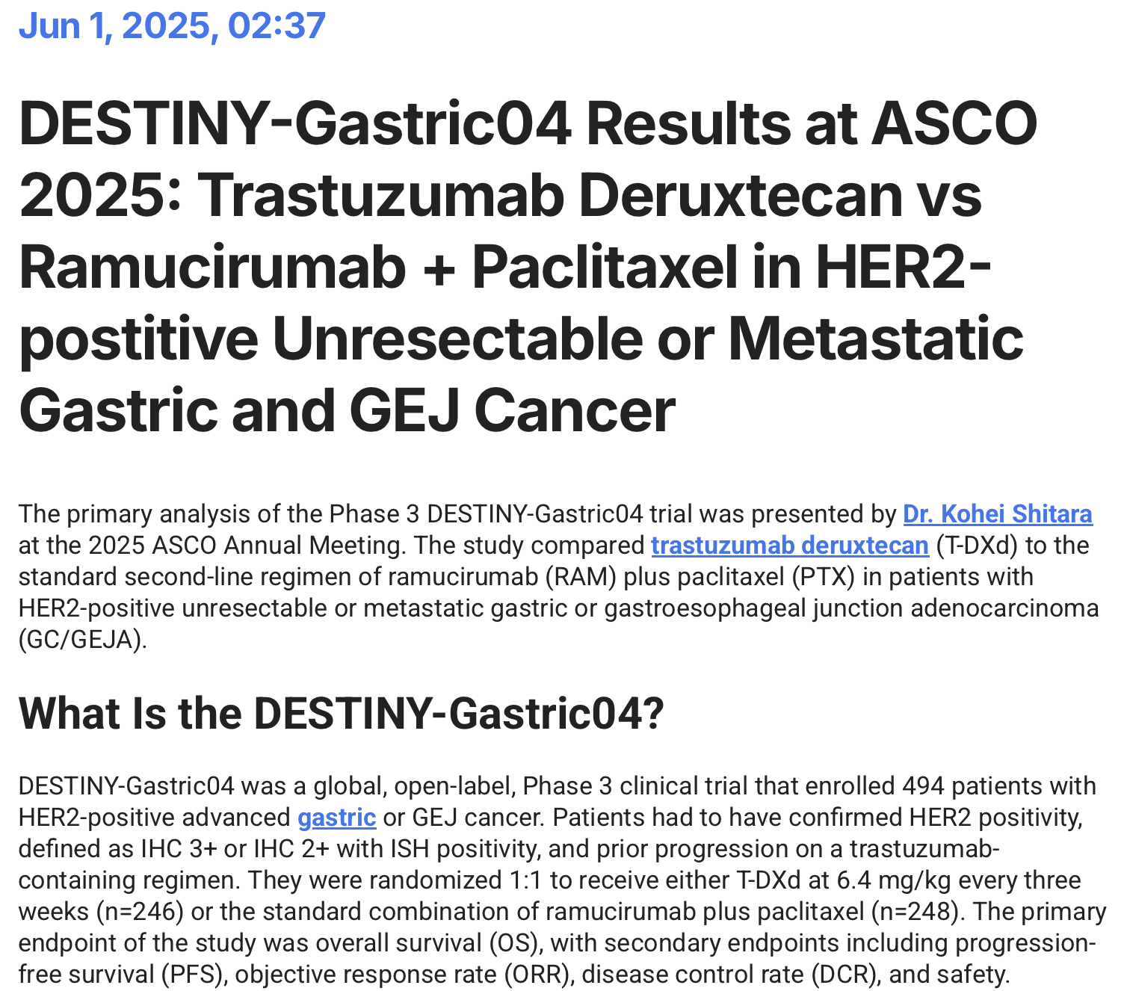
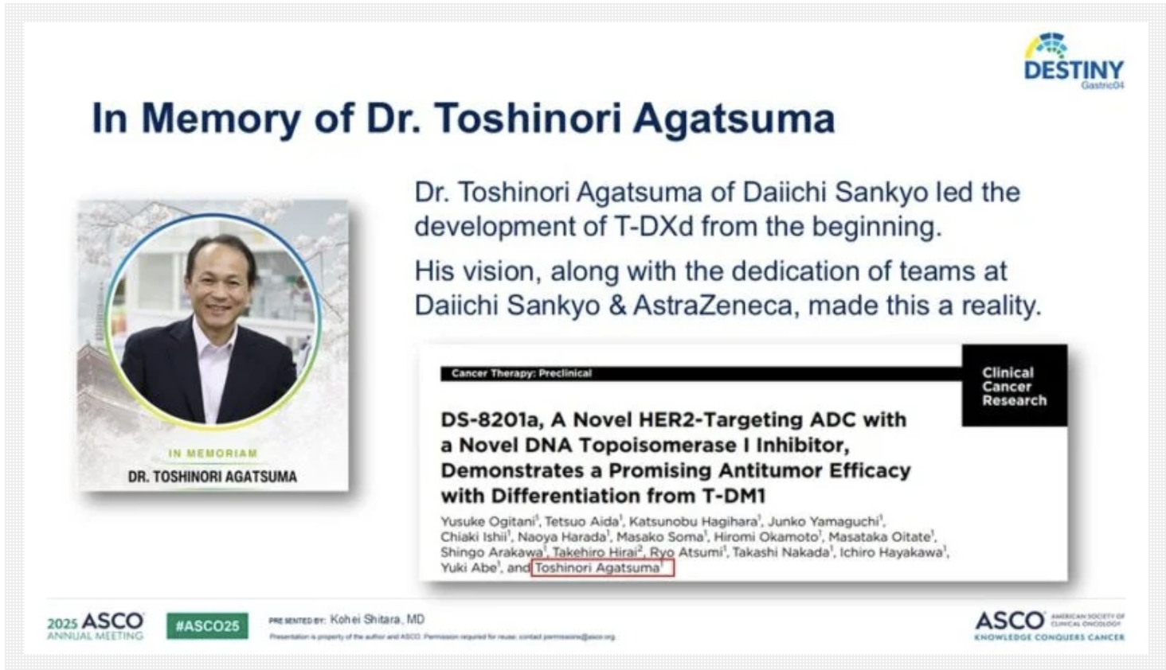

Slide 21
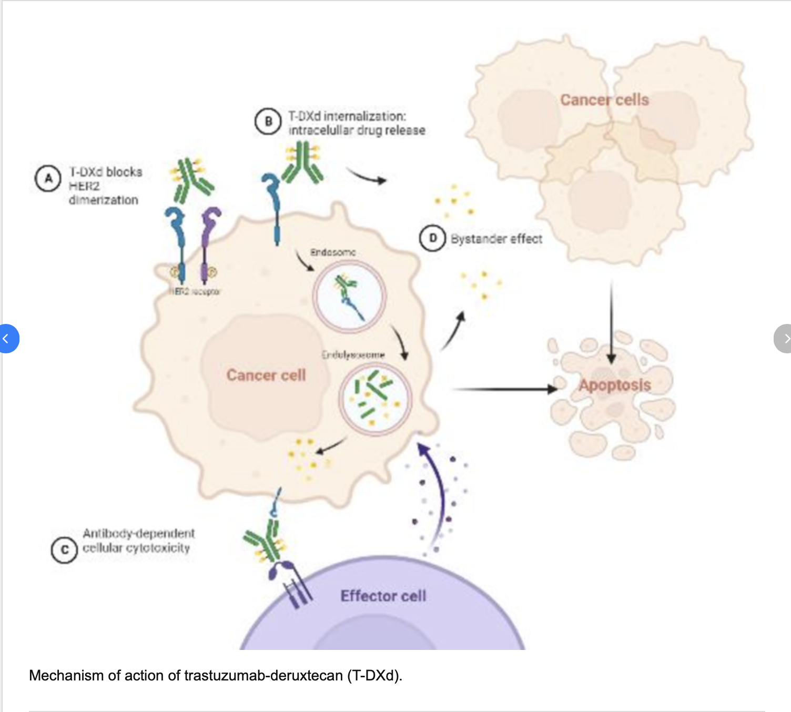

Slide 22
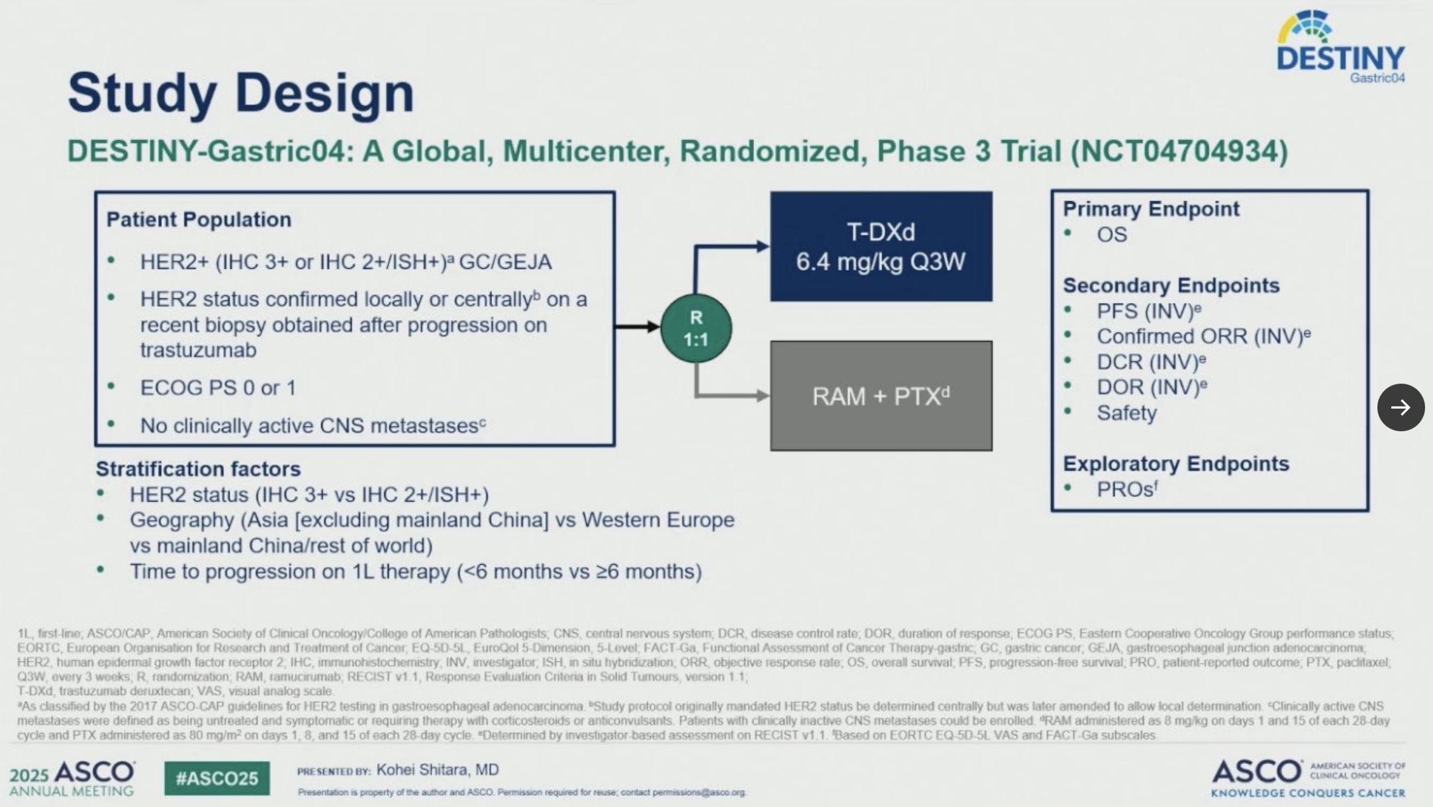

Slide 23
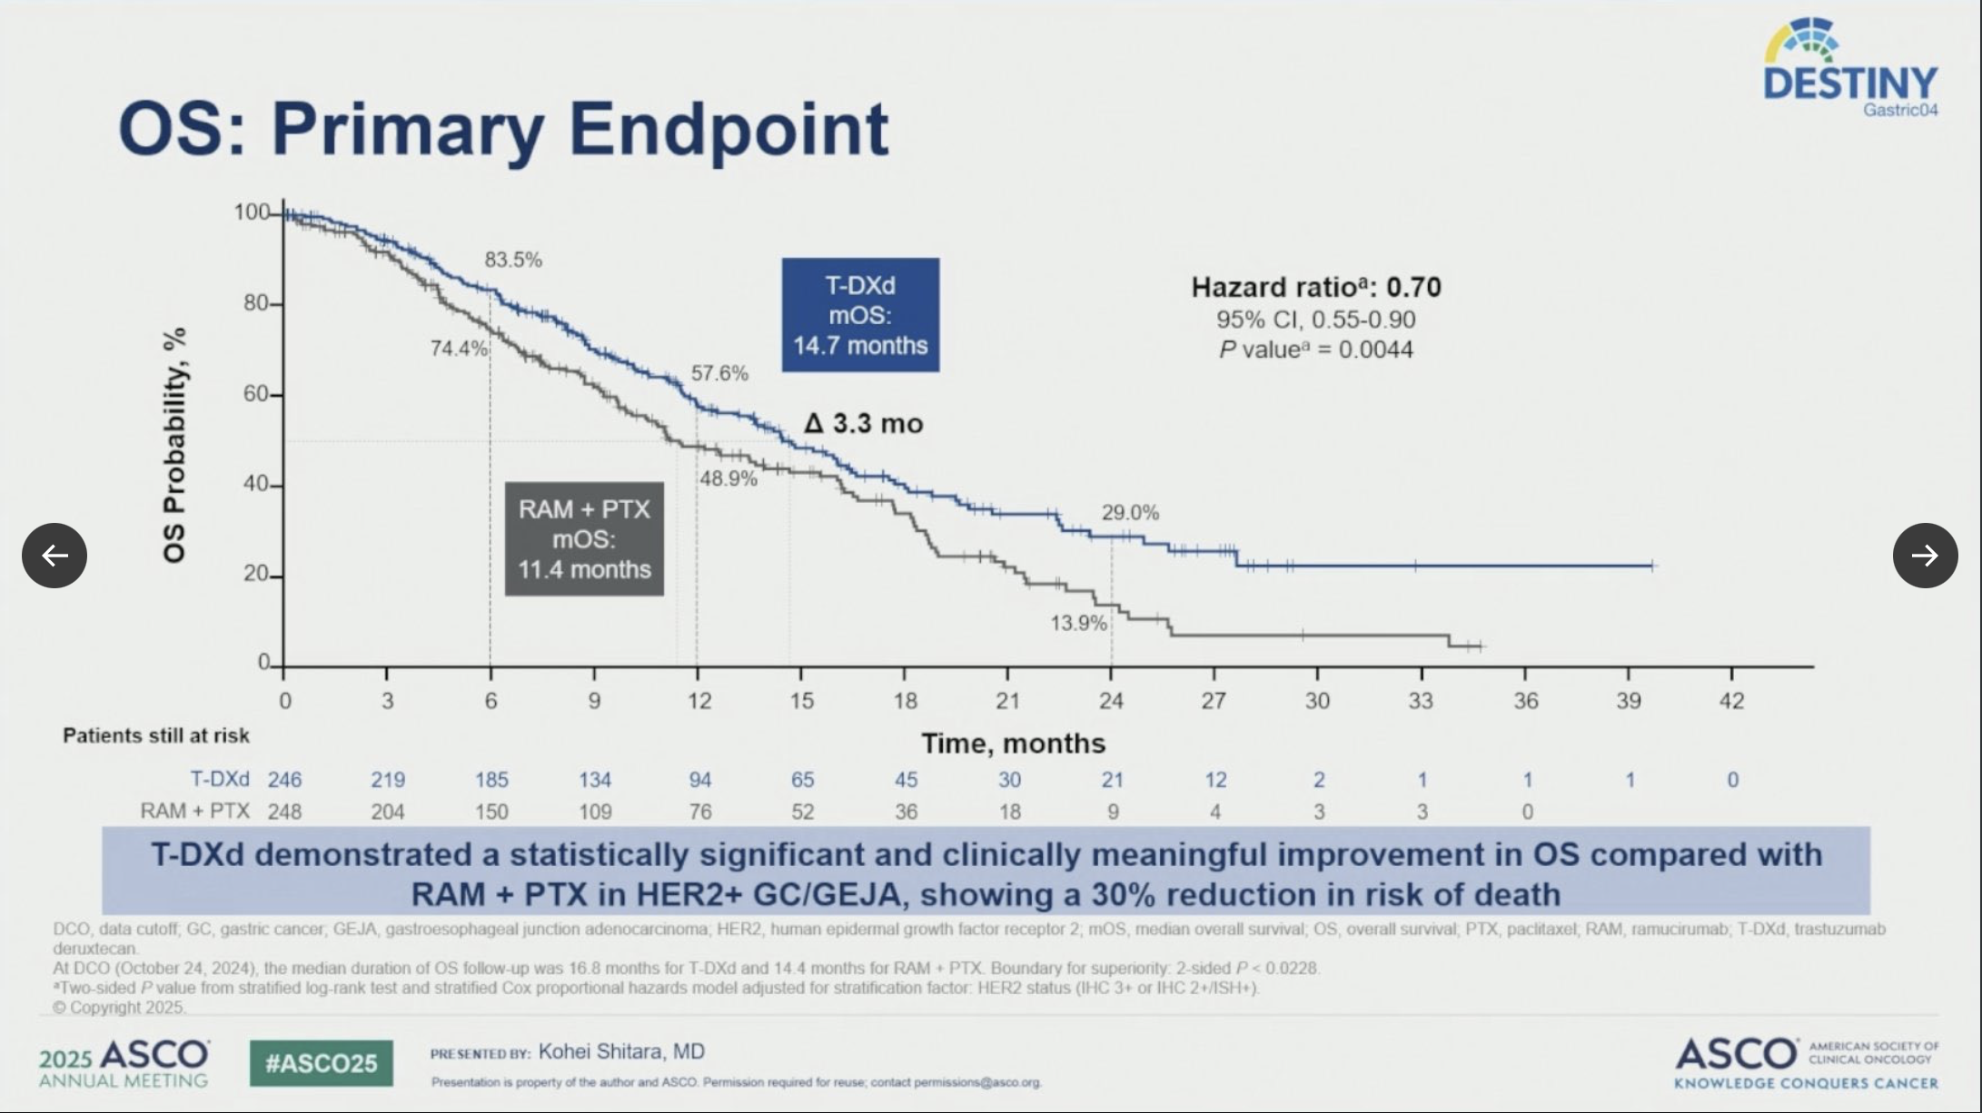

Slide 24
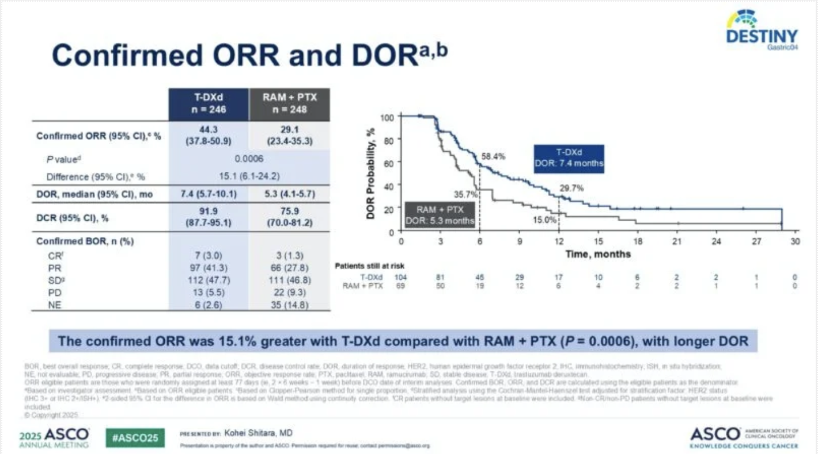

Slide 25
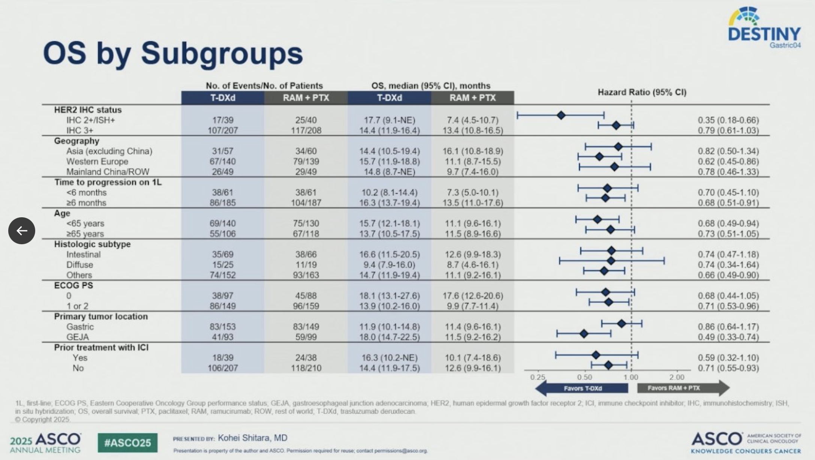

Slide 26
Safety and Tolerability
Grade ≥3 TEAEs were reported in 68.0% of patients receiving T-DXd versus 73.8% with RAM + PTX.
Serious adverse events occurred in 41.0% of T-DXd patients compared to 43.3% with RAM + PTX. Treatment discontinuation due to AEs occurred in 14.3% of patients in the T-DXd arm and 17.2% in the RAM + PTX arm.
Of special interest was drug-related interstitial lung disease (ILD) or pneumonitis, which was reported in 13.9% of patients treated with T-DXd (n=34). Most events were low grade, with only one Grade 3 ILD case and no Grade 4 or 5 cases. In contrast, ILD/pneumonitis occurred in 1.3% (n=3) of patients in the RAM + PTX group, including two Grade 3 and one Grade 5 event.

Slide 27
What People Are Saying About the DESTINY-Gastric04 Trial?
New Standard in 2L HER2+ Gastric Cancer?
DESTINY-Gastric04 (NEJM) T-DXd vs Ramucirumab+Paclitaxel
N=494, post-trastuzumab HER2+ GEJ/Gastric AC
Primary OS benefit: 14.7 mo vs 11.4 mo, HR 0.70 | p=0.004
PFS: 6.7 vs 5.6 mo
ORR: 44.3% vs 29.1%
But… some concerns
ILD/pneumonitis in 13.9% (though mostly grade 1–2)
No in-trial crossover, yet ~26% in control arm got T-DXd post-progression
HER2 heterogeneity not fully addressed
Subgroup CI >1.0 in many cohorts
Open-label + regional variations = interpret cautiously
Still, this cements T-DXd as new 2L SOC if HER2 remains positive post 1L.
HER2 “reconfirmation” post-trastuzumab is now non-negotiable.”

Slide 28

Be Part of Research

Slide 29
Campaign objectives
Primary objective:
Increase number of people registered with Be Part of Research by 300% over an 18-24 month period
Secondary objectives:
Increase volunteers from under-represented demographics
Black ethnicities: 1.9% increase (2.1% to ONS: 4.0%)
Asian ethnicities: 3.4% increase (5.9% to ONS: 9.3%)
18-24 age bracket by 3.4% (4.9% to ONS: 8.3%)

Slide 30
Key messages
Be Part of Research makes it easier than ever to find and take part in health and care research.
Simply sign up online and choose the areas of research you’re interested in.
You’ll then be matched to suitable studies and sent clear information about what’s involved and how you can take part.
The decision on whether to take part is always yours.

Slide 31


Leaflets

Slide 32



Print posters: 5 designs

Slide 33

Associate Principal Investigator
Scheme
Six month in-work training opportunity, providing practical experience for healthcare professionals starting their research career.
People who would not normally have the opportunity to take part in clinical research in their day to day role have the chance to experience what it means to work on and deliver a NIHR portfolio trial under the mentorship of an enthusiastic Local PI.
CIs working with a CTU can register their study on the scheme
https://www.nihr.ac.uk/health-and-care-professionals/career-development/associate-principal-investigator-scheme.htm

Slide 34

Principal Investigator Pipeline Programme
(PIPP)
Overview
Research delivery nurses or midwives
12 to 18 months
Free if you’re eligible
Live virtual lessons, online learning and hands-on experience
Cohort 4 applications are now closed
Please email nursingandmidwifery@nihr.ac.uk for more information
https://www.nihr.ac.uk/career-development/clinical-research-courses-and-support/principal-investigator-pipeline-programme

Slide 35
NIHR ODP https://odp.nihr.ac.uk/
Open data platform. Data on performance across whole RDN, including all specialty areas
NIHR Be Part of Research https://bepartofresearch.nihr.ac.uk/
See which studies are open across the country
Find a Clinical Research Study (ODP) http://csg.ncri.org.uk/portfolio/portfolio-maps/
Search for a study to fit criteria. Good for horizon scanning, eligibility criteria

Slide 36
RRDN Contacts
swc.rrdn@nihr.ac.uk
Study Support Service Manager: claire.matthews@nihr.ac.uk
CAG Research Lead: sharath.gangadhara@nhs.net

