Slide 1
Management of pT1b cancer after complete endoscopic resection
Interim Results of the PREFER Study
SWAG CAG 20/6/25

Slide 2
Background
Management of pT1a and T2+ cancer is relatively straight forward.
pT1b primary tumours are endoscopically resectable
But what about LNs
Risk of synchronous LN mets:
pT1a 0-1%
pT1b 0-46%
But are we comparing apples and oranges

Slide 3
PREFER
Basis was the retrospective series suggesting recurrence rates following surgery or surveillance after ER are similar (6% vs 8%)
PREFER protocol:
All patients with R0 resection of ANY pT1b cancer (oesophagus)
EUS c Bite-on-bite bx +/- FNA of abnormal LNs
3/12ly for 2 years
6/12ly for 2 years
Annual after.
PET 6/52 after ER, then at 1 year
Primary outcome = 5yr DFS and OS.
Secondary outcomes = LN mets, unresectable LR, Distant mets
So… not an RCT…but at least prospective and with excellent histological assessment at inclusion

Slide 4
Interim results
Median 30 month FU
Classified cases into low and high risk:
Low risk = sm1, no LVI/PNI, not poorly differentiated, not SCC
High risk = all other pT1b
Centres include:
Netherlands (8 units)
Germany (4 units)
Belgium (4 units)
UK (2 units)
Switzerland (1 unit)
Australia (1 unit)

Slide 5
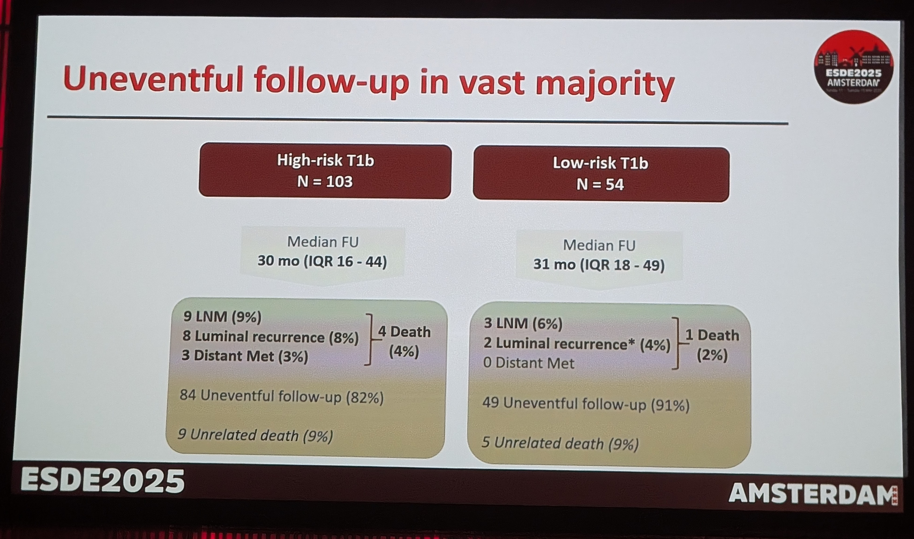
Interim results

Slide 6
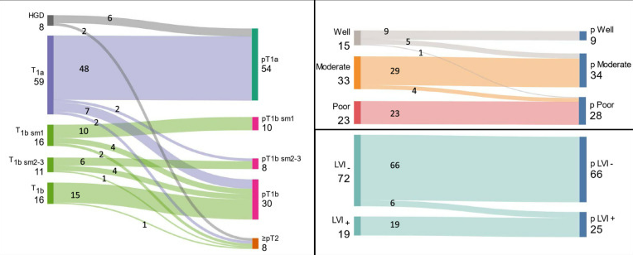
But what about CONGRESS
National UK Retrospective audit
All T1 cases
217 Pts had surgical resection after ER. Excluding R1 ER:
Stage migration in remaining 110 pts:
8/110 (7.2%) cases showed upward stage migration to pT2

Slide 7
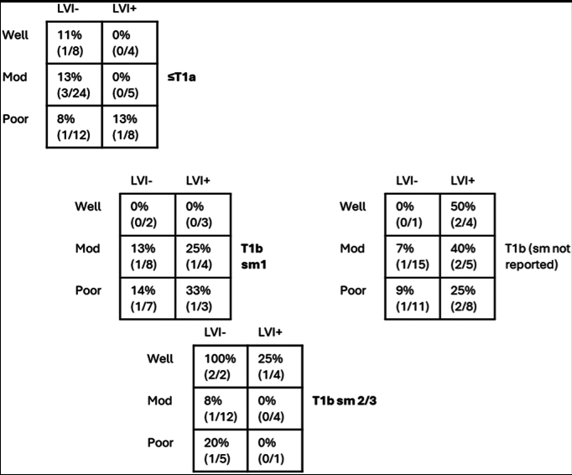
And the LN met rate?
Overall 13.5%
Predictors include:
Sm2-3
LVI
Signet Ring Cells
But, not in Multivariate
analysis

Slide 8
So, what should we do?
Shared Decision Making and Patient Autonomy
Proposal:
Low Risk pT1b R0 Barrett’s-associated adenoca
Offer patients surveillance (as per PREFER protocol) OR surgery
Ablate Barrett’s if accepts surveillance
High Risk pT1b
Continue to offer surgery and review position after final 5yr outcomes published

Slide 9
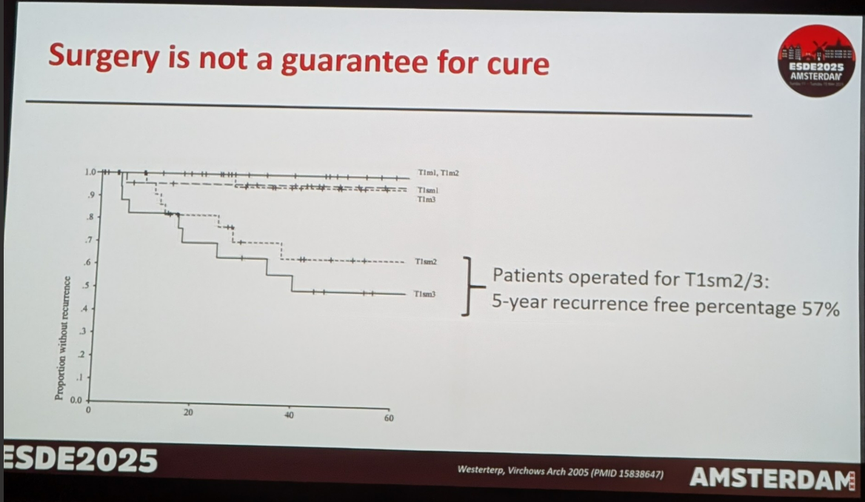
Future prospects
ER for local control of high risk pT1b, followed by adjuvant chemo +/- nivolumab?
Preserve function
Local control achievable by repeated ER if needed
82% DFS at 30/12 compares
Favourably with surgical series…

