Slide 1
Glioblastoma in Elderly People
Dr Alison Cameron
Consultant Neurooncologist
UHBW

Slide 2
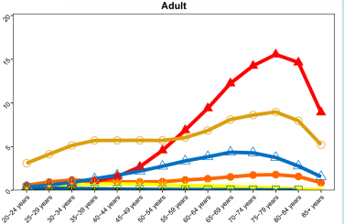
Why is this important?
Our gold standard treatment (Stupp protocol) is based on a trial where median age was 56 years, and those >70yr were excluded
Median OS was 14.5m with RT and TMZ
Annual incidence per 100,000 in USA 2014-18
Notes:
Red line GBM, brown pituitary, blue vest schwannoma, orange diffuse/anaplastic astro, yellow ODG, green MB

Slide 3
Survival is worse the older the person is at diagnosis…. But is this data skewed by BSC only where mOS 2-4 months?
Age (USA 2001-2017 data) | 1y relative survival | 5y RS | 10y RS
20-44 | 72% | 22% | 15%
45-54 | 59% | 9% | 5%
55-64 | 48% | 6% | 3%
65-74 | 32% | 4% | 3%
75+ | 14% | 2% | 1%
Swiss registry data 1980-1994:
only 25% of those >75 years received surgery +/or RT, compared to 82% of those <65 yr
Notes:
Based on about 130,000 cases for the survival data
Stupp trial didn’t see a sig survival benefit for those >60yr
But:
French series of stupp in those >=70y- 1 yr OS 49%
NOA-08 study (median 72y) 1 year OS 33% and if MGMT positive 41% if had RT and 67% if had TMZ

Slide 4
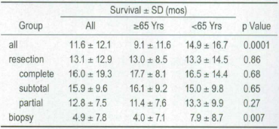
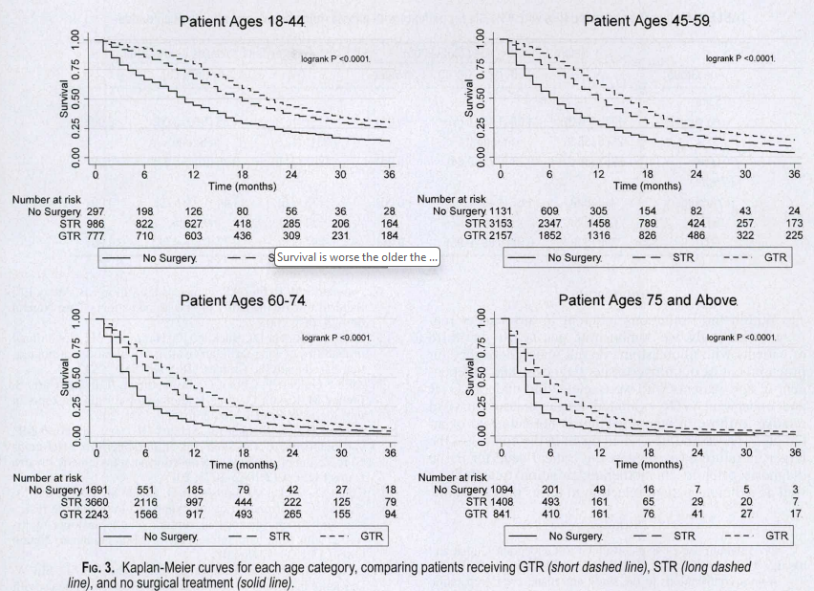
Surgery: extent of resection is probably important
Osvald et al J Neurosurg 2012
German data 2000-2006, 146>=65y v 215<65y
55 v 72% resection- but those resected did equally well whatever age
Harris et al Red J 2017
Australia 2007-2015 108 patients >=75 year
OS 12m GTR v 6.7m STR/Bx (1 year 47 v 21%)
Noorbakhsh et al J Neurosurg 2014
Seer data 1998-2009 >20k patients, 3631>=75y
GTR added 2m OS in those >=75y, 3m younger
Almenawer et al Neurooncol 2015
Metaanalysis of surgery in >=60y
Morbidity and mortality was better in those resection v biopsy
OS/PFS and post –op performance status better if resection v biopsy, and even better is GTR v STR
Notes:
Top pic data from german study (first)
Bottom pic from seer data (third)- in all age groups GTR better than STR better than no surgery
However there is some contradictory data and in later studies the impact of surgery is lost in MVA

Slide 5
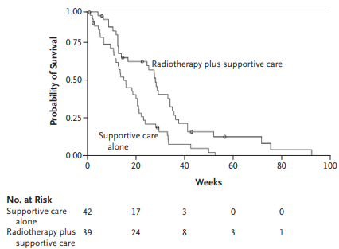
RCT RT (50GY in 28#) v BSC Kieme-Guilbert et al NEJM 2007
81 patients GBM, PS 70-100, >=70y [70-85y]
2001-2005, France
Discontinued early because RT was superior
48% debulking surgery
28% interrupted or delayed RT
15% discontinued RT
No difference in QOL/symptoms/cognition between groups
OS 29 v 17 weeks (3 month improvement)
PFS 15 v 5 weeks
Notes:
RT about 7 month mOS

Slide 6
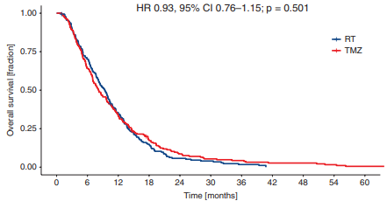
TMZ alone v RT alone (NOA-08) Wick et al Lancet Oncol 2012 and Neuro-oncol 2020
373 patients (331 GBM, 40AA) PS 60-100, 2005-2009
>=65y (median 72; [66-84])
MGMT 20%+/36%-/44% unK; 2020: 82pt +/139pt -
Sx: 28% GTR; 33% STR; 39% Bx
1:1 randomisation TMZ v RT
TMZ (100mg/m2 D1-7 q14 until progression; 76% completed at least 4 cycles (24% 1-3; 41% 4-6; 13% 7-9; 23% 10+cycle))
60Gy in 30-33# (GTV+2cm;84% completed)
Median OS 8.2 v 9.4m; EFS 3.4 v 4.6m (non-inferior)
Age not an independent prognostic factor (either above/below 70yr or as a continuous variable.)
Notes:
German/swiss study
62% TMZ and 70% RT group had salvage therapy at time of progression
Surgery was aindependant prognostic factor
2020 update: (7.5y fu) 221 patietns with MGMT status-37% positive

Slide 7
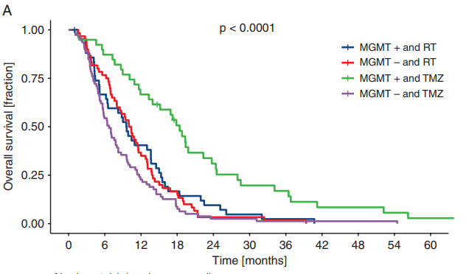
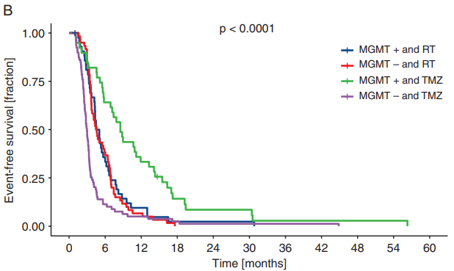
TMZ alone v RT alone (NOA-08) Wick et al Lancet Oncol 2012 and Neuro-oncol 2020
Notes:
Reuslts of TMZ in MGMT methylated surprisingly good- is this:
Dose dense chemo 9but RTOS 0525 didn’t show an advantage just more SE for dose dense albeit a different regime
Stat quirk
No RT to “get in the way” and delay TMZ admin
Also note: predictive benefit of MGMT and TMZ best in “receptor tyrosine kinese II” subgroup

Slide 8
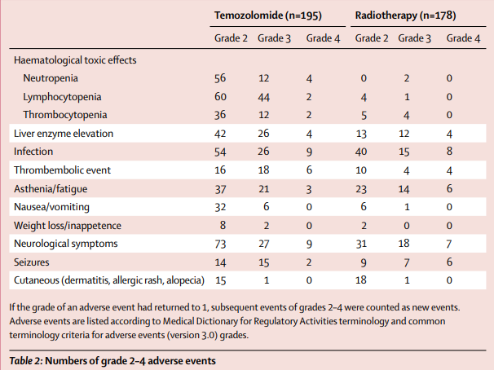
TMZ alone v RT alone (NOA-08) Wick et al Lancet Oncol 2012 and Neuro-oncol 2020
Notes:
well tolerated. 18% grade ¾ infection with tmz but 13% had this with RT- so much of this likely related to the steroids

Slide 9
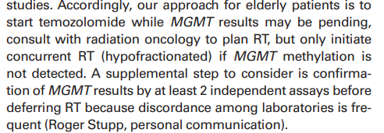
Notes:
Editorial 2020 from Columbia university irving medical centre in new york

Slide 10
TMZ v 60Gy in 30# v 34Gy in 10# Nordic study Malmstrom et al Lancet Oncol 2012
342 patients, 2000-2009, PS0-2, MGMT + 45%, 73% surgery
>60yr (60-65 excluded after 2004)-median 70y [60-88y],
MVA- prognostic- surgery, PS and 60-70 v >70y
TMZ 200mg/m2 D1-5q28 x6 (35% completed 6 cycles)
RT: 34Gy- 2% discontinued treatment; 60Gy – 23% discontinued(trend to older worse)
OS median 8.3m TMZ v 7.5m 34Gy v 6.0m 60Gy (long course sig worse)
QOL- generally better in the TMZ group than the RT group (eg for cognitive, role, physical drowsiness) but global ISQ
Notes:
Slightly complicated randomisation and results as some countries didn’t randomise to 60Gy

Slide 11
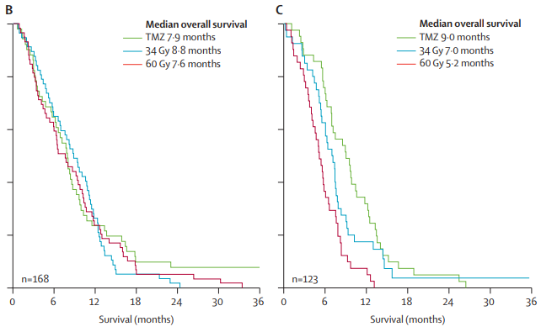
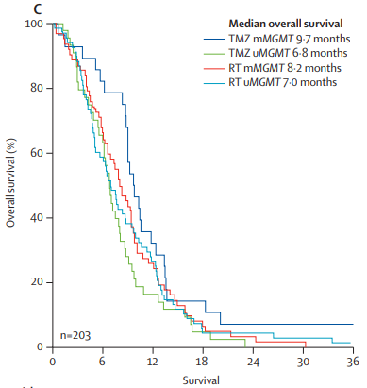
TMZ v 60Gy in 30# v 34Gy in 10# Nordic study Malmstrom et al Lancet Oncol 2012
60-70yr
Not sig
>70yr
sig

Slide 12
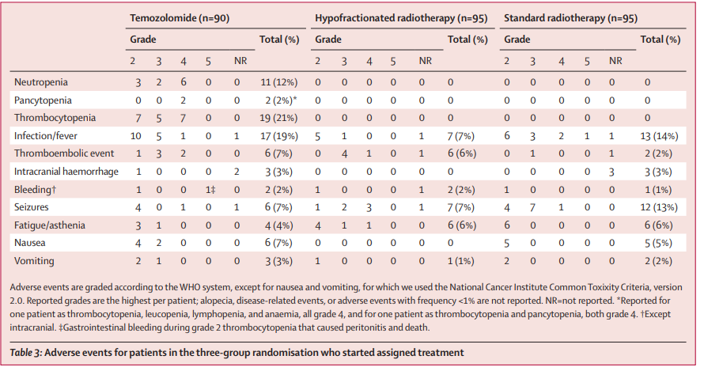
TMZ v 60Gy in 30# v 34Gy in 10# Nordic study Malmstrom et al Lancet Oncol 2012

Slide 13
40Gy in 15# v 40Gy in 15#+TMZ Perry et al NEJM 2017
564 patients 2007-2013, PS=0-2, 68% surgery, 75% on steroids, 47% MGMT+
>=65y –median 73yr [65-90](30% >=76yr)
TMZ concurrent 75mg/m2 D1-21 then 150-200mg/m2 D1-5q28 x12 (median 5) (31% didn’t receive any adjuvant TMZ)
2 deaths in each group related to treatment
Median OS 7.6m v 9.3m- bigger effect with older age (7.1 v 10.0m >75yr)

Slide 14
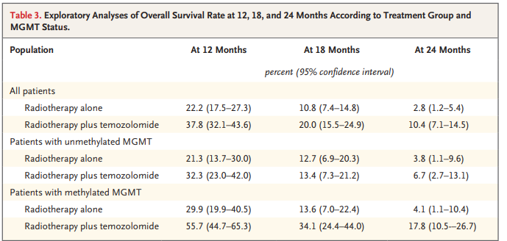
40Gy in 15# v 40Gy in 15#+TMZ Perry et al NEJM 2017

Slide 15
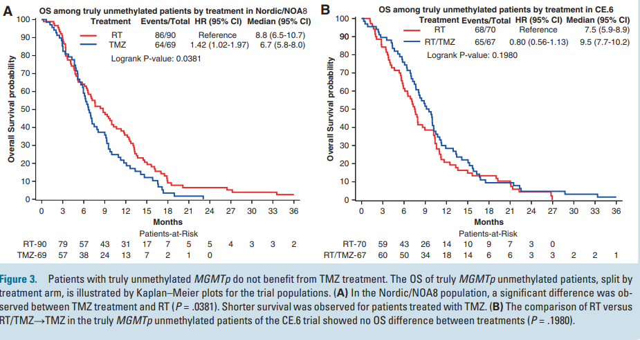
Combined analysis NOA-08, Nordic and Perry: Truly unmethylated MGMT do not benefit from TMZ Hegi et al Neuro-oncology 2024
Notes:
Grey zone patients should continue to have TMZ as not certain- small numbers

Slide 16
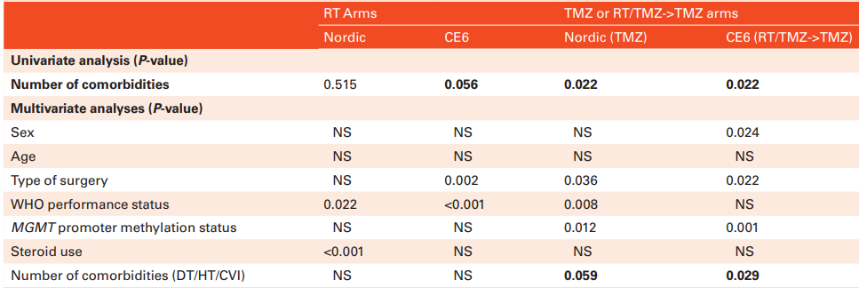
Combined analysis NOA-08, Nordic and Perry: Prognostic factors Malmstrom et al Neuro-oncology Advances 2024
1277 patients average age approx. 72y [60-92y]
Notes:
contribution of QoL at baseline to predict survival on top of clinical variables was only 2-4%.
One comorbidity ok, but 2-3 worse.
schneider M, Potthoff AL, Scharnbock E, et al. Newly diagnosed glioblastoma in geriatric (65 +) patients: impact of patients frailty, comorbidity burden and obesity on overall survival. J Neurooncol. 2020;149(3):421–427.
Lombardi G, Bergo E, Caccese M, et al. Validation of the comprehensive geriatric assessment as a predictor of mortality in elderly glioblastoma patients. Cancers (Basel). 2019;11(10):1509.

Slide 17
UK 3 centre Series Lorimer et al Clinical Oncology 2017
339 patients 2010-2015 >70yr, median 75y [70-90] (17% 80-84; 7% 85-89)
PS0-2 69%; 97% charlston comorbidity index <=3; 68% seen by oncology
Surgery:
nil 48% (13% of these had pall RT, rest BSC);
Bx 20%; STR 21%; GTR 11%. (34% then BSC)
Onc:
BSC 60%;
Pall RT 27% (97% 30Gy in 6#);
Rad RT 2%;
stupp C-RT 5% (17% discontinued concom TMZ; 22% completed 6 ad TMZ);
TMZ only 6%
Notes:
Brighton, RMH, Glasgow
One pall rt patient on 20# didn’t complete RT. Rest all did

Slide 18
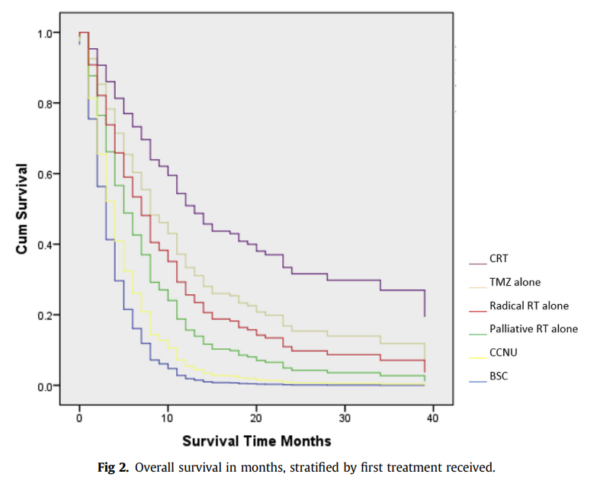
UK 3 centre Series Lorimer et al Clinical Oncology 2017
Med OS 3.8m
BSC 2.5m
Pall RT 6.8m
Rad RT 9.7m
TMZ alone 13.1m
Stupp 16.7m
Age not prognostic on MVA
Prognostic:
PS
Surgery
Seizures
Hemispheric/no mass effect/ not multifocal
Stupp/TMZ/pall RT
Notes:
Age not a significant factor when PS and treatment factors taken into account
“chronological age alone should not be used to determine treatment offered, as it is a poor representative of physiological reserve”

Slide 19
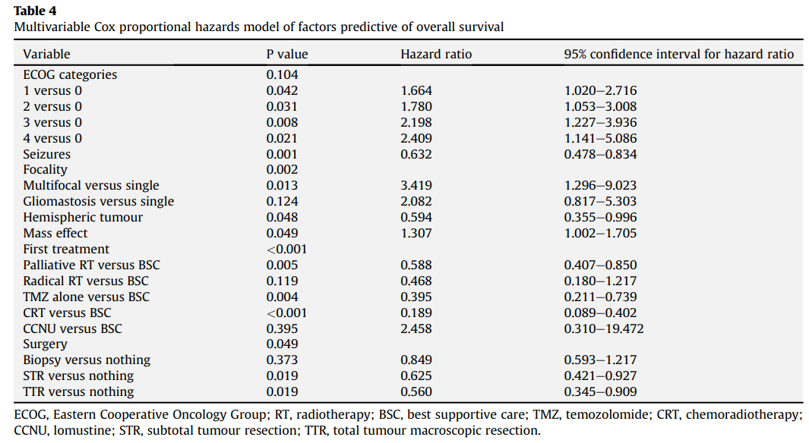
UK 3 centre Series Lorimer et al Clinical Oncology 2017
Notes:
No effect of comorbidities or comedication on outcomes in this series (note there was re if 2-3 comorbidities HT/DM/CVA in the combined noa/Nordic/perry)

Slide 20
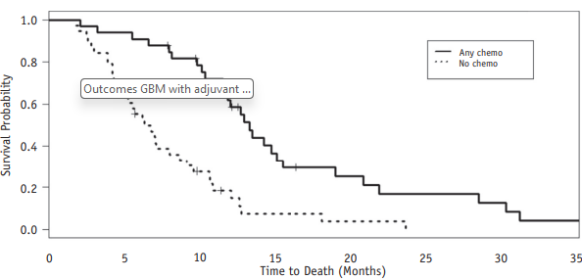
Australian Series Harris et al Red J 2017
108 patients 2006-2016 >75 yr: median 79yr (38% >80years) [74-87y]
57% GTR; 84% <=40Gy; 65%PS 0-1; 50% MGMT methylated
32% BSC (48% had a resection); 1% TMZ alone; 37% RT alone; 30% RT+TMZ
OS: BSC 2m; RT alone 6m; C-RT 13m
No admission for treatment related toxicity

Slide 21
Frankfurt series Baumgarten et al J of Neuro-Oncol 2023
143 patients 2010-2018 >=75yr, median 79 [75-110]
Pre-op KPS >=70 in 54% (74% if resection; 46% Bx only) (mOS 6 v 3m)
MGMT + 40%
27% surgery (rest Bx)- mOS 12 v 4m
66% RT- mOS 10 v 1.5m
41% Chemo- mOS 11 v 4m
In MVA- only treatment with RT/chemo were independent prognostic factors (not surgery)
Notes:
PS >70 v <70 6 v 3m
Sx v Bx only 12 v 4 m
Rt v nil 10 v 1.5m
Chemo v nil 11 v 4 m

Slide 22
RT dose: RCT 25Gy/5# v 40Gy/15# Roa et al JCO 2015 (IAEA study)
98 patients GBM >=50yr+PS 50-70/>=65yr+PS 80-100
2010-2013, limited health resource countries
82% surgery; 62% >=65 yr
No >= grade 3 toxicity and dex dose same at BL-3 months post RT
QOL similar
OS 7.9 v 6.4m
PFS 4.2 v 4.2m

Slide 23
Perry (ish) v Stupp (ish) C-RT meta-analysis Lu et al J of Neuro-oncol 2019
7 studies all retrospective cohort >65/>70 year 917 patients (65% stupp), resection in 53%; MGMT+45%
Based on 2 studies (334 patients)- PFS ISQ- 5.2 v6.1m
OS 3.5m worse for hypofractioned (917 patients) 9.9 v 13.5m
No difference if defined elderly as >65 yr or >70yr
Notes:
2 small cohort had 30-35 in 10 as the hypofractioned option

Slide 24
52.5Gy in 15# Perlow et al Cancer 2022
52.5Gy is biologically equivalent (tumour) to 60gy in 30#
62 patients from pooled analysis of 4 prospective trials >=65y +/or KPS<70.
median age 73y; 66% KPS<70; 54% MGMT+; 18% multifocal
97% surgery, 66% concurrent chemo (chemo prog factor on MVA)
Median OS=10.3m
KPS >=70 15.3m
KPS <70 9.3m
BED tumour: stupp=75Gy; IAEA/perry= 53Gy
BED brain: stupp=120Gy; perry= 94Gy; this regime=144Gy
Need additional studies to confirm findings.
Notes:
Old brian tumour studies showed dose response relationship with OS between 50 and 60Gy. Walker et al successfully showed that when increasing the dose from ≤45 to 50, 55, and 60 Gy in 1.8- to 2.0- Gy fractions, the median survival progressed from 13.5 to 28, 36, and 42 weeks, respectively.
One trial the SIB was 67.5Gy
2 patients grade 3 neuro tox (seizures)

Slide 25
French series Stupp Vaugier et al Nature 2021
128 Patients 2004-2018 >=70y All Stupp regime, PS0-2, median 74yr [70-88] (43%>=75.5; 15%>80y), 60% neurological disability (8% cognitive disability/22% communication)
50% GTR/14% STR/37%Bx
81% completed 6w CRT- 10% progressed; 9% discon TMZ
Ad TMZ- median 2 cycles, 28% all 6 (those had mOS 17.5m)
mPFS- 9.4m; mOS 11.7m (15% alive at 2 years)
Age>=80 not related to outcome- mOS 12.1m, mPFS 9.2m
Notes:
Neither age or neurological disability or biopsy only related to completion of c-rt.
20% had early neurological progression/death (during or <1month from CRT)
1y OS 49%

Slide 26
Comprehensive Geriatric Assessment in GBM Lombardi et al Cancers 2019
113 patients >=65y median 72y [65-84y]
44% MGMT +; 80% KPS 70-100
Fit (35%): functionally independent without serious co-morbidity
Vulnerable (30%): dependant for >=1 IADL/1-2 non severe co-morbidity
Frail (35%): >2 Gd3 comorbidity/ >=1 Gd 4 comorbidity /geriatric syndrome/dependent for >=1 ADL / >=85yr
Median OS: 16.5m v 12.1m v 10.3m (NS UVA, but was sig on MVA)
Prognostic MVA: fit v not; MGMT; KPS 100-70 v<70

Slide 27
People with brain tumour: 5y Bristol RT and Chemo delivery
2019-2024 34 patients >=75yr received RT
11 for meningioma aged 75-88 years
1 for paraganglioma and 1 chordoma (both 80y)
21 for GBM aged 75-81 years. 2 received 30Gy in 6#; 19x 40Gy in 15#
average 268 days (from RT date) for 14 who have died (8.9m)
2 likely to have died- last seen at 185 days
5 well in FU- av 238 days (7.9m) FU so far
2019-2024 12 patients >=75 yr received chemo
1 with multiple co-morbidities aged 80 had 6 cycles for recurrent prolactinoma with good effect and tolerance
11 aged 75-81yr had TMZ for GBM- 3 concurrent only, 7 concurrent and adjuvant and 2 for recurrence (1 despite unmethylated)
1 was aged 81 yr- MGMT+, debulked, PS1 but multiple co-morbidities- only had concurrent TMZ (tolerated well but adjuvant not given due to start of COVID pandemic)-lived 8.3 months
1 had PCV on recurrence
Notes:
3 GBM per year had RT
2 patients had chemo per year
Cancer stats wont give data on age groups for brain tumours in our region- but from 5 year national data (75-80y 2256pt; 1685 80-85, 1053 85-90, 508 >90y malignant brain tumour)- so given our population maybe 4% f england- expect 44 patients per year >75 with malignant brain tumour coming through he MDT

Slide 28
Conclusion
Elderly – once >65/70 years age is not prognostic once variation in treatment (and PS/comorbidities) taken into account
Patients with good PS/ few comorbidities are suitable to be offered treatment for GBM
Treatment Options:
MGMT+
TMZ alone (mOS 18 months in NOA-08; 10m in nordic)
Perry C-RT (mOS 13.5m)
Stupp C-RT (mOS 11.7-16.7 months)
EORTC GOLD study (proposed) would randomise between TMZ alone and Perry C-RT (hypothesis- TMZ alone may be superior)
MGMT-
Palliative RT- 30Gy in 6#; 25Gy in 5#; 40Gy in 15#- approx. 6-10 month OS
Stupp C-RT ?
EORTC GOLD study (proposed) would randomise between Perry C-RT and RT (40 in 15) alone (hypothesis- RT alone not inferior to Perry C-RT)

Slide 29
question
Should all patients PS0-3 be offered review by member of neuro-oncology team (Nurse/Oncologist/Surgeon) to discuss diagnosis and assess suitability for treatment?

