Slide 1
Gallium-68 FAPI PET/CT
Dr Randeep K Kulshrestha
Trust Clinical Lead for Nuclear Medicine & Consultant Radiologist
UHBW, Bristol

Slide 2


Beautiful Bristol & Sunny Weston…

Slide 3

…to Bath of course!

Slide 4
Outline
Introduction-68Ga-FAPI PET/CT—what is it?
FAPI.
Ga-68.
PET/CT.
How is it used?
Advantages over 18F-FDG PET/CT.
Limitations/Challenges.
Imaging examples.
Conclusion.

Slide 5
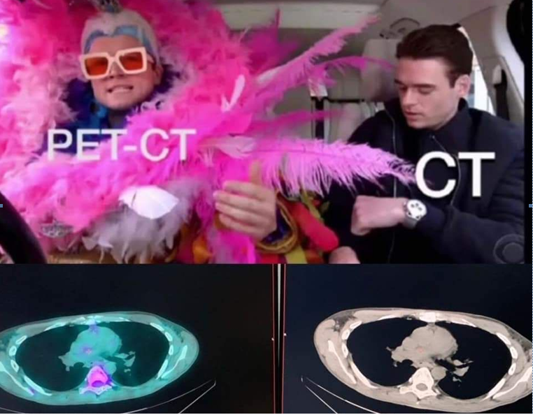
This is PET/CT!!!

Slide 6
But---we can do better??

Slide 7
Introduction
What is Gallium-68 FAPI PET/CT?
Showing promise as a diagnostic tool for oesophageal cancer.
Advs over traditional 18F-FDG PET/CT.
May provide better tumour-to-background contrast.
Better target volume delineation.
Therefore, is useful for radiation therapy planning.

Slide 8
Introduction
FAPI?
Fibroblast Activation Protein Inhibitor.
Molecule binds to fibroblast activation protein produced from cancers.
A protein highly expressed in the tumour microenvironment of many cancers, including oesophageal cancer.
Tumour stromal fibroblasts- Cancer Associated Fibroblasts.
Ga-68-radioactive isotope-can be attached to FAPI-PET tracer Ga-68-FAPI.
Allows for PET/CT imaging of tumours & surrounding environment.
FAPI-PET/CT- relatively new imaging technique -targets tumour microenviroment.
Due to low background in tissues, can see Primary or met lesions in brain, liver, pancreas & GI tract.
DOTA chelator can couple with yttrtium-90 for potential theranostic applications.

Slide 9
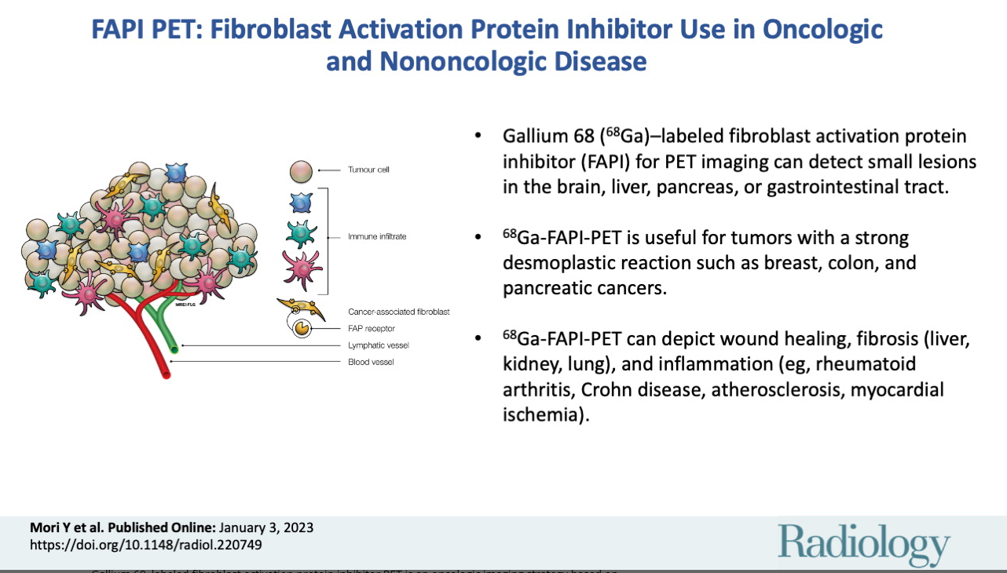
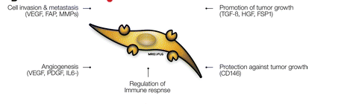
Pathology—FAP (Cancer associated fibroblasts) – membrane bound type 2 serine protease-most specific surface marker-2-3 mm stroma-90% malignant mass

Slide 10
Advantages of Ga-68-FAPI
Improved Tumour-to-background Contrast:
Offers better contrast cf 18F-FDG-easier to visualize tumours & extent.
Potential for better staging:
More sensitive at detecting LN mets-potentially leads to change in staging cf CT & EUS.
Target volume delineation: Improved image quality-can accurately define target volume for radiation therapy, reducing geographic misses.

Slide 11
Advantages of Ga-68-FAPI
Detection of Primary Tumours:
Can detect primary oesophageal tumours with high sensitivity.
Monitoring Treatment Response: Some studies showing Ga-68-FAPI PET/CT may be useful in monitoring response to chemoradiotherapy.

Slide 12
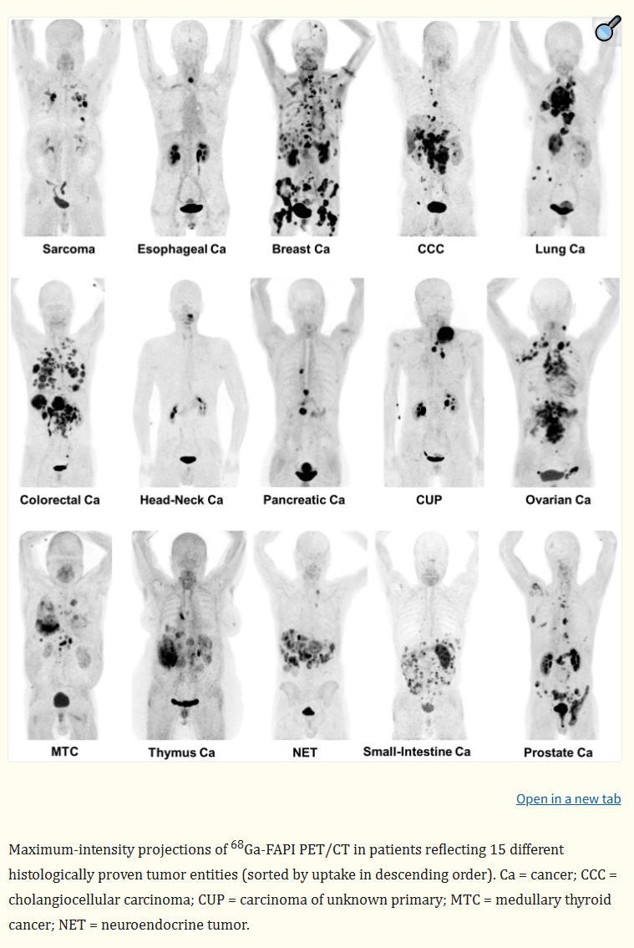
Potential Uses Ga-68 FAPI Kratochilwil, Flechsig, Giesel et al, Heidelberg, Germany, J Nucl Med. 2019 Jun;6096):801-805.
. 2019 Jun;60(6):801–805. doi: 10.2967/jnumed.119.227967
Can potentially be used in x15 different histological proven tumour entities.
Traditionally not seen well on 18F-FDG.

Slide 13
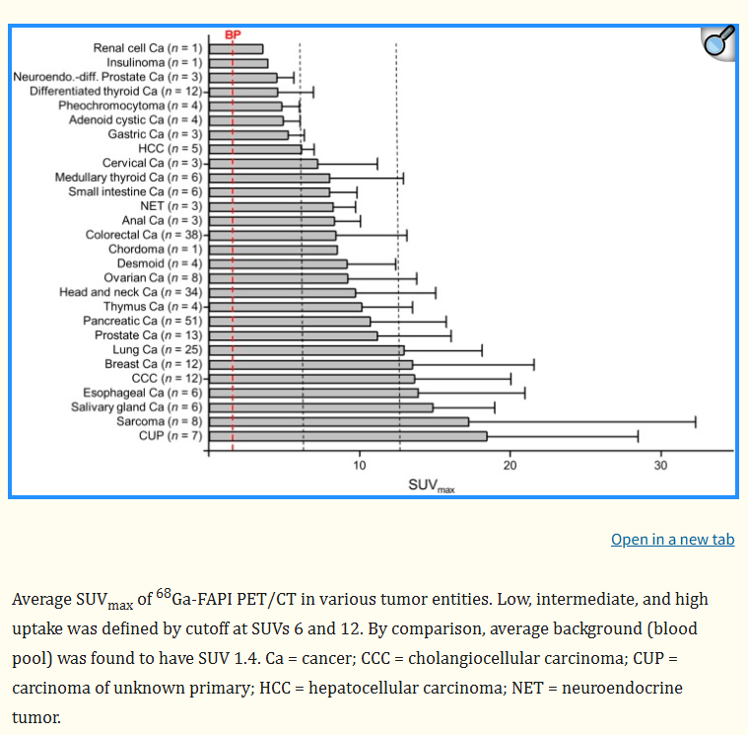
Comparing SUV max…
Highest SUV max (>12) found in sarcomas, oesophageal, breast, cholangiocarcinoma and lung cancer.
Lowest (SUV max <6), found in RCC, diff thyroid, adenoid cystic, gastric, phaeochromocytoma.
Intermediates (SUV max 6-12), found in HCC, colorectal, Head & neck, ovarian, pancreatic & prostate.

Slide 14
Comparison with 18F-FDG PET/CT?
18F-FDG PET/CT—widely used technique for staging.
Relies on glucose metabolism.
May not always accurately reflect tumour burden.
Ga-68 FAPI PET/CT--Higher tracer uptake.
Ga-68 FAPI-Can detect lesions missed by 18F-FDG.

Slide 15
PET/CT Imaging

Slide 16
Paper- Comparison of [⁶⁸Ga]Ga-DOTA-FAPI-04 and [¹⁸F]FDG Uptake in Esophageal Cancer – Liu et al. Frontiers in Oncol., 16 June 2022 - Volume 12 - 2022 | https://doi.org/10.3389/fonc.2022.875081
. 2022 Jun 16;12:875081. doi: 10.3389/fonc.2022.875081
Comparison of Ga-68 DOTA-FAPI-04 and 18F-FDG PET/CT
35 patients, 44-83 yrs.
x1 patient not detetected with 18F-FDG—all detected with FAPI.
Uptake in primary lesion (SUV max 13.8 vs 6.8), nodes (SUV max 9.3 vs 5.9), bone & visceral mets (SUV m,ax 10.4 vs 6.1) respectively higher with Ga-68 FAPI vs 18F-FDG PET/CT.
Ga-68-DOTA-FAPI-04 PET/CT has higher tracer uptake value & is superior to 18F-FDG PET/CT in detecting primary & metastatic lesions in patients with oesophageal cancer.

Slide 17
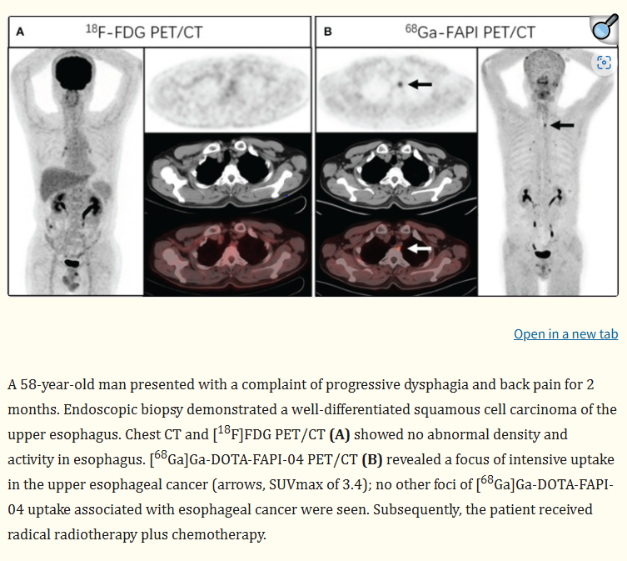
Ga-68 FAPI PET/CT Imaging 1

Slide 18
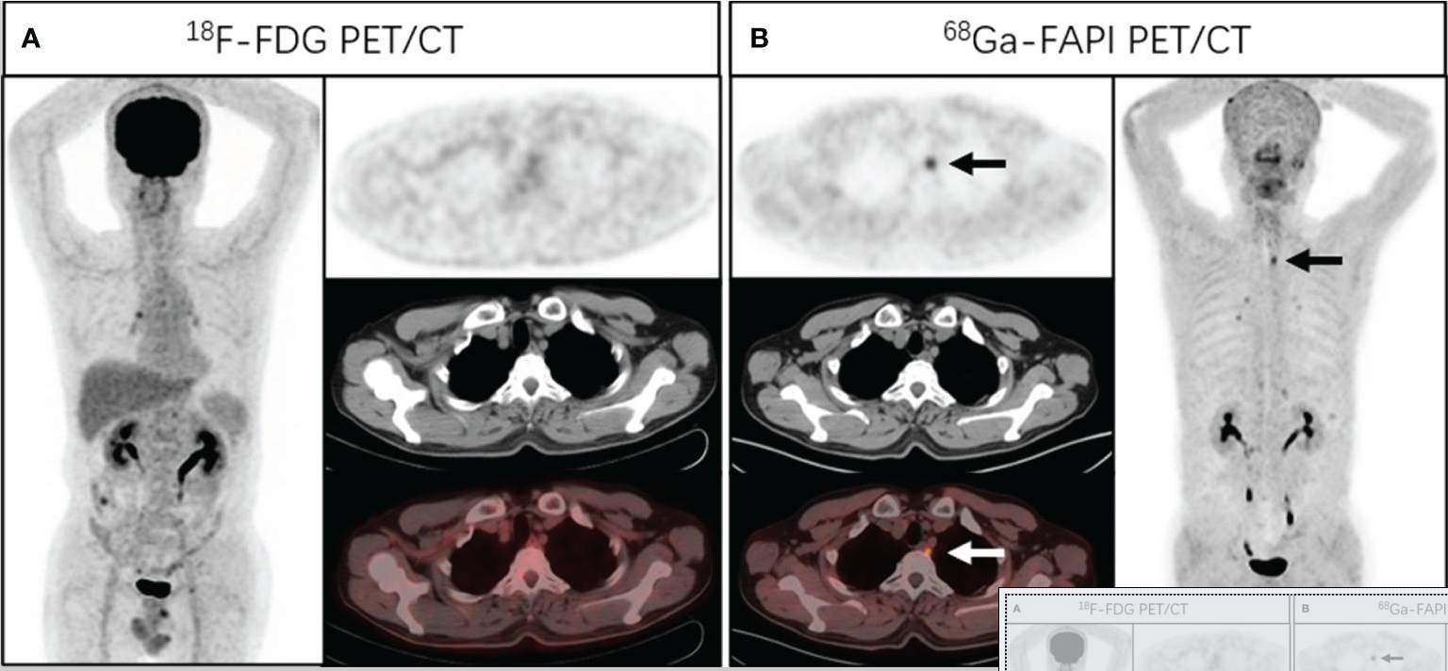
Ga-68 FAPI PET/CT Imaging 1

Slide 19
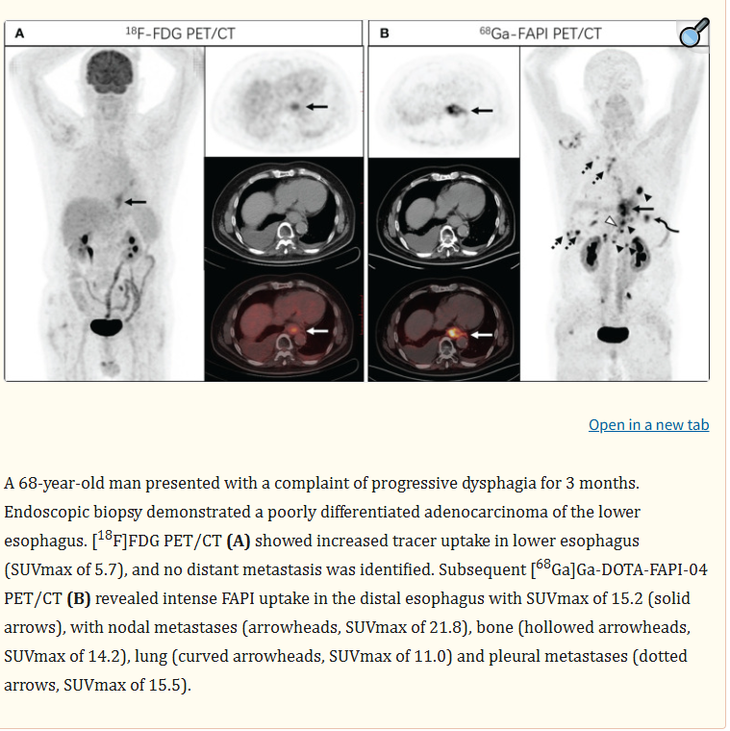
Ga-68 FAPI PET/CT Imaging 2

Slide 20
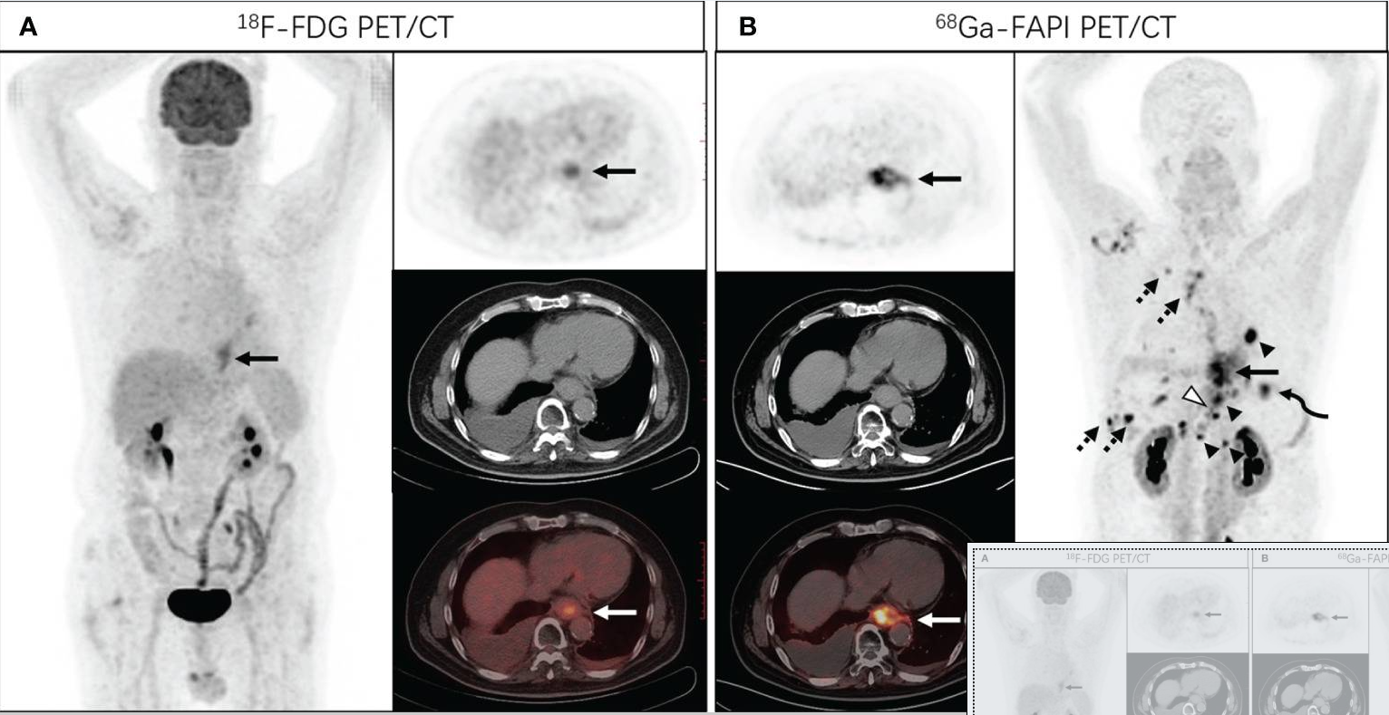
Ga-68 FAPI PET/CT Imaging 2

Slide 21

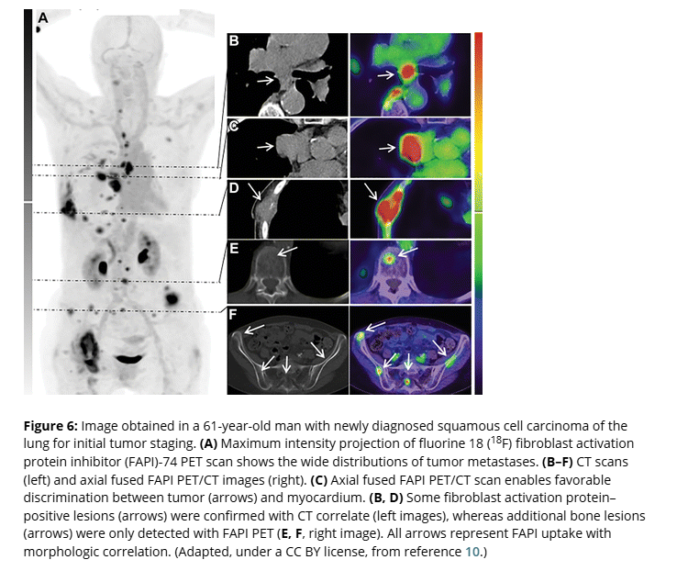
Another example…

Slide 22
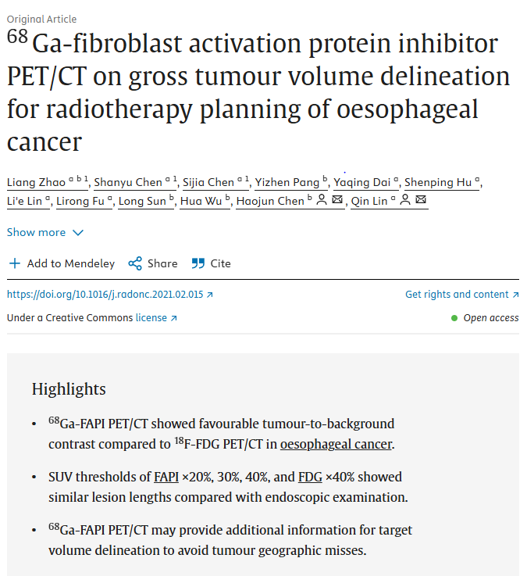
Gross Tumour Volume Delineation
Radiation & Oncology.
21 patients .
5 patients had GTV altered due to Ga-68 FAPI PET/CT

Slide 23
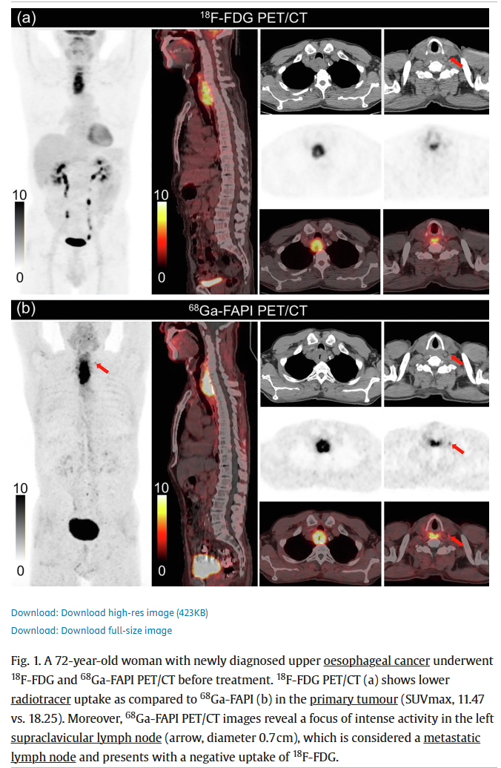
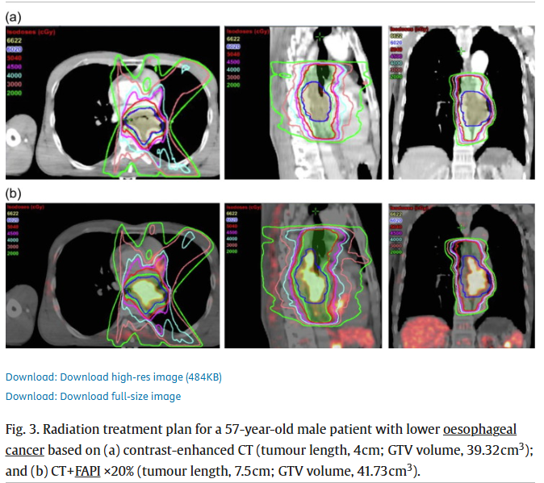
Ga-68 FAPI More sensitive than 18F-FDG & GTV altered

Slide 24
Limitations
Needs more justification from high quality research.
No funding yet from NHS for clinical applications.
PET/CT scanner on-site ideally-half life Ga-68 is 68 mins.
Cost of Gallium generator--£100,000 per year—have to justify with use for Ga-68 DOTATATE & other cancers maybe.
Both on-going projects for UHBW!

Slide 25
Conclusion
Gallium-68 labelled fibroblast activation protein (FAP) inhibitor (FAPI) PET/CT can help to dtect small primary or metastatic lesions in crucial organs like the brain, liver, pancreas & GI tract.
Ga-68 FAPI PET/CT (FAPI-04 & FAPI-174)is a very promising new imaging modality for oesophageal cancer, & many other cancers, such as lung, breast, colorectal, cholangiocarcinoma, pancreatic, sarcomas, Head & neck etc.
Rapid & stable tracer accumulation in target lesions.
Improved diagnostic accuracy in staging & target volume delineation.
Shows great potential for therapeutic applications due to DOTA chelator & coupling to lutetium-177 or Yttrium-90.
Can image wound healing, fibrosis (liver, kidney,lungs) and inflammation (rheumatoid arthritis, Crohn’s, atherosclerosis. Myocardial iscahaemia)—great potential.
Further research is ongoing to fully evaluate its exact role in the management of oesophageal cancer

Slide 26

Thank you! All the very best to you all ☺

