Slide 1
SWAG Skin Performance Report
April 2024 - April 2025

Slide 2
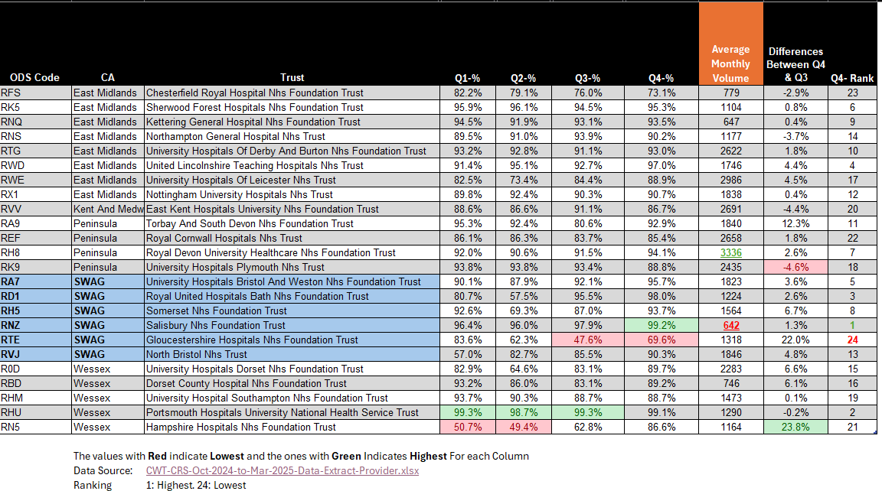
Skin FDS Peer Review – April 24-Mar 2025
Sub-heading

Slide 3
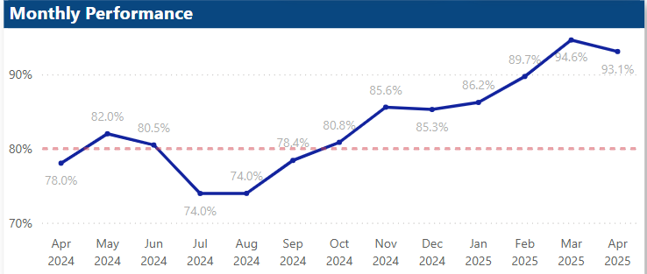
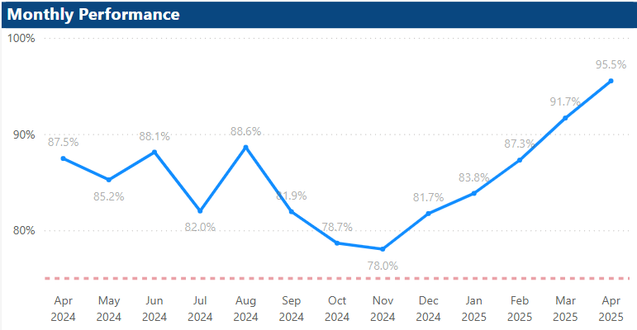
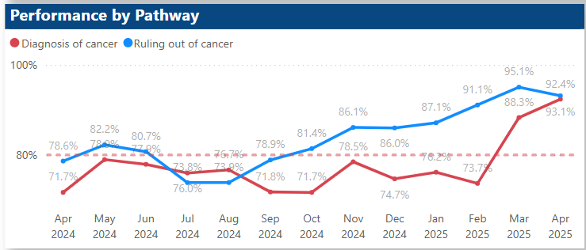
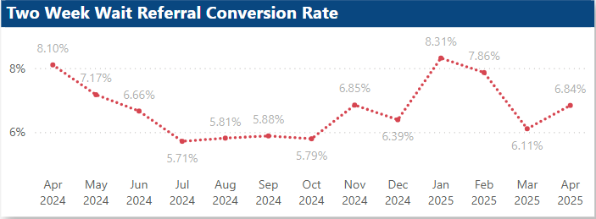
Skin – SWAG (April 2024-April 2025)
FDS Performance (28-Day)
62 Day Performance
Sub-heading

Slide 4
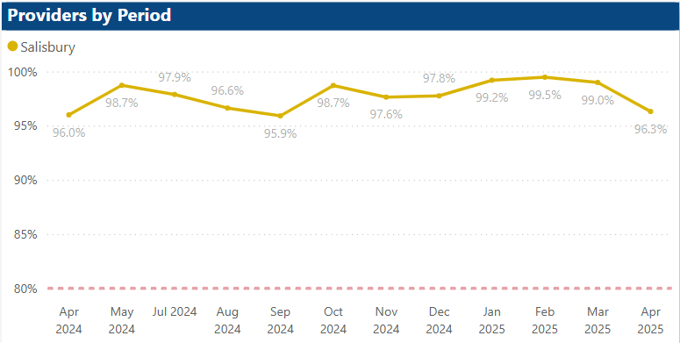
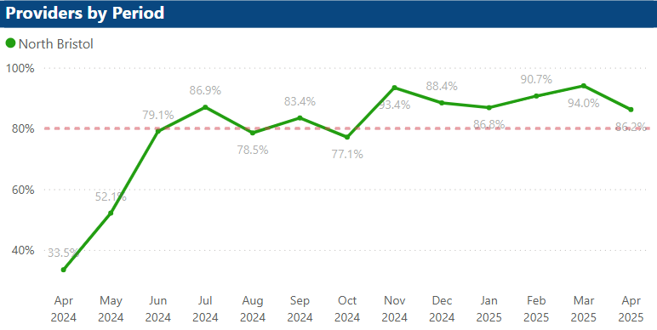
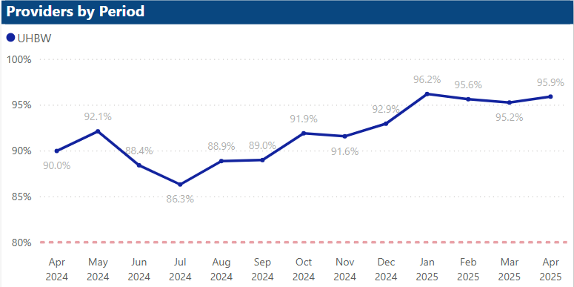
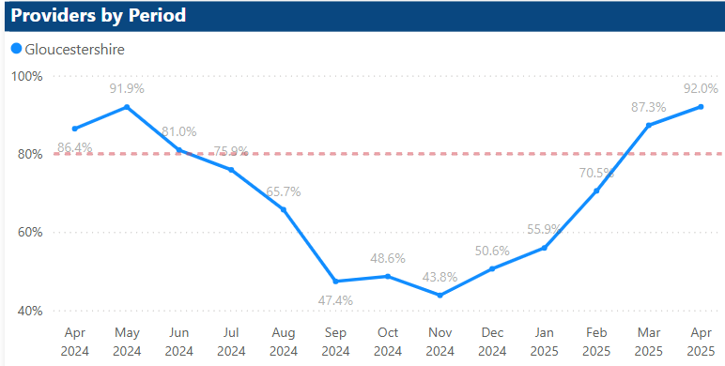
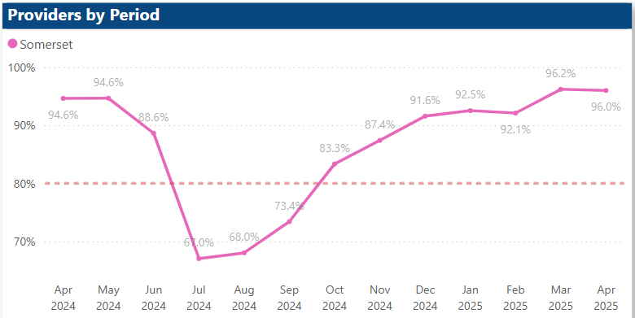
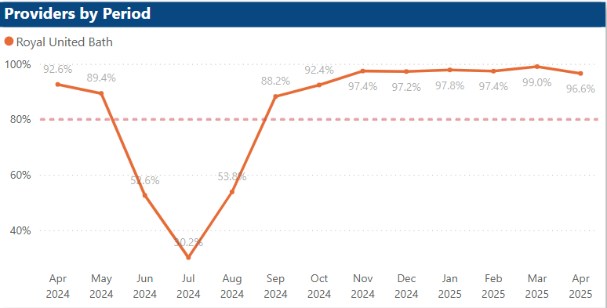
Skin FDS – SWAG Trusts (April 2024-April 2025)
Sub-heading
NHS Faster Diagnosis Standard (FDS) requires patients to be diagnosed or have cancer ruled out within 28 days of being referred urgently by their GP for suspected cancer. Interim Target is 80.
Reports were extracted from SWAG performance Dashboard

Slide 5
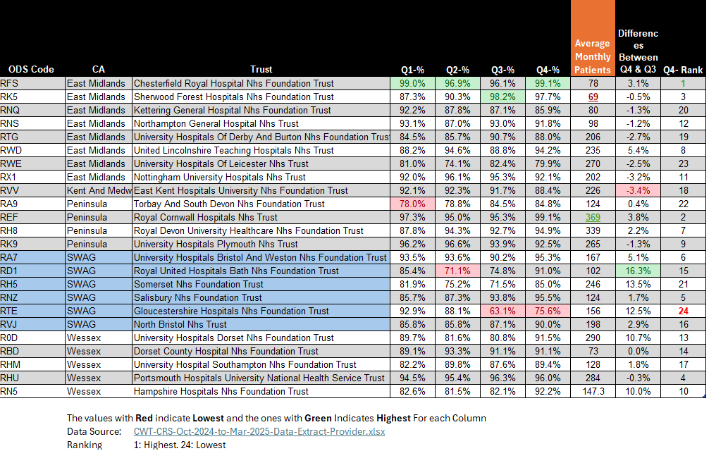
Skin 62-Day Peer Review – April 24-Mar 2025
Sub-heading

Slide 6
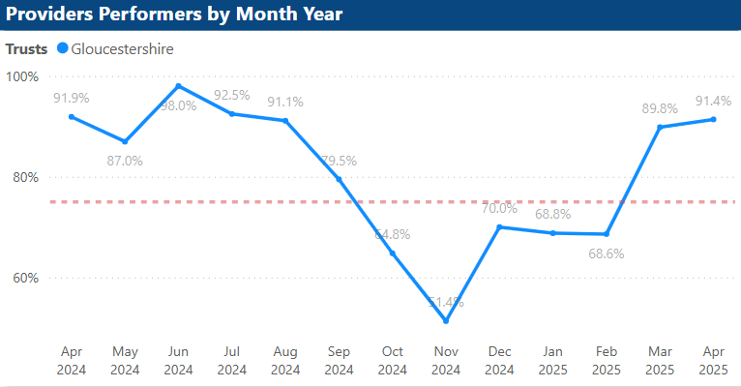
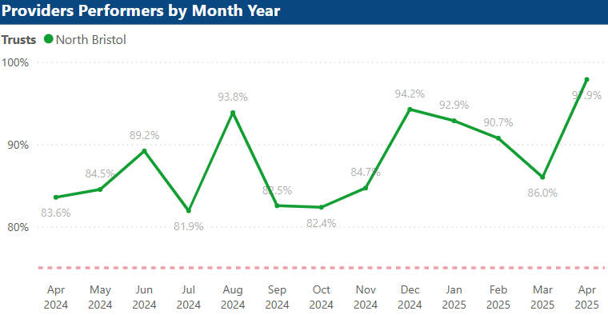
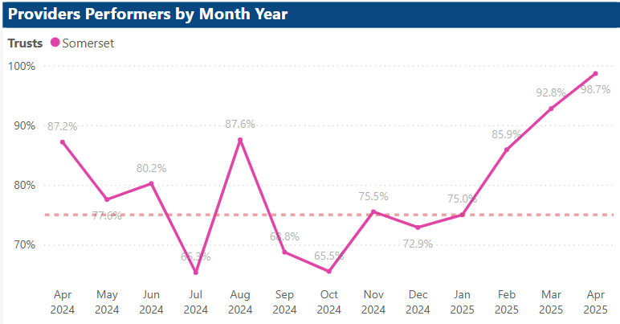
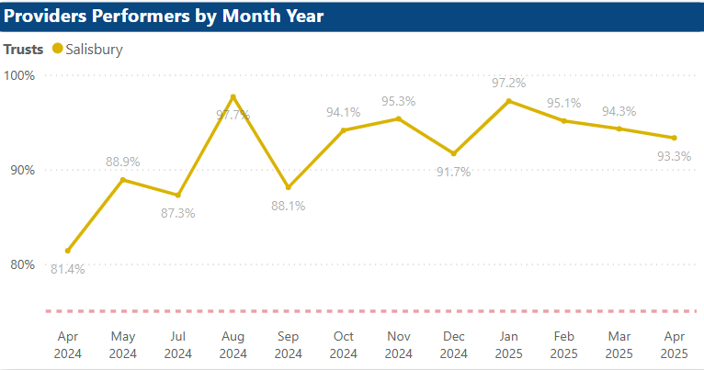
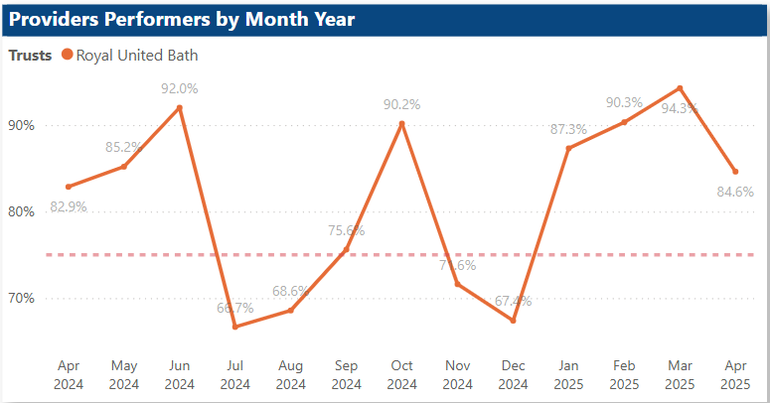
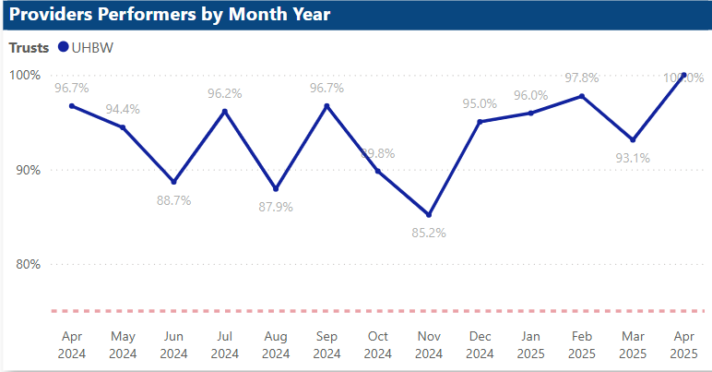
Skin 62-Day – SWAG Trusts (April 2024-April 2025)
Sub-heading
The 62-day cancer pathway is a national guideline that ensures patients diagnosed with cancer start treatment within 62 days of an urgent referral. Interim Target is 75%.
Reports were extracted from SWAG performance Dashboard

