Slide 1
SWAG Network Brain & CNS Cancer
Clinical Advisory Group
Research Update
Claire Matthews
04/06/2025

Slide 2
National Brain Cancer Research Recruitment
Apr 25 - Jun 25
Apr 24 - Mar 25
Data cut: 04/06/2025
Source: ODP All Portfolio

Slide 3
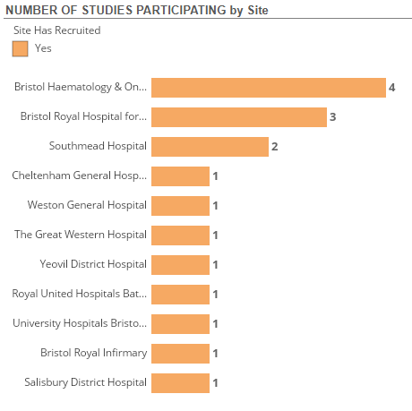
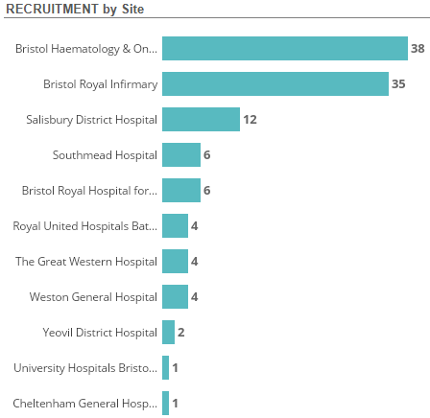
SWAG Region Brain Cancer Research Recruitment
Apr 24-June 25
Data cut: 04/06/2025
Source: ODP All Portfolio

Slide 4
Studies open to recruitment SWAG Region
CPMS ID | Short Name | Sites | Opening | Closure | Sample Size Eng | Eng Recruits
57397 | TROPION-Lung10 | Chelt | 25/06/2024 | 27/08/2027 | 21 | 4
54825 | APPROACH | BHOC | 17/01/2024 | 31/05/2031 | 234 | 48
54113 | LOGGIC/FIREFLY-2 | BRHC | 23/10/2023 | 31/03/2026* | 26 | 22
53094 | PRIMALung (EORTC 1901-LCG) | BHOC, Chelt | 19/12/2022 | 30/04/2026 | 68 | 44
45956 | FUTURE GB | NBT | 18/12/2020 | 29/05/2025 | 332 | 360
41890 | BTB | NBT | 31/01/2020 | 29/10/2029 | 500 | 406
33552 | PARADIGM 2 | UHBW, NBT | 08/11/2016 | 30/03/2026 | 52 | 44
18503 | SIOP Ependymoma II | BRHC, NBT | 12/02/2016 | 12/02/2026 | 230 | 234
18137 | PARADIGM (Cancer) | BHOC, Chelt, RUH | 03/03/2015 | 31/12/2024 | 143 | 142
8630 | Molecular Genetics of Adverse Drug Reactions (MOLGEN) | BHOC, RUH, Salis, Weston | 01/06/2009 | 30/04/2026 | 3800 | 3,663
4663 | AIP | GWH, Yeovil | 01/03/2007 | 31/12/2037 | 8500 | 5,429
Data cut: 04/06/2025
Source: ODP All Portfolio

Slide 5
Studies in set-up in SWAG region
CPMS | Short Name | Title | Site | Planned Opening | Planned Closure | Sample Size Eng | Sponsor
66182 | GLIOFOCUS | A Phase 3, open-label, randomized 2-arm study comparing the clinical efficacy and safety of niraparib with temozolomide in adult participants with newly-diagnosed, MGMT unmethylated glioblastoma | BHOC | 24/06/2024 | 26/01/2026 | 31 | Neurotrials Research, Inc.
53649 | CAAA603C12101: Phase Ib study with [177Lu]Lu-NeoB in Glioblastoma | CAAA603C12101: Phase Ib Dose Finding Study Assessing Safety and Activity of [177Lu]Lu-NeoB in Combination with Radiotherapy and Temozolomide in Subjects with Newly Diagnosed Glioblastoma with MGMT methylated and unmethylated promoter status | BHOC | 28/02/2025 | 28/08/2031 | 2 | Novartis Pharma AG
Data cut: 04/06/2025
Source: ODP All Portfolio

Slide 6
Be Part of Research is a UK-wide service that helps people find and take part in health and care research across nearly every health condition.
A resource for:
patients or their families keen to get involved in research
Researchers looking for target population for research
https://bepartofresearch.nihr.ac.uk/

Slide 7
Associate Principal Investigator
Scheme
Six month in-work training opportunity, providing practical experience for healthcare professionals starting their research career.
People who would not normally have the opportunity to take part in clinical research in their day to day role have the chance to experience what it means to work on and deliver a NIHR portfolio trial under the mentorship of an enthusiastic Local PI.
CIs working with a CTU can register their study on the scheme
https://www.nihr.ac.uk/health-and-care-professionals/career-development/associate-principal-investigator-scheme.htm

Slide 8
Principal Investigator Pipeline Programme
(PIPP)
Overview
Research delivery nurses or midwives
12 to 18 months
Free if you’re eligible
Live virtual lessons, online learning and hands-on experience
Cohort 4 applications are now closed
Please email nursingandmidwifery@nihr.ac.uk for more information
https://www.nihr.ac.uk/career-development/clinical-research-courses-and-support/principal-investigator-pipeline-programme

Slide 9
NIHR ODP https://odp.nihr.ac.uk/
Open data platform. Data on performance across whole RDN, including all specialty areas
NIHR Be Part of Research https://bepartofresearch.nihr.ac.uk/
See which studies are open across the country
Find a Clinical Research Study (ODP) http://csg.ncri.org.uk/portfolio/portfolio-maps/
Search for a study to fit criteria. Good for horizon scanning, eligibility criteria

Slide 10
RRDN Contacts
swc.rrdn@nihr.ac.uk
Study Support Service Manager: claire.matthews@nihr.ac.uk
CAG Research Lead: TBC

