Slide 1
Driving Rapid Transformation in High Priority Cancer Pathways
‘Days Matter’
Professor Tim Briggs, National Director for Clinical Improvement and Elective Recovery, has tasked the SWAG Cancer Alliance and its constituent healthcare providers to deliver rapid transformation across several challenged, high-priority cancer pathways within our region. This call to action aligns with our shared commitment to improving outcomes and ensuring timely, equitable access to care for all patients.
We are launching a rapid cancer improvement challenge, “Days Matter”, to improve Faster Diagnosis Standard (FDS), 31-day Standard and 62-day Standard performance in urology and colorectal cancer pathways.
We are looking to emulate the pathway improvements delivered by national and regional exemplars to realise improvement of 5% in FDS over the next three months and a further 10% by the end of 2025 in these challenged tumour sites.
We will be working closely with partners to identify and expedite key areas for immediate and medium-term improvement using evidence-based practices adopted by the highest performing providers.
Notes:
In May, we had a meeting with Prof Tim Briggs to discuss cancer performance across the SWAG region where he highlighted a number of pathways in which have struggled to make improvements in waiting times compared to some other pathways. This included Colorectal, Urology (bladder and prostate) and Gynaecology.
I think we all recognise that the despite best efforts and hard work of teams, there are still many patients waiting a long time in the pathway and there is variation across the region in how long a person is waiting. For example, FDS for urology is 50% for SWAG (Average Q4) and ranges between just below 40-low to mid 60s%.
Tim Briggs specifically tasked the SWAG CA to lead rapid pathway transformation over a short period (3m). He has asked us to lead the way nationally on these pathways and show others what can be done.
In response we have launched a programme of work – called Days Matter – a 100d cancer improvement challenge to see what can be changed in the time frame and provide the support and platform to enable this.
We wanted to make sure it linked back to the difference, hence the name Days Matter. It outlines the different it will make to patients going through the pathway rather than defaulting to language commonly used around performance and percentages.
We know that there will be improvements that go beyond the 100 days and we will support local teams to implement plans which go beyond the 100d.
We are asking for your help today and when you go back to your Trusts over the next few months, to take on the challenge to see what can be accelerated locally (or collectively) to make a step change in how we can improve the time it takes for to rule in/out cancer and start treatments.
Also helping us to benchmark better nationally and raise the profile of the SW nationally.

Slide 2
Driving Rapid Transformation in High Priority Cancer Pathways - ‘Days Matter’
Why?
The purpose is simple.
To reduce the number of days people wait for investigations and/or treatment – ultimately improving FDS and 62d performance
We will do this through adopting a GIRFT evidence-based methodology approach:
Data insights pack
Benchmarking intelligence
Pathway map analysis
Case study playbooks highlighting best practice
Peer learning
Innovation opportunities
Bringing together clinicians and managers to identify and deliver improvements from pick lists
Development of local pathway improvement action plans
By the end, we will:
Have delivered rapid, practical improvements (quick wins)
Provided support for local implementation
Supported learning and how to guides
Identified medium and longer term improvement plans for each pathway
Impact & Sustainability
Improved performance, outcomes,
streamlining
Future proofing pathways
Insights
Data analysis
Benchmarking analysis
Pathway analysis
How?
What?
Tools
Exemplar case studies
Innovation opportunities
Resource library
Improvement Plans
Regular reporting and check ins, peer review visits

Slide 3
Driving Rapid Transformation in High Priority Cancer Pathways - ‘Days Matter’
1
Prepare
In this initial phase, we will identify resources, produce a data insights pack, case study playbooks, identify exemplar performers, develop Days Matter methodology and reporting
2
Engagement & Development
Launching Days Matter, identifying Local Days Matter project teams.
Urology Clinical Advisory Group and Colorectal exceptional Clinical Advisory Group meetings.
Identify 30.60.90 and end of project Q3 goals
3
Implementation
Implementing locally identified action plans and regular SITREP reporting and project check-ins. Mobilising innovation projects.
4
Optimise & Measure
Document good practice and lessons learned.
Undertake evaluation of delivery and impact.
Identify medium-longer term plans and ongoing reporting cadence

Slide 4
How we will know we are making a difference - ‘Days Matter’
Programme impact success criteria:
Programme delivery success criteria:
Better patient outcomes and experience
Faster diagnosis and access to treatment
Improved equity of access
Programme development and launch
Comms and engagement plan delivered
Evidence-base and data analytics delivered
Effective and efficient programme governance established
Sustainability & continuous improvement
Identify successful changes and capture and share them to support wider implementation
Robust methodology developed and embedded
Our approach is shaped by data analysis, best practice and expert insight.
Named sponsorship by leaders at all levels of the programme delivery. Project teams identified.
Methodology developed and reporting established
Improved performance and reduced variation
Sustained improved productivity and performance.
Better use of resources
Streamlining of processes
Reduced variation in performance across SWAG
Programme Delivery
Key milestones and overall programme timelines are achieved.

Slide 5
Sub-heading

Slide 6
Sub-heading

Slide 7
‘Days Matter’ Governance
National Cancer Programme NHSE
GIRFT NHSE
Regional Cancer Team NHSE
SWAG Cancer Alliance Board
SWAG Cancer Alliance Delivery Group
Provider Elective Care Board (tbc)
Provider Internal project team

Slide 8
‘Days Matter’ SWAG CA Project Teams
Urology Contact list
Organisation | Name | Role | Contact
SWAG | Ruth Carr | Executive sponsor / Managing Director | Ruth.Carr@nbt.nhs.uk
SWAG | Jon Aning | SWAG Urology CAG Chair | jonathan.aning@nbt.nhs.uk
SWAG | Nicola Gowen | Programme Manager (Performance and faster diagnosis) | nicola.gowen@nbt.nhs.uk
SWAG | Becky Clack | Programme Manager (Innovation) | beckyclack@nhs.net
SWAG | Funmilayo Oladipo | Senior Analyst | Funmilayo.Oladipo@nbt.nhs.uk
SWAG | Prasanth Kunjumon | Project Support Coordinator | Prasanth.Kunjumon@nbt.nhs.uk
SCW CSU | Zoe Bristow | Project Manager (Playbooks) | zoe.bristow@nhs.net
NBT | Salah Albuheissi | Urology Clinical Lead - | Salah.Albuheissi@nbt.nhs.uk
NBT | John Kirby | Urology Service Manager – | John.Kirby@nbt.nhs.uk
NBT | Nick Smith | Executive sponsor | Nicholas.Smith@nbt.nhs.uk
NBT | Kane Sullivan | Deputy Divisional Director for ASCR | Kane.Sullivan@nbt.nhs.uk
UHBW | Hannah Marder | Cancer Manager | Hannah.marder@uhbw.nhs.uk
SDHFT | Niall Prosser | Exec Lead | niall.prosser@nhs.net
SDHFT | Jonathan Borwell | Lead Nurse | Jonathan.borwell@nhs.net
SDHFT | Max Johnston | Joint Clinical Leads | max.johnston@nhs.net
SDHFT | Victoria Insull | Operational Lead | victoria.insull@nhs.net
SDHFT | A Vandyken | Operational Lead | a.vandyken@nhs.net
SDHFT | Ardeshir Nasarwanji | Operational Lead | ardeshir.nasarwanji@nhs.net
SDHFT | Emilia Scutt | Cancer Manager | emilia.scutt@nhs.net
Evolving insights, Exemplar playbooks and Peer review Visits

Slide 9
‘Days Matter’ SWAG CA Project Teams
Urology Contact list
Organisation | Name | Role | Contact
SFT | Andy Heron | Executive Sponsor | Andy.Heron@SomersetFT.nhs.uk
SFT | Neil Trent | Specialty Leads | neil.trent@somersetft.nhs.uk
SFT | Tim Porter (Yeovil) | (Clinical Directors) | tim.porter@somersetft.nhs.uk
SFT | Marc Williams (Taunton) | MDT Leads supporting the Specialty Leads | Marc.williams@somersetft.nhs.uk
SFT | Cheryl Chambers | Clinical Nurse Specialists (Cancer Lead Nurse) – in place of Urology CNSs, as no lead CNS currently in post | Cheryl.chambers@somersetft.nhs.uk
SFT | Jess Head | Faster Diagnosis Leads (Faster Diagnosis Nurse) | Jessica.head@somersetft.nhs.uk
SFT | Johannah Taswell | Service Managers | Johannah.Taswell@SomersetFT.nhs.uk
SFT | Rosie Edgerley | Project/improvement Support for Service Managers who are the specialty leads | rosie.edgerley@somersetft.nhs.uk
GHFT | Alex Matthews | Executive Sponsor | alexandra.matthews3@nhs.net
GHFT | Kalpna Mistry | project/service manager | kalpna.mistry3@nhs.net
GHFT | Jon Eaton | Clinical Lead | jonathan.eaton@nhs.net
GHFT | Joe Jelski | Urology CAG lead representative | joseph.jelski@nhs.net
GHFT | Karen Edward | Nursing representative, | karen.edwards6@nhs.net
GHFT | Hannah Gay | Cancer Manager | hannah.gay1@nhs.net
RUH | Simon Sethi | Named exec sponsor | simon.sethi1@nhs.net
RUH | Ed Nicolle | Project/service manager | edward.nicolle@nhs.net
RUH | Jon McFarlane | Clinical lead | jmcfarlane2@nhs.net
RUH | Lucy Simmons | Clinical lead (as JM is on leave) | l.simmons1@nhs.net
Evolving insights, Exemplar playbooks and Peer review Visits

Slide 10
Prostate and Bladder Cancer
Insights Pack
Cancer Waits performance and >62d Backlog position
Southwest Prostate Dashboard
Model Hospital GIRFT metrics
Pathway map and analysis
Play Books
Case Studies at exemplars in 1st instance
Medway NHS Foundation Trust (Bladder)
Dartford and Gravesham NHS Trust (Bladder)
Royal Cornwall Hospitals NHS Trust (Bladder)
Royal Surrey Hospital NHS Foundation Trust (Prostate)
Epsom and St Helier University Hospitals Trust (Prostate)
Maidstone and Tunbridge Wells NHS Trust (Prostate)
East Kent Hospitals University NHS Foundation Trust (Prostate)
Benchmark pathway insights
Change management insights
Library of resources
Research and Innovation
Galeas / MRI Ai / Digital pathology incl. Ai / AMBU / ENIGMA
Adoptable key service features may incl.
Urology Investigation unit / CDC pathway fund optimisation
Digital Pathology and TATs
Live pathway capacity management (SPC)
Fast track pathway for high risk / same day pre-Ax
Joint / Parallel oncology / surgical clinic
Prostate
PSA at referral / referral practices
Standardised triage and STT
MRI optimisation and capacity
LATP workforce and estates
Standards of Care / MDT streamlining
CWT Active monitoring change
Staging optimisation
PSFU
Surgical capacity
Bladder
Advice and guidance
One stop Haematuria clinic
Non-medical flexi cystoscopy
Nurse led breaking bad news clinic
TURBT Capacity / TULA
Patient and Public Voice Partners

Slide 11
Q1&2 2025/26 Provider Improvement plan milestones
Prostate
GHFT non med LATP, MDT streamlining incl. SOC Q2
RUHB additional 32 LATPs and 8 theatre lists / quarter from Q1 and additional non medical LATP business case Q1 / additional HIFU consultant trained by Q3
SDH (PM) estates for additional LATP explored and MDT list triage supported by RPA live and admin role clarity in Q1, targeted GP education Q2, explore INIFY Q4
NBT additional 130 mpMRIs, 120 Pre op / quarter and RALP weekend lists from Q1, navigator recruitment Q1
SFT Nurse MRI triage , deontics review, YDC LATP estates investigation, optimise STT , additional 24 OPAs Q1 / Autonomous Lucida and all pt letters to EPRO, live performance reports Q2
Bladder
GHFT 1 stop haematuria clinic Q3
SDH (PM) improve access to 1 stop haematuria (scope capacity to improve) Q1 / narrow banding imaging Q1 but only 1 stack scope additional stack Q2/flexicystoscopy scope medilogik Q2
NBT additional 455 CTU reports <48 hours from Q1, Navigator from Q2, additional RIGID biopsy +/- TURBT from Q3
SFT 1 stop haematuria pilot CDC, Ai radiotherapy planning and additional 21 flexi's Q1 / live performance report Q2

Slide 12
‘Days Matter’ Delivery Timeline
16.06.2025
Identify SRO, Clinical Lead, Project Manager
Check in with SWAG Programme Manager
-
Define internal governance
Review local and 1st draft insights and exemplar playbooks
Attend SWAG Clinical advisory group 26th June
Review local improvement plan for existing, expedition potential and additional actions
07.07.2025
Identify and agree ‘Days Matter’ project team
1st biweekly ‘Days Matter’ High level Sit rep
14.07.2025
‘Days Matter’ project team agree 30.60.90 day and end of project (Q3) goals
Sign off project documentation and internal reporting cadence
w/b 14.07.2025
SWAG GIRFT pre-scheduled ‘Days Matter’ project review check in
‘Days Matter’ Project Team
Upcoming deadlines
21.07.2025
2nd ‘Days Matter’ sit rep
Risks / issues & mitigations
Completed actions
Upcoming deadlines
30.60.90 and Q3 goal RAG
Risks / issues & mitigations
04.08.2025
’3rd ‘Days Matter’ sit rep 04/08/2025
w/b 04/08/2025 SWAG GIRFT pre- scheduled ‘Days Matter’ project review check in
Agree future cadence SWAG reporting Q3 ‘Days Matter’
Completed actions
Evolving insights, Exemplar playbooks and Peer review Visits

Slide 13
Insights Provider packs
Sources
NHS Digital PTL and CWT
SW Prostate Dashboard
TAT diagnostics audit 2024
Pathway analysis 2024
Model Hospital
COSD / RCRD / NPCA
Metrics​
PTL (June 8th, 2025)​ and backlog
FDS – 28 Day​, Conversion rates, cancer / non cancer and clock stop profile (April 2024 – April 2025)​
31-Day (April 2024 – April 2025)​ incl. focus surgery ​
62-Day- Overall incl. broken down by sub tumour and treatment type (April 2024 – April 2025)​ ​
Prostate Referrals ​and pathway insights (benchmarked incl. Imaging and pathology) (Mar 2024 – Feb 2025)​
Turn Around Time (TAT) – Median Days​ 2023/2024​ (benchmarked)
Bladder Pathway analysis undertaken 2024
GIRFT Clinical Metrics
Additional insights
Staging Completeness​ (Last 12 months) Mar 2024– Feb 2025​
Early Diagnosis​ (Last 12 months) Mar 2024– Feb 2025​

Slide 14
SWAG Innovations
Existing Projects
Bladder
Galeas: SWAG wide for Nonvisible haematuria patients – live at all by end of Q2 2025/26
Prostate
Prostate MRI Ai Tools
Lucida Medical Pi – Live at SFT, National SBRI project at NBT, GHFT SWAG Innovation
RUH Bath – supplier to be selected by end of Q2 2025/26
Intelligent process automation
SFT, SDH, GHFT SWAG funded Operational Performance initiative – Phase 1 builds live / Phase 2 in planning pending evaluation
Cancer 360 – BSW Providers

Slide 15
Innovations – Snapshot
Health Innovation Network horizon scan repository
Potential areas for consideration in development or use elsewhere
Ambu’s aScope 4 Cysto
TULA
MRI Fusion Biopsy
MDT streamlining – Digital innovations incl. Ambient Voice Technology
Ai Data Mining – Cogstack
Ai Autonomy
Ai Digital Pathology reporting
Ai Radiotherapy contouring
Deep dive HIN support, due diligence required, no CA endorsement

Slide 16
Urology playbooks
Case studies
Pathway exemplar insights
Change management insights
Change narratives
Adoptable key service features
Library of resources: (SOPs, guidance, JDs, templates, protocols)
Bladder
Medway NHS FT
Dartford and Gravesham NHS Trust
Maidstone and Tunbridge Wells NHS Trust
Royal Cornwall Hospitals NHS Trust
Royal Surrey Hospital NHS FT
Prostate
Royal Cornwall Hospitals NHS Trust
Royal Surrey Hospital NHS FT
Guy’s and St Thomas’ NHS FT
Epsom and St Helier University Hospitals Trust
Maidstone and Tunbridge Wells NHS Trust
Medway NHS FT
East Kent Hospitals University NHS FT
London North West University Healthcare NHS Trust
DRAFT slides – awaiting checking with exemplar pathway providers
Caveat: These packs are evolving resources and are not exhaustive. For the most accurate and up-to-date versions, please refer to the SWAG NHS Futures platform. Please do not download, store, or share copies of these packs instead refer others to the NHS Futures versions. They are intended solely for use within the NHS to support improvement efforts. Sharing beyond the NHS is not permitted.

Slide 17
Exemplar Urology Q4 data 2024/25
28-day (target 77%) | % | 62-day (target 85%) | %
Royal Surrey | 88.3 | County Durham | 100
Croydon | 88.1 | Airedale | 92.5
Epsom | 85.4 | Croydon | 96
Bolton | 82.7 | Epsom | 90.2
Maidstone | 80.1 | Bolton | 87.9
Dartford | 78.1 | Cornwall | 87.1
Airedale | 77.6 | Royal Surrey | 86.9
Medway | 74.4 | Maidstone | 86.9
Guys & ST | 71.7 | Medway | 76.8
Cornwall | 65.3 | NWLUH | 73.3
NWLUH | 62.1 | East Kent | 70.5
East Kent | 60.1 | Guys & ST | 64.8
Urology: Prostate and Bladder

Slide 18
Urology Q4 24/25:
28-day: 82.7%
62-day: 87.9%
Case Study: Bladder
Greater Manchester CA: Bolton NHS FT TURBT Pathway improvement project
Previous pathway:
Haematuria > flexi and CT > TURBT > MIBC (T2+) further treatment
NMIBC clock stop at TURBT (T1 but not Ta/Tis)
62-day performance (2023-2024) T1 = 77% T2+ = 26%
Flexible cystoscopy stepdown policy & risk-stratified TURBTs
Flexible cystoscopy
Tumour appearance and size >5cm
Appearance consistent with MIBC
Solid/broad based/sessile
CT - Tumour size and presence of associated hydronephrosis
TURBT at ringfenced slots with urologist within 10 days
Consider MRI scanning if under-staging at TURBT likely
Clear instruction to inform PTL meeting - prioritisation CT available
Listing slip adjustment
Ring fenced pre op assessment slots
Tumour identified at TURBT - Inform of diagnosis & step off CWT pathway. Do not wait for histological confirmation routinely.
Defined risk stratification criteria
Ring-fenced TURBT slots for urgent cases wait time 7-10 days
Pre-op assessment same day as flexible cystoscopy or same week
Considerable increase of day case TURBTs
DRAFT slides – awaiting checking with exemplar pathway providers
Aim: Prioritise high-risk NMIBC and potential MIBC patients for earlier TURBT within a 2-week window
SOP: see attached files
Day 1
Day 5
Day 7
Day 14
Triage & CT request
CT reported
Flexi Cyst: solid lesion
CTU ? MIBC. Pre-op
Day case TURBT

Slide 19
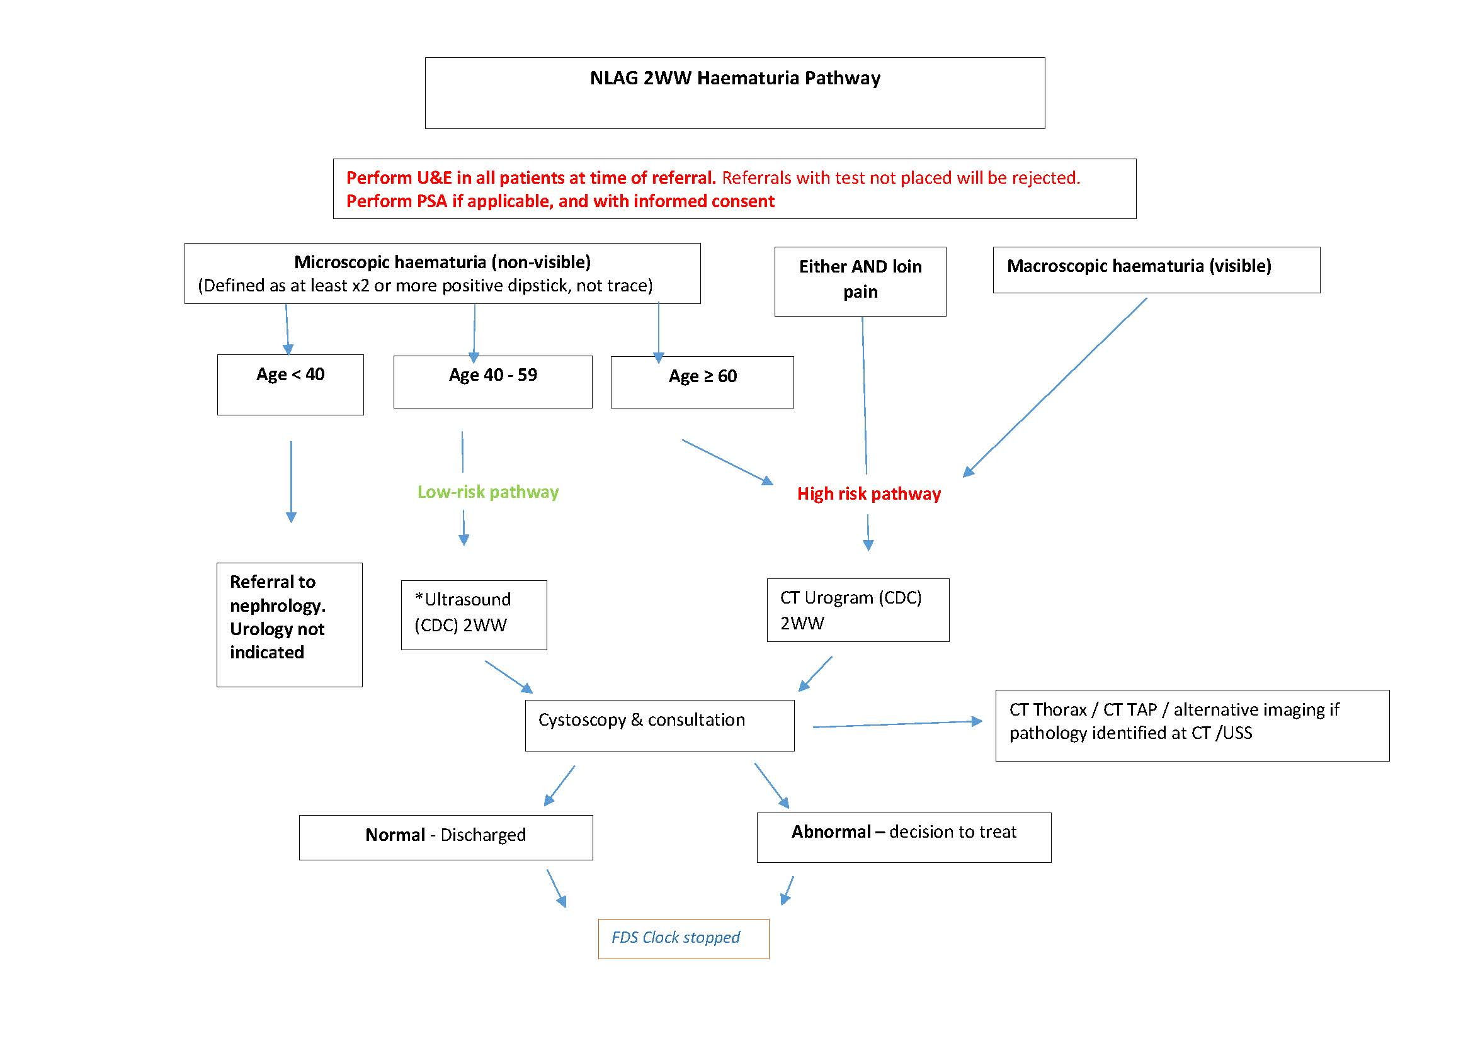
Urology Q4 24/25:
28-day: 63.7%
62-day: 74.4%
Case Study: Bladder
North Lincolnshire and Goole NHS FT
What works for them?
Triage of haematuria referrals by on call registrar/consultant on daily basis (weeks days). Imaging requested.
Urology CNS Telephone consultation. Flexi Cystoscopy 7-10days
Trained 11 clinicians (Registrars and CNS, not including consultants)
Designated rota co-ordinator, inhouse flexible cystoscopy service
Only use disposable cystoscope.
Designated admin for Flexible Cystoscopy waiting list (Band 2)
No haematuria list cancelled
Cancer tracker facilitating pathway and minimising breaches
DRAFT slides – awaiting checking with exemplar pathway providers

Slide 20
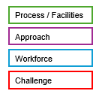
Urology Q4 24/25
28-day: 88.3%
62-day: 86.9%
Exemplar pathways: Prostate
Day 0
Day 3
Day 5
Day 8
Day 9
Day 21
Day 28
Day 16
Royal Surrey NHS Foundation Trust
Triage (3 hours)
Raised PSA telephone clinic daily
Directs/books into investigations OPA/MRI
MRI
Booked same day as telephone clinic
LATP booked in Day 5 after telephone call
MRI results
within 72 hours
Biopsy:
LATP performed
Day 14 if GA
Biopsy:
Histology / Pathology results
MDT – all diagnostic results available, Refer those for radical Rx
Experienced navigator/clinician, explain pathway imaging + biopsy
Non-cancer – give diagnosis at post-MRI outpatient appointment
Nurse-led biopsies (many lists every week) – over resourced.
Nurse-led clinics If no suspicion of cancer – clock stop
Reporting delays Looking at digital pathology or AI to improve.
Nurse-led clinics If no suspicion of cancer – clock stop
Nurse-led clinics breaking bad news. Rx options and referrals. 28-day clock stop.
Decision: medically fit for diagnostics/Ix
mpMRI apart from Frimley do BP and/or CT.
Ring-fenced MRI slots
DRAFT slides – awaiting checking with exemplar pathway providers
Patient informed if the MRI shows suspicion of cancer, will be called for biopsy within 3 days
Nurse-led biopsies:
LATP training at Edge Hill University
Supervision and support – identified prior to course. Centralised supervision to work through backlog from Royal Free?
Community of practice – peer support, sustainability & learn about challenges and how overcome
Workforce:
8 consultant urologists with special interests in prostate and bladder cancer
4 admin / tracking / booking clerks
2 hospital managers
10 clinical nurse specialists providing both diagnostic and treatments care
1 MDT coordinator
1 CNS support worker
Give appt to discuss results/undergo biopsy at time booking MRI

Slide 21
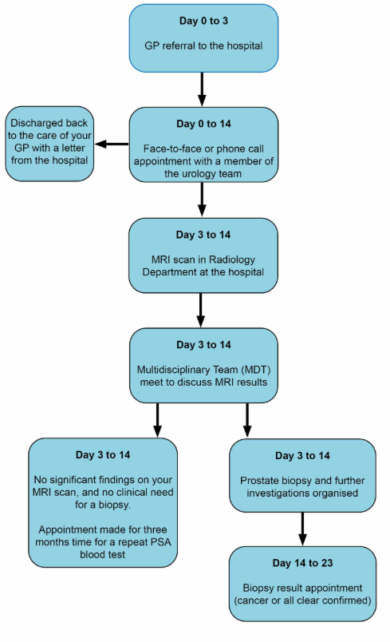
Urology Q4 24/25
28-day: 80.1%
62-day: 86.9%
Exemplar pathways: Prostate
Maidstone and Tunbridge Wells NHS Trust
Day 0
Day 3
Day 5
Day 9
Day 12
Day 19
Day 28
Day 0-3 Triage
Call and book on same day as referral
Check fit for Ix by clinician.
Perform G8 frailty Ax.
Don’t Ix those with:
Sig. comorbidities
Life expect. 10-15 yrs
Unfit D/C with monitoring
Day 5 biparametric MRI
No mpMRI
3T high-quality MRI
MRI 70% of pts.
Day 5 MRI reporting
Nurse T/C with results
Day 12 Biopsy ( LATP)
See F2F first time on day of biopsy
Biopsy clinicians:
1 x Consultant (complex cases)
3 x Registrars
2 x Nurses (training, 40 sup. cases)
Good at reading MRIs
Monitor target hit rates
Day 19 Diagnosis
Can take 4 weeks !
Cores sent on a sponge in a cassette – saves a lot of time so pathology just stick the cassette into the tissue processor. It doesn't fragment, which means the quality of the tissues are much better and it's easier for the pathologist to report.
Ensure MSU on referral
1 in 6 have UTI
Protocolised who biopsy:
4-5 biopsy
3 most get biopsy
1-2 only high PSA density
MRI accept bookings within 2-3 days of referral
Engage with radiologists
Clear backlog
W/E lists to catch up
Patient Choice: Patients on PTL taking longer thinking about options – delay from surgery to oncology & having opinion & then back to surgery. If Gleason 3 + 4 put on surveillance whilst thinking
DRAFT slides – awaiting checking with exemplar pathway providers
Prostate Office:
Everyone sits in same office
2 x nurses (STT, calls, book LATP)
Service manager
8A ANP – who does biopsies
MDT:
Electronic MDT request form forces people to put in there the things they want to discuss like a pre-MDT. E.g. Urology registrar sign off decision not to treat. On call urology urgent R/V if riddled with urological cancer for palliative care ref.
Reject incomplete MDT request forms - need name & e-mail so can immediately feedback MDT outcome.
Don't pre book MDT due to delays with histology results. Radiologist waste time reviewing case.
Joint clinic: urologist & oncologists in same room. Cuts time for review by oncologist - took 6 weeks (GIRFT recommendation)

Slide 22
Peer Reviews
2
Plan
SWAG formal communication to Trusts outlining process and provisional peer review visits.
3
4
5
Inform
SWAG share updated insights and best performer playbook packs with identified trust’s ‘Days Matter’ project team.
Trust ‘Days Matter’ team to share ‘Days Matter’ interim project report .
1
Prepare
Trust proposes preferred meeting date.
SWAG/GIRFT share insights and best performer playbook packs with identified Trust’s ‘Days Matter’ project team.
Communicate
SWAG confirm in person day meeting date.
Attendee identification request to include time with Chief Executive and Operational Officers and Medical Director
All MDT members and associated internal and external stakeholders to include business intelligence, administration and support services.
Request made for locally determined insights to support review.
Pre-Meet
System wide Pre-meet previously carried out at SWAG CAG (scheduled or extraordinary) highlighting exemplar and needing development service features.
6
Peer Review Visit
Agenda
Introduction to CEO, COO and Medical Director
Service overview by pathway stage
Insights
Areas for development
‘Days Matter’ project team, governance and resource
Exemplar Service Features
Interim Project report
Next steps / PDSA session.
7
Review
Action plan follow up review scheduled for subsequent virtual visit 3 months.
Priority areas identified
This will be in parallel
SWAG develop
and review insights,
best performer play
book and research &
Innovation packs.
to trusts establishing
‘Days Matter’ project
leadership,
teams, resource and
project initiation.
governance, project
Trust specific pre-meets with Clinical lead, Nurse lead, Service manager and ‘days matter’ team highlighting exemplar and needing development service features.

Slide 23
Adopt and Adapt Objectives
Optimise productivity and capacity, including consideration of:
Identification of most at risk
Non-medical triage
Straight to test and one stop pathways
Risk stratified use of scarce resources
Commitment to BPTP timelines
Benign template communication
Digital pathology reporting
MDT streamlining
PSFU
Parallel treatment planning clinics
Diagnostic and treatment Cancer prioritisation and capacity

Slide 24
Improvement Plans Workshop session for Urology
The Objective
The objective of the session is to identify challenges and explore improvement opportunities and begin to develop plans for ‘Days Matter’ Prostate and Bladder Cancer improvement over 30.60.90 and Q3, this may include using the described adoptable service features identified from the top performers nationally

Slide 25
Adoptable key service features may incl.
Urology Investigation unit / CDC pathway fund optimisation​
Digital Pathology and TATs​
Live pathway capacity management (SPC)​
Fast track pathway for high risk / same day pre-Ax​
Joint / Parallel oncology / surgical clinic​
Prostate​
PSA at referral / referral practices​
Standardised triage and STT​
MRI optimisation and capacity​
LATP workforce and estates​
Standards of Care / MDT streamlining​
CWT Active monitoring change​
Staging optimisation​
PSFU​
Surgical capacity​
Bladder​
Advice and guidance​
One stop Haematuria clinic​
Non-medical flexi cystoscopy​
Nurse led breaking bad news clinic​
TURBT Capacity / TULA​
Patient and Public Voice Partners

Slide 26
Summary Recommendations and next steps
Improvement Opportunity
Actions / Activities

Slide 27
NBT-Urology Improvement Plan
Trust : North Bristol NHS Trust
Project Team
Name | Role | Contact
Salah Albuheissi | Urology Clinical Lead - | Salah.Albuheissi@nbt.nhs.uk
John Kirby | Urology Service Manager – | John.Kirby@nbt.nhs.uk
Nick Smith | Executive sponsor | Nicholas.Smith@nbt.nhs.uk
Kane Sullivan | Deputy Divisional Director for ASCR | Kane.Sullivan@nbt.nhs.uk

Slide 28
UHBW-Urology Improvement Plan
Trust : University Hospital Bristol & Weston
Project Team
Name | Role | Contact
Hannah Marder | Cancer Manager | Hannah.marder@uhbw.nhs.uk

Slide 29
SDHFT-Urology Improvement Plan
Trust : Salisbury District Hospital
Project Team
Name | Role | Contact
Niall Prosser | Exec Lead | niall.prosser@nhs.net
Jonathan Borwell | Lead Nurse | Jonathan.borwell@nhs.net
Max Johnston | Joint Clinical Leads | max.johnston@nhs.net
Victoria Insull | Operational Lead | victoria.insull@nhs.net
A Vandyken | Operational Lead | a.vandyken@nhs.net
Ardeshir Nasarwanji | Operational Lead | ardeshir.nasarwanji@nhs.net
Emilia Scutt | Cancer Manager | emilia.scutt@nhs.net

Slide 30
GHFT-Urology Improvement Plan
Trust : Gloucestershire Foundation Trust
Project Team
Name | Role | Contact
Andy Heron | Executive Sponsor | Andy.Heron@SomersetFT.nhs.uk
Neil Trent | Specialty Leads | neil.trent@somersetft.nhs.uk
Tim Porter (Yeovil) | Clinical Director | tim.porter@somersetft.nhs.uk
Marc Williams (Taunton) | MDT Leads supporting the Specialty Leads
Cheryl Chambers | Clinical Nurse Specialist | Cheryl.chambers@somersetft.nhs.uk
Jess Head | Faster Diagnosis Leads
Johannah Taswell | Service Managers | Johannah.Taswell@SomersetFT.nhs.uk
Rosie Edgerley | Project/improvement Support for Service Managers | rosie.edgerley@somersetft.nhs.uk

Slide 31
RUH-Urology Improvement Plan
Trust : Royal United Hospitals, Bath
Project Team
Name | Role | Contact
Andy Heron | Executive Sponsor | Andy.Heron@SomersetFT.nhs.uk
Neil Trent | Specialty Leads | neil.trent@somersetft.nhs.uk
Tim Porter (Yeovil) | Clinical Director | tim.porter@somersetft.nhs.uk
Marc Williams (Taunton) | MDT Leads supporting the Specialty Leads
Cheryl Chambers | Clinical Nurse Specialist | Cheryl.chambers@somersetft.nhs.uk
Jess Head | Faster Diagnosis Leads
Johannah Taswell | Service Managers | Johannah.Taswell@SomersetFT.nhs.uk
Rosie Edgerley | Project/improvement Support for Service Managers | rosie.edgerley@somersetft.nhs.uk

Slide 32
SFT-Urology Improvement Plan
Trust : Somerset Foundation Trust Hospital
Project Team
Name | Role | Contact
Andy Heron | Executive Sponsor | Andy.Heron@SomersetFT.nhs.uk
Neil Trent | Specialty Leads | neil.trent@somersetft.nhs.uk
Tim Porter (Yeovil) | Clinical Director | tim.porter@somersetft.nhs.uk
Marc Williams (Taunton) | MDT Leads supporting the Specialty Leads
Cheryl Chambers | Clinical Nurse Specialist | Cheryl.chambers@somersetft.nhs.uk
Jess Head | Faster Diagnosis Leads
Johannah Taswell | Service Managers | Johannah.Taswell@SomersetFT.nhs.uk
Rosie Edgerley | Project/improvement Support for Service Managers | rosie.edgerley@somersetft.nhs.uk

Slide 33
Identification of opportunities / Adoptable key service features
Challenge / Problem | High impact opportunity | Actions / Activities | Inputs / resources | Outputs / anticipated results
Notes:
Thematic analysis of opportunities

Slide 34
PPV Forum Feedback
Query | Response

Slide 35
Key Actions
Aim
Opportunity overview
30.60.90 or Q3 Goal | 30 | 60 | 90 | Q3
Measurable benefit
Impact
Start Date
CWT FDS
CWT 31d Surgery
CWT 62d

