Slide 1
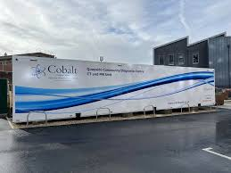
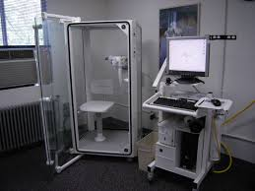
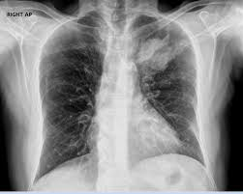
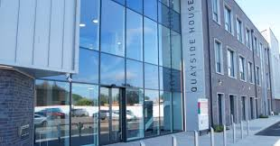
One stop lung cancer diagnostic clinic
Same day CT, OPA, lung function
Within 3 days of CXR report
Tue / Thur pm
Quayside House CDC Gloucester

Slide 2
Background
Historical delays to CT and CT reporting
Lung cancer service delivered by 4 consultants in lung cancer flavoured clinics at 4 different times of the week
2 in GRH, 2 CGH
Unable to robustly cross cover
Insufficient capacity
LCNS run ragged
Above mitigated by lung cancer consultant of the week through
Robust triage of referrals / reports
Telephone assessments/triage
Ad hoc extras / winging it

Slide 3
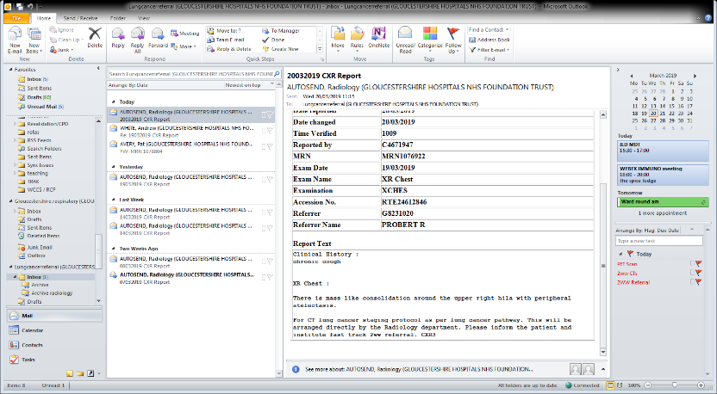
2018 – Straight to CT pathway
Suspicious CXR – CXR3 code – pt recalled for CT within 7 days by radiology
Respiratory triage 2ww referrals/Xray reports through inbox
Outcomes
Non cancer discharged without OPA
Telephone triage enables PET, lung function request day 1
If needs clinical review then OPA by day 7

Slide 4
Start and finish group set up in 2021
We started but failed to finish…
Lack of sufficient clinic rooms at appropriate times
Concerns from radiology about blocking out CT slots at acute sites
General NHS inertia
CDC opened Jan 24 in central Gloucester
Lots of clinic space
CT scanner, lung function, ECHO on site
ICB very keen to get services in there
15 min walk from GRH
Good public transport links
Radiology already started using CDC scanners for 2ww CTs. New thoracic radiologist started in August – allocated reporting sessions at CDC
Sept 24 - moved lung ca 2ww service to CDC
Patients from East of county have further to travel, mitigated by fewer visits

Slide 5
Clinic structure (Tuesday + Thursday)
1130 - 1230 | 4x one stop CT appointments
1230 – 1315 | CTs Hot reported
1315 – 1330 | Review of CTs radiology and respiratory
1330 - 1430 | 4x one stop 2ww appts ( 2 consultant lists)
1430 - 1600 | 4x standard 2ww appts + follow ups
1300 - 1600 | Lung function (prebooked and adhoc), bloods, 6MWT
2 consultant lists / rooms
2 LCNS rooms
+/- SpR
Purchase of ultrasound in progress –> diagnostic pleural tap and neck node FNA

Slide 6
Pre one stop May – August 24
59 patients referred following CXR (no CT scan), and were seen in 2ww clinic
40 CXR3 code – > direct recall CT and GP 2ww referral
19 GP 2ww referrals –> CT and 2ww appt requested at triage
25 not cancer
After one stop Sept – Oct 24
37 patients started pathway following CXR
31 CXR3 code - > direct recall CT and one stop appt
6 GP referrals - > one stop CT and 2ww appt requested at triage
15 not cancer

Slide 7
Pre one stop – 2.3 visits per patient
40 patients had 2 visits for CT and OPA on separate days
19 patients had 3 visits for CT / OPA / lung function on separate days
Post one stop – 1.3 visits per patient
10 patients had 2 visits
8 patients had CT and OPA on different days (mainly in first 2 weeks of new pathway)
3 had RFTs on different day
27 had one visit only
15 patients had CT and OPA on same day
12 patients had CT/OPA/RFTs same day

Slide 8
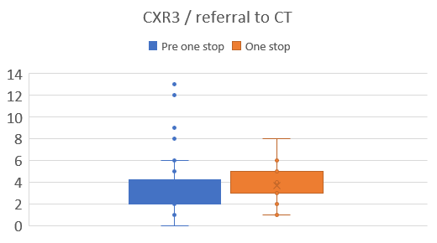
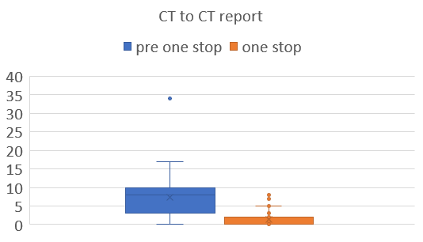
Ave time from CXR report (or referral) to CT slightly longer with one stop clinic, but less variability
Most CT scans same day reported

Slide 9
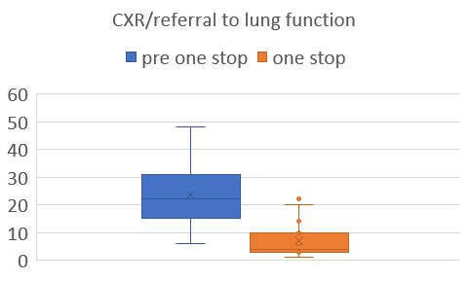
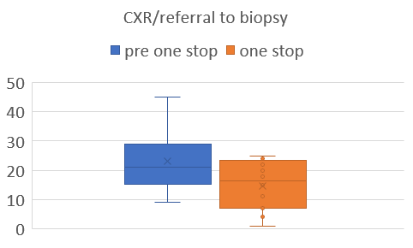
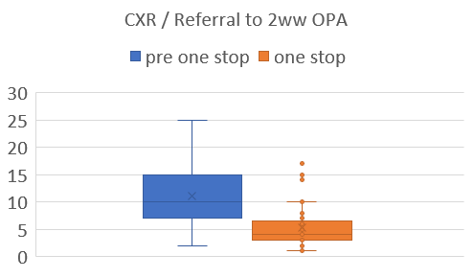
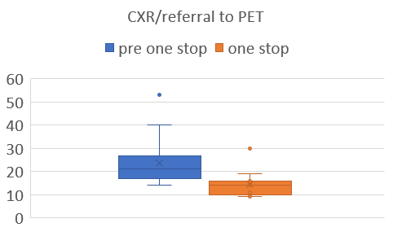

Slide 10
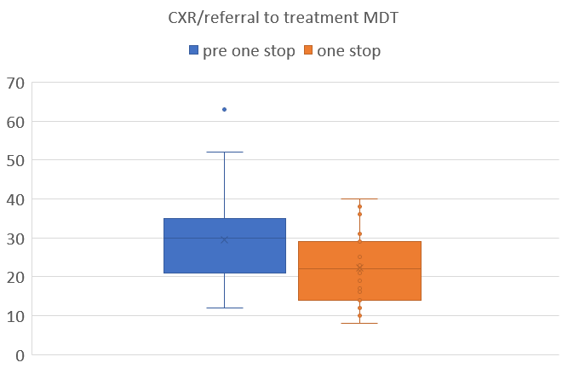
Average time from CXR report to treatment MDT dropped from 30 days to 22 days

Slide 11
GP referral
PET
RFTs
Treatment MDT
PRE
CT
OPA
Biopsy
CXR report
Day 5
Day 10
Day 22
Day 30
CT
PET
Treatment MDT
POST
OPA
Biopsy
RFTs
ctDNA
US guided neck node FNA

Slide 12
Learning
CXR3 report emailed to lung cancer inbox and navigator
Radiology continue to book direct recall CT as previous
Respiratory triage from CXR3 report
Once CT date confirmed navigator coordinates clinic appt
Need to start pathway from CXR3 report not GP referral, as GP referral often not received by CT date
Bypass GPs
Communication to GPs important
Predictability as/more important than speed when coordinating complex pathways
Communication and navigator essential
Hearts and minds (especially radiology bookers)
Initially requested 72 hours notice
Now able to get most booked in within 24 hours

Slide 13
Patient experience
It’s a whirlwind
Some concern about bypassing GP referral but
Patients were already being contacted ‘out of the blue’ directly by radiology
We are just adding an appointment afterwards to discuss scan results
They already have access to CXR and CT reports from NHS app
Overwhelming positive feedback, speed preferred by almost all
Patient survey – 13 responses
Ave travel time 40 mins (20-75). Ease of travel 8.3/10
Ease of having multiple tests 9/10
Overall satisfaction 9.1/10

