Slide 1
Data
How can we make it better?
Henry Steer
CAG May 25

Slide 2
Contents
NLCA – recap of how we got to where we are now
Why clinical validation is important
Data dashboards
Glos 104 day wait analysis

Slide 3
NLCA
Started in 2005 in response to data showing poor UK outcomes and high variability in outcomes
Trust level data published
Outliers highlighted
Evolution in data entry and quality over many years
  Further datasets linked and cross referenced – eg extra 6000 cases identified in 2016
    COSD/pathology reports/treatment events/SACT/HES/death certificates
  Trust first seen algorithm refined
Prior to 2016 – If outlier flagged then trusts could request pt level data to facilitate deep dive
2016 cohort – NCRAS sent list of allocated patients for validation prior to generation of report
  Trusts could cross reference with own datasets
  Correct errors in treatments/PS/ stage etc
  Identify wrong or missing patients

Slide 4
2016
Pre data validation

Slide 5
2018
Post data validation

Slide 6
2020 onwards
COVID
Contract with RCP expired. Eventually picked up by RCS
Option to validate data prior to report removed
2022 onwards Report based on rapid cancer registration dataset
  Mainly COSD records (ie the data the trust uploads)
  Linked to HES / RTDS / SACT / Death records
  Algorithm based allocations
  Pros - Rapidly available results -> Contemporaneous dashboard NLCA website
        Cheaper
  Cons - Loss of some accuracy
        Some misallocations

Slide 7
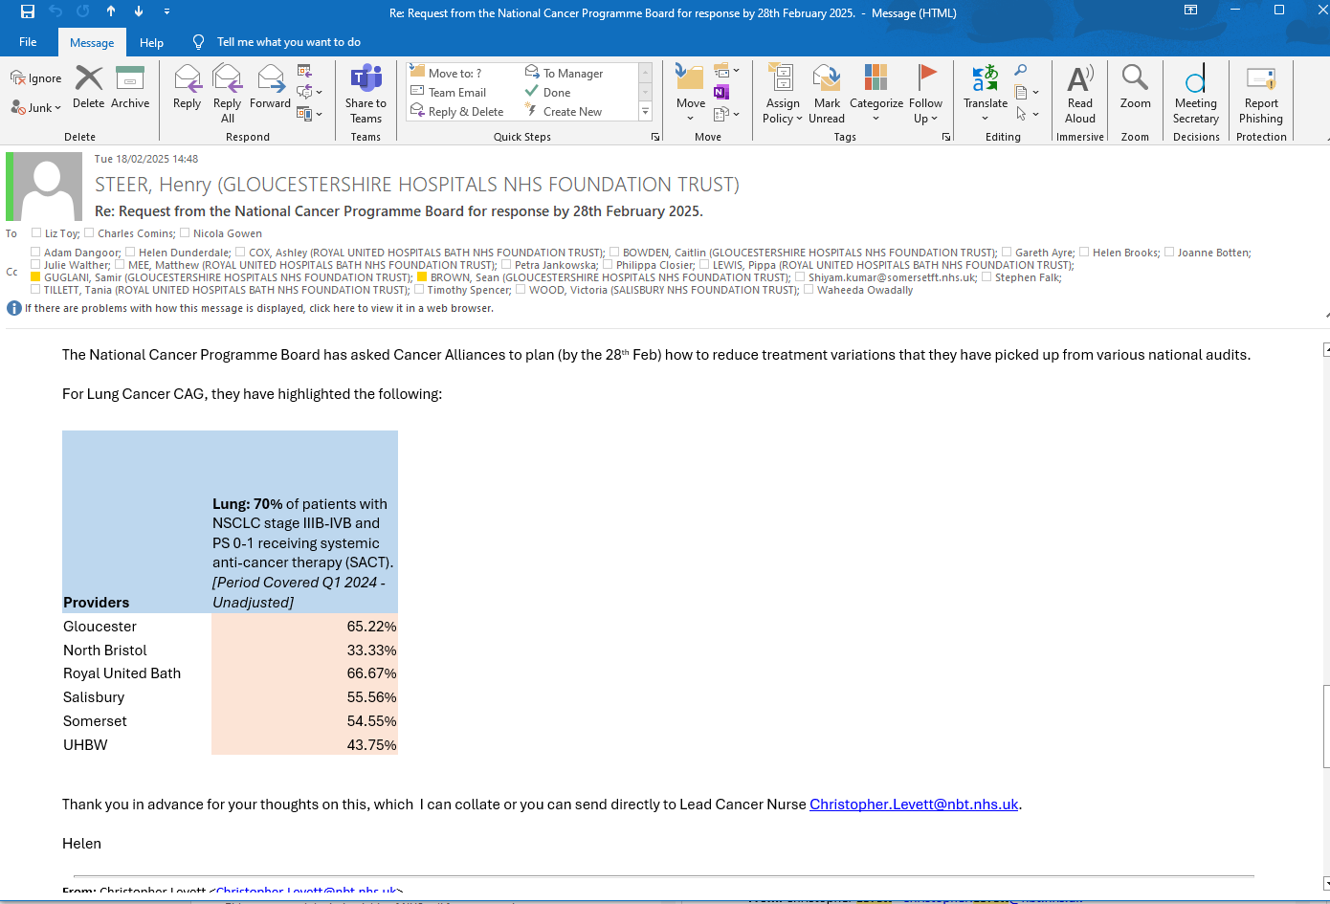

Slide 8



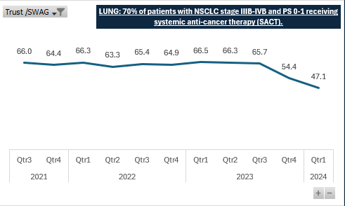
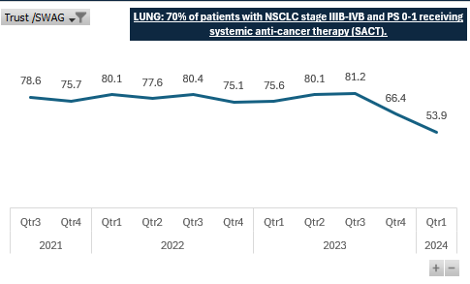
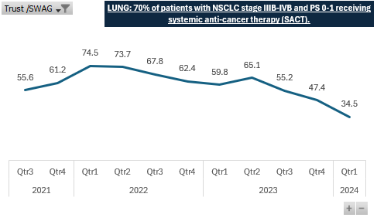
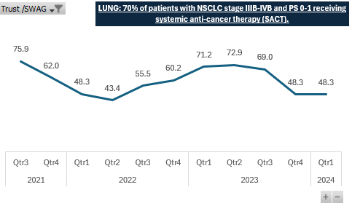
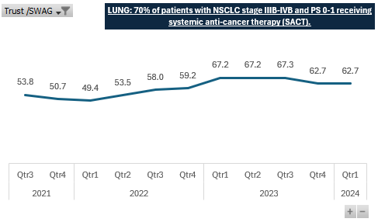
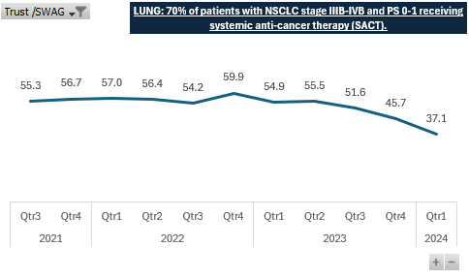
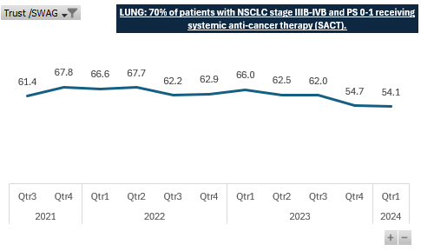
LUNG: 70% of patients with NSCLC stage IIIB-IVB and PS 0-1 receiving systemic anti-cancer therapy (SACT)
SWAG
Gloucestershire
North Bristol Trust
Agenda
Agenda
Royal United Bath
Salisbury
Somerset
UHBW
Data source – Rapid Registration Data set
Notes:
RCRD takes data from CWT and COSD (c 4-5 months in arrears) – COSD 2022 (21 months in arrears) complete registration records – basis of the work programme expectation will be that all SWAG providers work – even prior to the potentially less reliably validated data set RUHB (3 incidences) , NBT (2 incidences) and GHFT (demonstrates consistent) achieved 70%
COSD items – staging, PS records matched to SACT CWT 1st treatment
Clinical sign off of the data is not mandated in England
For quarterly reports, the NLCA is provided with data from the Rapid Cancer Registration Dataset (RCRD). This dataset is compiled mainly from COSD records, and is made available more quickly than the complete cancer registration dataset. However, the speed of production means that the range of data items is limited and several standard data items in the complete registration dataset are unavailable. It also does not have complete coverage of all patients diagnosed with lung cancer in England during the reporting period. The RCRD was linked to other national health care datasets, including Hospital Episode Statistics (HES) admitted patient records, the National Radiotherapy Dataset (RTDS), the Systemic Anti-Cancer Therapy Dataset (SACT), and the Office for National Statistics (ONS) death register

Slide 9
Which trusts clinically validate their data before COSD upload?

Slide 10
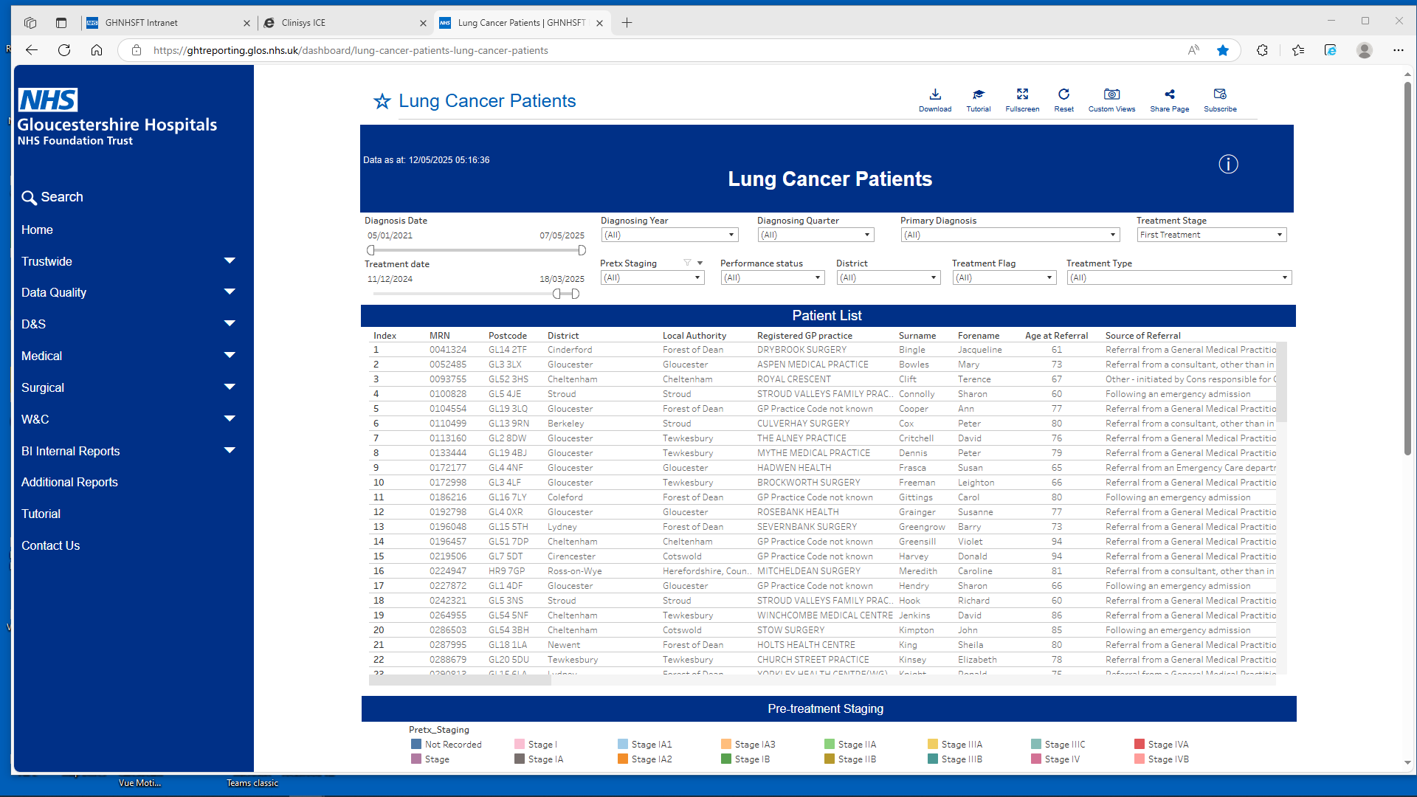

Slide 11
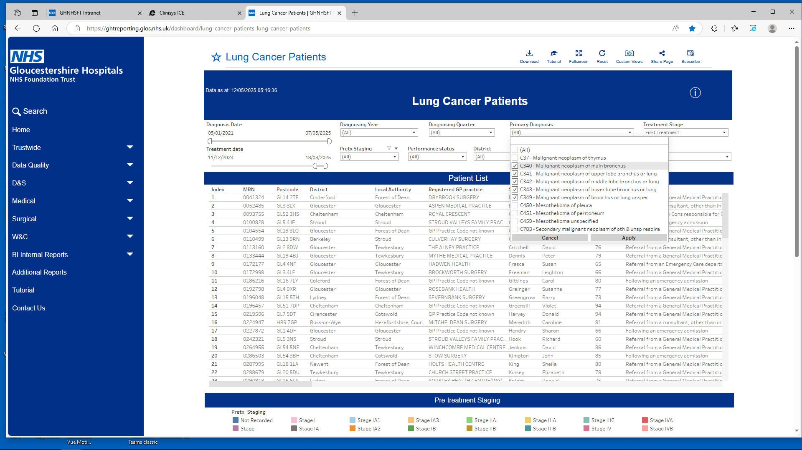

Slide 12
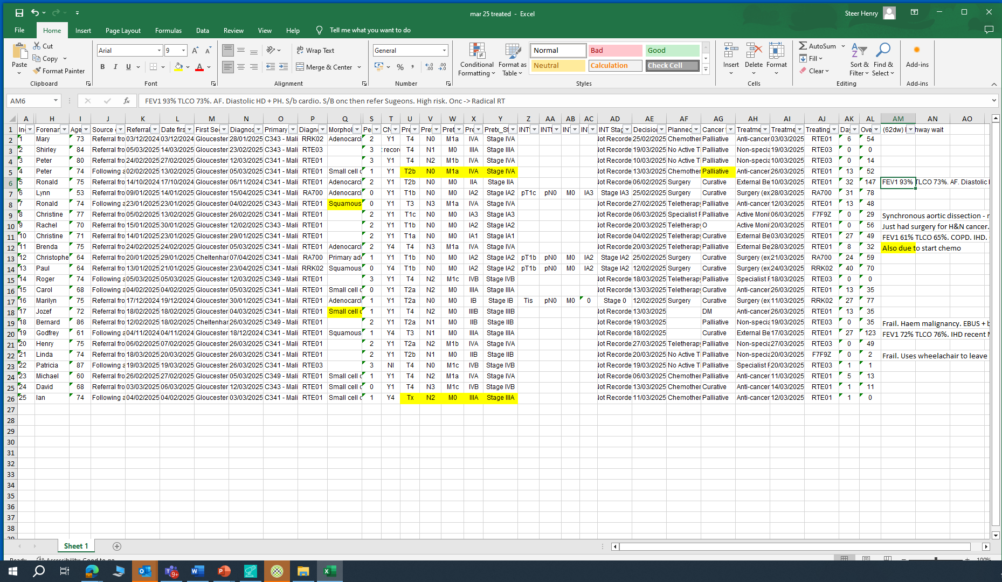
Approx 45-60 mins to check 25 patients

Slide 13
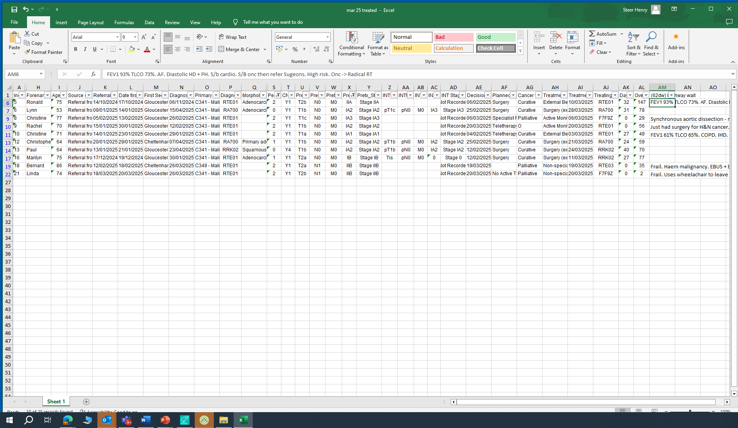

Slide 14
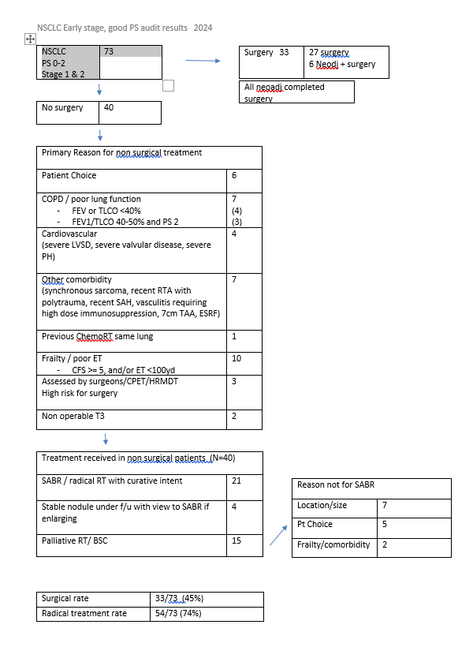
Annual Good PS, 1&2 audit

Slide 15
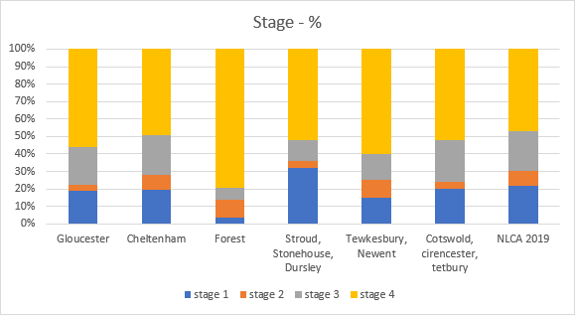
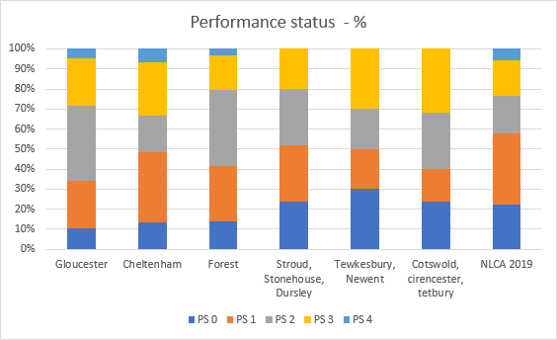
Location data
Post covid recovery FoD 2022

Slide 16


GHFT Lung data set
Of the 322 lung cancer patients treated, 77.6% (250) were seen within the 62-day standard. 22.4% (72) breached the target, with 8.7% (28) seen in 63–75 days, 8.4% (27) in 76–103 days, and 5.3% (17) over 104 days.
Sub-heading
Notes:
Excluded mucinous adenocarcinomas
Squamous 14% of all and 17% of breaches

Slide 17
Staging
Agenda
Agenda
Stage IIA
Out of all the 8 patients that have Stage IIA, 87.5% (7) breached, with delays split across all time bands: 25% within 63–75 days, 37.5% between 76–103 days, and 25% beyond 104 days. All the breaches had curative intent. 57.1% (4) had planned surgery, the remaining were planned for Chemotherapy, Teletherapy and a blank entry.
For the actual treatment types, 42.9% (3) had external beam radiotherapy and 57.1% (4) had surgery.
Stage IA2
Out of 32 patients, 56.2% (18) breached. Among them, 25% (8) were treated within 63–75 days, while 15.6% (5) were treated within 76–103 days and another 15.6% (5) after 104 days. The majority of these patients 94% (17) had curative intent.
Of the 18 patients who breached, 61.1% (11) had surgery planned and ultimately received surgery as their actual treatment. Additionally, 27.8% (5) had teletherapy planned; of these, four received external beam radiotherapy, and one received active monitoring as the actual treatment.
Staging | A. Within 62 days | B. 63-75 days | C. 76-103 days | D. 104 and above | Within 62 days | 63-75 days | 76-103 days | 104 and above | Total
Not Recorded | 100.0% | 0.0% | 0.0% | 0.0% | 1 |  |  |  | 1
Stage IA1 | 25.0% | 50.0% | 25.0% | 0.0% | 1 | 2 | 1 |  | 4
Stage IA2 | 43.8% | 25.0% | 15.6% | 15.6% | 14 | 8 | 5 | 5 | 32
Stage IA3 | 77.4% | 3.2% | 16.1% | 3.2% | 24 | 1 | 5 | 1 | 31
Stage IB | 72.2% | 22.2% | 0.0% | 5.6% | 13 | 4 |  | 1 | 18
Stage IIA | 12.5% | 25.0% | 37.5% | 25.0% | 1 | 2 | 3 | 2 | 8
Stage IIB | 57.9% | 10.5% | 10.5% | 21.1% | 11 | 2 | 2 | 4 | 19
Stage IIIA | 63.0% | 7.4% | 18.5% | 11.1% | 17 | 2 | 5 | 3 | 27
Stage IIIB | 89.7% | 6.9% | 3.4% | 0.0% | 26 | 2 | 1 |  | 29
Stage IIIC | 100.0% | 0.0% | 0.0% | 0.0% | 7 |  |  |  | 7
Stage IVA | 89.9% | 4.3% | 4.3% | 1.4% | 62 | 3 | 3 | 1 | 69
Stage IVB | 94.8% | 2.6% | 2.6% | 0.0% | 73 | 2 | 2 |  | 77
Grand Total | 77.6% | 8.7% | 8.4% | 5.3% | 250 | 28 | 27 | 17 | 322
Notes:
Higher proportions breaching by stage

Slide 18
Treatment Intent
Agenda
Agenda
Curative Treatment Intent
Among the 101 patients with curative treatment intent, 52.5% (53) breached: 19.8% (20) were treated between 63–75 days, another 19.8% (20) between 76–103 days, and 12.9% (13) after 104 days.
Regarding planned treatments, 58.5% (31) were scheduled for surgery, 22.6% (12) for teletherapy, 3.8% (2) for chemotherapy, while 15.1% had no recorded treatment plan.
In terms of actual treatment received, 56.6% (30) underwent surgery, 26.4% (14) received External Beam Radiotherapy (excluding Proton Therapy), 9.4% (5) had Chemoradiotherapy, and 5.7% (3) were treated with cytotoxic chemotherapy as part of an anti-cancer drug regimen.
Cancer Treatment Intent | A. Within 62 days | B. 63-75 days | C. 76-103 days | D. 104 and above | Within 62 days | 63-75 days | 76-103 days | 104 and above | Total
Curative | 47.5% | 19.8% | 19.8% | 12.9% | 48 | 20 | 20 | 13 | 101
DM | 75.0% | 0.0% | 25.0% | 0.0% | 3 |  | 1 |  | 4
O | 100.0% | 0.0% | 0.0% | 0.0% | 6 |  |  |  | 6
Palliative | 91.4% | 3.8% | 2.9% | 1.9% | 191 | 8 | 6 | 4 | 209
Unknown | 100.0% | 0.0% | 0.0% | 0.0% | 2 |  |  |  | 2
Grand Total | 77.6% | 8.7% | 8.4% | 5.3% | 250 | 28 | 27 | 17 | 322

Slide 19
Planned Treatment Type
Agenda
Agenda
Blank (Empty)
Among 31 patients with no recorded planned treatment, 38.7% (12) breached. Of these, 9.7% (3) completed treatment within 63–75 days, 16.1% (5) between 76–103 days, and 12.9% (4) after 104 days. Notably, 66.7% (8) of these patients had a diagnosis of C341 – Malignant neoplasm of upper lobe bronchus or lung.
Surgery
For 63 patients whose planned treatment was surgery, 49.2% (31) breached. Of these, 22.2% (14) were treated between 63–75 days, and 9.5% (6) after 104 days. The majority 80.6% (25) ultimately had surgery, while 9.7% (3) received external beam radiotherapy and another 9.7% (3) received anti-cancer drug regimens.
Planned Treatment | A. Within 62 days | B. 63-75 days | C. 76-103 days | D. 104 and above | Within 62 days | 63-75 days | 76-103 days | 104 and above | Total
Blank | 61.3% | 9.7% | 16.1% | 12.9% | 19 | 3 | 5 | 4 | 31
Chemotherapy | 87.7% | 8.8% | 1.8% | 1.8% | 50 | 5 | 1 | 1 | 57
No Active Treatment | 100.0% | 0.0% | 0.0% | 0.0% | 70 |  |  |  | 70
Specialist Palliative Care | 100.0% | 0.0% | 0.0% | 0.0% | 1 |  |  |  | 1
Surgery | 50.8% | 22.2% | 17.5% | 9.5% | 32 | 14 | 11 | 6 | 63
Teletherapy | 78.0% | 6.0% | 10.0% | 6.0% | 78 | 6 | 10 | 6 | 100
Grand Total | 77.6% | 8.7% | 8.4% | 5.3% | 250 | 28 | 27 | 17 | 322

Slide 20
Actual Treatment
Agenda
Agenda
Treatment Type | A. Within 62 days | B. 63-75 days | C. 76-103 days | D. 104 and above | Within 62 days | 63-75 days | 76-103 days | 104 and above | Total
Active Monitoring (excluding non-specialist Palliative Care) | 93.8% | 0.0% | 0.0% | 6.3% | 15 |  |  | 1 | 16
All treatment declined | 100.0% | 0.0% | 0.0% | 0.0% | 4 |  |  |  | 4
Anti-cancer drug regimen (Cytotoxic Chemotherapy) | 85.0% | 7.5% | 5.0% | 2.5% | 34 | 3 | 2 | 1 | 40
Anti-cancer drug regimen (Immunotherapy) | 66.7% | 6.7% | 20.0% | 6.7% | 10 | 1 | 3 | 1 | 15
Anti-cancer drug regimen (other) | 55.6% | 33.3% | 11.1% | 0.0% | 5 | 3 | 1 |  | 9
Chemoradiotherapy | 44.4% | 0.0% | 44.4% | 11.1% | 4 |  | 4 | 1 | 9
External Beam Radiotherapy (excluding Proton Therapy) | 74.4% | 9.0% | 5.1% | 11.5% | 58 | 7 | 4 | 9 | 78
Non-specialist Palliative Care (excluding Active Monitoring) | 100.0% | 0.0% | 0.0% | 0.0% | 67 |  |  |  | 67
Radiosurgery | 100.0% | 0.0% | 0.0% | 0.0% | 1 |  |  |  | 1
Specialist Palliative Care | 96.4% | 0.0% | 3.6% | 0.0% | 27 |  | 1 |  | 28
Surgery (excluding enabling treatment) - USE FOR TREATMENT DATES 1st JULY 2020 or LATER | 45.5% | 25.5% | 21.8% | 7.3% | 25 | 14 | 12 | 4 | 55
Grand Total | 77.6% | 8.7% | 8.4% | 5.3% | 250 | 28 | 27 | 17 | 322
Curative Treatment Intent
Of the 9 patients who received Chemoradiotherapy, 55.6% (5) breached: 44.4% (4) were treated between 76–103 days, and 11.1% (1) after 104 days. All had Teletherapy as their planned treatment type, with curative intent, and were all treated at Cheltenham General Hospital. Staging information (INT stage) was not recorded for any of these patients. Among these patients that breached, 80% (4) were classified as Stage IIIA and 20% (1) as Stage IIIB.
Among the 55 patients who underwent surgery, 54.5% (30) breached: 25.5% (14) were treated within 63–75 days, 21.8% (12) within 76–103 days, and 7.3% (4) after 104 days. All breaches in this group were under curative intent. Notably, 66.7% (20) of the breaches were treated at Bristol Royal Infirmary.
Notes:
Intro of chemorad and other SACT on the breach profile for actual which werent on the planned slide indicates the changed proportion

Slide 21
Age Group
Agenda
Agenda
50-64
Among the 62 patients in the 50–64 age group, 37.1% (23) experienced a breach. Of these, 16.1% ended their pathway within 63–75 days, 17.7% ended their pathway between 76–103 days, and 3.2% beyond 104 days. Surgery accounted for 56.5% (13) of the breaches in this age group, while 46.2% (6) of those who breached were diagnosed at Stage IA2.
Age Group | A. Within 62 days | B. 63-75 days | C. 76-103 days | D. 104 and above | Within 62 days | 63-75 days | 76-103 days | 104 and above | Total
25–49 | 75.0% | 25.0% | 0.0% | 0.0% | 3 | 1 |  |  | 4
50–64 | 62.9% | 16.1% | 17.7% | 3.2% | 39 | 10 | 11 | 2 | 62
65–74 | 80.4% | 4.7% | 7.5% | 7.5% | 86 | 5 | 8 | 8 | 107
75–84 | 80.2% | 7.8% | 6.0% | 6.0% | 93 | 9 | 7 | 7 | 116
85+ | 87.9% | 9.1% | 3.0% | 0.0% | 29 | 3 | 1 |  | 33
Grand Total | 77.6% | 8.7% | 8.4% | 5.3% | 250 | 28 | 27 | 17 | 322

Slide 22
Performance Status
Agenda
Agenda
Performance Status 1
Patients with a recorded performance status of "1" had the highest number of breaches, accounting for 35.8% (39) of all delayed cases. Within this group, the most common primary diagnoses were C341 – Malignant neoplasm of upper lobe bronchus or lung at 48.7% (19), and C343 – Malignant neoplasm of lower lobe bronchus or lung at 35.9% (14). Regarding treatment intent, 41.0% (16) were scheduled for surgery, 33.3% (13) for teletherapy, and 12.8% (5) for chemotherapy.
Performance Status 0
Similarly, patients with a performance status of "0" represented the next highest breach proportion at 35.0% (21). Among these breaches, 61.9% (13) had a primary diagnosis of C341, and 23.8% (5) had C343. The treatment intent breakdown showed that 66.7% (14) were planned for surgery, 19.0% (4) for teletherapy, and one patient planned for chemotherapy.
Performance Status | A. Within 62 days | B. 63-75 days | C. 76-103 days | D. 104 and above | Within 62 days | 63-75 days | 76-103 days | 104 and above | Total
0 | 65.0% | 16.7% | 15.0% | 3.3% | 39 | 10 | 9 | 2 | 60
1 | 64.2% | 15.6% | 9.2% | 11.0% | 70 | 17 | 10 | 12 | 109
2 | 85.5% | 1.2% | 9.6% | 3.6% | 71 | 1 | 8 | 3 | 83
3 | 100.0% | 0.0% | 0.0% | 0.0% | 62 |  |  |  | 62
4 | 100.0% | 0.0% | 0.0% | 0.0% | 6 |  |  |  | 6
Not recorded | 100.0% | 0.0% | 0.0% | 0.0% | 2 |  |  |  | 2
Grand Total | 77.6% | 8.7% | 8.4% | 5.3% | 250 | 28 | 27 | 17 | 322

Slide 23
Conclusion
Agenda
Agenda
Longest pathways
  Curative intent treatment
      Surgery, ChemoRT, SABR
    Stage 2 and 3
15 104 day waits reviewed
  Delayed/complex diagnostic pathway 3
  Surgical delays 3
  Crossed pathways surgery to oncology 4
  Other comorbidity 4
  Pt choice 1

Slide 24
Joint treatment clinics
Agenda
Agenda
Rationale – reduction in long waits, reduce numbers who cross pathways
All neoadjuvant patients
SABR vs resection in borderline fitness
Surgery vs chemoRT
Challenges
  Changing job plans
  Clinic room capacity
  Introducing inefficiency
? Best model
  Parallel rather than joint clinics

Slide 25
Summary
If we want to return to clinically validated data, this will need to be done before COSD uploads
Virtues of a lung cancer dashboard.
Could all providers have same outputs? - > network wide audits
Glos 104 day data supportive of combined surgical / oncology clinic

