Slide 1
SACT Demand and Capacity Update
May 2025

Slide 2
Overview of SACT Capacity and Demand modelling requirement
National Cancer Alliance Planning Pack requirement for all Alliances in 2024/25
SACT delivery remains a challenge across the country. Cancer Alliance to lead a bi-annual evaluation of demand and capacity across the footprint that will enable Alliances to identify any challenges to delivery.
Carry out demand and capacity assessment of SACT services
Identify any challenges to SACT delivery and escalate appropriately – e.g. variation in Oncology DNA rates across our geography
Share good practices and challenges within the region and with other Cancer Alliances.

Slide 3
SWAG Cancer Alliance Plan on a Page
2025-2026
Two core ambitions for cancer: ​ 55,000 more people would survive their cancer for at least 5 years by 2028; and,​ 75% of cancers would be diagnosed at stages 1 and 2 by 2028.​
Work Programmes
Treatments and Care
Building capacity and expertise
Sustainable Operational performance and Faster Diagnosis
Early Diagnosis
Cross-cutting
Operational Performance
Develop and deliver an Operational Performance Improvement Plan which will contribute to an improvement in Cancer Waiting Times performance across the three standards: Faster Diagnosis, 31 day DTT and 62 day Standards
Improvement plans for tumour sites where 62d performance is in the bottom quartile
Actions where waiting more than 31d
Lung 62d pathway performance
Seasonality plans (including continued focus on skin)
Faster Diagnosis (FDS)
Achieving the faster diagnosis standard by March 2026
Reducing the FDS gap between cancer versus non-cancer
Priority Pathways
Urology (inc bladder and kidney)
Gynaecology
Breast
Skin
Head and neck
Locally – lower gastrointestinal
Timely presentation – local campaigns and community engagement activity to increase symptom knowledge and encourage earlier presentation
Primary care – work with Primary Care Networks and other primary care stakeholders to promote consistent implementation of NG12 guidance
Local Innovation – Identify, fund, support and share learning from real world implementation and evaluation of new locally developed innovations, or promising innovations from other localities
Screening – Work with NHSE Regional Public Health and Commissioning teams and local partner to develop plans to increase uptake and coverage of the NHS screening programmes and encourage uptake of HPV vaccination
Optimise use of qFIT, ensuring it is being used to inform use of colonoscopy, and to identify and address themes for FIT test rejections.
Targeted Early Diagnosis programmes
Lung cancer screening
Pancreatic cancer case finding
Liver surveillance
SACT: Continue to evaluate demand and capacity of SACT services
Treatment Variation – priority recommendations from clinical audit/GIRFT reports to reduce variation in treatment:
Lung
Bowel
Oesophageal
Ovarian (new)
Primary breast (new)
Pancreatic (new)
Non-Hodgkins Lymphoma (new)
Living with and beyond cancer (LWBC)
Complete the embedding of local agreements for PCS and PSFU pathways, including digital tracking and monitoring
Deliver co-produced improvement plans for sustainable commissioning and delivery for:
a) psychological support
b) cancer prehabilitation
c) behaviour change and interventions to increase physical activity
Patient Engagement & Involvement
Use and encourage insight and feedback (CPES) to inform service improvements
Maintain a comprehensive approach to community and public engagement
Alliance Development
Strengthening Leadership and Culture
Developing a robust communication and Stakeholder engagement Plan
Health Inequalities
Ensure that diverse voices of local communities are heard and integrated into all work programmes
Workforce
Facilitate the implementation of the ACCEND in providers for non-medical cancer workforce .
Continue to deliver priority recommendations identified throughout the SWAG Workforce Strategy
Development of SWAG multi-professional educational resources available
Supporting new roles and ways of working
ENABLERS
Workforce
Patient involvement and engagement
Clinical Advisory Groups & Relevant Networks
Digital & Diagnostics

Slide 5
Process Planned
Data
Agreed timeframe for data in scope
Access to funding for staff time to support the work
Time & Motion Modelling
All Provider Trusts to participate
Agreed duration – e.g. several days repeated over 2 consecutive weeks – 2 or more full consecutive weeks
Access to funding for staff time to support the work
All complete to same level dataset
Option to have onsite support from Alliance Team
Reporting
All Trusts to receive bespoke report and offer of Alliance/ MSD supported review meeting
Alliance to host workshop style session for all Trusts to share findings, review and agree next steps
All Provider Trusts to participate

Slide 6
Process - Actual

Slide 7
SACT Capacity and Demand Project 2024-2025: Q4 Summary Report
Provider Trust:
Gloucester Hospitals Foundation Trust
SACT Lead Nurse/ Key Contact:
Julie McNally/Cat Harker/ Josh Peet
Summary of local aims for SACT Capacity and Demand project:
Impact of on the day delays to capacity Impact of late deliveries from off site pharmacy on day unit timings Review to check if scheduling timings of treatment are correct/ representative of those currently used Assess delays on the unit of response to STAR bleep Use data to create robust picture of demand and capacity in support of workforce business case
Feedback on the management and experience of participating in the SACT Capacity and Demand project:
Hard to commit to any timeframe longer than 1 working week due to the staffing implications. Had to backfill staff time with bank nurses to free up Avening ward staff to complete time in motion study, this was really difficult as was very difficult to find Bank staff to deliver SACT as I had used 5 SACT staff for the study. Used the admin team support to input data and for data reconciliation work post-audit. Some delay to the processing of the data as a result. The study was carried out the week before Christmas which was a quieter week than usual due to Patients choice of delay SACT until the New Year. This may therefore impact activity observed
Summary of your intended aims and outcomes for the work:
To use the data as a foundation for a future workforce business case looking at the expansion of the SACT Nursing workforce. Intending to share this at internal Trust meetings, but also with the scope to use this at ICB level when the final report is collated

Slide 8
SACT Capacity and Demand Project 2024-2025: Q4 Summary Report
Provider Trust:
Somerset Foundation Trust
SACT Lead Nurse/ Key Contact:
Abbey Doyle/Jeanette Chapman/Emma Wells-Bur
Summary of local aims for SACT Capacity and Demand project:
Impact of on the day delays to capacity Impact of late deliveries from off site pharmacy on day unit timings If scheduling timings of treatment are correct/ representative of those currently used
Feedback on the management and experience of participating in the SACT Capacity and Demand project:
YOHDU - unable to participate in audit due to exceptional levels of sickness within the department, only able to collect pharmacy delivery times vs appointment times currently- plan to do audit in next phase. MPH BDU-Audit undertaken but taken longer than excepted. Gathering data for time and motion audit very time consuming and questions within audit not fitting day to day outcome of work, Information post time and motion audit was difficult to pull., Required considerable support from admin team to input data. Too costly for the amount of staff required to complete the data due to 4 separate zones which would’ve been to spread out for reduced data collectors to gather the information. Very subjective answers depending on each data collectors views and opinions of exactly what data was required.
Summary of your intended aims and outcomes for the work:
At governance meetings locally and discuss at a network levels with other trusts to compare and learn. Hoping to use data to confirm scheduling accurate and look to areas to improve efficiency of delays/bookings.

Slide 9
SACT Capacity and Demand Project 2024-2025: Q4 Summary Report
Provider Trust:
Salisbury Foundation Trust
SACT Lead Nurse/ Key Contact:
Helen Neale
Summary of local aims for SACT Capacity and Demand project:
To validate chair utilisation, assess demand and any inefficiency - Issues: Visiting consultants/lack of consistency around blood test validity causing prescribing delays, under resourced pharmacy departments/ scheduling/administrative challenges Challenges: Staff having to work harder because of process inefficiency, coupled with historic practices and at times resistance to change/improvement Opportunities: Data to evidence and influence causes of delays (late prescribing/lack of pharmacy staffing)
Feedback on the management and experience of participating in the SACT Capacity and Demand project:
Worked Well: Using a variety of colleagues to collect data from the Time and Motion Study allowed them to see what happens day-to-day on the SACT Unit. This was informative for all and helped with collaborative working moving forwards. What could have been improved: Collection of the raw data and assimilation into the template is very time consuming and did need clinical input (which is always stretched). Ideally the MSD tool would come with a programme to allow data collection from Time and Motion Study directly into hand-held device at point of data collection. This then would ideally feed into MSD modelling without assimilation into raw data template/MSD template.
Summary of your intended aims and outcomes for the work:
This work will be shared with the Trust Senior Leadership Team and staff who work as part of the SACT Unit. This will then need to flow into an improvement project around operational efficiency.

Slide 10
SACT Capacity and Demand Project 2024-2025: Q4 Summary Report
Provider Trust:
University Hospitals Bristol and Weston
SACT Lead Nurse/ Key Contact:
Sally Long
Summary of local aims for SACT Capacity and Demand project:
To review current capacity and chair utilisation of the main SACT day unit and identify the reasons and incidence of any delays experienced by patients. To review the cancellations and delays that came into the unit and the impact of these on any lost treatment slots. To make projections for future demand and growth required in chair and nursing capacity.
Feedback on the management and experience of participating in the SACT Capacity and Demand project:
It worked well to simplify the data collection and have very clear aims, and to compare to the scheduled bookings to ensure that patients weren’t missed. We mainly looked at chair time and any reasons for delays, as well as cancellation data. We did gain some valuable data and information. The team did comment that it added to their workload, but we did manage to do the data collection without additional resource on the unit. We found that doing the second week of data collection was time consuming and didn’t really add much value. Data entry and analysis was also time consuming.
Summary of your intended aims and outcomes for the work:
Shared with the day unit team to report back to them the findings and recommendations. Presented the report at SACT group, BHOC executive board and shared with senior leaders. The final report and recommendations will feed into other work that is in progress to scope the expansion of the satellite units and provide additional chair base and capacity. The data and report will provide valuable evidence for these proposals. Other productivity recommendations will be implemented, such as transitioning to subcutaneous formulations that become available in 2025.

Slide 11
Provider Status
 | UHBW | RUH | GHT | Salisbury | Somerset | NBT
Core metrics | Complete | Complete – queries re Workforce outstanding | Pending | Complete | Complete | Complete – pending MSD review
Time & Motion | Complete | Complete | Complete, all data now being collated | Complete | Complete, all data now being collated (Taunton complete/ Yeovil TBC) | Not being undertaken – recently reviewed capacity and +2 Chairs in planning to be opened
MSD Report | Complete | Complete | Pending | Complete – Initial review meeting held | Pending – final queries in progress | N/A
Findings | Need for improved use of delay and deferral capacity | Reliance upon use of ‘unstaffed’ chairs/ capacity to maintain operational flow | Pending | Pharmacy operational pressures creating delays | Pending | N/A

Slide 12
Overview – Project Approach
Process – Time/ effort vs outputs of MSD approach
Engagement – Good involvement from all SACT Teams and staff felt ‘recognised’ by the work
Consider wider stakeholder engagement for any subsequent work – Management, Pharmacy (variable), Facilities & Estates
Data Assessment – Review existing SACT Dataset for usefulness going forward (with guidance from Funmi)
Recognition that capacity assessment doesn’t currently include wait-times to start 1st treatment - ‘hidden’ pressure

Slide 13
Insights & Opportunities
Venous Access
Variable issues with venous access when patients attend for treatment – potential opportunity for improvement, training or equipment (warmers)
Hypersensitivity
Patient reaction to treatment can impact operational flow – potential opportunity for further training (e.g. SIM training) for more junior staff to help build skills and competency
Cancellation and Delay Processes
Ensure these are streamlined, responsive and allow wherever possible for the re-utilisation of available capacity
Patient Information
Ensure patient guidance is clear with regards to the practical arrangements for getting to clinic, challenges with parking and access, location, etc
Also ensure patients have easy access in the event of them becoming too unwell to attend clinic, who to contact if they have concerns, etc.
Maximise Use of Subcutaneous Treatments
Using information now available, and with Pharmacy input, asses the potential opportunity and impact of switching more treatments to subcut
SACT Education
Further to the above, opportunity to consider more Alliance-wide resource and support for Education and Training, especially where Trust’s have limited in-house resource

Slide 14
Next Steps
SACT CAG – Review and guidance on areas of work to carry forward
Consider Lived Experience involvement in improvement work
Provider Trust level reporting/ discussions with Alliance/ MSD Support
Ensure each Provider has an improvement plan (MSD modelling options) with evaluation arrangements and monitor/ revisit in 25/26

Slide 15
UHBW Reporting Summary

Slide 16
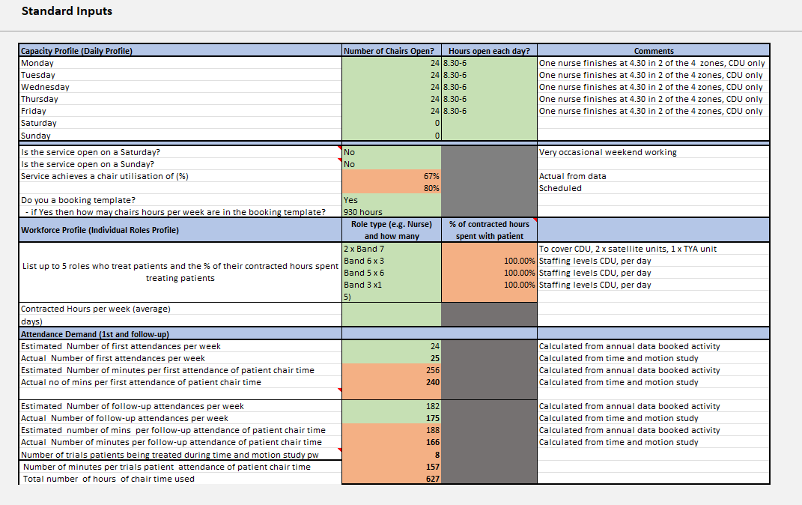
UHBW Core Service Info (BHOC Site):

Slide 17
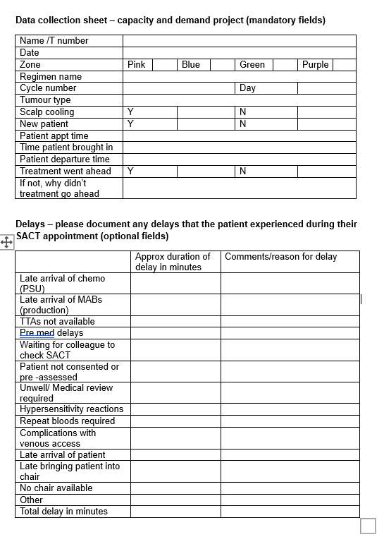
UHBW Time & Motion Template:

Slide 18
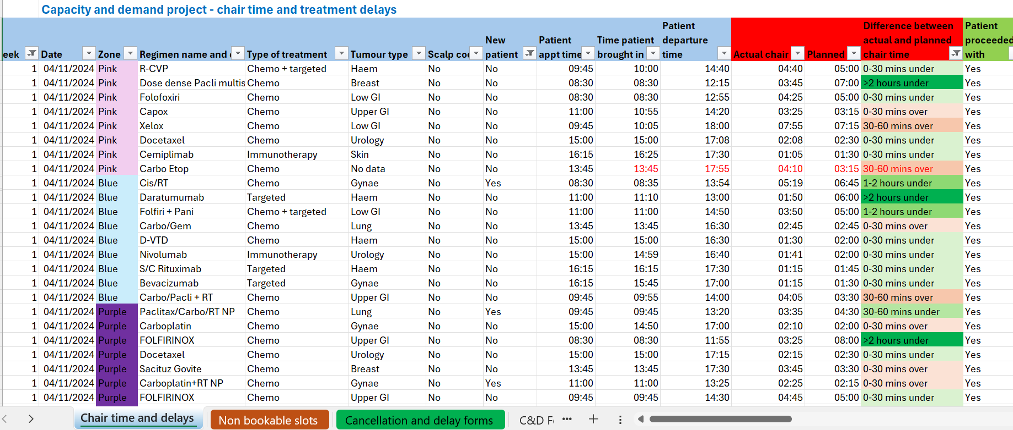
UHBW Time and Motion Records:

Slide 19
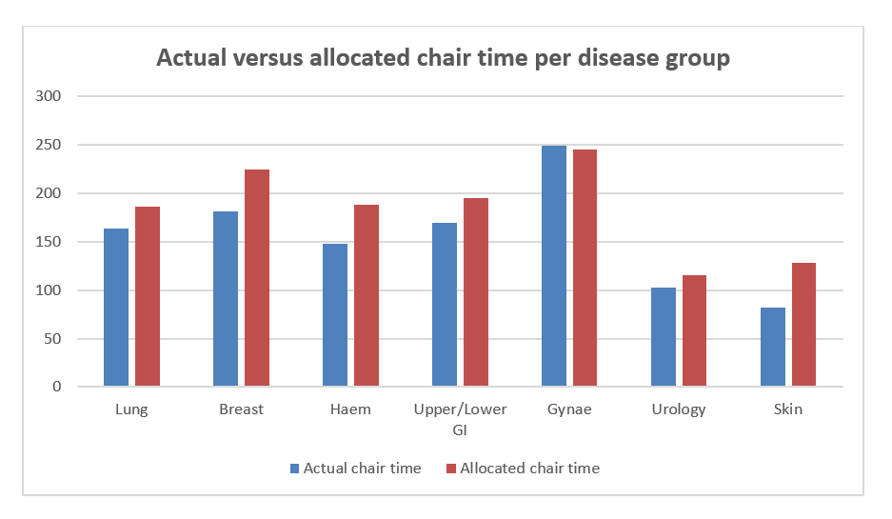
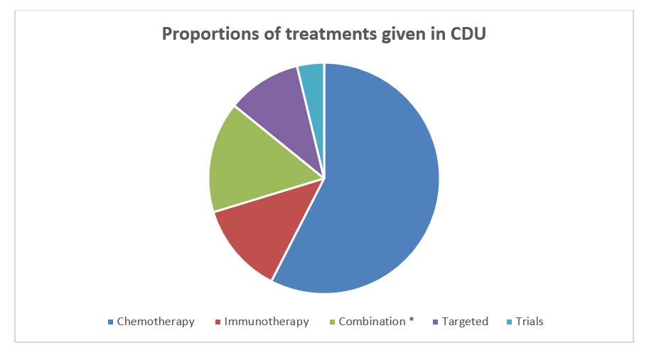
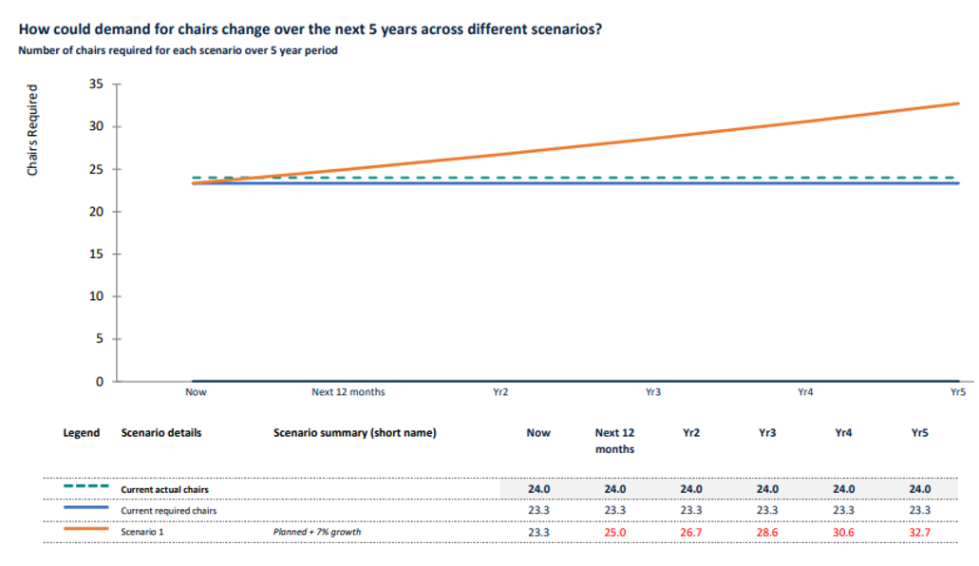
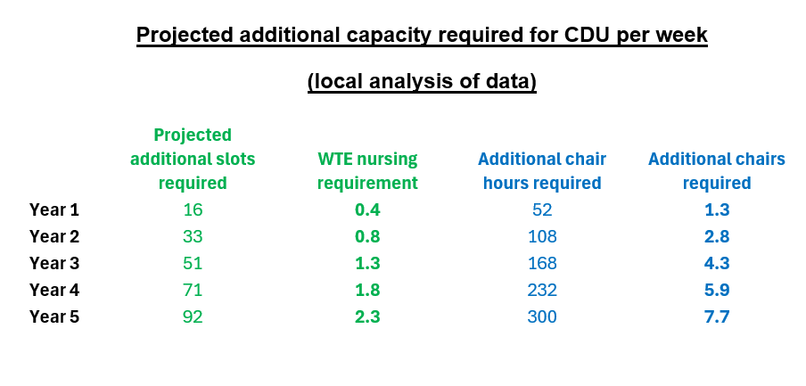
UHBW Outputs:

Slide 20
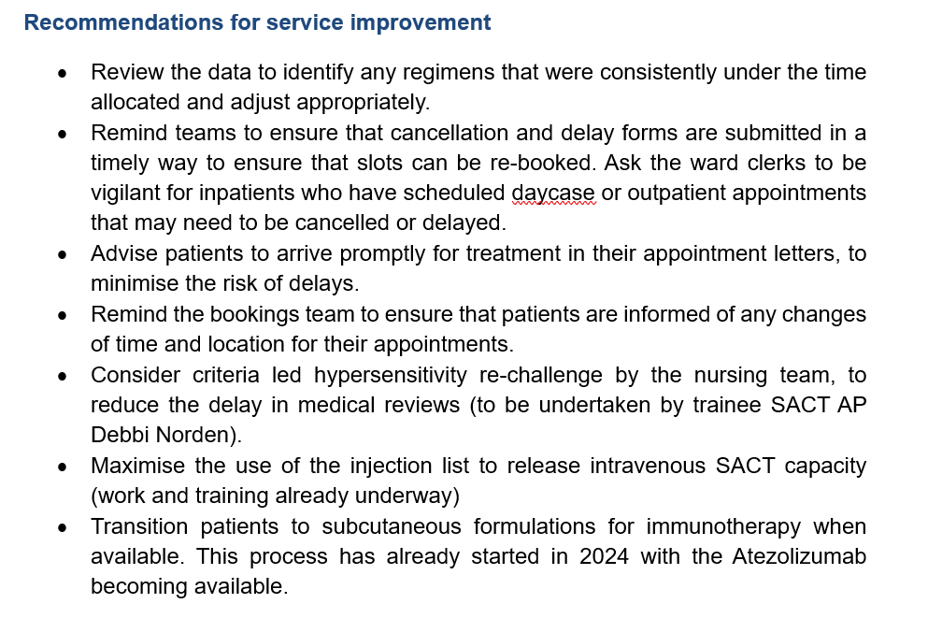
UHBW Outputs:

