Slide 1
SWAG Network Lung Cancer Clinical Advisory Group
Research Update
Gareth Ayre
20/05/2025

Slide 2
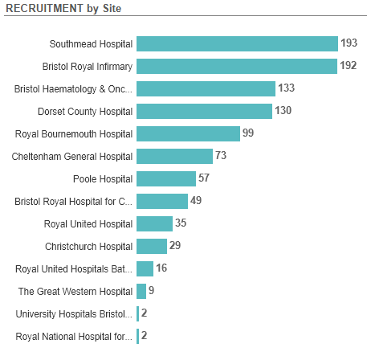
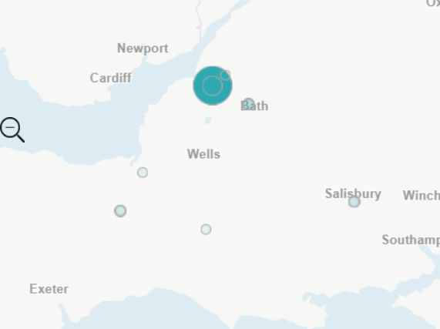
Recruitment by site Apr 2022 - present

Slide 3
Screening / diagnosis
DART | DART: The Integration and Analysis of Data using Artificial Intelligence to Improve Patient Outcomes with Thoracic Diseases | NBT, Taunton
SCOOT | Sample Collection for The Integration and Analysis of Data Using Artificial Intelligence to Improve Patient Outcomes with Thoracic Diseases | NBT, Taunton
Pleural
ASSESS-Meso | Prospective observational cohort study collecting data on demographics, symptoms and biomarkers in people with mesothelioma | NBT, Taunton
Meso-ORIGINS | Observational study of Risk prediction and Generation of paired benign-meso tissue sample | NBT, Taunton
eVOLVE-Meso | Volrustomig (bivalent PDL1 / CTLA4 Mab) vs carbo-pem or Ipi-Nivo in MPM | Taunton
HIT-Meso | RCT of proton hemithorax irradiation in MPM | NBT, Cardiff
Peri-operative
CANFit | Phase II, randomised feasibility basket trial of a home-based exercise programme in early-stage disease | Taunton, Yeovil
Fit4Surgery | RCT to investigate an App-based, personalised prehabilitation programme to enhance recovery of physical function and reduce complications after lung cancer surgery | NBT

Slide 4
Adjuvant post-surgery
Interpath V940-009 | Adjuvant Pembro With or Without V940 in Participants With Resectable Stage II to IIIB (N2) NSCLC not Achieving pCR After Neoadjuvant chemo-pembro | BHOC
Stage 3 NSCLC
PACIFIC-9 | Durvalumab +/- oleclumab or monolizumab following cCRT for inoperable stage 3 NSCLC | BHOC, Torbay
PACIFIC-8 | Durvalumab +/- domvanalimab (TIGIT) following cCRT for inoperable stage 3 NSCLC | Cheltenham
Metastatic NSCLC
REFINE | Maintenance pembro dosing interval | BHOC, Yeovil, Cheltenham, Salisbury
TROPION-Lung-10 | Pembro vs Rilvegostomig (TIGIT/PD1) +/- Dato-Dxd (TROP2 ADC) in 1L metastatic NSCLC with PDL1>50% | Cheltenham
LION | Lifting Immune CheckpOints with NSAIDs Pan Tumour Trial of Cox-Inhibitor and Immune Checkpoint Blockade | Bath

Slide 5
Radiotherapy
TOURIST (PRINCE + QUARTZ) | Efficacy of palliative RT in metastatic NSCLC | BHOC, Cheltenham, Taunton
Small cell
PRIMALung | MRI surveillance +/- prophylactic cranial irradiation in SCLC | BHOC, Cheltenham
Non-site specific
MITRE | Impact of host microbiome on immunotherapy efficacy and toxicity | BHOC, Bath, Taunton, Salisbury
WAYFIND-R | Registry in patients profiled with NGS | BHOC, Taunton, Cheltenham
DETERMINE | Lung cancer arms: HER2 (trastuzumab-pertuzumab) and MET dysregulation (mutations other than exon 14 skipping, high level amplification, fusions - capmatinib) | BHOC
Respiratory
SELF-BREATHE | A self-guided, internet-based intervention for patients with chronic breathlessness: feasibility randomised controlled trial | Taunton, Yeovil

Slide 6
Pipeline studies
Bristol
BNT324-01 – Ph1b / 2 single arm, multiple cohort study of BNT 327 (VEGF/PD1 bivalent MAb) + BNT 324 (B7-H3 ADC) for 1L and 2L NSCLC, 1L and 2L SCLC and 2L EGFR
KRAScendo-02 – 1L KRAS G12C. Divarasib/pembro vs chemo/pembro
Taunton
BNT 327-06 – 1L NSCLC. Ph 2/3 RCT of Chemo + BNT327 vs SOC
Rare mutation trials open at Torbay:
EGFR exon 20ins – REZILIENT 3 (1L chemo +/- zipalertinib – option to crossover on PD)
HER2 – SOHO 02 (1L Oral HER2 TKI vs SOC chemo)

Slide 7
Be Part of Research is a UK-wide service that helps people find and take part in health and care research across nearly every health condition.
A resource for:
patients or their families keen to get involved in research
Researchers looking for target population for research
https://bepartofresearch.nihr.ac.uk/

Slide 8
Associate Principal Investigator
Scheme
Six month in-work training opportunity, providing practical experience for healthcare professionals starting their research career.
People who would not normally have the opportunity to take part in clinical research in their day to day role have the chance to experience what it means to work on and deliver a NIHR portfolio trial under the mentorship of an enthusiastic Local PI.
CIs working with a CTU can register their study on the scheme
https://www.nihr.ac.uk/health-and-care-professionals/career-development/associate-principal-investigator-scheme.htm

Slide 9
Principal Investigator Pipeline Programme
(PIPP)
Overview
Research delivery nurses or midwives
12 to 18 months
Free if you’re eligible
Live virtual lessons, online learning and hands-on experience
Cohort 4 applications are open and will close at 11 am on Friday 30 May 2025
Please email nursingandmidwifery@nihr.ac.uk for more information
https://www.nihr.ac.uk/career-development/clinical-research-courses-and-support/principal-investigator-pipeline-programme

Slide 10
NIHR ODP https://odp.nihr.ac.uk/
Open data platform. Data on performance across whole RDN, including all specialty areas
NIHR Be Part of Research https://bepartofresearch.nihr.ac.uk/
See which studies are open across the country
Find a Clinical Research Study (ODP) http://csg.ncri.org.uk/portfolio/portfolio-maps/
Search for a study to fit criteria. Good for horizon scanning, eligibility criteria

Slide 11
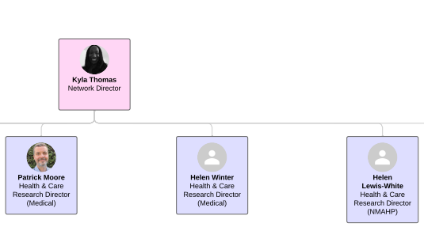
Specialty & Settings Support SWC RRDN
Cancer Specialty Lead: Mark Beresford (RUH)
Haematology Specialty Lead: Sally Moore (UHBW)
Palliative Care Specialty Lead: TBA
Imaging Specialty Lead: Hedvig Karteszi (UHBW)
Hospital Settings Lead: Edward Carlton (UoB)
National Cancer Specialty Leads: Jonathan Wadsley, Amarnath Challappalli, Lizzie Smyth

Slide 12
RRDN Contacts
swc.rrdn@nihr.ac.uk
Study Support Service Manager: claire.matthews@nihr.ac.uk
CAG Research Lead: gareth.ayre@uhbw.nhs.uk

