Slide 1
Lung Cancer Genomics - ctDNA
Lung Clinical Advisory Group May 2025
Laura Yarram-Smith
Consultant Clinical Scientist - Solid Tumour and Inherited Cancer Lead
SW Genomic Laboratory Hub

Slide 2
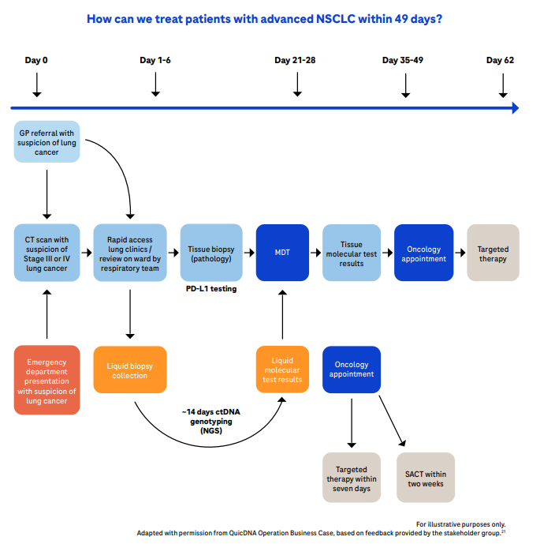
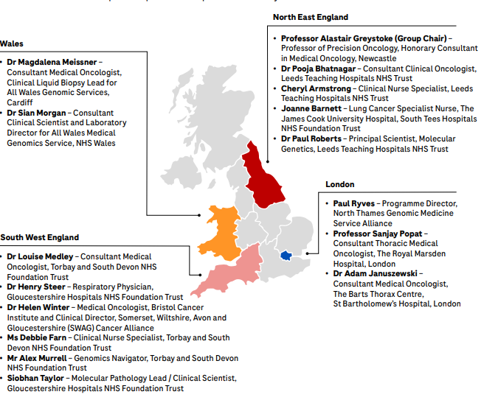
Challenges
Access to biopsy
Delays in Tissue Pathways
Shortage of Oncologist Capacity
Capacity on SACT units

Slide 3
ctDNA update
Total tests carried out 585. Over 9.9% of total Lung ctDNA tests nationwide (SWGMSA equates to 7% of national population)
All 9 trusts within the South West GMSA are fully engaged with the project
% referral numbers | Total numbers | SW
Population |  | 7%
Jan % |  | 9.99%
Total numbers | 5872 | 585
Total % |  | 9.96%
Pathway survey carried out in Feb
70% of Trusts who completed the survey felt that the biggest delay in their pathway was around Royal Marsden result processing.
Average time from result received to report issued is 14 days (around the same as the national average)

Slide 4
NSCLC Pilot Uptake – breakdown by Trust
Awaiting Health Economics cost-effectiveness publication

Slide 5
Live Clinical Service
National Genomic Test Directory for Cancer v12.0 – published May 2025
Now includes lung ctDNA testing. Test code M4.14.
Testing for SW patients continues to be delivered via the Royal Marsden laboratory
NHSE are funding 15,000 NSCLC patients nationally for 2025/26
Test Code | Test Name | Target Gene(s) [essential] | Target Gene(s) Clinical trials | Test Scope | Technology | Optimal Family Structure | Further Eligibility Criteria Essential targets only
M4.14 | Multi-target ctDNA combined Multi-target NGS panel - small variant (EGFR, ALK, BRAF, KRAS, MET exon 14 skipping and copy number variations) and structural variant (ROS1, RET, ALK, NTRK1, NTRK2, NTRK3, MET exon 14 skipping) | EGFR, ALK, BRAF, KRAS p.(G12C), MET exon 14 skipping, ROS1, RET, NTRK1, NTRK2, NTRK3 | SNV: ERBB2 CNV: ERBB2 | Small variant detection | Panel | Singleton | Patients with radiologically suspected stage III/IV lung cancer, likely unsuitable for curative intent surgery or radical radiotherapy and an ECOG Performance Status between 0-3. Additionally, patients with a confirmed new histological diagnosis of NSCLC, previously untreated for advanced disease where diagnostic molecular testing has failed, and an alternative option would be to re-biopsy.

Slide 6
ctDNA Reports: RM 360Dx Liquid biopsy
Female non-smoker
Breast and endometrial cancer (treated)
FH Cancer
CT scan suggestive of Stage IV Lung Cancer
Will I respond to this treatment?
Can I pass this to my children?
Are there any clinical trials for me?

Slide 7
Future
Faster testing, closer to the patient – Delivered at the SWGLH
Validation of MSK-ACCESS panel – ongoing
MSK (Memorial Sloan Kettering) have developed a well-published assay, known as MSK-ACCESS, that has been commercialised for de-centralisation by SOPHiA Genetics
MSK - Analysis of Circulating cfDNA to Evaluate Somatic Status
Astra Zeneca have funded the SWGLH to embark on implementation (1 of 10 labs worldwide).
SOPHiA Genetics have supported with training and initial validation.
MSK-ACCESS panel
146 genes
Detects SNVs, Indels, CNVs, fusions, MSI
Paired germline sample analysis to distinguish somatic variants,
remove ‘noise’ and exclude CHIP variants.

Slide 8
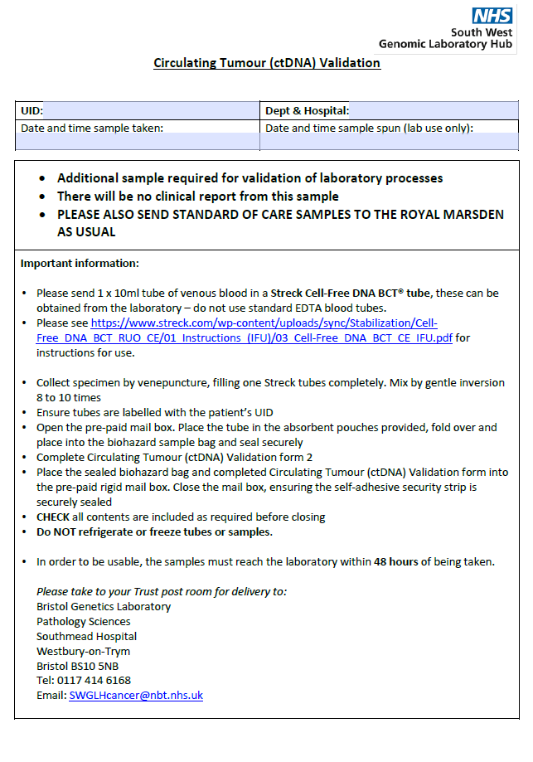
How can you help?
We need patient samples to allow validation of the MSK-ACCESS in-house test.
A referral form is available to accompany the samples.
Standard of Care ctDNA testing should also be undertaken.
No results will be issued from the validation samples (SoC undertaken)
Please contact rduh.swgmsaadmin@nhs.net if you can help, thanks!

